Slide 1
Social Network Analysis
Network Dynamics: Population Models
Prof. Keeheon Lee
TA. Jaekeun Lee
010-5599-9411
agdal1125@gmail.com

Slide 2
Table of Contents
- Information Cascades
- Network Effects
- Power Laws and Rich-Get-Richer Phenomena

Slide 3
Information Cascades

Slide 4
Following the Crowd
Information Cascade/ Herding (Informational Effects)
Direct-Benefit Effects
Happens when sequential decision is made by people
People abandon private information in favor of inferences based on earlier people’s actions
Rational behavior as a result of drawing inference from limited information
When following others give off direct benefit
example)
Fax machine, Computer operating systems, Social Networking Sites

Slide 5
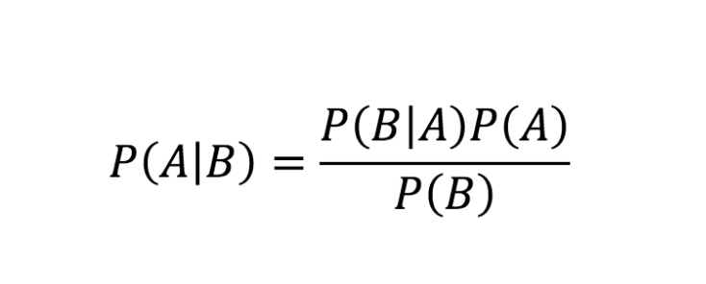
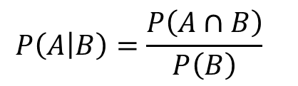
Bayes Rule: A Model of Decision Making under Uncertainty
Conditional Probability
Conditional Probability of A given B is
probability of A given that B already happened
$$P\left(A | B\right)=\frac{P\left(A∩B\right)}{P\left(B\right)}$$
Bayes’ Rule
Description of the probability of an event
based on the conditions that might be related to the event
Prior probability
Posterior probability
(of A given B)

Slide 6
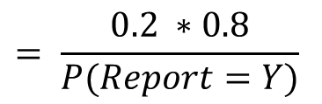


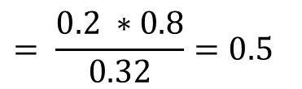
Bayes Rule: A Model of Decision Making under Uncertainty
Example: Eyewitness testimony
80% of taxi cabs are black, 20% are yellow
A witness to a hit-and-run accident claims the taxi cab involved was yellow
Suppose the eyewitness is imperfect and color may be misidentified
The witness’s claim will be 80% true
Frequency of Yellow cab
(Prior probability)
Accuracy of testimony
$$P\left(True=Y | Report=Y\right)=\frac{P\left(True=Y\right) ∗P\left(Report=Y \right| True=Y)}{P\left(Report=Y\right)}$$
$$= \frac{0.2 ∗0.8}{P(Report=Y)}$$
$$= \frac{0.2 ∗0.8}{0.32}=0.5$$
$P\left(Report=Y\right)=P\left(True=Y\right)∗P\left(Report=Y \right| True=Y)+P(True=B) ∗P(Report=B|True=B)$
$$0.2 ∗0.8$$
$$0.8 ∗0.2$$

Slide 7



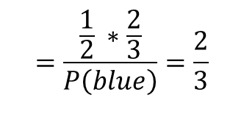
Bayes Rule: Herding Experiment
Example: Urn Experiment
50% chance that urn contains 2 red, 1 blue and in the other case, 1 red, 2 blue marbles
Each Student picks one marble, and check the color
The student predicts majority of marbles blue or red, and write the prediction
Students can only see the predictions written by other students
$$\text{P}\text{(}\text{majority}\text{_}\text{blue}\text{) = }\text{P}\text{(}\text{majority}\text{_}\text{red}\text{)}\text{ =}\frac{1}{2}$$
$$\text{P}\text{(}\text{blue}\text{|}\text{majority}\text{_}\text{blue}\text{) = }\text{P}\text{(}\text{red}\text{|}\text{majority}\text{_}\text{red}\text{)}\text{ =}\frac{2}{3}$$
First student picked Blue
$$P\left(majority_{blue} | blue\right)=\frac{P\left(majority_{blue}\right)∗P\left(blue | majority_{blue}\right)}{P\left(blue\right)}$$
$$=\frac{\frac{1}{2} ∗\frac{2}{3}}{P\left(blue\right)}=\frac{2}{3}$$
$∴$ First student will write blue
$P\left(blue\right)=P\left(majority_{blue}\right)∗P\left(blue | majority_{blue}\right)+P\left(majority_{red}\right)∗P\left(blue | majority_{red}\right)$ = $\frac{1}{2}$

Slide 8
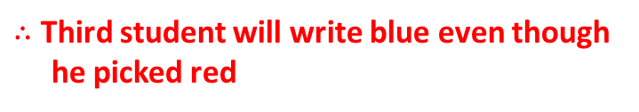
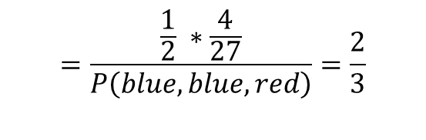
Bayes Rule: Herding Experiment- continued
Example: Urn Experiment
50% chance that urn contains 2 red, 1 blue and in the other case, 1 red, 2 blue marbles
Each Student picks one marble, and check the color
The student predicts majority of marbles blue or red, and write the prediction
Students can only see the predictions written by other students
$$\text{P}\text{(}\text{majority}\text{_}\text{blue}\text{) = }\text{P}\text{(}\text{majority}\text{_}\text{red}\text{)}\text{ =}\frac{1}{2}$$
$$\text{P}\text{(}\text{blue}\text{|}\text{majority}\text{_}\text{blue}\text{) = }\text{P}\text{(}\text{red}\text{|}\text{majority}\text{_}\text{red}\text{)}\text{ =}\frac{2}{3}$$
Second student wrote blue and Third student picked Red
$$P\left(majority_{blue} | blue,blue,red\right)=\frac{P\left(majority_{blue}\right)∗P\left(blue,blue,red | majority_{blue}\right)}{P\left(blue,blue,red\right)}$$
$$=\frac{\frac{1}{2} ∗\frac{4}{27}}{P\left(blue,blue,red\right)}=\frac{2}{3}$$
$∴$ Third student will write blue even though
he picked red
$P\left(blue,blue,red\right)=P\left(majority_{blue}\right)∗P\left(blue,blue,red | majority_{blue}\right)+P\left(majority_{red}\right)∗P\left(blue,blue,red | majority_{red}\right)$ = $\frac{6}{54}=\frac{1}{9}$

Slide 9
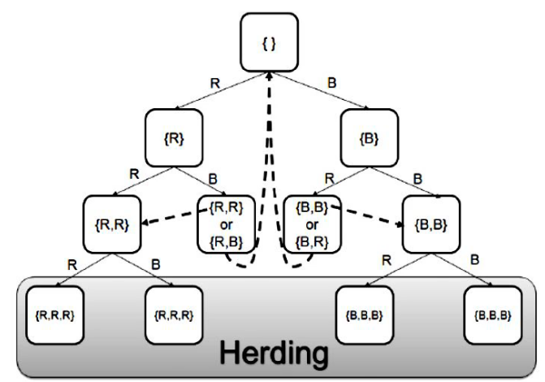
Bayes Rule: Herding Experiment
Example: Urn Experiment

Slide 10
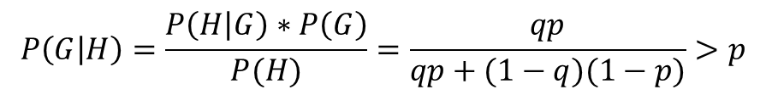
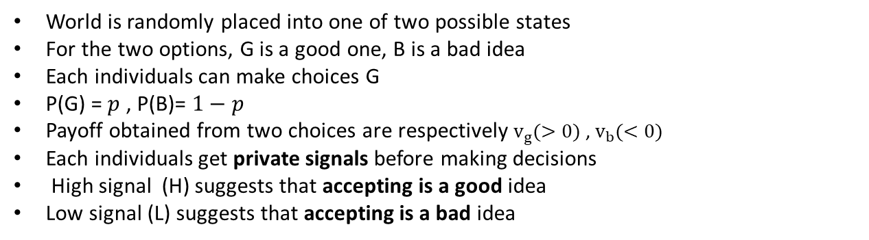
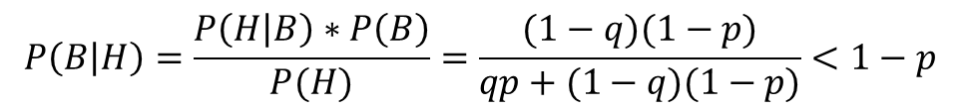
General Cascade Model
Individual decisions
Assumption:
$$P\left(G | H\right)=\frac{P\left(H | G\right)∗P\left(G\right)}{P(H)}=\frac{qp}{qp+(1−q)(1−p)}>p$$
World is randomly placed into one of two possible states
For the two options, G is a good one, B is a bad idea
Each individuals can make choices G
P(G) = $p$ , P(B)= $1−p$
Payoff obtained from two choices are respectively $v_{g}(>0)$ , $v_{b}(<0)$
Each individuals get private signals before making decisions
High signal (H) suggests that accepting is a good idea
Low signal (L) suggests that accepting is a bad idea
$$P\left(B | H\right)=\frac{P\left(H | B\right)∗P\left(B\right)}{P(H)}=\frac{(1−q)(1−p)}{qp+(1−q)(1−p)}<1−p$$
Individuals are more likely to accept, if received high signal
Individuals are more likely to reject if received low signal
 |  | States
 |  | B | G
Signals | L | q | 1-q
 | H | 1-q | q
People are prone to the private signals → scientific explanation of herding effect

Slide 11
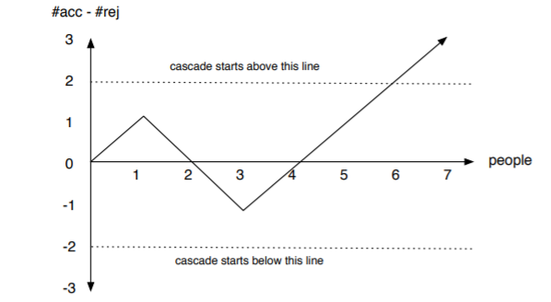
Sequential Decision Making and Cascades
Cascade begins when the difference between the number of acceptances and rejections reaches two

Slide 12
Lessons from Cascades
Cascades can be wrong
Cascades can be based on very little information
Cascades are fragile
If the first two people happen to get high signals, a cascade of acceptances will start immediately, even though it is the wrong choice for the population
People ignore their private information once a cascade starts, thus only the pre-cascade information influences the behavior of the population
Cascades can start easily, but also end easily.

Slide 13
Network Effects

Slide 14
Network Effect as Externalities
Externality
Situation where the welfare of an individual is affected by the actions of other individuals, without mutually agreed upon compensation
example)
When someone joins SNS, they have increased existing user’s welfare (positive)
When someone uses the same road, traffic becomes more congested (negative)
When someone buys a diet coke (X) → compensated with a payment

Slide 15
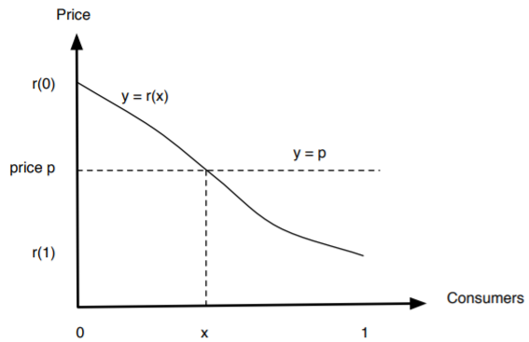
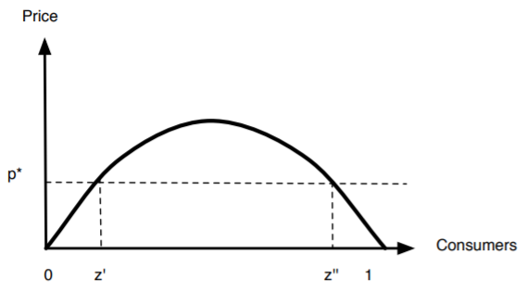
Economy with/without Network Effect
Economy without
Network effect
Economy with
Network effect
Customer’s willingness to pay and the price is
Determined by the customer’s intrinsic interest
+
The number if other people using the good
(Larger the user population, the more willing to pay)
Population using the good f(z)
Customer’s willingness to pay and the price is
Determined by the customer’s intrinsic interest
Each customer is specified by a single
reservation price r(x)
Equilibrium
r(x) = 1-x , f(z) = z
r(x)*f(z)

Slide 16
Stability, Instability and Tipping Points
Economy with Network effect
(0 , z’) , ( z’’ , 1 ) : There is “downward pressure” on the consumption of the good
( z’, z’’ ) : There is “upward pressure” on the consumption of the good
Critical (Tipping Point)
Strong Stability point

Slide 17
Power Laws and Rich-Get-Richer Phenomena

Slide 18
Understanding Popularity
Definition of Popularity
Phenomena characterized by extreme imbalances
A few people achieve wider visibility, and very few attain global name and recognition
How to quantify these imbalances?
Network approach to analyze popularity
In-links: web pages that are referred to from other sites
As a function of k , what fraction of pages on the Web have k in-links?
Large k = greater popularity

Slide 19
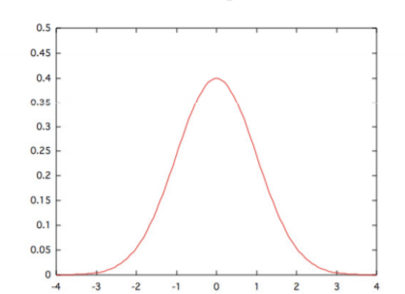
Experiment on the Web
Normal (Gaussian) Distribution (Assumption)
Central Limit Theorem:
If we take any sequence of small independent random quantities, then in the limit their sum will be distributed according to the normal distribution

Slide 20
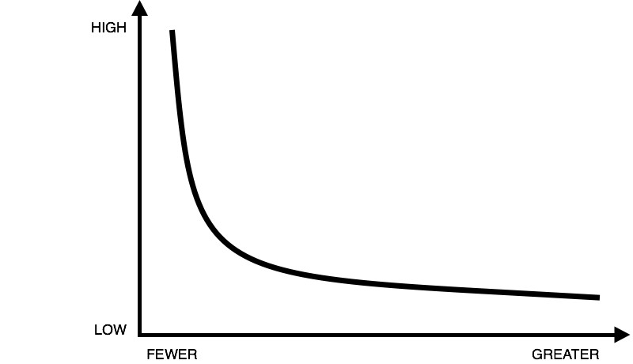
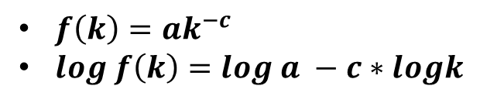

Power Laws
Power Law
In reality, it is approximately proportional to $\frac{1}{k^{2}}$
There are few very popular web pages with many in-links
There are other examples that power law can be applied:
Power law distribution presents straight line
on the log-log graph
$f\left(k\right)=ak^{−c}$
$log f\left(k\right)=log a −c∗logk$
The fraction of telephone numbers that receive k calls per day
The fraction of books bought by k people
The fraction of scientific papers that receive k citations

Slide 21
Rich-Get-Richer Models
How is a network with power law distribution of in-links being built?
Pages are created in order and named as 1,2,3,4,5….,N
Creation of page j will produce link to a previous page by choosing between option ① and ②:
  ① with probability p, page j chooses a page i uniformly at random from
  among previous pages
  ② with probability 1 – p , page j chooses a page i uniformly at random
  creates a link to the page that i point to

Slide 22
Rich-Get-Richer Models
Rich-get-richer dynamics:
When you copy the decision of a random earlier page, the probability that you end up linking to some page L is directly proportional to the total number of pages that currently link to L
The probability that L has an increase in popularity is directly proportional to L’s current popularity

Slide 23
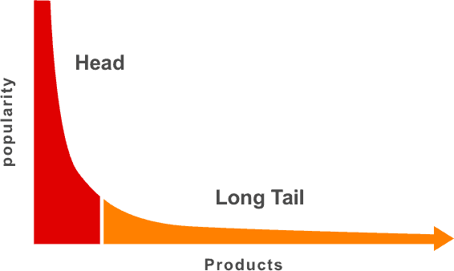
The Long Tail
Distribution of popularity can be important for businesses
Chris Anderson: “The Long Tail”, 2004
Everywhere in media:
  ‘hits’ – small number of blockbusters
  ‘niche products’ – interests a small segment of the audience
Amazon, Netflix
Google uses popularity measures (page rank) to rank web pages
Amazon gain money from giant inventory of niche products → recommendation systems

