Slide 1

Forecasting Promising Technology and Business Strategy through Corporate Patent Network
Undergraduate Directed Study
Jaekeun Lee
(Supervised by Prof. Keeheon Lee)

Slide 2
Table of Contents
1. Research Topic
2. Literature Review & Significance
3. Methodology
4. Results
5. Discussion & Limitations

Slide 3
Research Topic

Slide 4
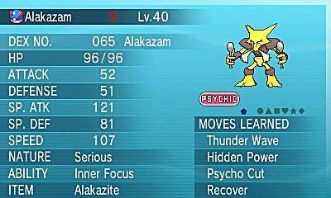
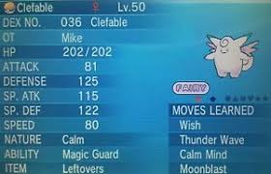
Evaluate Assets, Identify Competitive Strength
1. Research Topic
2
3
4
5
→ Allocation of Resources, Effective Strategy Planning

Slide 5
Forecasting Promising Technology and Business Strategy through Corporate Patent Network
1. Research Topic
2
3
4
5
Can we assess or quantify strength of intellectual property by companies?
How can we compare patent assets of multiple companies?
Can we predict company’s next strategy?

Slide 6
Literature Review & Significance

Slide 7
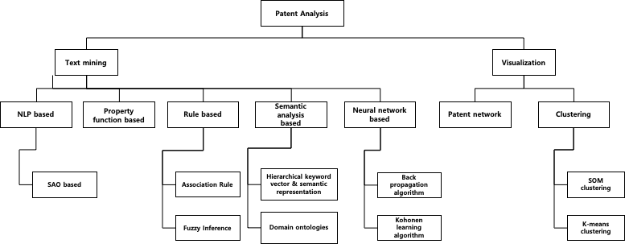
Overview of Taxonomy of Patent Analysis Techniques
1
2. Literature Review and Significance
3 4 5

Slide 8
Analysis by Corporate Unit?? + Prediction?
1
2. Literature Review and Significance
3 4 5

Slide 9
Methodology

Slide 10
1
2
3. Methodology
4
5
USPTO Full Text Data
Data Collection
Parse XML → DB format
Retrieve Necessary Information, Form new relation table
+ Company Selection
Forbes top 10 in IT Sector
Market Value, Asset, Revenue
Data Extraction
Patent id
Company
(Rawassignee)
Title, Abstract
Descriptive Statistics by Companies
Data Analysis
LDA Topic Modeling
Patent Network by Companies
Visualization with Gephi
Prediction
(Link-based)
Corporate Strategy Prediction

Slide 11
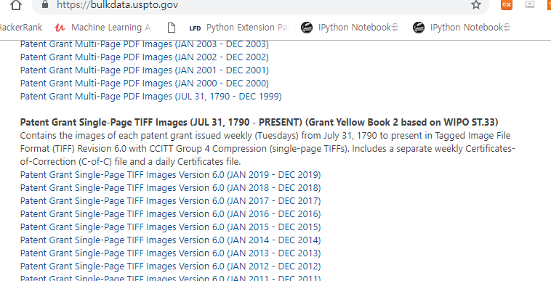
United States Patent and Trademark Office (USPTO) Data
1
2
3. Methodology
4
5
Data Collection

Slide 12
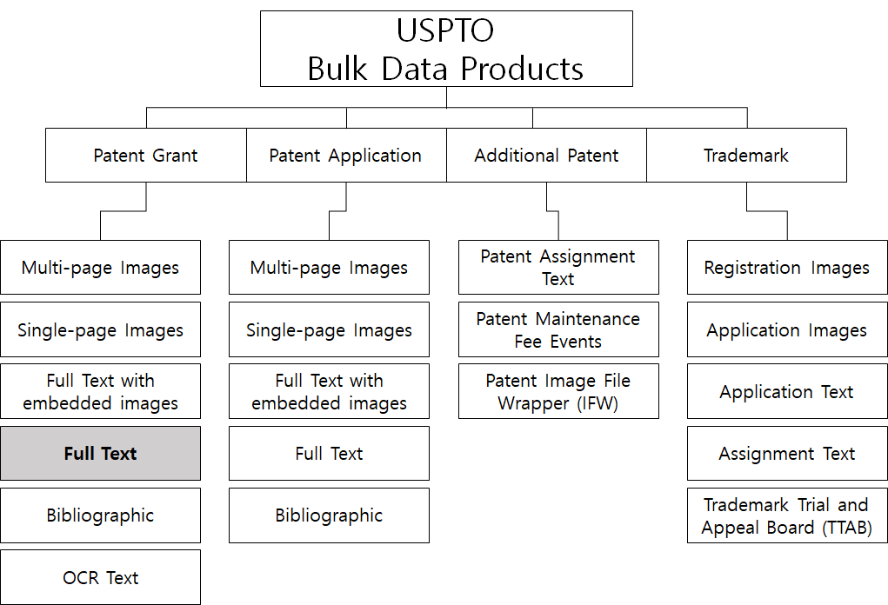
1
2
3. Methodology
4
5
Data Collection
United States Patent and Trademark Office (USPTO) Data

Slide 13
1
2
3. Methodology
4
5
Data Extraction
Data and Variables
Most recent 10 years of data (2008~2018)
63GB
Python Programming
SQL (Structured Query Language) for DB querying

Slide 14
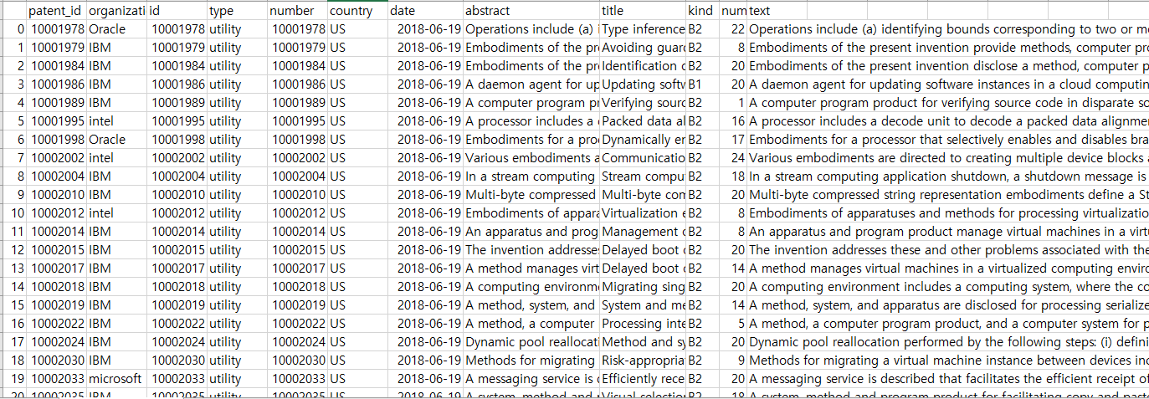
1
2
3. Methodology
4
5
Data Extraction
Abstract + Title = Text
Added Organization Column

Slide 15
1
2
3. Methodology
4
5
Data Analysis

Slide 16
1
2
3
4. Results
5

