Slide 1
CREDIT ONE
Data Science Plan of Action

Slide 2
Problem
Over the past year Credit One has seen an increase in the number of customers who have defaulted on loans they have secured from various partners, and Credit One, as their credit scoring service, could risk losing business if the problem is not solved.

Slide 3
Goals
Build a model to identify which customers are most likely to default on their loans.
If possible, determine what credit limit is appropriate for a customer based on their current and historical financial standing.

Slide 4
Process
Zumel and Mount’s Stages of the Data Science Process
Defining the Goal
Data Collection and Management
Modeling
Model Evaluation and Critique
Presentation and Documentation
Model Deployment and Maintenance

Slide 5
The Data
Sourced from Credit One’s database.
Contains 30,000 customer records over a 6 month period and consists of a combination of demographic and financial datapoints.
Demographic datapoints:
Age; Sex; Education Level; and Marital Status
Financial datapoints:
Total Credit Issued; Payment Status (Delinquency), Billed Amounts, and Payment Amounts between April and September; and Default Status

Slide 6
Data Management
Data Identification
Which data can be employed to help us achieve our goals?
What biases exist in our data?
Data Cleaning
Identifying and removing/correcting duplicate and erroneous data.
Converting categorical data into numerical for analysis.
Data Analysis
Identifying patterns and correlations
Modeling
Employ computer learning to create a predictive model to achieve our goals

Slide 7
Issues with Data
Duplicate Information
Easily removed
Missing Information
None identified
Confusing or Unintuitive Categories
Establish easily understood naming conventions

Slide 8
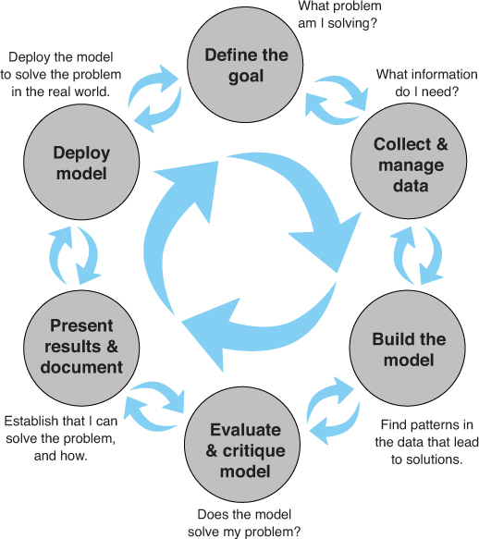
Process Visualized
Source: Zumel, Nina, and John Mount. Practical Data Science with R. 2nd ed., Manning Publications Co., 2020.

Slide 9
Initial Insights
Strongest correlations are:
Month to month bills (0.80-0.95 = STRONG)
Higher bills one month tend to indicate higher bills across all months.
Month to month delinquency (0.47-0.82 = MODERATE to STRONG)
Delinquency in payments indicates higher chance of a history of delinquency.
Delinquency to default (0.19-0.32 = LOW)
Higher delinquency rates indicate a slightly higher risk of default.
Monthly bill to delinquency (0.18-0.29 = LOW)
Higher monthly bills indicate a slightly higher risk of delinquency payments.
Credit balance to default (-0.15 = SLIGHT)
Slight inverse correlation between credit balance and default risk.

