Slide 1
Smart Home Power Management
Analyzing Energy Usage in Sub-Metered Housing

Slide 2
Background
Client is designing a large Smart Home apartment housing development and wants to investigate the benefits of adopting the use of electrical sub-metering devices for power management.

Slide 3
Objective
Present support for adopting sub-metering devices for efficient power management in Smart Home developments.
Detail the benefits of sub-meters in power usage analytics.
Demonstrate the potential for prediction of future energy consumption based on historical data.

Slide 4

Data Sourcing
Raw Data Set is available through the UC Irvine Machine Learning Repository
http://archive.ics.uci.edu/ml/datasets/Individual+household+electric+power+consumption
We are working with a pre-cleaned data set accessed through a secure SQL database

Slide 5
Data Description
Over 2 million observations with 10 attributes documenting the energy usage of a sub-metered residence in Sceaux, France over the course of 47 months from 2006-2010
There are three sub-meters that correspond to:
Kitchen, containing mainly a dishwasher, an oven and a microwave (sub-meter 1)
Laundry room, containing a washing-machine, a tumble-dryer, a refrigerator and a light (sub-meter 2)
Electric water-heater and air-conditioner. (sub-meter 3)

Slide 6
Data Preparation
Our focus is on sub-metering, so we will only be exploring 5 of the 10 attributes: the energy read-outs on the three sub-meters, as well as their date and timestamps. The remaining 5 attributes will be disregarded.
Date and time will have to be converted to DateTime format that is readable in our programming language (R).
Data is pre-cleaned of missing values, but will need to be tidied for easy manipulation and visualization.

Slide 7
Preliminary Analysis
All meters have extended periods of inactivity.
Standard deviation of wattage on meters 1 & 2 is 4-6x higher than the mean, indicating large spikes in usage followed by low usage or total dormancy.
These circuits need capacity for higher spikes in consumption than the circuit monitored by Meter 3.

Slide 8
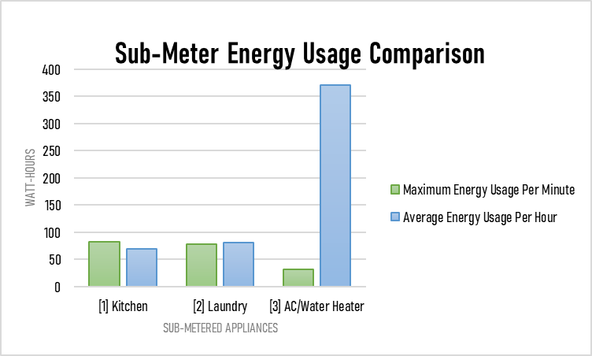
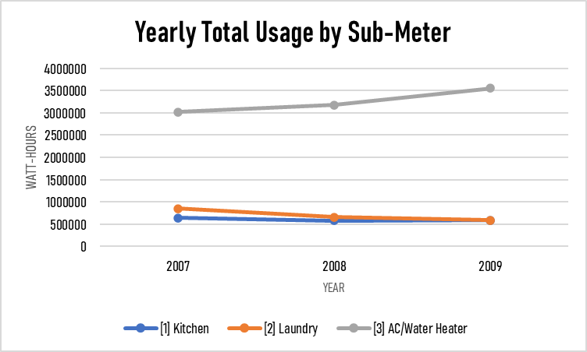
Preliminary Analysis
Meter 1:
Least active, but highest maximum energy usage (82 Wh). Draws power less than 25% of the time.
Meter 2:
Similar activity to meter 1 in both maximum energy usage and average energy usage. Draws power at least 25% of the time but less than 50%.
Meter 3:
Most active by far, but lowest maximum energy usage (31 Wh). Indicates frequent and sustained energy usage at lower levels. Draws power at least 50% of the time but less than 75%.

Slide 9
Predictions
Time of day is a likely predictor for usage of each meter in different regards.
Meter 1:
Most likely to see spikes during mealtimes when oven/microwave in use. Could see sustained usage during bedtime hours or while resident is out of the house when dishwasher is used.
Meter 2:
Washer/dryer and light most likely to see usage during non-working hours and when resident is home (evenings & weekends). Refrigerator could draw energy at any hour.
Meter 3:
Most likely to see seasonal fluctuations in usage. Could see spikes in morning or evening, depending on when resident(s) bathe, or midday during hotter months when AC kicks on. Potential for better energy efficiency depending on how effectively resident monitors and controls AC use.

Slide 10
Predictions
Other patterns we may expect to observe upon further analysis:
Sequential usage between meters based on behavior patterns and appliance needs. For example:
Spike in meter 1 reading coinciding with meter 3 due to dishwasher usage followed by hot water replenishment
Water heater (meter 3) usage triggered by washing machine usage (meter 2)

Slide 11
Recommendations
Record AC and water temperature settings. Could help user monitor energy consumption more accurately and choose optimal settings for energy efficiency.
Knowing weather data would also be helpful. Being able to compare historical energy usage (particularly on submeter 3) to outdoor temperatures could help predict future seasonal usage.
Incorporate app technology that communicates with residents' smart devices to know when they are home or away - monitor energy usage by appliances when no one is home.

Slide 12
Thank You!

