Slide 1
Evaluating Techniques for WiFi Locationing
IOT Analytics

Slide 2
GOAL
While GPS is a reliable navigation system for outdoor spaces, it encounters hurdles when used indoors.
We will determine whether an effective indoor user location positioning system can be developed using WiFi fingerprinting.

Slide 3

DATA LOCATION & DESCRIPTION
UCI Machine Learning Repository
archive.ics.uci.edu/ml/datasets/UJIIndoorLoc
19937 observations consisting of 529 attributes recorded by 19 different users on 25 unique devices.
Archive also contains a collection of 1111 test records.
Attributes include building, room, and floor numbers, as well as a relative position (inside or outside the room); latitude and longitude; user ID; phone ID; timestamp; and 520 WiFi Access Point signals (pings).
WAP signal intensities range from -104 to 0, and 100 indicating “no signal”.

Slide 4
DATA SCIENCE PROCESS
Approach as a classification problem
Use solely the WAP pings and ignore latitude/longitude since the purpose is to find a positioning strategy other than GPS for use indoors
1111 test records were not necessarily recorded in the same predetermined locations as the training data. These could be used in a regression problem seeking to determine precise latitude/longitude, but we are attempting to predict specific locations within the buildings. As such, they will not be used for our classification exercise. Instead we will do a standard train/test split on the main data set.
Using the four attributes that define the indoor location, create a single unique identifier to use as dependent variable.
Test multiple algorithms to determine the most successful classifier for the problem at hand.

Slide 5
KNOWN ISSUES WITH DATA
Data set is very large and includes over 500 features, so training is likely to be intensive. Subsetting data by individual buildings and training models on the smallest set first will speed up run times.
Most WAPs are not detected from every building. Zero variance features will be removed from each subset (individual buildings) before training models to improve efficiency and accuracy.
Data is a sparse matrix, which will present issues for certain types of algorithms (for instance, Support Vector Machines). We’ll train several models with at least three different algorithms to determine the best type to use for this particular problem.

Slide 6
DATA MANAGEMENT
Break data up by building to reduce data frame size and improve model building.
Create unique location IDs using the location data collected (building, floor, room, relative position). These serve as the class levels of the dependent variable.
Remove zero variance features to reduce feature set and improve both run time and accuracy of models.
Train and test algorithms on the smallest data set first to determine strongest candidate for final model. Once best model is determined, train and test on other two buildings as well as full data set and compare results.
Building | Observations | Classes | Floors | WAPs
A (0) | 5249 | 259 | 4 | 201
B (1) | 5196 | 243 | 4 | 208
C (2) | 9492 | 403 | 5 | 204
CAMPUS | 19937 | 905 | N/A | 466

Slide 7
MODELS USED & RESULTS
Top 5 algorithms used:
C5.0, Bagged AdaBoost, K-Nearest Neighbors, Random Forest, and Naïve-Bayes
Also tried the following with listed issues:
Stochastic Gradient Boosting & eXtreme Gradient Boosting: resulted in machine locking up or run time being excessive
Bagged Flexible Discriminant Analysis: Too computationally expensive with unsatisfactory results (took nearly 5 hours to complete and had 43% accuracy).
Averaged Neural Networks: Less than 2% accuracy.
Sparse Distance Weighted Discrimination: Less than 0.2% accuracy.
Model | Accuracy (Train) | Kappa (Train) | Accuracy (Test) | Kappa (Test)
C5.0 | 0.7218829 | 0.7206901 | 0.7246608 | 0.7235458
Bagged AdaBoost | 0.5282888 | 0.5260961 | 0.5418994 | 0.5398284
K-Nearest Neighbors | 0.5864817 | 0.5847303 | 0.5754190 | 0.5736931
Random Forest | 0.7651897 | 0.7641757 | 0.7909018 | 0.7900471
Naïve-Bayes | 0.4351567 | 0.4324263 | 0.4557063 | 0.4530776

Slide 8
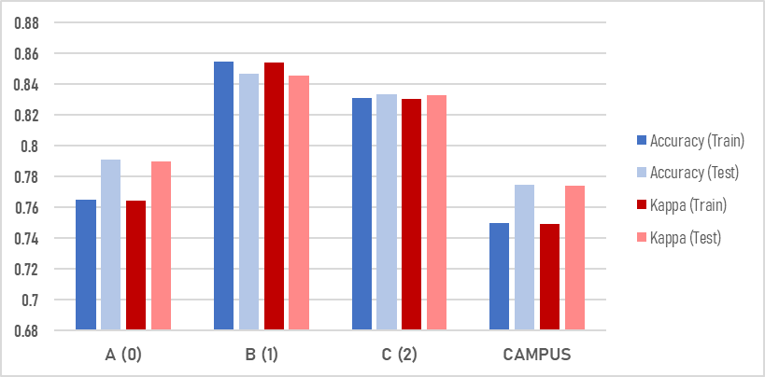
APPLICATION OF BEST MODEL
Random Forest Classifier had the most success training on Building A.
Applied to Buildings B and C individually, followed by the complete data set as a whole.
Significant accuracy loss occurs when model is applied to multiple buildings together.
Building | Accuracy (Train) | Kappa (Train) | Accuracy (Test) | Kappa (Test)
A (0) | 0.7651897 | 0.7641757 | 0.7909018 | 0.7900471
B (1) | 0.8545401 | 0.8536377 | 0.8465909 | 0.8456247
C (2) | 0.8307571 | 0.8302094 | 0.8333333 | 0.8328078
CAMPUS | 0.7496664 | 0.7493000 | 0.7746686 | 0.7743414

Slide 9
TAKEAWAYS & RECOMMENDATIONS
Using existing WiFi technology for location services requires a highly localized approach. Expanding navigation beyond a single building results in reduced reliability. Full integration of outdoor/indoor location services is not yet perfected and effective implementation of WiFi location services requires extensive prior “fingerprinting”, which is inefficient and open to human error.
No iPhones were used in the gathering of this data. iPhone is one of the most popular smartphones on the market and not including it in the fingerprinting may have undesirable ramifications on performance for a large swath of users.

Slide 10
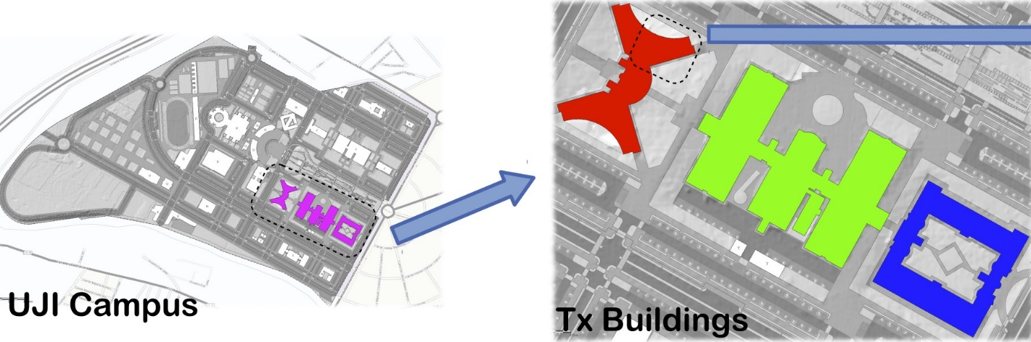
TAKEAWAYS & RECOMMENDATIONS
Performance could be improved with more WAPs placed strategically based on architecture.
Worst results came in Building A. While there are fewer hotspots, it is not dramatically lower than Building B, which has fewer observations, or Building C, which has an extra floor and 55% more dependent variable classes.
Biggest difference between these buildings appears to be architecture. Building A (red) is X-shaped, possibly causing interference issues with the WiFi signals. Building B (green) is a tri-winged structure connected by an intersecting hallway, and Building C (blue) is a more traditional rectangle shape.
Despite having an additional floor and about 150 additional dependent variable classes, the model performs nearly as well on Building C as it does on Building B, indicating the open architecture may make WiFi location services more reliable.

