Slide 1
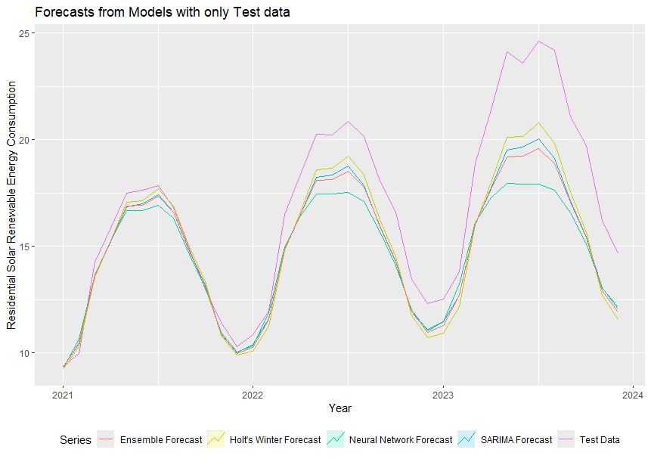
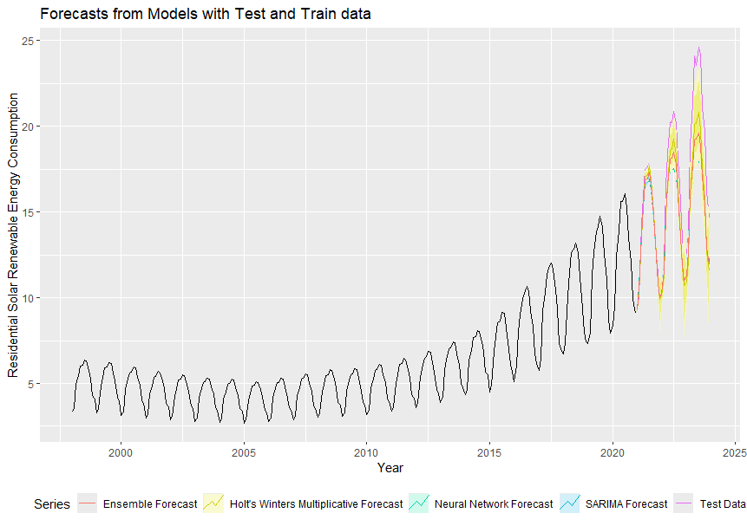
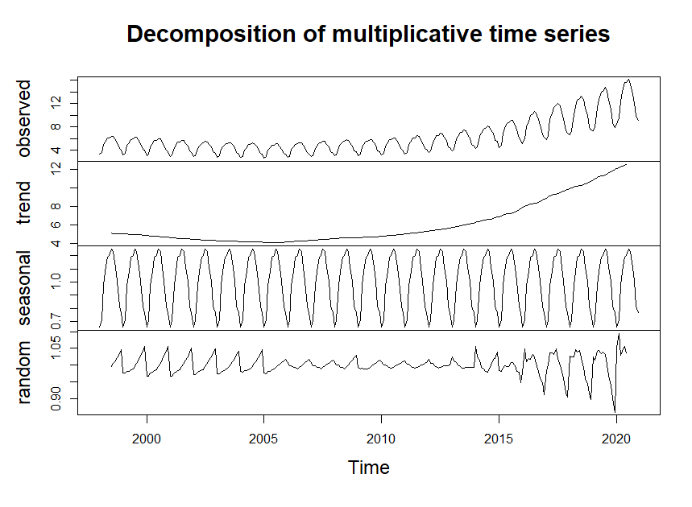
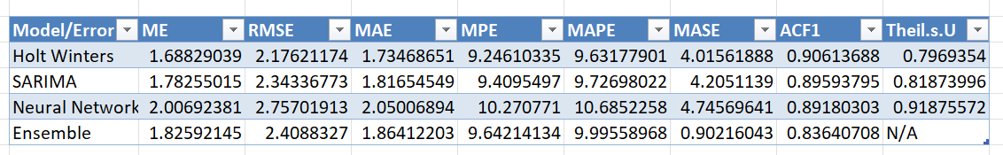

Forecasting Residential Solar Energy Consumption in the US
Anita Gee Department of Applied Analytics, Woods College of Advancing Studies, Boston College
Abstract
This project focuses on forecasting residential solar energy consumption in the United States using four models. Accurate electric load forecasting is vital in the energy sector as both overestimation and underestimation can lead to significant costs such as resource wastage in the case of overestimation, while underestimation can cause service failures and productivity loss.
We have selected four models to forecast the next three years of residential solar energy consumption in the United States: Holt’s Winter Multiplicative Model, Seasonal Autoregressive Integrated Moving Average (SARIMA) model, autoregressive neural network model, a type of artificial neural network (ANN), and an ensemble model, which averages the three models listed above. These models tend to be the most used when forecasting energy demand and consumption. We will then compare these forecasts to the actual data to determine the accuracy of the models.
Based on the results, Holt's Winter Multiplicative model is the best model to forecast residential solar energy consumption since it has almost all the lowest errors even though all the models underestimate residential solar energy consumption after 2021 with a big jump in 2022-2023.
One reason could be that in 2022, President Biden signed into law an expansion of the Federal Tax Credit for Solar Photovoltaics. This means that any person who installs residential solar PV systems will receive a 30% federal tax credit. This means that any data before 2015 that is used to generate forecasts for renewable energy may not be as accurate as using more recent data. Overall, residential solar energy may be hard to predict given regime changes. For example, in 2025, the presidential administration is focused on fossil fuels.
Methods
Data and Preprocessing
Data: Residential solar energy consumption data from the US Energy Information Administration (EIA) from 1998 to 2023 was split into training (1998-2020) and testing (2021-2023) datasets using an 80-20 split.
Forecasting Models: Four models
Holt’s Winter Multiplicative Model: An ETS model with multiplicative error, additive trend, and multiplicative seasonality. It was built using the HoltWinters function from the stats package in R, with seasonal set to multiplicative.
SARIMA Model: Combines autoregressive methods with the moving average and includes seasonal components. It was built using the auto.arima function with seasonal = TRUE from the forecast package in R.
Autoregressive Neural Network (ANN) Model: Built using the nnetar function from the forecast package in R.
Ensemble Model: The average of the forecasts from the three individual models.
Model Evaluation: The forecasts were compared to actual data to determine the accuracy of the models. The accuracy function from the forecast package in R was used.
Advantages and Disadvantages
Advantages of SARIMA and Holt’s Winter Models: Easy to build and require only a small amount of historical data to forecast.
Disadvantages of SARIMA and Holt’s Winter Models: Inability to handle non-linear data and are not as flexible.
Advantages of ANN Model: High accuracy with low errors, reliability, and high efficiency in forecasting energy consumption; can handle non-linear data.
Disadvantages of ANN Model: Computationally intensive, requires more historical data for training, more data preprocessing, hyperparameter tuning, and is sensitive to input parameters.
Results
Overall Trend: There was an overall increase in residential solar energy consumption in the United States from 1998 to 2023, resembling an exponential trend (Figure 1 and Figure 2).
Seasonality: Multiplicative seasonality was observed, where seasonal variation changes proportionately with the trend. As residential solar energy consumption increases, the seasonal fluctuation also increases (Figure 1 and Figure 2).
Model Performance: All models predicted the seasonality of the test set well but underestimated the peaks and troughs of residential solar energy consumption after the first year.
Best Model
The model that best forecasts the test set (residential solar energy consumption 2021-2024) is the Holts Winter Multiplicative model (Figure 3). This is confirmed by the error metrics. Holt's Winter has the lowest error for Mean Error (ME), Root Mean Square Error (RMSE), Mean Absolute Error (MAE), Mean Percentage Error (MPE), Mean Absolute Percentage Error (MAPE) and MASE (Mean Absolute Scaled Error). The ensemble method had the lowest ACF1 (Autocorrelation Function at Lag 1) (Table 1).
Discussion
The Holt’s Winters Multiplicative model is the most accurate for forecasting residential solar energy consumption compared to the other models because it considers multiplicative seasonality and lowest error metrics (Figure 2).
However, all the models underestimated residential solar energy consumption after 2021, with a large increase in consumption between 2022-2023.
This underestimation may be because President Biden signed into law an expansion of the Federal Tax Credit for Solar Photovoltaics in 2022. This expansion means residents who install residential solar PV systems will receive a 30% federal tax credit (“Solar Investment Tax Credit: What Changed?” 2022). The EIA also predicts that by the end of 2023, utility-scale solar installations will more than double compared to 2022 2022 (Motyka, Marlene et al. 2023).
2023).
As more state governments and corporations push to have renewable energy portfolios and many state and federal governments pass laws to incentivize renewable energy, these could impact forecasts and may increase higher than predicted. However, changes in administration, could lead to a decrease in renewable energy. For example, in 2025, the new presidential administration has focused on fossil fuels. Thus, it may be hard to accurately forecast residential solar energy over long periods of time.
Figure 2. Forecasts from Four Models Plotted Against Test Data. This is a plot of the residential solar energy consumption from 2021 to 2023. The test data ( purple) is shown along with all four models, ( Ensemble Forecast(Red), Holt’s Winters Multiplicative (Yellow), Neural Network (Green) and SARIMA (blue)) that forecast residential solar energy consumption from 2021 to 2023..
Conclusion
Based on the results, Holt's Winter Multiplicative model is the best model to forecast residential solar energy consumption since it has almost all the lowest error even though all the models underestimate residential solar energy consumption after 2021 with a big jump in 2022-2023 consumption. However, it may be hard to predict residential solar energy consumption accurately over long periods of time given that presidential administrations change every four years. Thus, solar energy consumption can increase higher than predicted or lower than predicted depending on administration changes.
Introduction & Significance
Ensuring a sufficient supply of energy, particularly electric energy, is a critical priority worldwide due to its inability to be stored for large-scale use. Accurate electric load forecasting is vital in the energy sector as both overestimation and underestimation can lead to significant costs such as resource wastage (overestimation), and service failures and productivity loss (underestimation).
Accurate forecasting for mid/long-term forecasting is challenging due to the nonlinear, multidimensional nature of electricity demand and unpredictable factors like structural breaks and weather patterns. However, it can help decide the construction of new generation facilities, and development of transmission and distribution systems. The development of models to improve long-term electric energy demand forecasting accuracy is still important in energy policy field (de Oliveira and Cyrino Oliveira 2018).
Moreover, because of large fluctuations in power generation of renewable sources such as solar and wind power, accurate forecasting is very important, and utility companies can provide surplus power from other sources of energy when renewable energy sources cannot meet the demand at certain times (Aslam et al. 2021).
References
Aslam, Sheraz, Herodotos Herodotou, Syed Muhammad Mohsin, Nadeem Javaid, Nouman Ashraf, and Shahzad Aslam. 2021. “A Survey on Deep Learning Methods for Power Load and Renewable Energy Forecasting in Smart Microgrids.” Renewable and Sustainable Energy Reviews 144 (July):110992. https://doi.org/10.1016/j.rser.2021.110992.
Hussain, Anwar, Muhammad Rahman, and Junaid Alam Memon. 2016. “Forecasting Electricity Consumption in Pakistan: The Way Forward.” Energy Policy 90 (March):73–80. https://doi.org/10.1016/j.enpol.2015.11.028.
Mat Daut, Mohammad Azhar, Mohammad Yusri Hassan, Hayati Abdullah, Hasimah Abdul Rahman, Md Pauzi Abdullah, and Faridah Hussin. 2017. “Building Electrical Energy Consumption Forecasting Analysis Using Conventional and Artificial Intelligence Methods: A Review.” Renewable and Sustainable Energy Reviews 70 (April):1108–18. https://doi.org/10.1016/j.rser.2016.12.015.
Motyka,Marlene, Thomson, Jim, Hardin, Kate, and Amon, Carolyn. 2023. “2024 Renewable Energy Industry Outlook.” Deloitte Insights. December 4, 2023. https://www2.deloitte.com/us/en/insights/industry/renewable-energy/renewable-energy-industry-outlook.html.
Figure 3. Decomposition of the Train data into trend, seasonal and random components. This plot shows the observed values in the first row. The trend component in the second row. The seasonal component in the third row. The residuals over time in the fourth row.
Figure 1. Forecasts from Four Models Plotted Against Test and Train Data. This is a plot of the residential solar energy consumption from 1998 to 2023. The train set ( black) and the test data ( purple) are shown along with all four models, ( Ensemble Forecast(Red), Holt’s Winters Multiplicative (Yellow), Neural Network (Green) and SARIMA (blue)) that forecast residential solar energy consumption from2021 to 2023.
Table 1. Errors for All Four Models.
This table shows the ME, RMSE, MAE, MPE, MAPE, MASE, ACF1, Theil.s.U for Holt Winters, SARIMA, Neural Network and Ensemble Methods

