Slide 1
Efficient KNN Join Algorithm for spark
Ramanathan Sivagurunathan | MS Student
Supervisor: Dr. Ying Zhou
School of Information Technologies

Slide 2
Agenda
Introduction
Previous Works
Problem Statement
Solution
Detailed Algorithm
Results and Analysis

Slide 3
KNN Join
KNN Stands for K Nearest Neighbour
In KNN Classification, a vector v is classified by finding K nearest vectors in Training data [v1, v2 … vk] and classify v based on those training vectors’ class.
KNN Join, we have a set of test vectors [Vt1, vt2 … vtn]. For every test vector we find the KNN.
Applications:
Classifying Patient Symptoms with other previously treated patients for diagnosing rare diseases
Dating Profile matching
Drawback
High Computational Complexity => Not usable for big datasets

Slide 4
Solution for Big datasets
Better Algorithm with lower computational complexity
Leverage Distributed Clusters

Slide 5
Distributed Frameworks
There are two widely adopted Distributed Frameworks
Hadoop MapReduce
Designed for scalability not for performance
All intermediate results of tasks are stored in disks, resulting in high disk usage
Spark
In Memory Data Processing Primitives giving high performance
Up to 100x faster than mapreduce when data fits in memory and 10x if it spills over disk
Considered as a replacement for Hadoop mapreduce
Due to these performance reasons we are designing our algorithm for spark, as it is the future

Slide 6
Previous Research Works
Types of Algorithm Classes in KNN Algorithms
Indexing
Partitioning
All these algorithms focus on reducing the number of distance computation
The algorithms are primarily for centralized environment
Until now there is only one research which focused on hadoop mapreduce.

Slide 7
Problem Statement
How to get Better KNN Performance for huge Datasets ?

Slide 8
Assumptions and Solution
Assumptions:
S dataset (Training Dataset) is very large
R dataset (Test dataset) is huge but smaller than S
R dataset changes but S dataset remains fixed
Solution:
Partition Based algorithm designed for Spark Framework
Our algorithm is an iterative algorithm and mapreduce does not do well in such scenarios.

Slide 9
Solution Overview
Partition R (Test Dataset) and S(Training Dataset) into partitions with same pivots as a center in both R and S. Partition should not be too large or too small.
We are leveraging the neat idea that except for point near the edge of the partition, most data should be able to find its neighbor within a single partition.
We do a self Join of a Partition in R with same partition in S. Find all the neighbors for data in the middle of the partition. For all such points KNN computation is complete.
For data points on the edge, we find all the nearby partition which might contain a nearest neighbor and check those partitions as well. We check all such partition and update the KNN results for those points

Slide 10
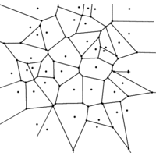
Detailed Algorithm
Select some random number of vectors (pivots) in the Training Dataset.
Each pivot is a separate partition. In spark, dividing the data in to partition helps us to run an operation in parallel on each partition. The operation is called “map”
Assign vectors in both Training and Test Dataset to closest pivots. All vectors belonging to a pivot form a partition. The partition data is stored in spark as a tuple of the form (partition_id, List(vectors))
Partition id x in R and S dataset will be colocated. This avoids lots of shuffle
Voronoi Partition

Slide 11
Detailed Algorithm …
Self Join: For any partition in Test Dataset, find k nearest neighbors in Training Dataset in the same partition. In spark we join two dataset using “join” operation, which gives us elements of same key in both dataset together. This helps us to run operation on taking partition from R and S together.
S Dataset
R Dataset
P2
P2
P1
P1
P4
P3
P3
P4
P5
P5
P8
P8
P6
P6
P7
P7

Slide 12
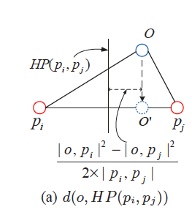
Detailed Algorithm …
If distance of nearest neighbor is less than distance to border then KNN Found for the vector
Else Move the vector to another closest partition and find nearest neighbor in that partition nearer than previously found. In spark we achieve by repartitioning using “partitionBy”. Any vector which needs to be moved automatically gets moved to right partition.
Repeat until we find KNN for all the test vectors
Additional Optimization
Instead of moving to one partition we can replicate to “x” partition, and combine the results afterwards.
Distance to border

Slide 13
Test Environment
Used Mesos for resource Management for Spark Tasks
Cluster contains
1 Master Node (8 vCPU with 16 GB RAM and 160 GB HDD)
10 Slave Nodes (8 vCPU with 64 GB RAM and 160 GB HDD)
Datasets
HIGGS Dataset with 11 Million Vectors. Each with 28 dimensions
Forest Dataset with 500K Vectors. Each with 10 dimensions

Slide 14
Test Environment …
Algorithms
Brute force algorithm
We have written a brute force algorithm which can leverage spark’s parallel in memory computation. This algorithm is also called as Block Nested Loop Join
We partitioning the data into smaller subsets in both R and S. This is to run the algorithm in parallel in all the nodes. Every subset in R will be searched with every subset in S.
R and S Dataset
We have kept both to be same so that we can calculate the worst case. Practically R dataset will be much smaller than S dataset

Slide 15
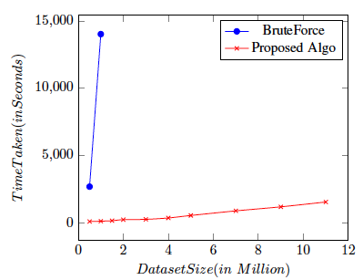
Results
Our proposed algorithm is approximately 100 times better performance than brute force algorithm in 1M x 1M join with 6 dimensions
The performance boost is mainly due to reduction in number of computation per vector in R dataset and Less data shuffles needed
The average computation per vector in our proposed algorithm is 10,000 where as in brute force it is 1000,000 for 1Mx1M join
Possibly about 800 - 1000 times better performance in 11M x 11M Join
Brute force has quadratic increase in time while our algorithm is near linear
This has zero disk usage and better network usage
k

Slide 16
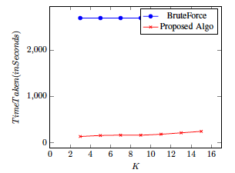
Results …
When K is increased the time taken slightly increases.
This is because a K is increased the distance between a point to its Kth neighbor increases and causing more points to be on the edge of the partition
If the number of created partitions is less then more comparison per partition and it can result in longer time
If the number of partition is also too small can result in more points on edge and causing lots of shuffle

Slide 17
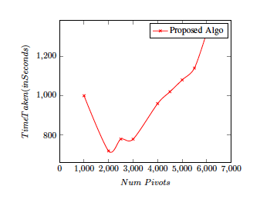
Results …
The graph shows the effect of number of partitions on the performance
If the number of partitions is less then more comparison per vector is needed and it can result in longer time
If the number of partition is high then size of the partition becomes smaller, it can result in more points on edge and causing lots of shuffle

Slide 18
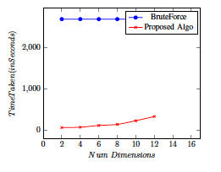
Results …
The graph shows the effect of dimensions on run time.
With increasing dimensions, the performance drops a lot. As dimension grows beyond 12, the performance drops significantly as more and more points lie on the edge. But still the performance of our algorithm is better than brute force but not very highly though.

Slide 19
Thank you

