Slide 1
Chapter 4 Training Models (and overview of classifiers)
Balaji Padmanabhan
Professor, Information Systems & Decision Sciences
Director, Center for Analytics & Creativity
Muma College of Business, USF
bp@usf.edu

Slide 2
Outline
Main ideas in Chapter 4 so you can complete the code independently
Overview of common machine learning classifiers

Slide 3
Main Idea
Two ways you can think of building predictive models
As an “optimization” procedure, where a cost function is used to determine what is optimized
This is what Chapter 4 does.
Example
As a heuristic algorithm that learns a classifier
This class will present examples of both

Slide 4
Part 1: Training as Optimizing Cost Functions

Slide 5
Linear Regression Example
Model (parameterized)
MSE (Cost function)

Slide 6
The Normal Equation
θ-hat = (X^{T}.X)⁻¹.X^{T}.y
The optimal parameters can be solved in closed form through matrix operations
See implementation in code of the normal equation to optimize parameters and compare with sklearn’s package

Slide 7
An Alternate Way
What if the problem is very large?
100,000 features, 1 billion records
How expensive would the matrix multiplication operation be?
What if there are limits on how much data can be in memory?
Making it difficult to calculate the closed form

Slide 8
Enter Gradient Descent
General procedure to alter parameters of a model to obtain some eventual convergence
Key is a cost function that it is trying to optimize, and knowing how the cost function changes as the parameters change (you can calculate this in the algorithm)
If the cost function is convex (simple way is straight line joining two points does not intersect any other point in the line) then this will reach a global optima
MSE and all norms are convex

Slide 9
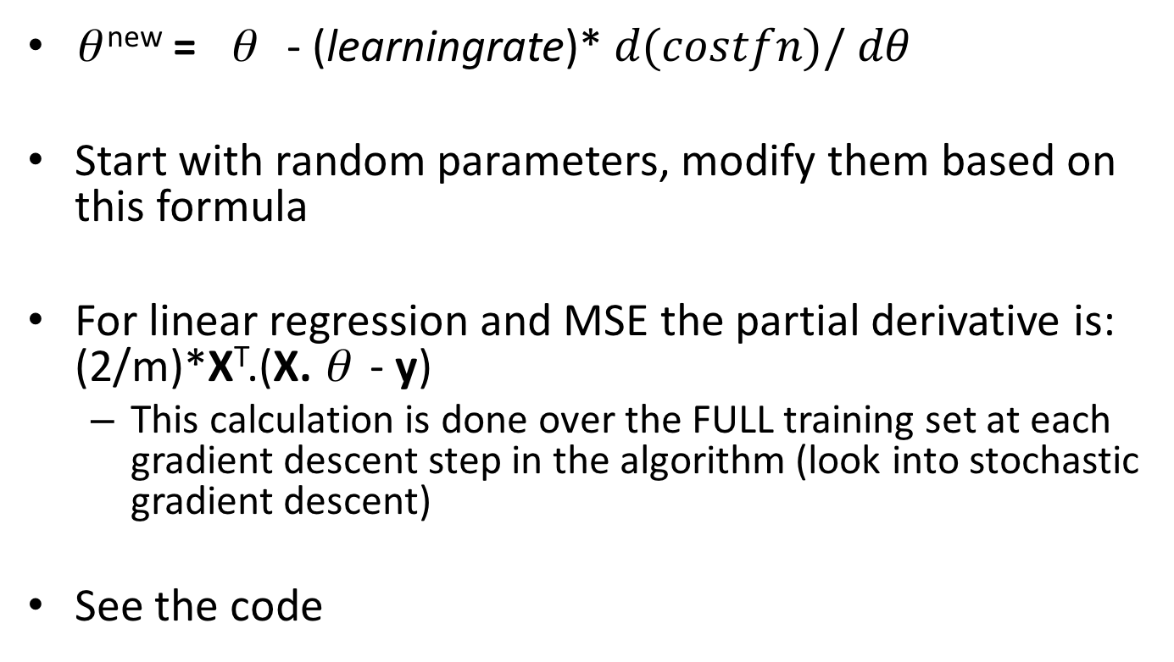
Gradient Descent
θ ^{new} = θ - (learningrate)* $d(costfn)/dθ$
Start with random parameters, modify them based on this formula
For linear regression and MSE the partial derivative is: (2/m)*X^{T}.(X. θ - y)
This calculation is done over the FULL training set at each gradient descent step in the algorithm (look into stochastic gradient descent)
See the code

Slide 10
Regularization
Idea of adding a penalty of sorts to the cost function to constrain search
Why?
New cost function is what is optimized in the training data
Non-regularized cost function is what is looked at in the test data

Slide 11
Regularized Linear Models
Ridge Regression
Regularization term added to MSE cost function is α * ∑ θ ²
There is both a closed form solution and a gradient descent method you can use now
Beauty is you can create polynomial terms and add regularization to avoid overfitting to build flexible non-linear models

Slide 12
Other Regularized Linear Models
Lasso Regression
Regularization term added to MSE cost function is α * ∑ |θ|
Has a tendency to eliminate weights of the least important features
So sort of becomes a cool “feature selection” idea through using just regularization
Elastic Net is a regularized linear model that combines ridge and lasso regression ideas

Slide 13
Revisit Main Idea
Two ways you can think of building predictive models
As an “optimization” procedure, where a cost function is used to determine what is optimized
This is what Chapter 4 does.
Example
As a heuristic algorithm that learns a classifier
This class will present examples of both

Slide 14
Part 2: Building Heuristic Classifiers

Slide 15
Data Mining Methods: Tree Induction Algorithms Using Recursive Partitioning

Slide 16
Decision Tree Learned from Data
Occupation = “Owner”
Occupation = All Others
CreditRisk=High
Income < 50K
Income ≥ 50K
CreditRisk=High
CreditRisk=Low

Slide 17
The “Recursion” in “Recursive Partitioning”
The coolest idea in tree induction algorithms
All you need is a systematic method for taking a given dataset and splitting it once.
The idea of recursion means, all we do is pretend that each smaller dataset now is the actual dataset
Simply re-apply the same systematic rule again and again…

Slide 18
A “Stack” as a Data Structure
Think of a stack as an open box
Pushing means adding an object or objects to the top of the stack (box)
Popping means removing the topmost item in the stack (box)
Node 1
Node 2
Node 3
Node 1
Node 2
Node 3
Node 5
Node 4
Node 1
Node 2
Node 3
Node 5
Node 4

Slide 19
The Basic Recursive Partitioning Idea
node = entire data
push(node)
While stack_not_empty {
Node = pop()
Split(node, right, left)
push(right), push(left)
}
Node 1
Node 5
Node 3
Node 6
Node 1
Node 4
Node 3
Node 1
Node 2
Data

Slide 20
Basic Algorithm
node = entire data
push(node)
While stack_not_empty {
Node = pop()
Split(node, right, left)
If not empty (right, left)
push(right), push(left)
else mark “node” as a leaf of the tree
}
Full tree = set of all leaves
Prune full tree and output a (possibly) smaller tree

Slide 21
Goodness of a Node
Compute probability that two items chosen at random from this node are the same.
Sample with replacement
Example:
A node with 5 zeros and 5 ones
Probability of choosing a zero * probability that the next item chosen will also be zero PLUS
Probability of choosing a one * probability that the next one chosen will also be a one
0.5*0.5 +_0.5 * 0.5 = 0.5 (not very good)
Gini and Entropy are two common measures of goodness

Slide 22
Splitting Heuristic
Generate all possible splits at each stage
Compute the goodness of the split (by looking at the goodness of the children nodes)
Pick the best split and continue

Slide 23
Pruning the Large Tree:

Slide 24
Data Mining Methods: Neural Networks

Slide 25
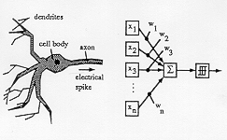
From a network of neurons to a neural network

Slide 26
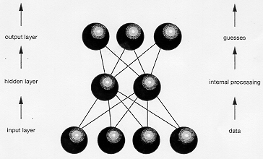
Structure of a Neural Network

Slide 27
Learning a Neural Net from Data
Learning a neural network means learning:
the structure (number of nodes in the hidden layer) and
the actual weights on every connection.
The number of hidden layer nodes is trial and error (so, user specified typically)
There is an algorithm called “backpropagation” that determines weights (which we will discuss later)

Slide 28
One Approach for Learning the Weights
Backpropagation (the initial learning scheme):
Start with a random set of weights
Repeat for fixed number of generations (epoch)
Repeat through the training data set (each generation)
Select next data point from the training data
Use the current NN to make a prediction
Calculate the error made by the NN
Modify each weight by a small amount to reduce the error
(learning rate and momentum parameters come in here)
Calculate the overall error in the training data set
See if the process can be terminated
End of generation

Slide 29
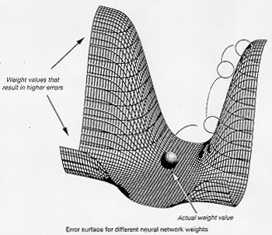
The gradient descent method of adjusting weights.

Slide 30
The Nearest Neighbor Classifier
Given a data set D
A new point P to make a prediction for
Compute the distance from P to each point in D.
Select the “k” nearest neighbors to P in D
Combine their predictions into an output

Slide 31
Genetic Algorithms

Slide 32
Using Natural Selection to Generate Good Solutions for anyoptimization problem
Need a computational way of evolving solutions to a problem.
Analogy: Over time through various operators, chromosomes mate and genetic material is passed on to the offspring. Children with “better” chromosomes have a greater probability to adapt and survive. The weak chromosomes gradually die out.

Slide 33
Design Components
Need a computational way of evolving solutions to a problem.
What is the equivalent of a chromosome?
What is the equivalent of a chromosome having “good” genetic material?
What is the equivalent of a population of chromosomes?
What is the equivalent of reproduction?
What is the equivalent of survival of the fittest?
If we can answer the above in a computational framework, we can use the process of natural selection to evolve good solutions to a problem.

Slide 34
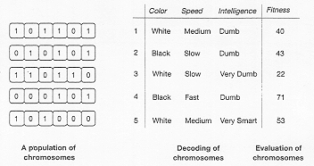
How a Population of Chromosomes Looks Like

Slide 36
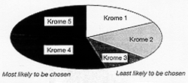
Survival of the Fittest
Give chromosomes with better fitness a higher probability of being chosen for reproduction.

Slide 37
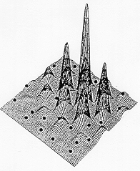
How solutions evolve in a GA

Slide 38
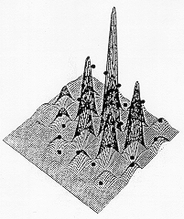
Chromosomes Evolving Over Generations

Slide 39
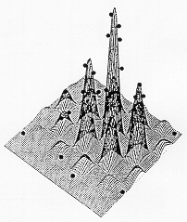
Chromosomes Evolving Over Generations

Slide 40
Examples
Optimal weights for a neural network.
Learning Classifier Systems (LCS)
Finding Patterns in Data
Portfolio Optimization

