Slide 1
Reinforcement Learning
One of the sub-fields in machine learning, focused on learning what action to make at any point in time.
Agents, state, action and reward framework.
Goal is to learn an optimal policy, or the algorithm that decides which action to take

Slide 2
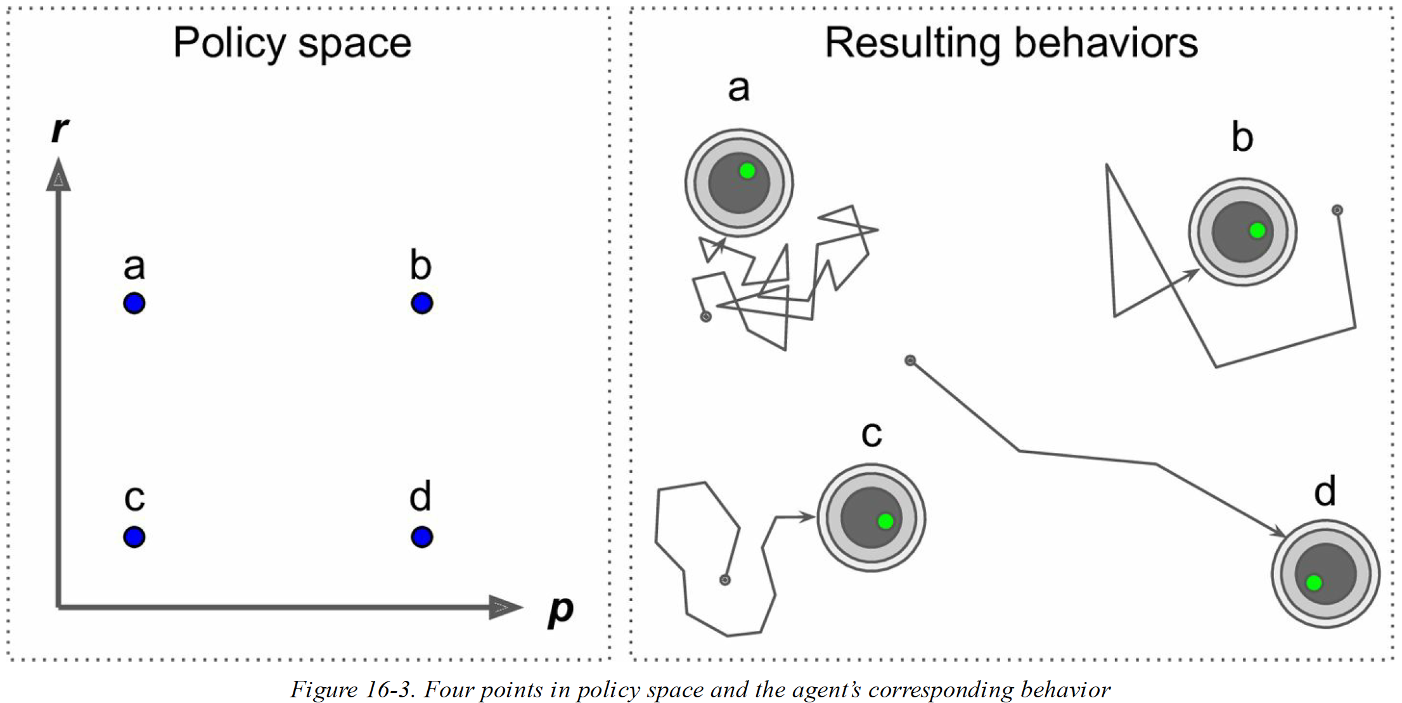
Simple Robot Example Policy: Move Forward (p) or Rotate Random (1-p)

Slide 3
How to Calculate Optimal Policy?
Try out different values of parameters and run/simulate
See testbed OpenAIgym
Policy Gradients
Q-Learning Framework
Deep Learning

Slide 4
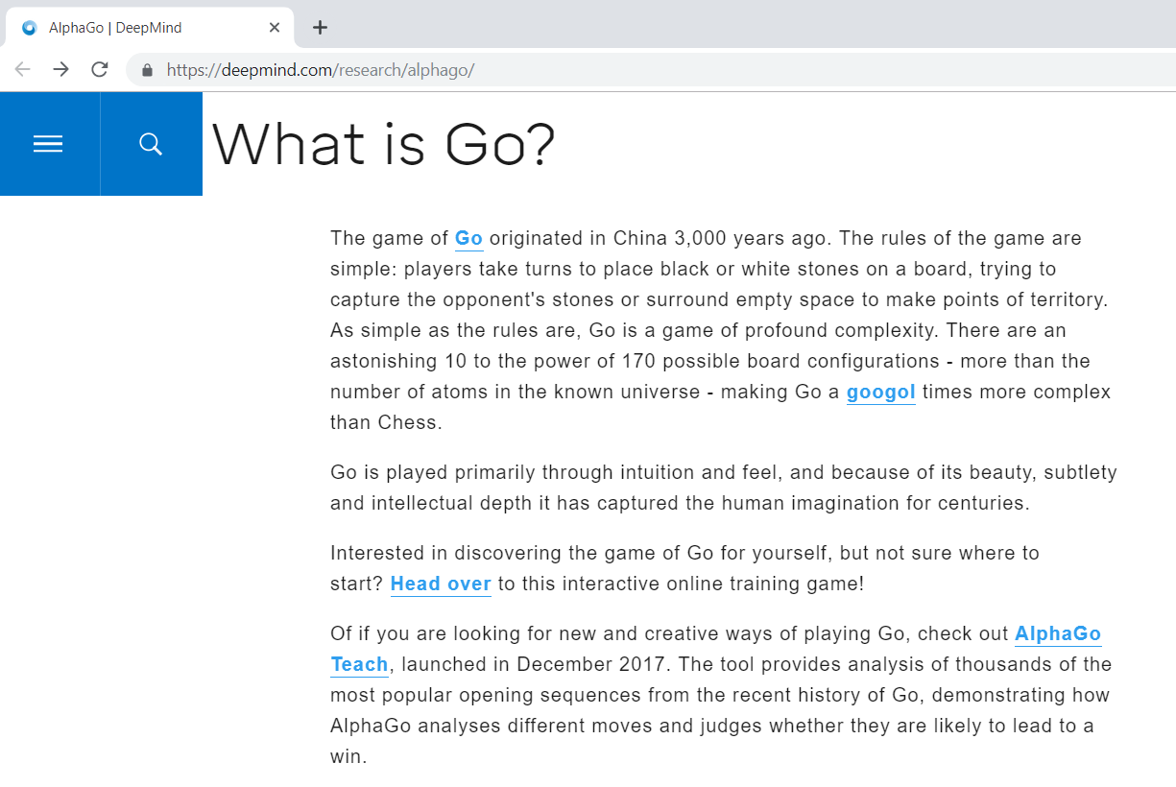
DeepMind’s AlphaGo

Slide 5
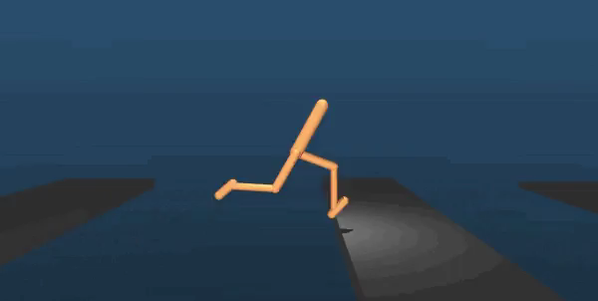
Obstacle Course
Source: TheVerge

Slide 6
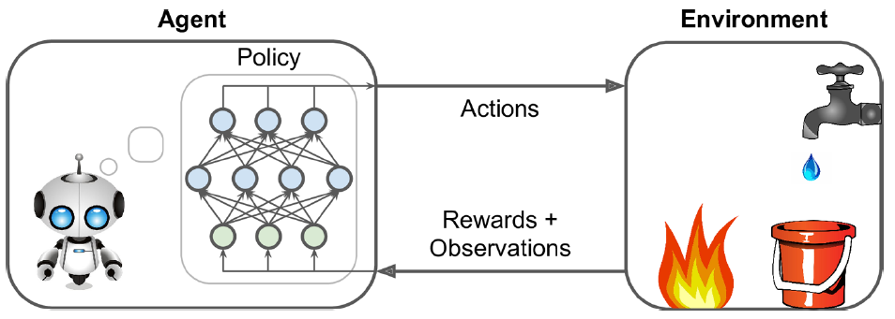
Policy Search
The “agent” uses an algorithm to determine its actions.
This algorithm is called a “policy”
Policy can be any algorithm such as neural network, decision tree, etc. (and even a rule-based deterministic algorithm)

Slide 7
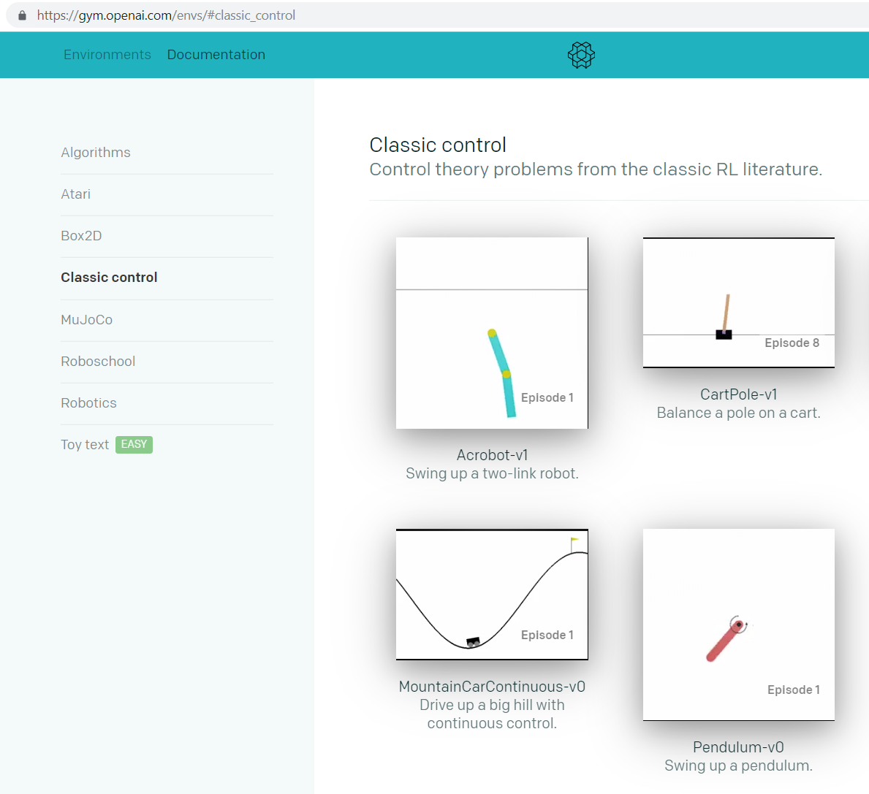
OpenAI Gym:
Provides the “environments” for reinforcement learning
Has a python API
There are many different environments

Slide 8
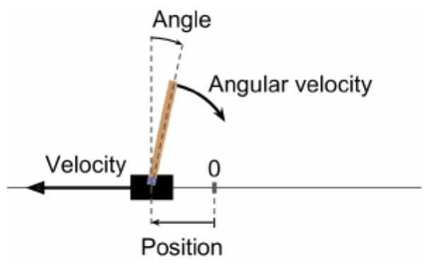
CartPole environment
Balance a pole placed on a cart by moving it vertically and horizontally

Slide 9
Cartpole Example
Reinforcement learning is NOT “hard-coding”
If angle <85 AND angular velocity > 1:
move cart to right:
velocity = 2 units,
position = 1 unit

Slide 10
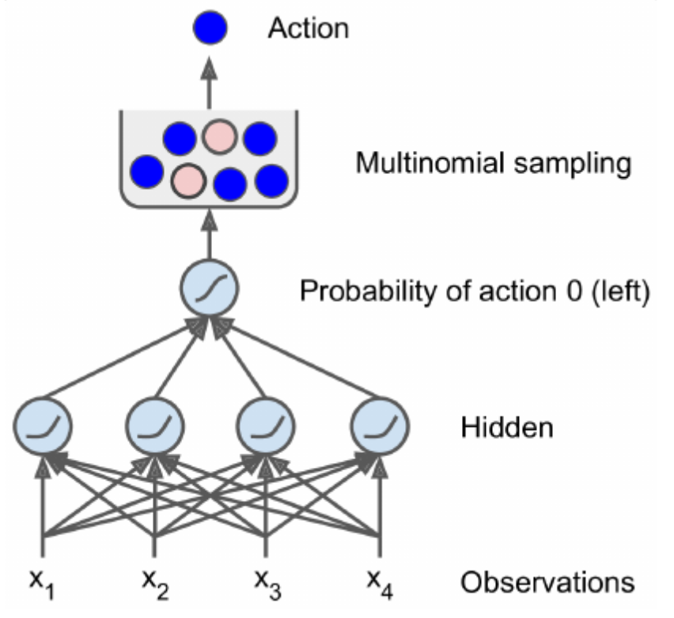
Optimizing Cartpole
Reinforcement learning is letting an algorithm (Neural Network) FIGURE OUT the action itself

Slide 11
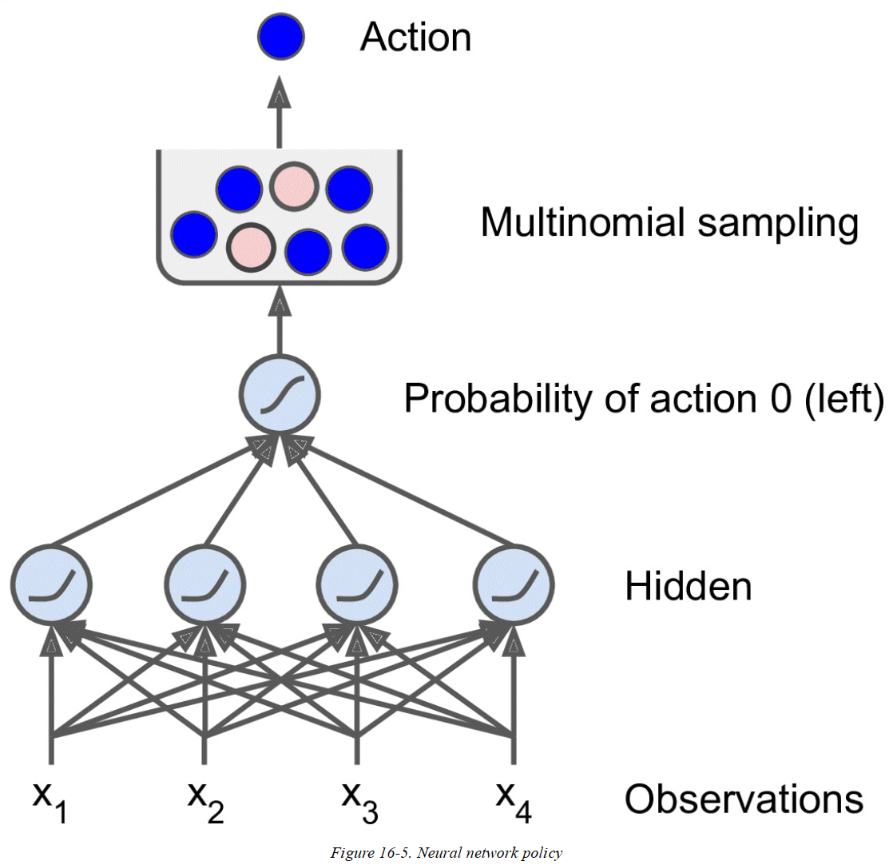
Using a Neural Network to Predict Action
Evaluate based on discounted future rewards

Slide 12
Neural Network Policies
How do we train the NN?
(We need to know the rewards)
Solution: Credit (reward) assignment

Slide 13
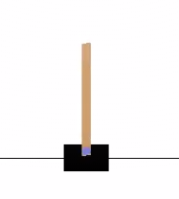
Credit Assignment Problem
Imagine the CartPole problem:
NN managed to balance for 99 steps.
It fell at 100th step
Which step(s) is/are to blame?
Which step(s) was/were good?
Problem:
Rewards are sparse
Rewards are delayed
Which step should get credit?
Which step should get the blame?

Slide 14
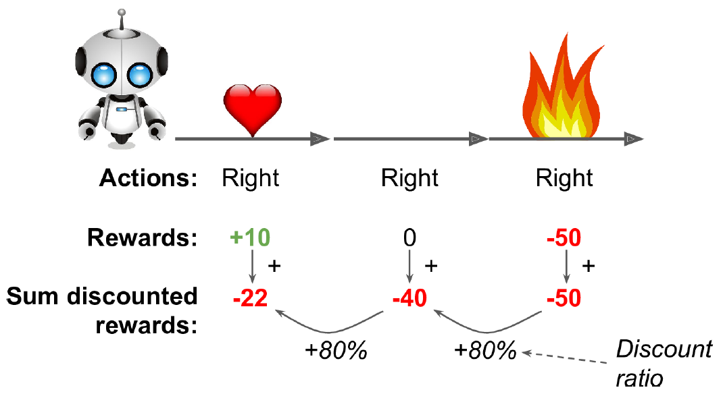
Credit Assignment Problem
Solution:
Evaluate each action based on sum of all rewards before it.
Apply a discount factor (gamma) at each step.
Example:
If you play long enough, good actions, on average, will get higher scores

Slide 15
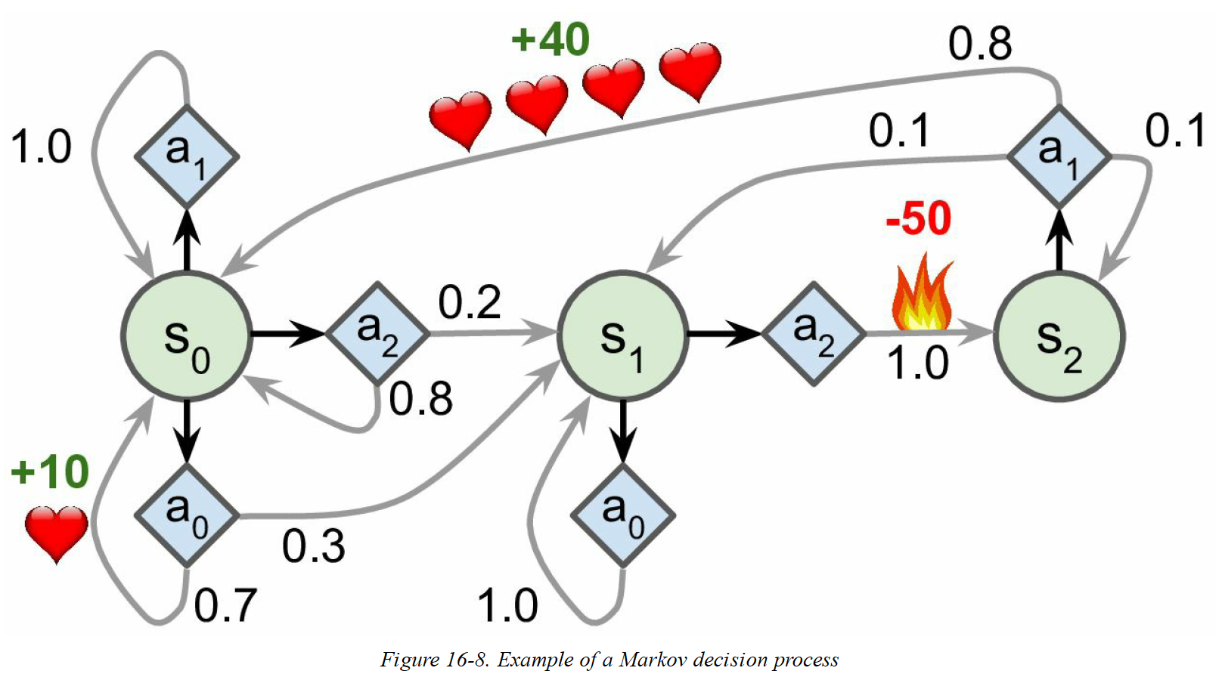
Markov Chains and Markov Decision Processes: Q-Learning is a method of computing optimal policies here

Slide 16
Lots of Future Opportunities
In Combining RL with DL
Google Deep Mind

Slide 17
Yann LeCun Director of AI Research at Facebook DL Talk
https://www.youtube.com/watch?v=0tEhw5t6rhc

