Slide 1
ADDRESSING THE HIV/AIDS STIGMA IN SOUTH AFRICA THROUGH BLOCKCHAIN
Thabang Aubrey Kgosiemang

Slide 2
STRUCTURE
Introduction
Background
Problem Statement
High level solution
Prototype demonstration

Slide 3
INTRODUCTION
The widespread stigma surrounding HIV/AIDS in South Africa
Analysis of the implications of the HIV/AIDS stigma
Introduction to a high-level solution that uses blockchain technology to tackle HIV/AIDS stigma
The role of blockchain technology in reducing the HIV/AIDS stigma
The platform’s anonymity and security provided by blockchain technology
How the blockchain technology can create a positive and supportive community that encourages testing and treatment

Slide 4
BACKGROUND
South Africa continues to struggle with one of the highest rates of HIV/AIDS transmission worldwide.
Despite important advances in medicine and public health campaigns, HIV/AIDS stigma is still widespread
These current solutions fail to address the social and cultural barriers contributing to stigma.
This stigma leads to discrimination against individuals living with HIV/AIDS.
The stigma also leads to fear for testing and delay to seek treatment, worsening virus transmission and containment efforts.

Slide 5
PROBLEM STATEMENT
The HIV/AIDS stigma in South Africa has extensive implications, including:
  Economic implications: Individuals with HIV/AIDS may lose jobs due to the discrimination faced in a workplace. The individuals’ economic contributions may be reduced due to the stigma’s psychological impact.
  Societal implications: Women face double stigma and discrimination also due to the gender-based societal norms.
  Mental health implications: People living with HIV/AIDS often experience psychological distress and social isolation, and this may lead to fear for disclosure, leading to increased transmission

Slide 6
HIGH LEVEL SOlUTION
To effectively address the issue, blockchain technology can be used to create a decentralized, safe, secure platform that aims to reduce the stigma associated with HIV/AIDS in South Africa.
The platform will:
Enable individuals to anonymously share their HIV/AIDS related experiences, struggles and breakthroughs.
Use blockchain’s immutability and transparency to ensure accuracy and authenticity of shared stories.
Use blockchain algorithms and data structures such as Merkle trees to create a supportive, compassionate community through verified, trustworthy stories.
3. Organizing transaction data within Blocks:
Nodes: Represent transactional data, the shared stories(Hash A, Hash B, etc.)
Pairs of nodes hashed until one hash remains, known as root hash
Each non-leaf node is a hash of its previous hash, every leaf node is a hash of transactional data.

Slide 7

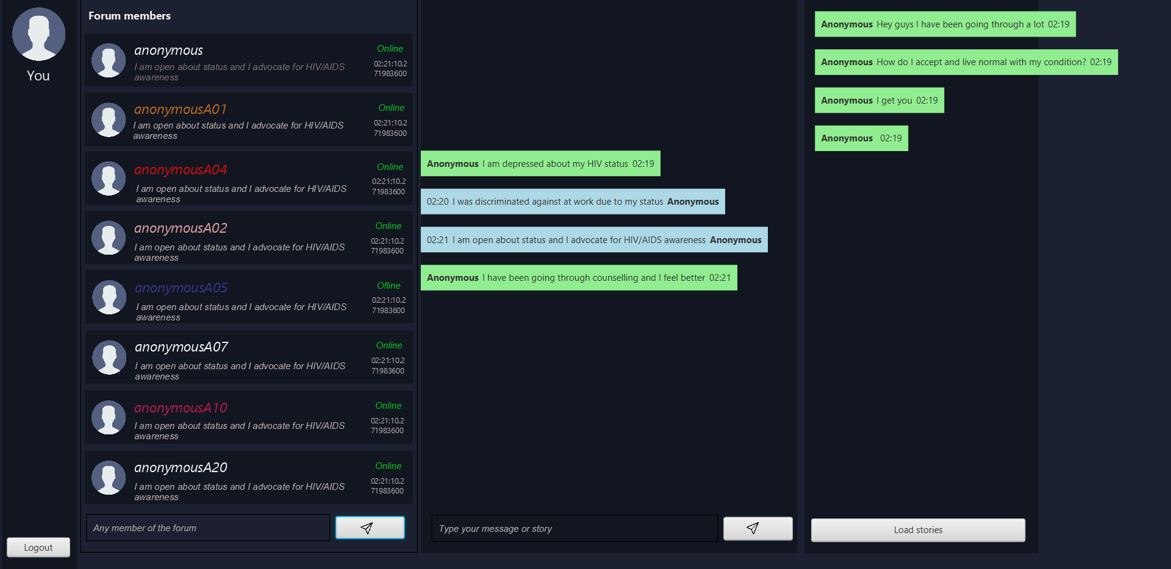
GUI

Slide 8
THANK YOU
Thabang Aubrey Kgosiemang
217011260
217011260@students.uj.ac.za

