Slide 1
BLOCKCHAIN-BASED SECURE PLATFORM PROTOTYPE
Thabang Aubrey Kgosiemang

Slide 2
PURPOSE OF THE PROJECT
Social stigma and lack of trust prevent people from using sensitive digital platforms openly.
Centralized systems risk data tampering and privacy breaches.
Project explores how blockchain principles can improve data integrity, trust, transparency and security.
This Prototype focuses on building a secure registration and data handling layer.
A core foundation for future privacy-focused systems.

Slide 3
TOOLS, TECHNOLOGIES / PLATFORMS USED
Java – Core application logic and system control
JavaFX – Graphical User Interface (GUI)
Blockchain logic - hashing and block structure to ensure data integrity.
IntelliJ IDEA – Development and debugging
File I/O – Local data persistence (prototype storage)

Slide 4
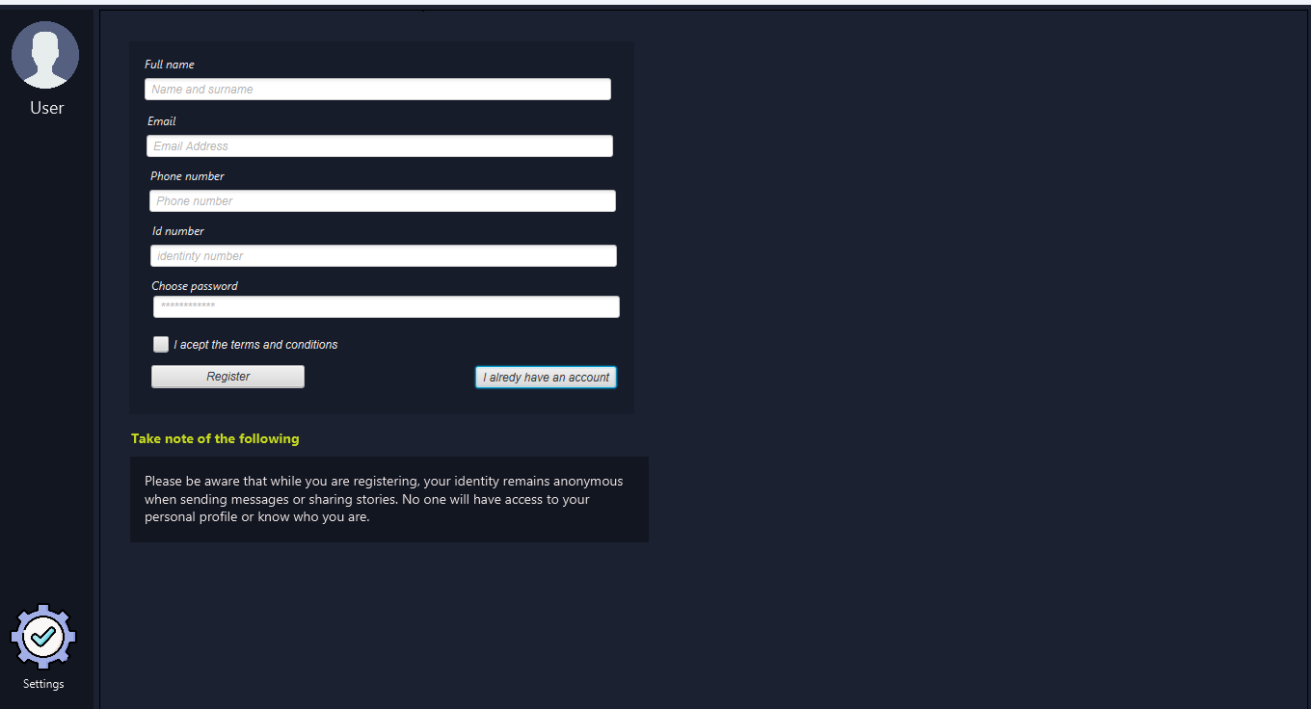
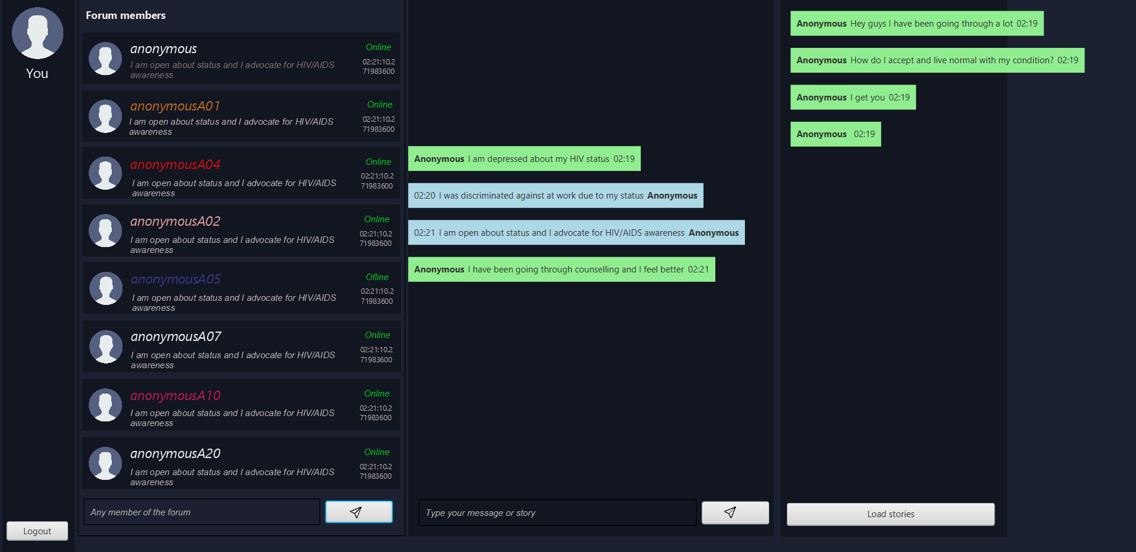
GUI

Slide 5
SKILLS SOURCE
University coursework
Practical programming projects
Online tutorials and documentation
Debugging and experimentation

