Slide 1
Welcome to: Visualization with D3
Adapted from Frank Elavsky’s NUIT workshop: https://github.com/nuitrcs/Intro_to_d3_workshop
Notes:
3

Slide 2
Good News/Bad News
What I am about to tell you will be great if you are a ‘Mastery’ individual
What I am about to tell you will be difficult if you are an ‘Achievement’ individual
Everyone is different! But it is good to know the frustrating stuff up front.

Slide 3
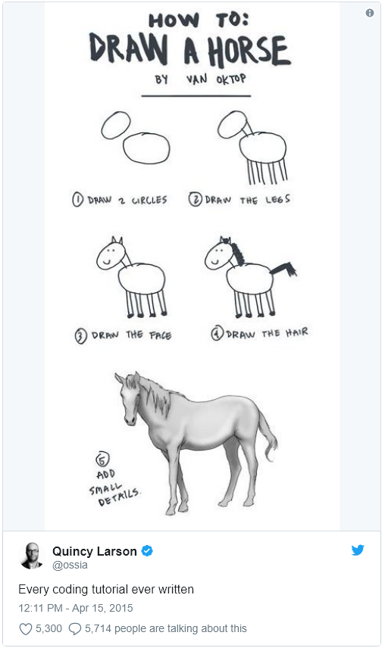

Slide 4
Before I say anything, write this down:
console.log(this)

Slide 5
console.log(this) is your most powerful weapon
Use it. All the time.
It is your 6th sense in frontend development: it lets you ‘see’ where you are in your code and the DOM. It is your eyes into your scope, your selections, and your life.

Slide 6
Getting Started:
Task #1: Get your tools
Get a text editor: Sublime, Atom, Notepad++, or Brackets
Make sure you have either Chrome or Firefox
Task #2: Open your files in a text editor
“index.html”, “index.css”, “scatterplot.js”
Notes:
8, 6 & 2

Slide 7
Task #3: Setting up a local server
Python
Navigate to dir
Run:
Python 3x: python -m http.server
Python 2x: python -m SimpleHTTPServer
Point your browser to localhost:8000

Slide 8
Port note:
You may need to specify a unique port number, if we all share an internal IP
Node: call http-server -p 9876 -c-1
Python: python -m http.server 9876

Slide 9
Now: Introduction to D3.js
Hands-on learning and plenty of resources.
Notes:
3

Slide 10
What is D3 capable of?
https://ligo.northwestern.edu/media/mass-plot/index.html
http://www.r2d3.us/visual-intro-to-machine-learning-part-1/
http://bit.ly/2wJEeIy
http://nbremer.github.io/urbanization/
https://www.nytimes.com/interactive/2014/upshot/buy-rent-calculator.htmlhttps://bost.ocks.org/mike/algorithms/
Notes:
3

Slide 11
But why is it so hard?
Why not just something like d3.call(bargraph).with(my_data)?
These solutions exist and you should use them when appropriate:
vega/vega-lite/altair
plotly
ggplot2
matplotlib
bokeh
Notes:
1

Slide 12
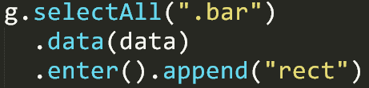
Two very important things:
Binding data to the DOM
Low-level geometric expressiveness
Notes:
3

Slide 13
Think of making a cake
How do most people do it?
Notes:
1 “Is box-cake even good though?”

Slide 14
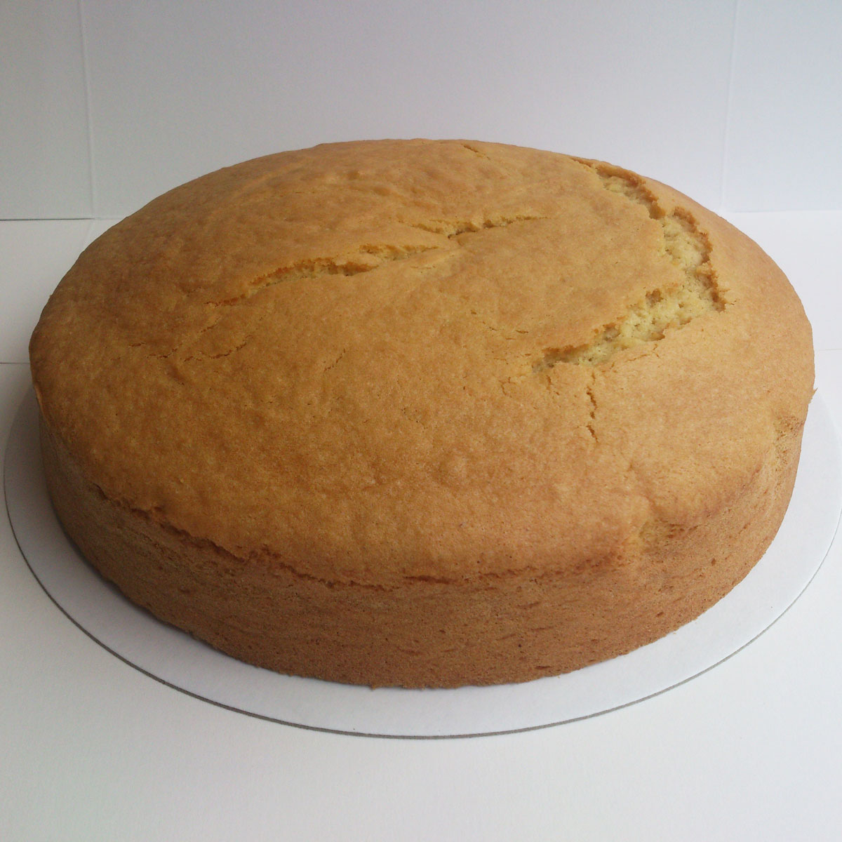
Microsoft Excel
Notes:
1

Slide 15
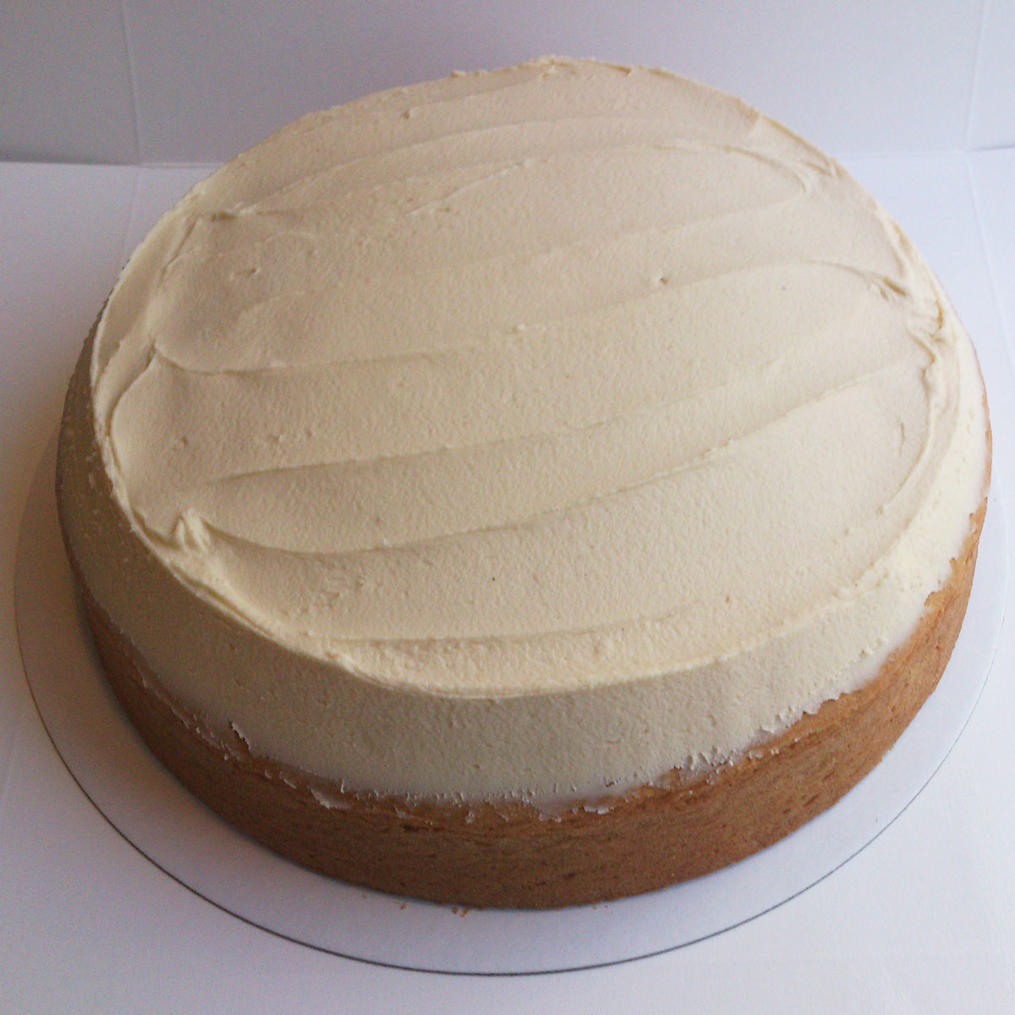
Plotly, ggplot2, Matplotlib
Notes:
1

Slide 16
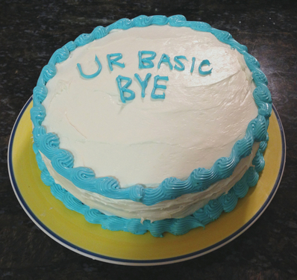
Tableau, Vega
Notes:
1

Slide 17

D3 is tiramisu
Notes:
1

Slide 18

Or whatever cake you want
Notes:
1

Slide 19
“Boxed” cake is easy
Eggs + water + their pre-mixed flour,
Bake,
and then if you have the time: add frosting
In the end? Boring!
Notes:
1

Slide 20
Cake “from scratch” is hard:
You have to think about each ingredient, its quality, its needs
You must imagine your end-result + find a useful recipe
It can take a long time to master each ingredient
In the end? A unique masterpiece!
Notes:
2

Slide 21
Challenge #1
Change the data file from “testData.csv” to “congress_data114.csv”
Use the “x_dimension” for x, and “alt_dimension” for y
Also change the labels in the plot axes
Change the color map to something new
Make all the fonts larger and sans-serif

Slide 22
Challenge #2
Change the data file from “congress_data114.csv” to “congress_data.csv”
Continue using the “x_dimension” for x, and “alt_dimension” for y
Only plot one congress number at a time
Create some method to go from one congress number to the next
Bonus points for using d3 transitions

