Slide 1
Welcome to: Visualization with D3
Adapted from Frank Elavsky’s NUIT workshop: https://github.com/nuitrcs/Intro_to_d3_workshop
Notes:
3

Slide 2
Good News/Bad News
What I am about to tell you will be great if you are a ‘Mastery’ individual
What I am about to tell you will be difficult if you are an ‘Achievement’ individual
Everyone is different! But it is good to know the frustrating stuff up front.

Slide 3
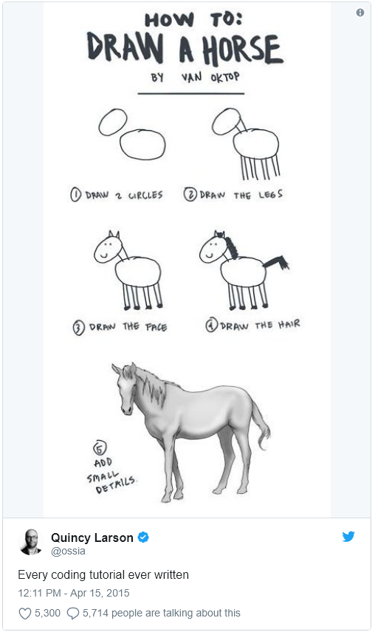

Slide 4
Before I say anything, write this down:
console.log(this)

Slide 5
console.log(this) is your most powerful weapon
Use it. All the time.
It is your 6th sense in frontend development: it lets you ‘see’ where you are in your code and the DOM. It is your eyes into your scope, your selections, and your life.

Slide 6
Getting Started:
Task #1: Get your tools
Get a text editor: Sublime, Atom, Notepad++, or Brackets
Make sure you have either Chrome or Firefox
Task #2: Open your files in a text editor
“index.html”, “index.css”, “scatterplot.js”
Notes:
8, 6 & 2

Slide 7
Task #3: Setting up a local server
Python
Navigate to dir
Run:
Python 3x: python -m http.server
Python 2x: python -m SimpleHTTPServer
Point your browser to localhost:8000

Slide 8
Port note:
You may need to specify a unique port number, if we all share an internal IP
Node: call http-server -p 9876 -c-1
Python: python -m http.server 9876

Slide 9
Now: Introduction to D3.js
Hands-on learning and plenty of resources.
Notes:
3

Slide 10
What is D3 capable of?
https://ligo.northwestern.edu/media/mass-plot/index.html
http://www.r2d3.us/visual-intro-to-machine-learning-part-1/
http://bit.ly/2wJEeIy
http://nbremer.github.io/urbanization/
https://www.nytimes.com/interactive/2014/upshot/buy-rent-calculator.html
https://bost.ocks.org/mike/algorithms/
Notes:
3

Slide 11
But why is it so hard?
Why not just something like d3.call(bargraph).with(my_data)?
These solutions exist and you should use them when appropriate:
vega/vega-lite/altair
plotly
ggplot2
matplotlib
bokeh
Notes:
1

Slide 12
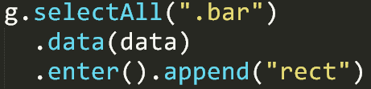
Two very important things:
Binding data to the DOM
Low-level geometric expressiveness
Notes:
3

Slide 13
Think of making a cake
How do most people do it?
Notes:
1 “Is box-cake even good though?”

Slide 14
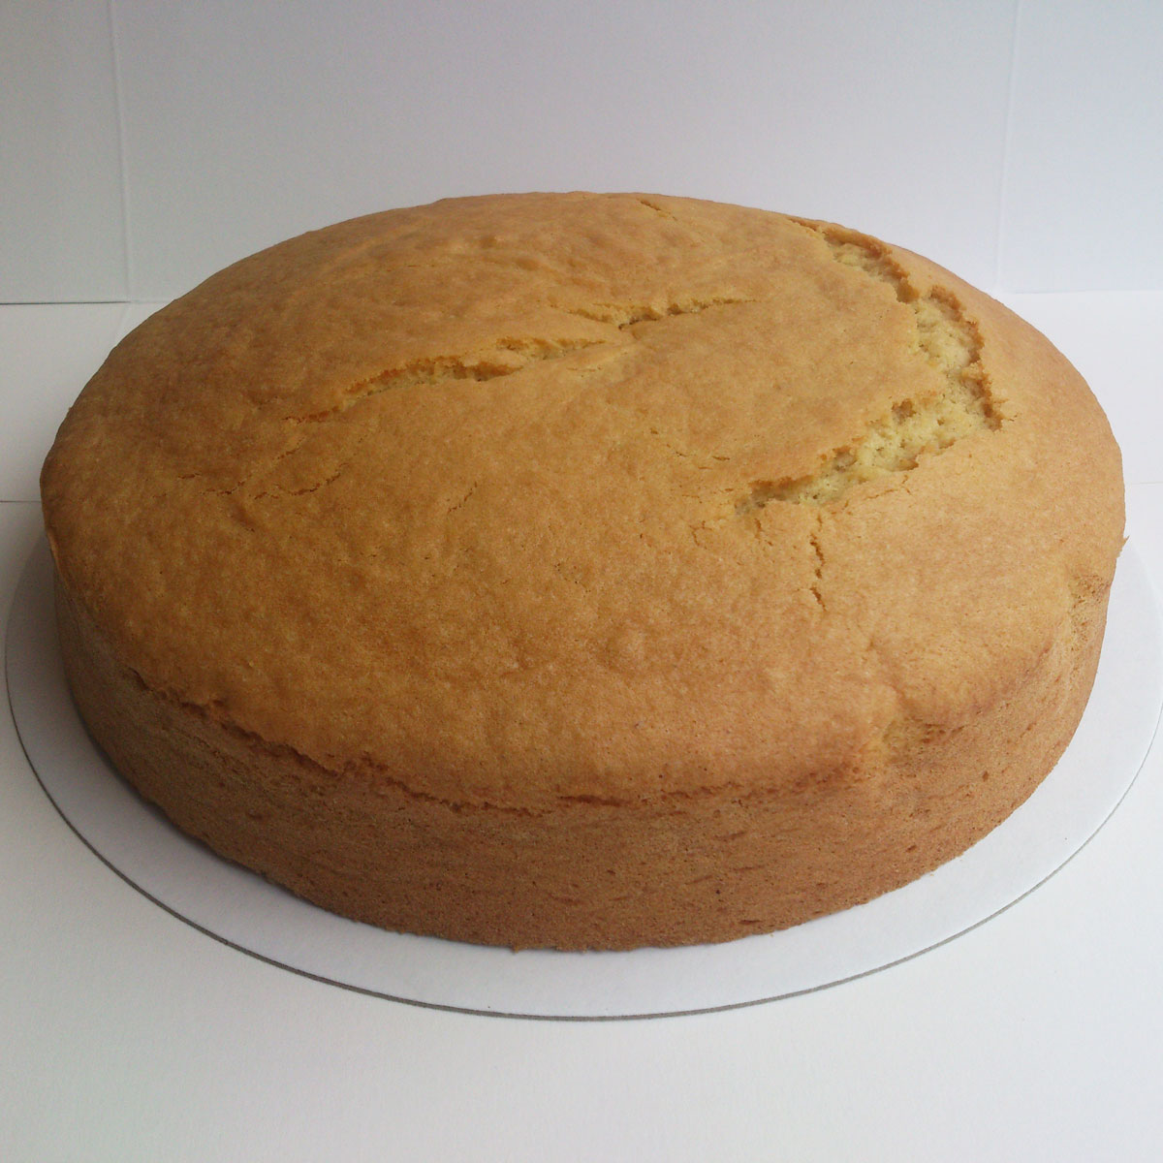
Microsoft Excel
Notes:
1

Slide 15
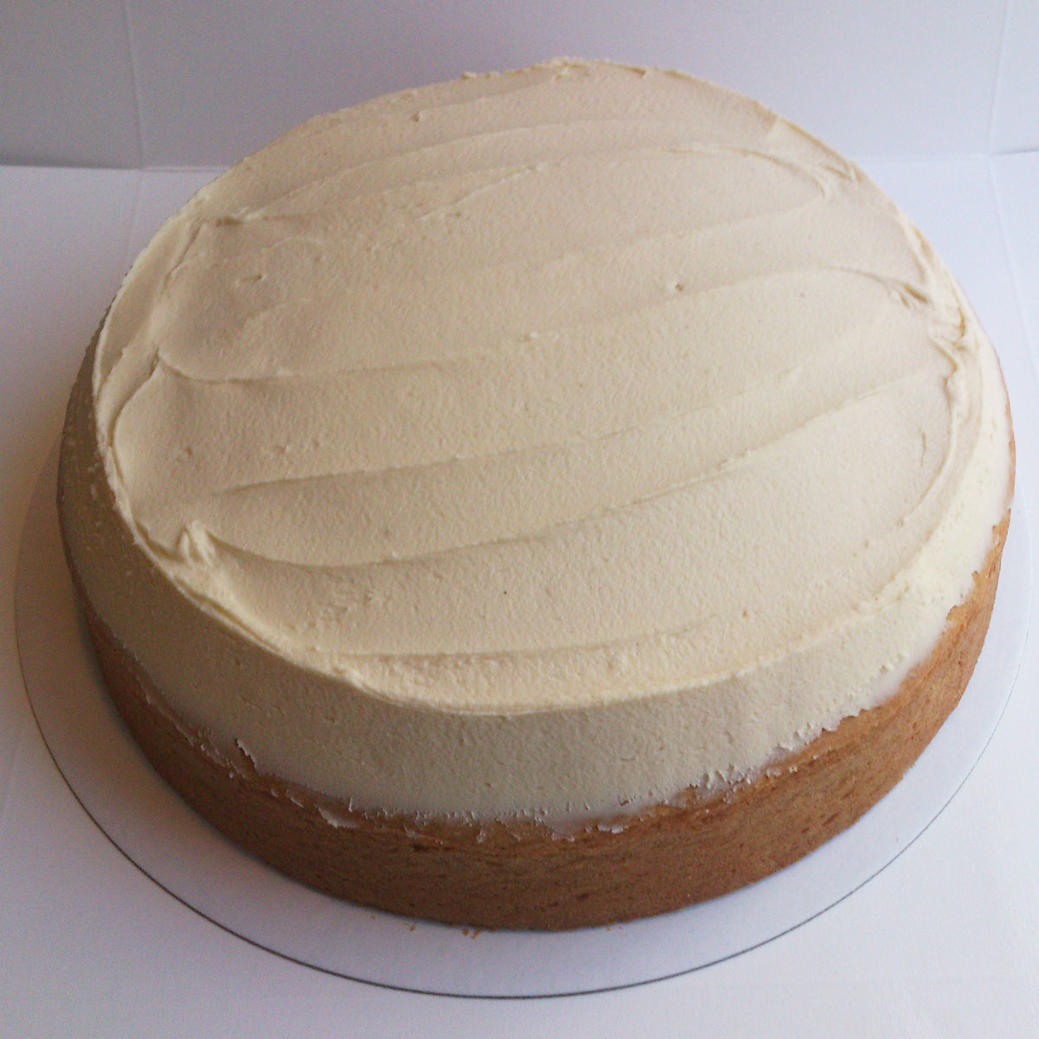
Plotly, ggplot2, Matplotlib
Notes:
1

Slide 16
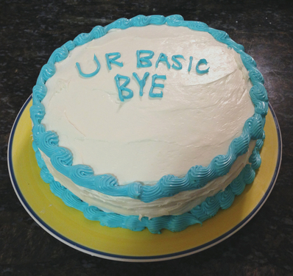
Tableau, Vega
Notes:
1

Slide 17

D3 is tiramisu
Notes:
1

Slide 18

Or whatever cake you want
Notes:
1

Slide 19
“Boxed” cake is easy
Eggs + water + their pre-mixed flour,
Bake,
and then if you have the time: add frosting
In the end? Boring!
Notes:
1

Slide 20
Cake “from scratch” is hard:
You have to think about each ingredient, its quality, its needs
You must imagine your end-result + find a useful recipe
It can take a long time to master each ingredient
In the end? A unique masterpiece!
Notes:
2

Slide 21
Challenge #1
Change the data file from “testData.csv” to “congress_data114.csv”
Use the “x_dimension” for x, and “alt_dimension” for y
Also change the labels in the plot axes
Change the color map to something new
Color by “party_code”
Make all the fonts larger and sans-serif

Slide 22
Challenge #2
Change the data file from “congress_data114.csv” to “congress_data.csv”
Continue using the “x_dimension” for x, and “alt_dimension” for y
Only plot one congress number at a time
Hint: use the .filter function
Create some method to go from one congress number to the next
Bonus Points for using the party names, rather than codes, in the legend
Extra Bonus Points for using d3 transitions somehow.

