Slide 1
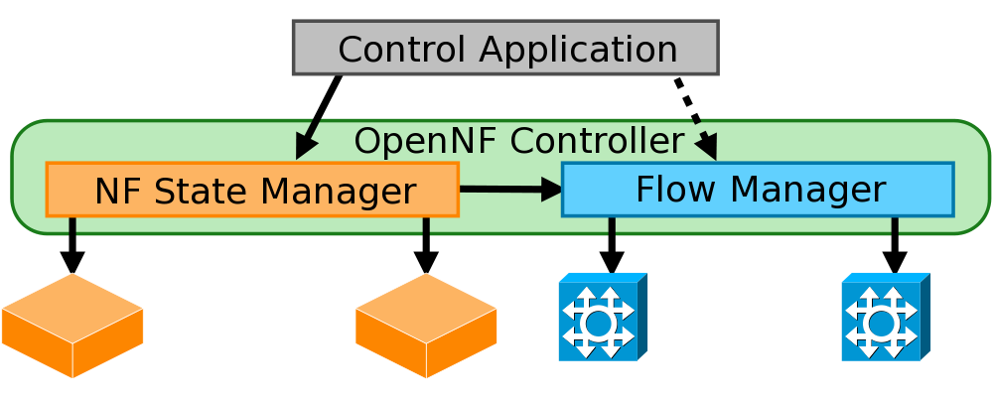

OpenNF: Enabling Innovation in Network Function Control
Aaron Gember-Jacobson, Chaithan Prakash,
Raajay Viswanathan, Robert Grandl,
Junaid Khalid, Sourav Das, Aditya Akella

Slide 2


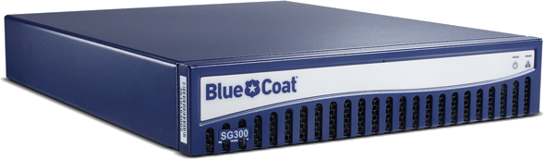

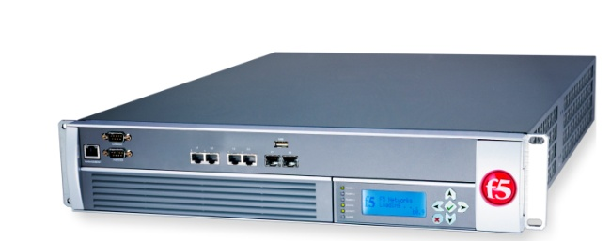


Network functions (NFs)
Perform sophisticated stateful
actions on packets/flows
WAN
optimizer
Caching
proxy
Intrusion
detection
system (IDS)

Slide 3

NF trends
NFV → dynamically allocate NF instances
SDN → dynamically reroute flows
Dynamic reallocation
of packet processing
WAN
optimizer
Caching
proxy
Xen/KVM
Intrusion
detection
system (IDS)

Slide 4

Example: elastic NF scaling
Satisfy performance SLAs
Minimize operating costs
Accurately monitor traffic
CPU
Packet loss

Slide 5

Example: elastic NF scaling
Problem: NFV+SDN is insufficient
Satisfy performance SLAs
Minimize operating costs
Accurately monitor traffic
To simultaneously…
CPU
Cannot effectively implement
new services or abstractions!
Packet loss

Slide 6


Why NFV + SDN falls short
?
Packet loss
SLA:
<1%
 | 1. SLAs | 2. Cost | 3. Accuracy
Reroute new flows [Stratos - arXiv:1305.0209]
Reroute existing flows [SIMPLE - SIGCOMM ‘13]
Wait for flows to die [Stratos - arXiv:1305.0209]
?

Slide 7
SLAs + cost + accuracy:
What do we need?
Quickly move, copy, or share internal NF state alongside updates to network forwarding state
Guarantees: loss-free, order-preserving, …
✓
✓
✓
…
1
2
3
…
Also applies to other scenarios

Slide 8
Outline
Motivation and requirements
Challenges
OpenNF architecture
  State export/import
  State operations
  Guarantees
Evaluation

Slide 9


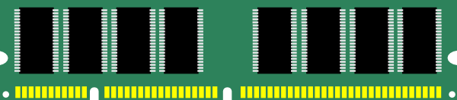
Challenges
Supporting many NFs with minimal changes
Dealing with race conditions
Bounding overhead
Route
Update
Packet
State

Slide 10
OpenNF overview
Control Application
move/copy/share state
OpenNF
Controller
NF State Manager
Flow Manager
export/import State

Slide 11
NF state taxonomy
State created or updated by an NF applies to either a single flow or a collection of flows
Per-flow state
Multi-flow state
TcpAnalyzer
Connection
HttpAnalyzer
ConnCount
Connection
TcpAnalyzer
All-flows state
HttpAnalyzer
Statistics

Slide 12

NF API: export/import state
Functions: get, put, delete
put
Per
Scope
Multi
All
Filter
get
NF
No need to expose/change internal state organization!

Slide 13
Control operations: move
Control Application
Flow Manager
move (port=80, Bro₁, Bro₂)
forward(port=80, Bro₂)
NF State Manager
get(per, port=80)
put (per, Chunk1)
del(per, port=80)
[Chunk1]
put (per, Chunk2)
[Chunk2]
Bro₁
Bro₂
Also provide copy and share

Slide 14


Lost updates during move
move(red,Bro₁ ,Bro₂ )
R2
detect-
MHR
R3
Missing
state
Missing
updates
R1
R2
B1
Bro₁
Bro₂
Loss-free: All state updates should be reflected in the transferred state, and all packets should be processed
Split/Merge [NSDI ‘13]: pause traffic, buffer packets
  Packets in-transit when buffering starts are dropped

Slide 15


NF API: observe/prevent updates using events
NF
B1
R2
R1
R1
R1
Only need to change an NF’s receive packet function!

Slide 16
Use events for loss-free move
enableEvents(red,drop) on Bro₁
get/delete on Bro₁
Buffer events at controller
put on Bro₂
Flush packets in
events to Bro₂
Update
forwarding
R3
R1
R2
R1,R2
R1
R1,R2,R3
Drop
R2
Bro₁
Bro₂

Slide 17
Re-ordering of packets
False positives from Bro’s weird script
Bro₁
Controller
Switch
Bro₂
5. Flush buffer
6. Request
forwarding update
R2
R2
R3
R2
R3
R4
R3
R4
R3
R3
Order-preserving: All packets should be processed
in the order they were forwarded by the switch

Slide 18
OpenNF: SLAs + cost + accuracy
Dealing with diversity
Dealing with race conditions
Export/import state based
on its association with flows
Events
+
Lock-step forwarding updates

Slide 19





Implementation
Controller (3.8K lines of Java)
Communication library (2.6K lines of C)
Modified NFs (3-8% increase in code)
Bro IDS
iptables
Squid Cache
PRADS

Slide 20
Overall benefits for elastic scaling
Bro IDS processing 10K pkts/sec
  At 180 sec: move HTTP flows (489) to new IDS
  At 360 sec: move back to old IDS
SLAs: 260ms to move (loss-free)
Accuracy: same log entries as using one IDS
  VM replication: incorrect log entries
Cost: scale down after state is moved
  Stratos: scale down delayed 25+ minutes
[arXiv:1305.0209]

Slide 21
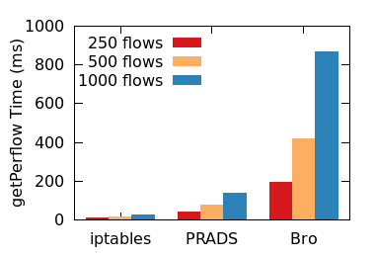
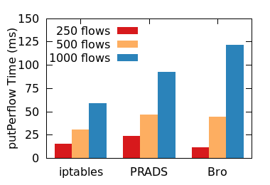
Evaluation: state export/import
Cost grows with
state complexity
Serialization/deserialization
costs dominate

Slide 22
Evaluation: operations
PRADS asset detector processing 5K pkts/sec
Move per-flow state for 500 flows
881 packets
in events
Packets
dropped!
686 462
Bro: 5% of alerts missed!
NG NG PL LF PL+ER OP PL+ER
838 pkts
in events
+
1120 pkts
buffered
Operations are efficient, but
guarantees come at a cost!

Slide 23

Conclusion
Dynamic reallocation of packet
processing enables new services
Realizing SLAs + cost + accuracy requires
quick, safe control of internal NF state
OpenNF provides flexible and efficient
control with few NF modifications
http://opennf.cs.wisc.edu

Slide 24
Backup
Related work
Copy and share
Order-preserving move
Bounding overhead
Example control application
Evaluation: controller scalability
Evaluation: importance of guarantees
Evaluation: benefits of granular control

Slide 25
Existing approaches
Virtual machine replication
  Unneeded state → incorrect actions
  Cannot combine → limited reallocation
Split/Merge [NSDI’13]
  State allocations and accesses occur via library
  Addresses a specific problem → limited suitability
  Packets may be dropped or re-ordered → wrong NF behavior

Slide 26
Copy and share operations
Used when multiple instances need some state
Copy – no or eventual consistency
  Once, periodically, based on events, etc.
Share – strong or strict consistency
  Events are raised for all packets
  Events are released
  one at a time
  State is copied
  before releasing the next event
Copy (multi-flow): 111ms
Share (strong): 13ms/packet

Slide 27
Order-preserving move
Flush packets in events to Inst₂
enableEvents(blue,buffer) on Inst₂
Forwarding update: send to Inst₁ & controller
Wait for packet from
switch (remember last)
Forwarding update:
send to Inst₂
Wait for event
for last packet from Inst₂
Release buffer of packets on Inst₂
B3
B3
B4
Buf
B1,B2,B3
B1,B2,B3,B4
B1
Drop
B1,B2
B3
B1
B2

Slide 28
Bounding overhead
  Applications decide (based on NF & objectives):
Granularity of
operations
Guarantees
desired
Per
Multi
Filter
Scope
All
✓
✓
✓
…
✓
✓
✓
…
+
LF
1
2
3
…
None
LF+OP

Slide 29
Example app: elastic NF scaling
scan.bro
vulnerable.bro
weird.bro
movePrefix(prefix,oldInst,newInst):
copy(oldInst,newInst,{nw_src:prefix},multi)
move(oldInst,newInst,{nw_src:prefix},per,LF+OP)
while (true):
sleep(60)
copy(oldInst,newInst,{nw_src:prefix},multi)
copy(newInst,oldInst,{nw_src:prefix},multi)

Slide 30
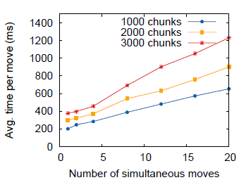
Evaluation: controller scalability
Improve scalability with P2P state transfers

Slide 31
Evaluation: importance of guarantees
Bro₁ processing malicious trace @ 1K pkts/sec
After 14K packets: move active flows to Bro₂
Alert | Baseline | NF | LF | LF+OP
Incorrect file type | 26 | 25 | 24 | 26
MHR Match | 31 | 28 | 27 | 31
MD5 | 116 | 111 | 106 | 116
Total | 173 | 164 | 157 | 173

Slide 32
Evaluation: benefits of granular control
HTTP requests from 2 clients (40 unique URLs)
Initially: both go to Squid₁
20s later: reassign Client₁ to Squid₂
 | Ignore | Copy-client | Copy-all
Hits @ Squid₁ | 117 | 117 | 117
Hits @ Squid₂ | Crash! | 39 | 50
State transferred | 0 MB | 4 MB | 54 MB

