Slide 1
ECOS: Practical Mobile Application Offloading for Enterprises
Aaron Gember, Chris Dragga, Aditya Akella
University of Wisconsin-Madison

Slide 2



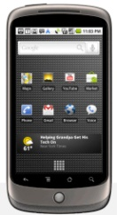

Mobile Device Trends
More mobile device usage in enterprises
  Need to run complex applications
Complex mobile applications have significant CPU, memory, and energy demands
Need to reconcile application
demands and device capabilities

Slide 3




Designing for Remote Computation
Mobile apps designed to use remote services
  e.g., Google Voice Search, Apple’s Siri, Amazon Silk
  Requires developers to use this paradigm
Remote desktop / VNC
  User interface not designed for mobile devices

Slide 4
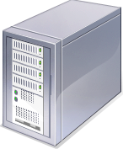

Application-Independent Offloading
Dynamically divide execution between mobile device and compute resource
  Application code unmodified
  Informed by model and/or runtime monitoring
Several proposed systems – Chroma [Balan et al. 2003], MAUI [Cuervo et al. 2011], CloneCloud [Chun et al. 2011]

Slide 5

Roadblocks to Offloading Adoption
Privacy and trust
  Proposed systems largely ignore privacy
  Privacy is paramount in enterprises
Resource sharing and churn
  Proposed systems consider one device,
  plus a dedicated resource
  Enterprises have many devices and many resources

Slide 6
Enterprise-Centric Offload System
allows many devices to opportunistically
leverage diverse compute resources,
while controlling where applications
offload depending on privacy, performance,
and energy constraints of users and apps.
Augment offloading decisions with
privacy and resource considerations

Slide 7
Outline
Offloading benefits and roadblocks
Privacy and trust
Resource sharing and churn
ECOS Prototype
Evaluation for small enterprise

Slide 8

Privacy and Trust
Data may leave device without explicit actions
Sufficient privacy requires
  Protecting execution state in transit
  Executing on trusted compute resources
Offloading benefits and opportunities
should not be significantly diminished

Slide 9
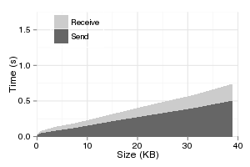
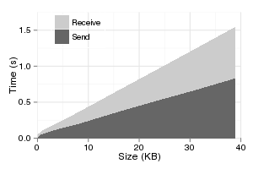
Overhead of Privacy Protection
Encrypting state in transit with TLS
  High latency and energy overhead
Limited number of trusted compute resources
  Reduced offloading opportunities
Encrypted
Unencrypted

Slide 10



Data-Driven Privacy Protection
Data Privacy | Resources Trusted | Communication Protection
None | Any | None
Enterprise | All internal resources | None
User | Select servers and desktops | Encrypt always
Policy specifies labels for devices & applications

Slide 11
Resource Sharing and Churn
Systems consider one device and static resource
Challenges
  Devices with varying applications and objectives
  Limited resources and diverse capabilities
  Offload requests not know a priori
Enable many mobile devices to opportunistically leverage diverse compute resources

Slide 12






One-to-One Scheduling
Each offload assigned a dedicated resource
Dedicated CPU capacity -> faster performance
Fewer “slots” -> reduced offload opportunities
More affected by trust constraints or reduced resource availability

Slide 13


Multiplexing Based on Objective
Offloads with same objective use same resource
Performance improvement
  Resources with unused CPU > mobile CPU speed
Energy savings
  Separate from performance seeking offloads

Slide 14
Resource Affinity
Use same resource for subsequent offloads
  Cache state → less latency and energy overhead
  Assumes constant resource availability/capacity
Resource not capable/available
  Deny offloads until capacity increases
  Assign a new resource, re-transfer or migrate state

Slide 15
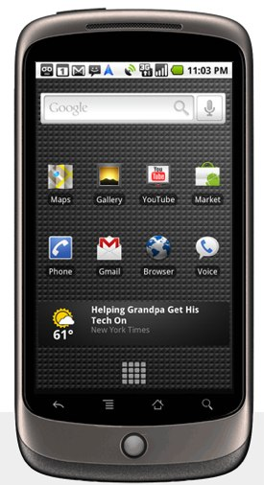


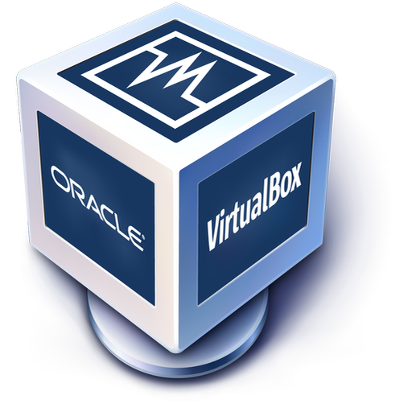


Prototype
1110101011
0001101001
1101010110

Slide 16
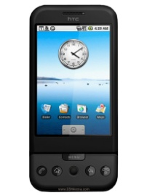


Evaluation
Small enterprise setting
  12 phones (Android emulator)
  4 to 6 desktops (2.4Ghz quad-core, 4GB RAM)
Two applications
  AI-decision making (Chess)
  Speech-to-text (emulated)
Varying objectives and privacy levels

Slide 17
Performance Improvement

Slide 18
Energy Savings

Slide 19
Resource Allocation Efficiency

Slide 20
Summary & Future Work
Enterprise-Centric Offloading System
  Considers privacy requirements/costs
  Resources assigned based on user goals
  Maximize latency and energy benefits
Future Work
  Dynamic privacy label assignment
  Network path provisioning – mobility, bandwidth
  Larger evaluation

