Slide 1


Management Plane Analytics
Aaron Gember-Jacobson, Wenfei Wu, Xiujun Li, Aditya Akella, Ratul Mahajan
Notes:
Today, I’m excited to talk about a tool we developed to help network operators evaluate whether they are using good management practices.

Slide 2


Important network planes
Management plane
Defines the network’s physical structure
Configures the control plane
Analyze
using ???
Control plane
Computes routes
Analyze using traceroute, Rocketfuel, pathchar, pathload, etc.
Data plane
Forwards packets
Notes:
Computer networks are logically composed of three important planes: data, control, and management. The data plane forwards packets. The control plane generates forwarding tables and filters for the data plane. And the management plane defines the network’s physical composition and control plane configuration.
The networking community has developed many tools to characterize how control and data planes function, including traceroute, Rocketfeul, pathchar, and pathload. However, little work has gone into characterizing the management plane.

Slide 3
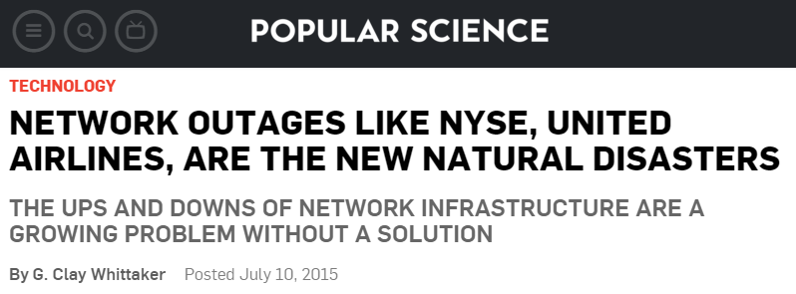
Why analyze the management plane?
http://popsci.com/network-outages-nyses-united-airlines-are-new-natural-disasters
Good management practices are important!
Does a network management practice impact network health (i.e., problem frequency)?
Notes:
It’s important to analyze the management plane, because poor management practices can have a profound impact on the network. For example, post mortem analysis of the network outage that impacted United Airlines this summer revealed that a poor network design, with insufficient redundancy, caused the problem. In many other high profile outages, network configuration errors are the culprit.
To help reduce the frequency of such problems, it is important for organizations to employ good network management practices, such as limiting the number of configuration changes. However, many factors contribute to network problems, so it’s not always clear whether a given management practice impacts a network’s health—or the number of problems it experiences.

Slide 4
Disagreement among experts
To what extent does a management practice impact the frequency/severity of problems?
Notes:
Even experts aren’t entirely sure how management practices impact network health. We surveyed 51 network operators recruited from the NANOG mailing list, our campus network, and a large online service provider to determine how much they thought specific management practices impacted the frequency or severity of problems in their networks. This graph shows how many operators thought a practice had no, low, medium, high, or an unknown impact for 9 different management practices.
As you can see from these results, there is a great diversity of opinion. The number of changes is the only practice that operators consistently believed had high impact. The supposed impact of other practices varied widely. For example, operators are almost evenly spread with regards to the impact of network size and the fraction of changes that are automated.

Slide 5





Management plane analytics (MPA)
Inventory
MPA framework
Practices
that cause
poor health
Quantify management practices and network health
Analyze relationships
Configs
Apply to 850+ networks from a large online service provider
Predictive
model
Tickets
Notes:
To remedy this gap in understanding, we built a tool that systematically analyzes the network management plane.
Operators provide information about a network’s design and operation as input, including inventory records, archived snapshots of device configurations, and logs of trouble tickets from incident management systems. Our tool uses this data to quantify an organization’s management practices and the health of its networks.
Our framework then analyzes the relationships between management practices and network health, and produces two pieces of output. First, it provides a list of the practices that cause a decline, or improvement, in network health. This helps operators determine which practices they should focus on improving. Second, it provides a model that allows an operator to predict the health of a network given a set of management practices. Operators can use this model to conduct what-if analysis and shape future practices.
Today, I’ll show some results from applying MPA to 850+ networks from a large online service provider. However, we have made our tool publicly available so any network operator can apply MPA to their networks.

Slide 6
Outline
Motivation
How do we…
  Quantify an organization’s practices?
  Identify which practices impact network health?
  Predict network health given a set of practices?
Notes:
In the rest of this talk, I’m going to focus on three aspects of our framework’s design. First, how do we quantify an organization’s management practices? Second, how we identify which practices impact network health? Finally, how we predict network health given a set of practices?
Let’s start by talking about how we quantify a organization’s management practices.

Slide 7
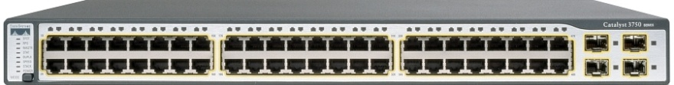





Classes of management practices
Design practices – long-term decisions
about network structure
  # of devices, roles, models
  routing protocols, size of routing domains, …
Operational practices – day-to-day
activities that address emerging needs
  frequency of config changes, fraction automated, types of stanzas changed, …
Practices not directly logged!
Notes:
There’s two broad classes of practices we’re interested in exploring. The first are design practices, which are long-term decisions about how the network is structured. For example, how many devices does the network contain, what roles do they play—are they core routers, edge switches, firewalls, etc.—and what specific device models are used—Cisco 3750s, Juniper MX10s, etc. The practices also encompass elements of the control plane: for example, which routing protocols are used, and how large are the routing domains?
The second class of practices are operational practices. These are the day-to-day activities conducted by network operators to address emerging needs: e.g., adding a new subnet to accommodate new machines, or changing an access-control list to fix a security hole. Here, we care about things like how frequently are device configurations changed, what fraction of these changes are automated, what types of configuration stanzas are changed, etc.
Unfortunately, quantifying these two sets of practices is hard, because most operator decisions are not directly logged. Even if an organization has documented best practices, there is no guarantee operators actually follow these practices.

Slide 8


Inferring management practices
+
Quantify on a
monthly basis
Discretize into
equal-width bins
Inventory
Configs
Practices
(28)
Tickets
Health
(# of tickets)
Data from 850+ networks for 17 months
Notes:
Fortunately, we can infer an organization’s management practices from other readily available data sources. In particular, we use inventory records and archived snapshots of device configurations to determine how the network is designed and operated.
To quantify network health, we count the number of trouble tickets present in an incident management system. This metric implicitly captures any failures or performance problems that are identified by monitoring systems or reported by users. There are other ways we might quantify network health, but operators have indicated that ticket count is a useful metric.
We compute 29 practice metrics plus our health metric for each network on a monthly basis. We also discretize the raw metrics into equal-width bins to help reduce noise.
In our study, we use data from 850+ networks from a 17 month period. This encompasses tens of thousands of devices, hundreds of thousands of configuration changes, and tends of thousands of tickets.

Slide 9
Outline
Motivation
How do we…
  Quantify an organization’s practices?
  Identify which practices impact network health?
  Predict network health given a set of practices?
Notes:
Now that we know how to quantify an organization’s practices, let’s talk about how we identify which practices impact network health.

Slide 10
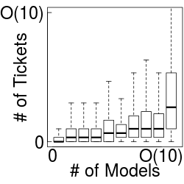
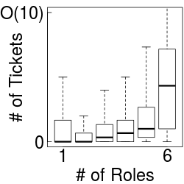
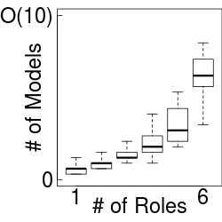



Statistical dependencies
Challenge: identify causal relationships
Notes:
We start by looking at the statistical dependencies between management practices and network health.
This graph shows the relationship between the number of device models used in a network and the number of tickets for that network; recall that number of tickets is our measure of network health. There is a clear relationship between this practice and network health.
Similarly, we see a clear relationship between the number of device roles and network health. In fact, if we dig a little further, we see that the number of device models is related to the number of roles. This relationship makes sense: a network operator is likely to use different device models for core routers, edge switches, and firewalls.
Unfortunately, these statistical dependencies make it hard to determine which practices actually impact network health. Is it the number of device models, the number of roles, or both that cause poor network health?

Slide 11







Experimental design
Treatment
Practice
Health
Outcome
causes
Other practices
Confounding factors
Randomized experiment
Quasi-experimental design (QED)
[Krishnan et al. IMC ‘12, IMC’ 13]
Notes:
To establish a causal relationship between a specific practice and network health, we must eliminate the effects of other practices which influence the practice of interest and/or network health.
This is similar to studies in the medical or social sciences, where scientists want to determine if a particular treatment, such as a new medication, results in a particular outcome, such as a lower risk of heart disease. They must eliminate the effects of confounding factors, such as person’s diet and stress level, to be confident that the treatment is the actual cause of the outcome.
One way to eliminate the effects of these confounding factors is to randomly select which people, or networks in our case, receive treatment. This helps ensure that the values of the confounding factors are randomly distributed, and thus will not bias the outcome of the experiment.
However, it’s not always practical to run a true randomized experiment. For example, it would unethical to ask a random set of people to start smoking to determine if it increases the risk of heart disease. Similarly, we don’t want to ask operators to increase the number of device models in a random set of networks, because it may increase the number of problems these networks experience.
Instead, we want to use existing data to determine whether a causal relationship exists. To do this, we leverage a technique from the medical and social sciences known as quasi-experimental design. Recent network measurement studies have used one type of QED to examine how video streaming quality and ad placement impact viewer behavior. However, we adopt a slightly different approach due to inherent limitations in network management data.

Slide 12
Propensity score matching
Randomized
Pre-defined
Want randomized
Randomized
Treatment | Confounding |  | Outcome
# Models | # Roles | # Changes | # Tickets
3 | 2 | 6 | 1
3 | 2 | 11 | 1
3 | 2 | 2 | 2
5 | 2 | 6 | 2
5 | 2 | 12 | 2
5 | 2 | 1 | 2
5 | 3 | 1 | 2
5 | 4 | 18 | 3
Compare
cases from population samples where distribution of confounding factor values are similar
0.5
Treated
0.5
0.3
0.5
0.5
Untreated
0.3
0.3
0
Propensity score = predicted probability (Treatment = yes | Confounding Practices = …)
Notes:
In particular, we use an approach known as propensity score matching. The central idea of propensity score matching is to replicate the randomization of confounding factors that occurs in a randomized experiment.
Recall that in a randomized experiment we randomly select which units are subjected to treatment in order to ensure that the values of the confounding factors are randomly distributed. In a QED we are using existing data, so we cannot control the treatment variable; some samples are naturally treated and some are untreated.
So, how do we ensure that the values of confounding factors are random and not correlated with whether a sample is treated? The answer is to compare cases from population samples where the distribution of confounding factors are similar. For example, in this set of cases, you can see that the distribution of confounding factors in both the treated and untreated samples are similar.
We can find population samples with similar distributions of confounding factors using propensity scores. A case’s propensity score is the predicted probability of that case receiving treatment, given its confounding practices. We compute predicted probabilities using logistic regression. For example, if there are 2 roles and 6 changes, it is clear that there is a one half probability the case is treated. Similarly if it has 2 roles and 11 changes its predicted probability would be the same as the predicted probability for a case with 2 roles and 12 changes, resulting in a propensity score of one half. We also have samples with a propensity score of 0.3 and 0.
Now if we select all the cases with a propensity score of one half, then we have treated and untreated population samples where the distribution of confounding factors are similar.

Slide 13
Test for causality
Can we reject?
H₀: median = 0
Treatment | Confounding |  | Outcome
# Models | # Roles | # Changes | # Tickets
0.5
0.5
0.3
0.5
0.5
0.3
0.3
3 | 2 | 6 | 1
Sign-test
p-value < 10⁻³?
3 | 2 | 11 | 1
3 | 2 | 2 | 2
5 | 2 | 6 | 2
# of pairs
5 | 2 | 12 | 2
5 | 2 | 1 | 2
5 | 3 | 1 | 2
< 0 0 > 0
2 - 2 = -0
1 - 2 = -1
Notes:
To test for causality, we pair each treated case with an untreated case that has a similar propensity score. For example, we can pair a treated and untreated case with propensity score 0.5. Note that it doesn’t matter if their confounding factors are similar; only the propensity score needs to be similar. We compute the difference in their outcomes, and track how many pairs have a difference less than, equal to, or greater than 0.
We can do the same for the other treated case with propensity score 0.5. And, finally we pair the treated case with propensity score 0.3 with an untreated case with propensity score 0.3.
If there is no causal relationship, then the difference in outcomes should be random, and the median of this distribution should be 0. Thus, to test for causality, we want to check if we can reject the null hypothesis that the median equals 0. For this small example, it’s obvious that the median is not zero, but on real data we use a sign-test. We use a conservative p-value threshold of 10⁻³ to determine whether we can reject the null hypothesis.

Slide 14
Causal relationships
Agrees with operators
Practice | p-value
No. of change events | 1.05 x 10⁻¹²
No. of change types | 5.75 x 10⁻¹²
No. of roles | 2.99 x 10⁻¹⁰
Frac. events w/ ACL change | 9.10 x 10⁻⁹
No. of devices | 1.92 x 10⁻⁸
Avg. devices changed per event | 3.56 x 10⁻⁸
No. of models | 1.31 x 10⁻⁷
No. of VLANs | 6.46 x 10⁻⁶
Frac. events w/ interface change | 5.27 x 10⁻³
Intra-device complexity | 1.53 x 10⁻²
Discredits belief that impact is low
Operators had mixed beliefs
< 10⁻³
Notes:
Now let’s take a look at some actual results. We applied our methodology to the data we have from the large online service provider. Here, I’m showing the level of confidence of a causal relationship for the 10 management practices that have the highest statistical dependence with network health. We observe that 8 of these practices have a statistically significant causal relationship.
Several of the practices for which operators had mixed beliefs regarding their impact are in fact causally related with network health, including number of devices and the number of devices that are changed together. These results also match the prevailing belief that the number of change events has a high impact on health, and partially discredits the belief that the fraction of configuration changes that involve an ACL has low or no impact.

Slide 15
Outline
Motivation
How do we…
  Quantify an organization’s practices?
  Identify which practices impact network health?
  Predict network health given a set of practices?
Notes:
While knowing which practices have a causal relationship with network health helps operators determine which practices they should focus on improving, they need a way to evaluate whether a revised practice is better. In particular, they need a way to predict what a network’s health would be given a particular set of management practices.

Slide 16
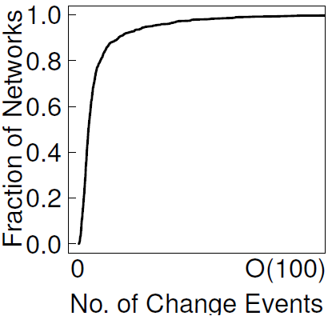
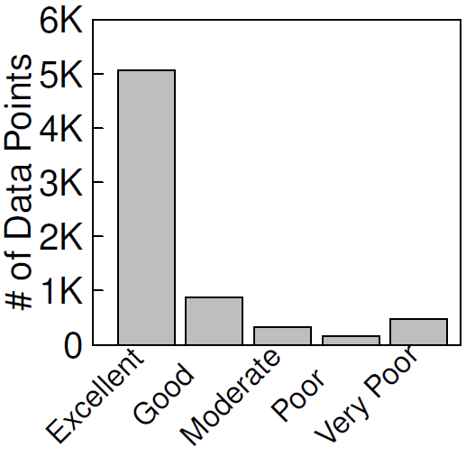
Predicting network health
Build decision trees using machine learning
Model arbitrary boundaries
Easy to understand
Challenge: heavy skew in practices and health
73%
Notes:
We use machine learning to build such predictive models. We tried several different models including, support vector machines, bayesian networks, and decision trees. We settled on decision trees for two reasons. One, they give us the best accuracy, because they can model arbitrary boundaries between cases. Two, they are easy for operators to understand.
However, we find that network operations data is heavily skewed. For example, most of the OSP’s networks have a small number of configuration changes per month, but a few networks have many changes per month. Similarly, 73% of our samples are from networks and months where there is at most one ticket—which we consider to be excellent network health.
This skew makes it difficult to accurately predict the health of networks whose management practices are outliers, and to predict when a network will be unhealthy.

Slide 17


Addressing skew
Oversampling – repeat minority
class examples during training
Boosting – in each iteration, increase
the weight of examples that were
misclassified using the prior model
x2
Notes:
We do two things while constructing the decision tree to address this skew.
First, we use systematic oversampling.
Second, we use boosting.

Slide 18
Model accuracy
91% with 2-classes
Overall accuracy: 81%
Majority predictor
Decision tree (DT)
DT with oversampling
and boosting (MPA)
Notes:
Applying these techniques to data from the OSP, we obtain a decision tree whose overall accuracy is 81%.
This is moderately better than a majority class predictor, whose overall accuracy is 73%. However, when we look at the precision for each health class, we see that a majority predictor has zero precision for all classes except the majority excellent health class.
Using a decision tree allows us to predict cases from the good and very poor health classes with 23% and 52% accuracy. It also raises the precision for the majority class to 83%. However, a decision tree constructed without our techniques for addressing skew has zero precision for the moderate and poor health classes.
Using oversampling and boosting, we can achieve a precision of 11% for the moderate and poor health classes. Again, it also raises the precision for the majority class by another 3 percentage points. However, these techniques do come at the cost of a decrease in precision for the good and very poor health classes: their precision drops by 3 to 7 percentage points.
An alternative way to improve precision is to use coarser health classes. For example, if we use just two health classes, which may be sufficient in many cases, the overall of accuracy of our model is 91%.

Slide 19

Conclusion
Management plane analysis is important
MPA framework
  Determine which practices
  cause a decline in health
  Construct a predictive model
  of health based on practices
Results from an OSP with 850+ networks
http://github.com/agember/mpa

