Slide 1

Improving the
Safety, Scalability, and Efficiency of Network Function State Transfers
Aaron Gember-Jacobson & Aditya Akella
Notes:
Today, I’m going to be talking about how we can better manage network function state amidst dynamic changes to NF deployments.

Slide 2






Dynamic NF deployments
NFV: start instances on-demand
SDN: re-route flows on-demand
NF that is…
Hypervisor
v2
v2
Auto-scaled
Immediately
updated
Opportunistically
augmented
Notes:
Two key trends are making NF deployments more dynamic.
This opens the door for new services and abstractions. In particular, we can have NFs that are: automatically scaled, kept up-to-date, and opportunistically enhanced.

Slide 3

What about NF state?
E.g., endpoint metadata,
packet payloads, counters
Possible solutions
  Only re-route new flows
  Clone virtual machines
NF state management frameworks
  E.g., Split/Merge [NSDI’13], OpenNF [SIGCOMM’14]
Notes:
When we want to make dynamic changes to an NF deployment, we must deal with the fact that many NFs are stateful. As flows traverse the NF, the NF creates a variety of per-flow and cross-flow state, such as: information about the connection endpoints, reassembled packet payloads, connection or packet counters, and other NF-specific information.
If we simply reroute traffic without considering this state, an NF will process that traffic incorrectly because it doesn’t have the state it needs.

Slide 4
State transfers in OpenNF
Control App
move(red, IDS₁→IDS₂)
OpenNF Controller
redirectPkts(red)
forward
(red,IDS₂)
putState(…)
getState(red)
IDS₁
IDS₂
Notes:
So, how do these NF state management frameworks work? For concreteness, I’m going to describe OpenNF, but Split/Merge and other frameworks are similar.

Slide 5
Problems
2) Safety
overflow → loss → incomplete analysis
1) Efficiency
buffering → output delayed
Control App
move(red, Bro₁, Bro₂)
OpenNF Controller
OpenNF Controller
redirectPkts(red)
forward
(red,Bro₂)
putState(…)
getState(red)
3) Scalability
transfer via controller
IDS₁
IDS₂
Notes:
The first problem is efficiency. When a state transfer is occurring, packets are not processed by IDS1; instead, they are sent to the controller and buffered. As a result, any packet or log output that results from processing these packets doesn’t occur until after the state transfer finishes and these packets are released to IDS2.

Slide 6

This talk
2) Safety
overflow → loss → incomplete analysis
1) Efficiency
buffering → output delayed
1) Efficiency
buffering → output delayed
How do we solve
these issues?
3) Scalability
transfer via controller
Notes:
The first problem is efficiency. When a state transfer is occurring, packets are not processed by IDS1; instead, they are sent to the controller and buffered. As a result, any packet or log output that results from processing these packets doesn’t occur until after the state transfer finishes and these packets are released to IDS2.

Slide 7
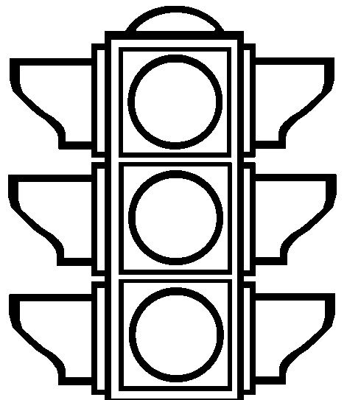


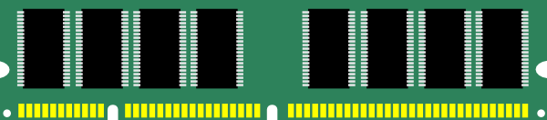
Output delay
No packet processing (+ output)
during state transfer
Live virtual machine migration
  State is small →
  memory page is too coarse
A B C
A B C
D E F
D E F
1 2 3
1 2 3
1 2 3
1 2 3
G H I
G H I
7 8 9
7 8 9
J K L
J K L
4 5 6
4 5 6
4 5 6
4 5 6

Slide 8

Packet reprocessing
Process packet again
Process packet again; no output
P1
P2
move(red, NF₁→NF₂)
Recopy?
S1
S2
S1
S2
P1’
P2’
P2
NF₁
NF₂
Process packet
Controller
How do we suppress output?
wrappers for network and file I/O functions

Slide 9
Benefits of reprocessing (1)
Buffering does not impact output latency
4x lower
latency
Notes:
Output does not depend on buffering → reduced latency overhead

Slide 10

Benefits of reprocessing (2)
We can safely recover from buffer overflow
P3
P4
P2
Recopy
S1
S1
S2
S3
S4
S4
P2’
P3’
P2
P3
P4
P4’
NF₁
NF₂
Always has
up-to-date state
Controller
Notes:
NF₁ always has up-to-date state → if buffer overflow occurs, retransfer state from NF

Slide 11
This talk
1) Efficiency
buffering → output delayed
1) Efficiency
buffering → output delayed
Packet
reprocessing
2) Safety
overflow → loss → incomplete analysis
2) Safety
overflow → loss → incomplete analysis
3) Scalability
transfer via controller
3) Scalability
transfer via controller

Slide 12
Minimizing controller overhead
We don’t want to send state/packets
through the controller
OpenNF Controller
Peer-to-peer transfer
NF₁
NF₂
Notes:
Transfer state/packets directly between NF instances
Establishing a peer-to-peer connection and transferring state is relatively easy. The key challenge is conducting a peer-to-peer transfer of packets.

Slide 13
Challenge: injecting packets
Use virtual Ethernet (veth)
interfaces and bridging
vethP2Pin
vethP2Pbr
bridge
vethNFbr
ethIn
vethNFin
NF₁
NF₂
Notes:
NF2 can implement order preserving

Slide 14
Benefits P2P transfer (1)
State transfers occur over a direct connection
Up to 70% faster

Slide 15
Benefits P2P transfer (2)
Less work for the controller
Near Constant

Slide 16
Summary
1) Efficiency
buffering → output delayed
1) Efficiency
buffering → output delayed
Packet
reprocessing
P2P
transfer
2) Safety
overflow → loss → incomplete analysis
2) Safety
overflow → loss → incomplete analysis
3) Scalability
transfer via controller
3) Scalability
transfer via controller
http://opennf.cs.wisc.edu

