Slide 1

Fast Control Plane Analysis
Using an Abstract Representation
Aaron Gember-Jacobson, Raajay Viswanathan, Aditya Akella, Ratul Mahajan

Slide 2
Configuration errors are common
Multiple routing protocols
Routing process priorities
Route exchange
Traffic Selectivity
  Route Filters
  ACLs
Human errors are unavoidable
Notes:
** take better screen shots
** include “redistribute commnad”
** highlight accordingly

Slide 3




Errors lead to policy violations
Policy
Violation
Network verification is important

Slide 4
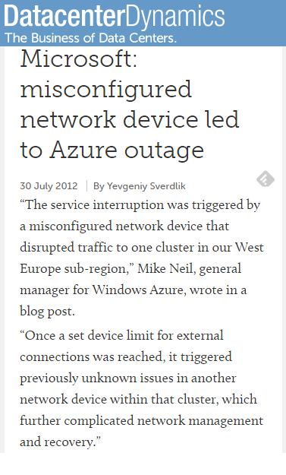
Some violations only occur under failures
R_{C}
R_{B}
DST
1
OSPF
1
3
R_{A}
SRC
Network verification under arbitrary failures is required

Slide 5


State-of-the-art verification with failures
Analyze current data plane [HSA NSDI’13, VeriFlow NSDI’13]
  Cannot verify policies across failures
Simulate low level protocol messages [Batfish NSDI’15]
Generate data planes for each failure case
  Time consuming
Forwarding Table
Forwarding Table’
Forwarding Table
Forwarding Table’
Forwarding Table’’
Forwarding Table’’
Forwarding Table’’’
Forwarding Table’’’
Forwarding Table
Forwarding Table’
Forwarding Table’’
Forwarding Table’’’

Slide 6
How do we speedup network verification under failures ?
Network verification under failures
Graph
Analysis
Notes:
[include here]
Insight: convert network verification into graph analysis

Slide 7

Network verification under failures using graph algorithms
4
2
2
10
6
…...
0
1.2
Network configurations
Collection of weighted digraphs
Graphs encode the network’s forwarding behavior under all possible failure scenarios
Verification reduces to checking simple graph-level properties → polynomial time
Collection of digraphs → ARC: Abstract Representation for Control planes
Notes:
[that graph algorithms are key does not come through]
[weights on the second graph]
[we beliveve this si new paradigm for verification; akin to HSA or AntEater that showed how to convert network verification to SAT solving.

Slide 8
Outline
Motivation
Requirements & Challenges for ARC creation
Our approach for constructing ARCs
Network verification using ARCs
Evaluation

Slide 9
Requirement: Encoding forwarding behaviors under all failures
Graph contains all possible paths in the actual network
Actual path under particular failure scenario is obtainable through graph traversal
4
2
2
2
10
6
0
1.2
6
10

Slide 10
ARC construction: First steps
OSPF
Shortest path
A
BGP
D
SRC
10
SRC
10
1
C
DST
10
1
DST
20
20
20
1
1
E
10
1
B
10
10
1
Opportunities
Challenges
Network topology is essentially a graph
Routing protocols do least cost forwarding
  OSPF: Djikstra’s Algorithm using OSPF weights
  BGP: Min AS hops
Route redistribution
Routing cost varies / protocol
Administrative Distance
Traffic class filters
Routing granularities
…
Need sophisticated approaches to determine
graph structure and edge weights
Notes:
[title the columns: opportinities and …]
[2 parts on top of each other]
[visual cue for route distribution ]
[name the routers]

Slide 11
ARC Construction: Graph Structure
Inter-device: advertisements
X
Y
Dst:T
X.3_{I}
Y.3_{O}
Z.3_{I}
T
2
OSPF₃
3
1
Z
X.3_{O}
Y.3_{I}
Z.3_{O}
BGP₁
Src:S
Intra: Route
redistribution
S
A
B
A.1_{I}
B.1_{O}
Z.1_{I}
Intra: within device forwarding
A.1_{O}
B.1_{I}
Z.1_{O}
One directed graph per Src-Dst subnet pair
Vertices: hosts, routing processes
Edges: flow of data enabled by exchange of routing information
Notes:
[
Her is config, here is digraph
Intra device
DO NOT incrementally construct the digraph.
[absence of ospf to bgp edge]
Each routing processing : 2 vertices
Three types of edges:
Inter device : models flow of data dure to route advertisements
Intra-between process : models flow of data due to route redist
Intra-within process: models flow of data in a device. [[add anumatiion]]

Slide 12
ARC construction: Edge weights
For single routing instance, use:
  OSFP link weights
  BGP hop counts
Multiple processes: AD? Redistribution?
  Normalize weights across instances
Novel algorithm for scaling weights
Dst:T
X.3_{I}
0.4
Y.3_{O}
0.6
Z.3_{I}
2
3
0
0
0
X.3_{O}
2
Y.3_{I}
3
Z.3_{O}
Z.5_{O}
0.4
0.6
Src:S
1
2
A.1_{I}
1
B.1_{O}
1
Z.1_{I}
0
0
0
A.1_{O}
1
B.1_{I}
1
Z.1_{O}
Shortest path in ARC == actual path
Notes:
[have a pic of the digraph]

Slide 13
Policy verification using ARCs
Does the graph satisfy some property ?
Is a policy violated in the network?
::
What graph algorithms to use ?

Slide 14
Verify always blocked policy
Does there exist a path from SRC to DST in the corresponding ARC?
Is communication between SRC and DST not allowed under any failure scenario?
::
Connected components
DST
C
Dst
Src
1
B
C_{O}
D_{I}
1
3
SRC
C_{I}
D_{O}
D

Slide 15
Verify ‘k-’reachability policy
Are there ’k’ edge-disjoint paths from SRC to DST ?
Is DST always reachable from SRC with ‘< k’ failures ?
::
Max-flow algorithm on ARC
F
OSPF
G
F_{O}
G_{O}
1
∞
F_{I}
G_{I}
E
E_{O}
B
C
Dst
B_{I}
E_{I}
C_{I}
D
DST
SRC
D_{O}
B_{O}
C_{O}
3 edge-disjoint paths
D_{I}
Src
Max-flow = 3
Notes:
[figure out the wording: atkleast k, greater thanl, etc]

Slide 16
Verify path equivalency
Is a traffic class forwarded in the same manner, before and after a configuration change?
::
Are ARCs the same ?
u₂
w₂
u₁
u₆
w₆
w₁
u₃
u₁
?
w₁
u₇
w₃
w₇
u₄
u₁₀
w₄
w₁₀
u₈
w₈
u₅
w₅
u₉
w₉
Re-scaling algorithms can result in different weights
Reduce weights to canonical form and compare
Notes:
[replace weights with u and v]
Scaling: can result in u and v being different for same path forwarding
[re-use figures]
[use implies for bullet 2]

Slide 17
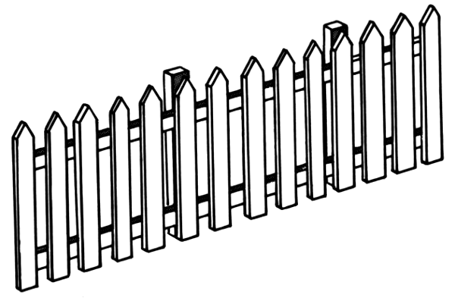
Additional properties we can verify
Always isolated: Traffic of different tenants are always isolated
Always traverse waypoints: Traffic between hosts always traverse waypoints

Slide 18
Evaluation
ARC construction performance
ARC verification performance
ARC fidelity

Slide 19
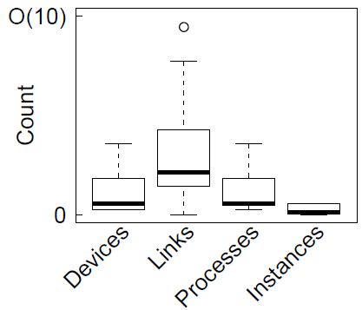
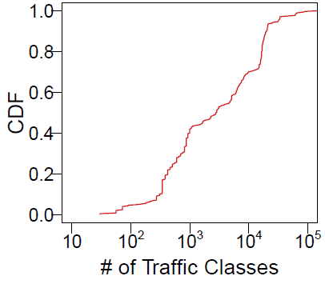
Network configurations
Configurations from 314 data
center networks operated by a
large online service provider
Notes:
[animation should point to graphs being talked about]

Slide 20
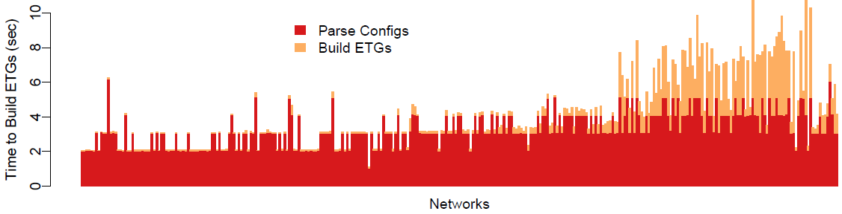
Time to generate ARC
Parse configurations
Build ARC from scratch
Time to build ARCs (seconds)
Networks (sorted by size)
Fast (<10 seconds) even for large networks
Notes:
** remove ETGs
Generate from scratch;
Generate new arc in response to config change will take less time
Batfish cannot do incremental verification.
Why not monotonic?
-- Number of traffic classes change
Numbers are small
Time take = function of traffic classes. Larger networks have more traffic classes not always
Make the point about incremental updates taking less time.

Slide 21
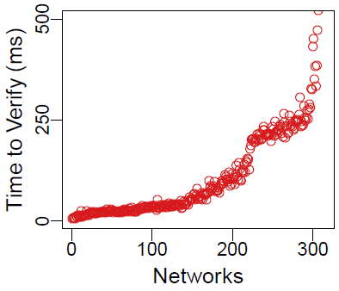
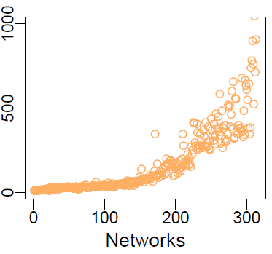
Time to verify ARC
Always blocked
(connected components)
Always reachable
with < k failures
(max flow)
Equivalent paths
(convert to canonical
weights and compare)
< 500 ms
< 1 sec
Up to 100 s
Verification per traffic class is parallelizable
Notes:
Refer to
[[pop up a bubble around numbers]]
graph algorithms for each propety

Slide 22
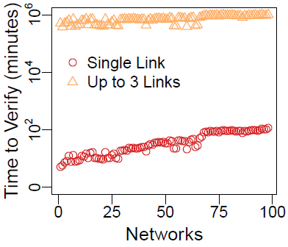
Comparison with Batfish
Always blocked
using ARC
Always blocked
using Batfish
< 500 ms
Up to 694 days!
3 - 5 orders of magnitude speedup
Notes:
We ran batfish for single link failures
We look at 3 link failures batfish would take 694 days !

Slide 23
ARC fidelity
For any given failure scenario, is ARC shortest path == actual network path?
Formally prove ARC fidelity for networks with:
  Routing protocols : OSPF, RIP, BGP
  Route redistribution is acyclic
  Route selection preference follow a global order
96% of networks satisfy these properties

Slide 24
ARC fidelity
For remaining networks
  We can still generate the graph structure
  Cannot generate edge weights
  Verify “always blocked”, “k-reachability”
All properties can be verified
96%
4%
Cannot verify path equivalence
Notes:
[[say: important properties like … can still be verified]]

Slide 25
Summary
Network verification under failures can be formulated as graph analysis
Presented an abstract representation, ARC
Can construct high fidelity ARCs for 96% of networks
O(10³)-O(10⁵) speedup in verification
https://bitbucket.org/uw-madison-networking-research/arc

