Slide 1





Automatically Repairing
Network Control Planes
Using an Abstract Representation
Aaron
Gember-Jacobson
Aditya
Akella
Ratul
Mahajan
Hongqiang
Harry Liu
Notes:
SYSTEM WE BUILT THAT AUTOMATES THE CURRENTLY DIFFICULT, MANUAL TASK OF CORRECTING CONTROL PLANE CONFIGURATION ERRORS

Slide 2




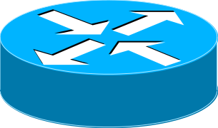
Control plane == heart of the network
Control
plane

Slide 3


Configuring the control plane
Allow Alice & Bob’s computers to communicate
Protocol instances
Link/path weights
Traffic filters
…
Complex!
Alice
Bob

Slide 4

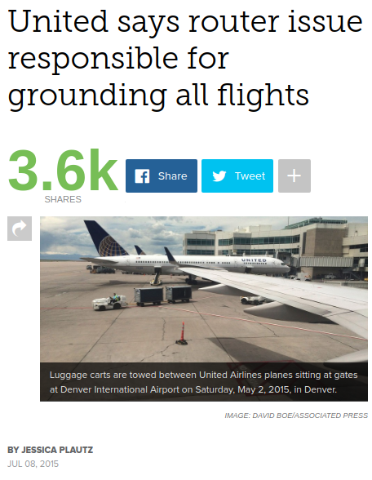

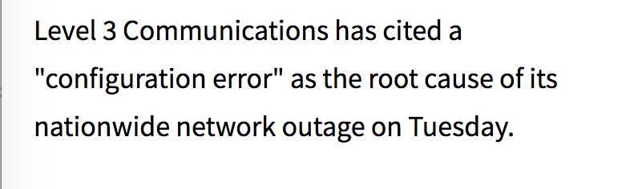
Configuration errors are common
Took hours to repair the network

Slide 5



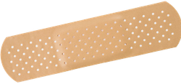
Existing tools
Synthesis (e.g., SyNET, Propane)
Verification (e.g., ARC, Minesweeper)
Correct
configurations
Repeat when
policies change
Policies
Synthesizer
Entirely new
configurations
☹️
Configurations
Operator
Verifier
Repaired
configurations
Violations
Policies
Manual intervention
☹️
Notes:
MANUAL INTERVENTION IS ALSO REQUIRED WHEN POLICIES
GIVEN THE LIMITATIONS OF EXISTING TOOLS, WE INTRODUCE A NEW SYSTEM CALLED CPR

Slide 6
Our contribution: CPR
Broken
configurations
Policies
Repaired
configurations

Slide 7
Challenges
Broken
configurations
Compute repairs that…
1) Satisfy all policies
2) Are feasible to implement
3) Require minimal changes
Inspiration:
network verification & program repair
Policies
Repaired
configurations

Slide 8

Our approach
Broken
configurations
Graph-based model
Constraint problem
A =?, B = ?
A $⋀$ B
Policies
Repaired
configurations
Repaired model

Slide 9


Example network
R
A
B
Policies
R ⇨ T prefers A→ B → C
S ⇨ T traverses firewall
S ⇨ T reachable under single link failure
S
OSPF
OSPF
FW
C
T
OSPF

Slide 10
Background: ARC [SIGCOMM’16]
R
A
B
Policies
R ⇨ T prefers A→ B → C
S ⇨ T traverses firewall
S ⇨ T reachable under single link failure
S
OSPF
OSPF
FW
C
T
OSPF
Shortest path
1 edge-disjoint path
R
S
Max-flow = 1
∞
0
0
A_{O}
1
B_{I}
1
C_{O}
1
1
A_{O}
B_{I}
FW
C_{O}
FW
∞
0
0
0
∞
0
∞
0
0
A_{I}
B_{O}
C_{I}
A_{I}
B_{O}
FW
C_{I}
1
1
FW
1
1
∞
0
0
T
T
Notes:
CREATE ONE SUCH GRAPH FOR EVERY TRAFFIC CLASS

Slide 11
Repairing ARC
Add and remove
edges in the ARC
Policies
R ⇨ T prefers A→ B → C
S ⇨ T traverses firewall
S ⇨ T reachable under single link failure
Challenge: satisfying multiple policies
NP-hard
☹️
2
R
S
Max-flow = 1
0
∞
A_{O}
1
B_{I}
1
C_{O}
A_{O}
1
B_{I}
1
C_{O}
FW
FW
0
0
0
∞
∞
∞
A_{I}
B_{O}
FW
C_{I}
A_{I}
B_{O}
FW
C_{I}
1
1
1
1
0
1
∞
T
T

Slide 12
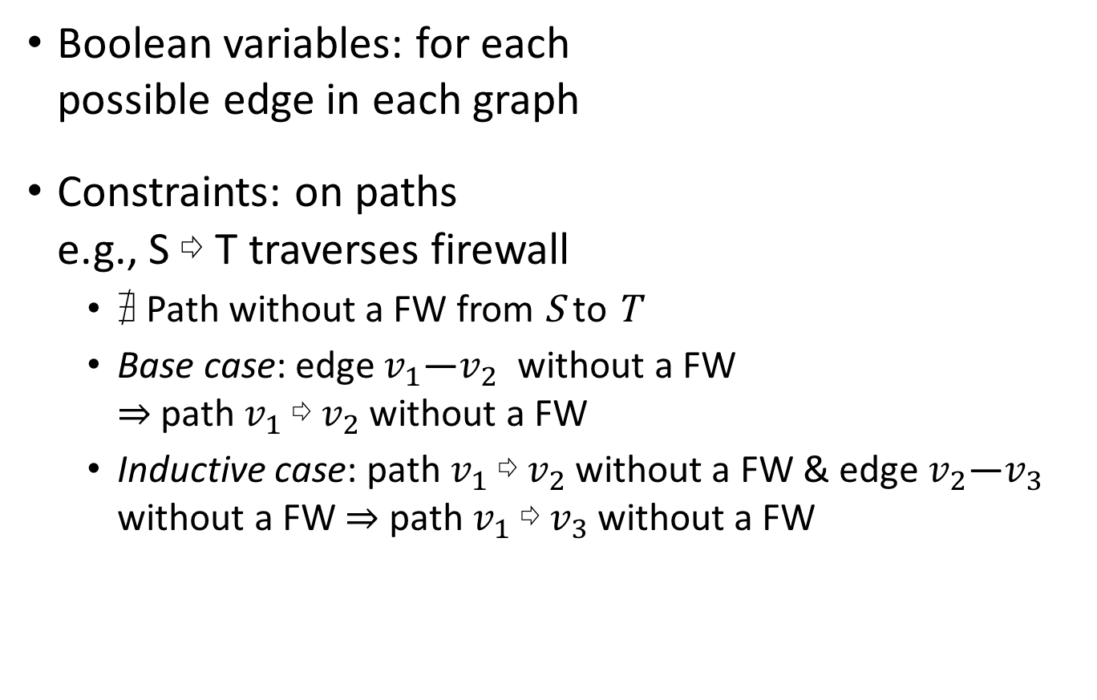



Repair as constraint solving
Boolean variables: for each
possible edge in each graph
Constraints: on paths
e.g., S ⇨ T traverses firewall
  ∄ Path without a FW from S to T
  Base case: edge $v_{1}$—$v_{2}$ without a FW
  $⇒$ path $v_{1} \text{⇨} v_{2}$ without a FW
  Inductive case: path $v_{1} \text{⇨} v_{2}$ without a FW & edge $v_{2}$—$v_{3}$ without a FW $⇒$ path $v_{1} \text{⇨} v_{3}$ without a FW
$$v_{1}$$
$$v_{2}$$
$$v_{3}$$
S
T
Notes:
CONSTRAINTS ARE EXPRESSED IN FIRST-ORDER LOGIC

Slide 13
Satisfying solution
Policies
R ⇨ T prefers A→ B → C
S ⇨ T traverses firewall
S ⇨ T reachable under single link failure
Is it a feasible solution?
2
R
S
Max-flow = 1
0
0
A_{O}
1
B_{I}
1
C_{O}
A_{O}
1
B_{I}
1
C_{O}
FW
FW
0
0
0
0
0
0
A_{I}
B_{O}
FW
C_{I}
A_{I}
B_{O}
FW
C_{I}
1
1
1
1
0
1
0
FW
T
T

Slide 14
Translating repairs
R
A
B
S
OSPF
OSPF
Challenge: conflicts between traffic classes
FW
Cannot enable routing
for a single Src-Dst pair
C
T
OSPF
R
S
0
0
A_{O}
1
B_{I}
1
C_{O}
A_{O}
1
B_{I}
1
C_{O}
FW
FW
0
0
0
0
0
0
A_{I}
B_{O}
FW
C_{I}
A_{I}
B_{O}
FW
C_{I}
1
1
1
1
0
1
0
FW
FW
T
T

Slide 15
Hierarchical ARC
Disallow conflicts in model
Add constraints to enforce hierarchy
Is it a minimal
solution?
3
1
FW
R
S
0
0
1
1
1
1
1
1
1
1
A_{O}
A_{O}
B_{I}
B_{I}
C_{O}
A_{O}
B_{I}
C_{O}
C_{O}
A_{O}
B_{I}
C_{O}
FW
FW
FW
FW
0
0
0
0
0
0
0
0
0
0
0
0
A_{I}
A_{I}
B_{O}
B_{O}
C_{I}
A_{I}
B_{O}
C_{I}
C_{I}
A_{I}
B_{O}
C_{I}
FW
FW
FW
FW
1
1
1
1
1
1
1
3
1
3
0
0
0
1
0
1
FW
FW
T
T
T
T
Notes:
DEFINE COMMON SUBGRAPH THAT MODELS CONFIGURATION ELEMENTS THAT APPLY TO ALL TRAFFIC
IF WE WANT TO ADD AN EDGE FOR A SPECIFIC SRC-DST PAIR, WE MUST ALSO ADD IT TO THE COMMON GRAPH, BECAUSE ROUTING ADJACENCIES APPLY TO ALL TRAFFIC CLASSES
FURTHERMORE, IF WE ADD AN EDGE TO THE COMMON GRAPH, WE MUST ADD IT TO GRAPHS FOR ALL SRC-DST PAIRS
ADD CONSTRAINTS TO ENFORCE HEIRARCHY
GIVEN NEW CONSTRAINTS, SATISFYING SOLUTION MUST CHANGE SLIGHTLY
IN THIS CASE THE REPAIR IS MINIMAL, BUT HOW DO WE GUARANTEE THIS?

Slide 16

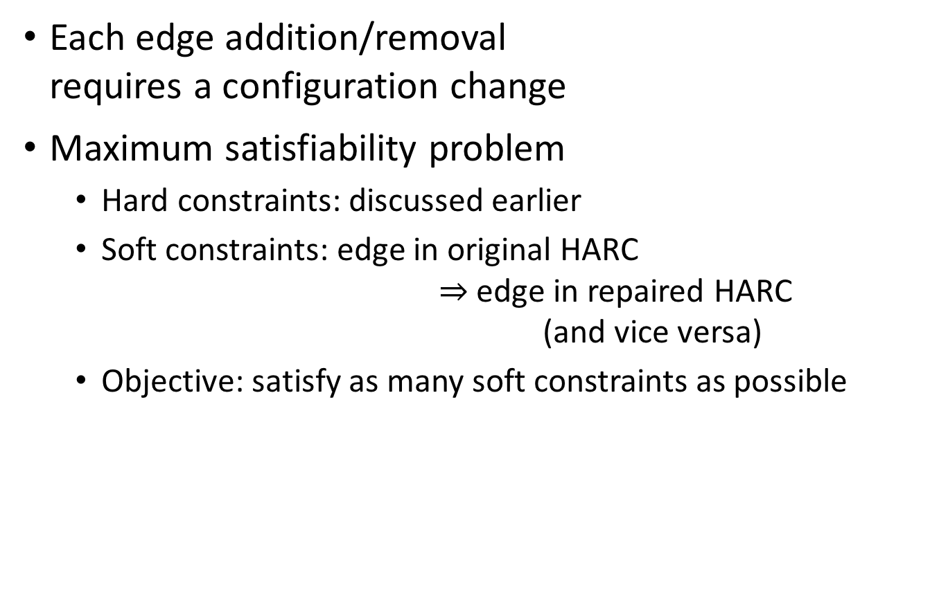


Repair minimality
$$v_{1}$$
$$v_{2}$$
Each edge addition/removal
requires a configuration change
Maximum satisfiability problem
  Hard constraints: discussed earlier
  Soft constraints: edge in original HARC
  $⇒$ edge in repaired HARC (and vice versa)
  Objective: satisfy as many soft constraints as possible
$$±$$

Slide 17
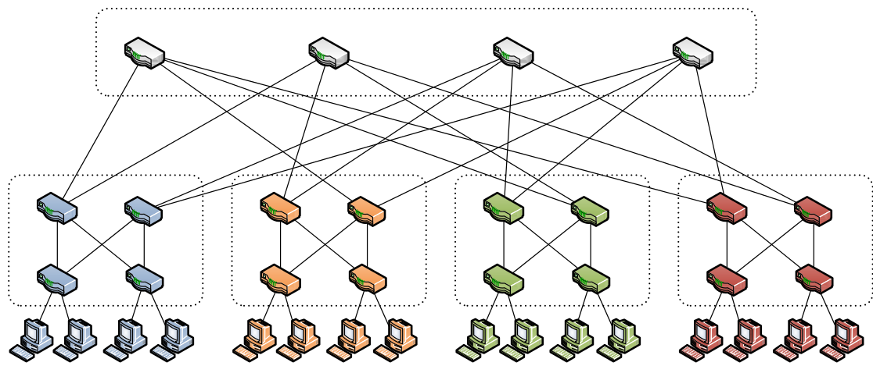
Evaluation: dataset
96 real data center networks
Synthetic fat tree
configurations
Routers
Policies
Median = 8
Max = 24
Median = 1K
Max = 82K
Two
snapshots
Repair older configurations
to satisfy newer policies

Slide 18
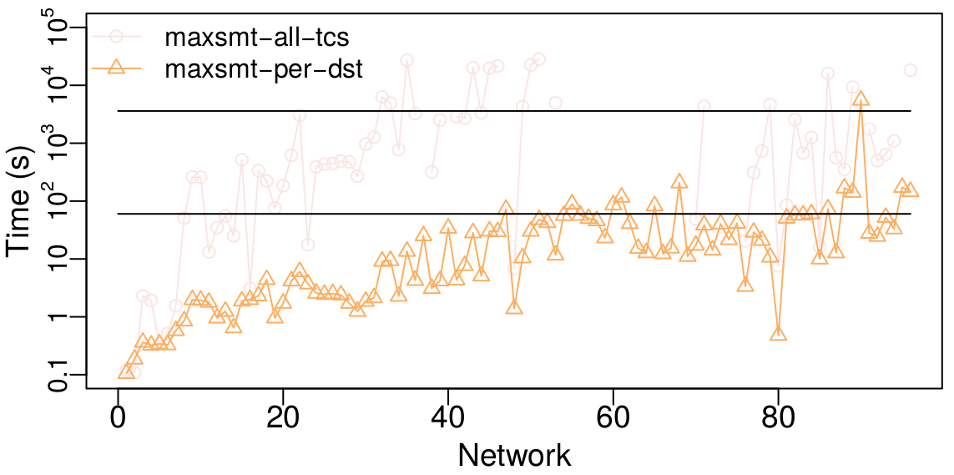
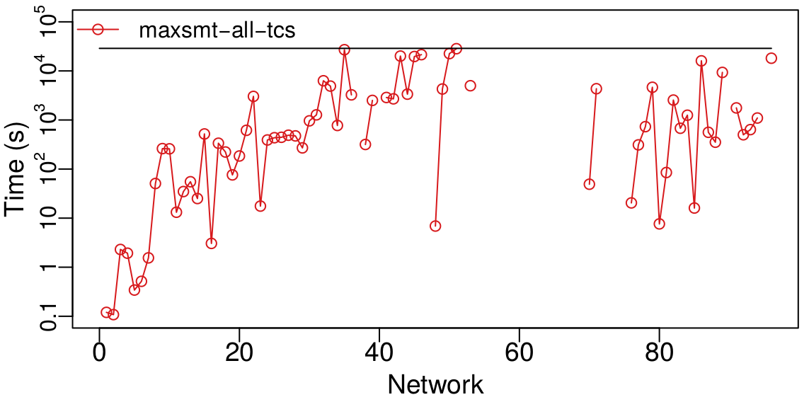
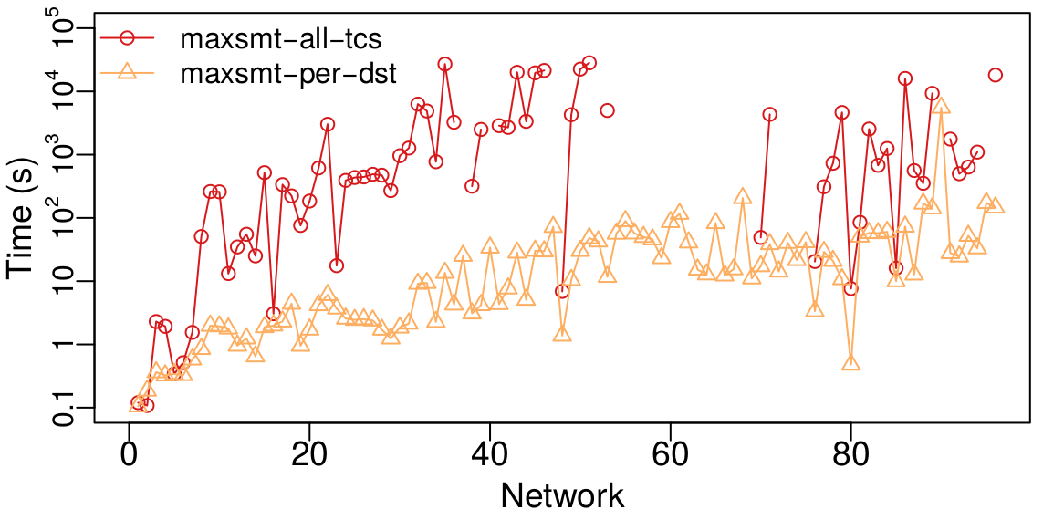


Evaluation: performance
8 hours
1 hour
1 minute
$$Parallelize$$
72% repaired in < 8 hours
$≈$2 orders of magnitude reduction
86% repaired in < 1 minute
99% repaired in < 1 hour

Slide 19
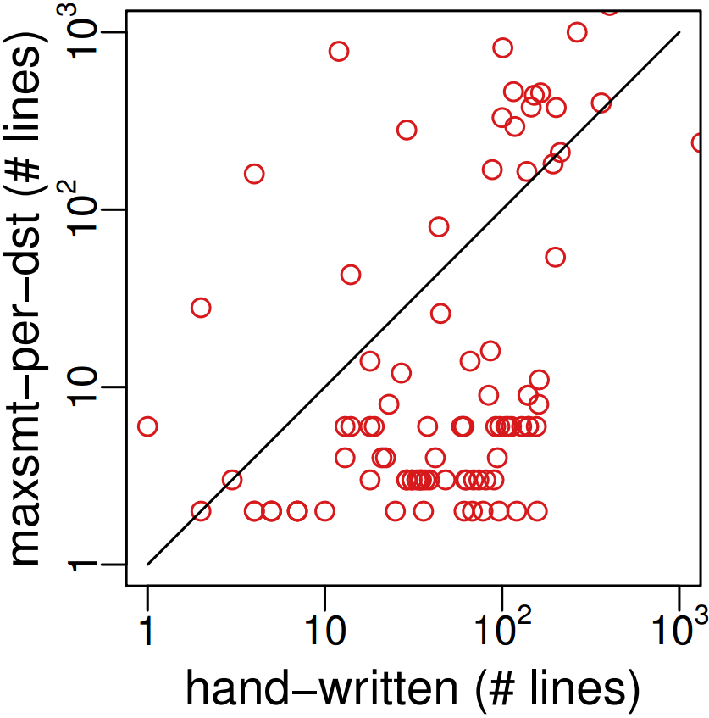
Evaluation: CPR vs hand-written repairs
Overlapping
filtering rules
are condensed
in hand-written
repairs
CPR changes
same or fewer
lines in 79%
of networks

Slide 20

Summary
Automatically repair configurations
for distributed control planes
Formulate a maximum satisfiability
problem based on hierarchical ARC
Compute repairs for small data centers in < 1 hour
Try It!
http://aaron.gember-jacobson.com/go/cpr

Slide 21
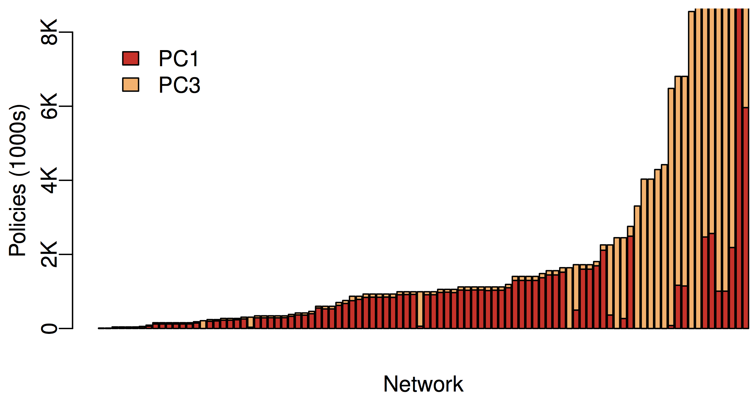
Dataset: real data center policies
S ⇨ T blocked
S ⇨ T reachable under single link failure

Slide 22
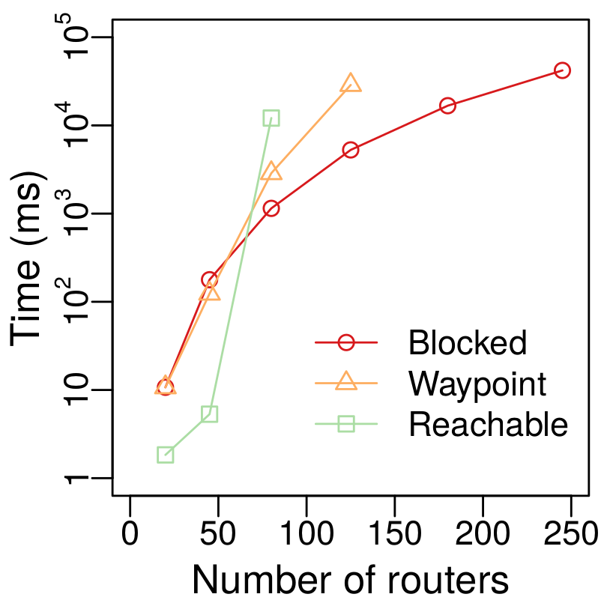
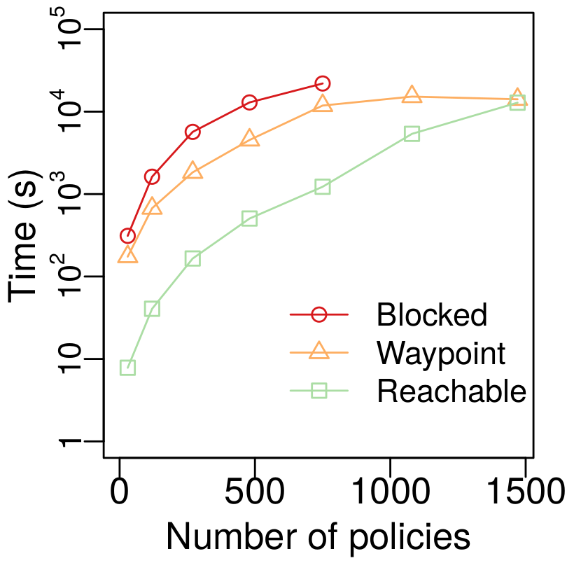
Evaluation: scalability (fat trees)

