Slide 1


A Comparative Study of
Handheld and Non-Handheld Traffic
in Campus Wi-Fi Networks
Aaron Gember, Ashok Anand, and Aditya Akella
University of Wisconsin—Madison

Slide 2
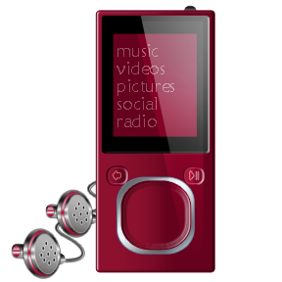

Prevalence of Handhelds
51% of undergrads own an Internet-capable handheld and 12% plan to purchase [EDUCASE 2009]
73% increase in American handheld usage between 2007 and 2009 [PEW 2009]
15% of clients in campus Wi-Fi networks are handhelds
Notes:
We’re interested in the differences between handheld and non-handheld devices because handhelds are becoming an increasing fraction of wireless clients
Handheld devices like smartphones, portable music players, and e-book readers and becoming more prevalent

Slide 3
Prior Studies
Traffic patterns in campus Wi-Fi [Comp. Net. 2008, Mob. Comp. Comm. 2005]
  Most do not differentiate device types
  Sessions, mobility, and protocol usage
Public Wi-Fi and 3G Networks [IMC 2008, 2009, 2010]
  Application, session, and location trends
Little focus on content
Notes:
- Prior studies have already explored wireless clients in aggregate, without differentiating between handhelds and non-handhelds
Traffic patterns in campus Wi-Fi networks have been studied to observe session, mobility, and protocol usage characteristics
Observations from non-handhelds do not necessarily apply to handhelds
Studies that do focus specifically on handhelds are 5 years old, and handheld usage has changed significantly since then
More recent studies that focus specifically on handheld usage consider mobile devices in public Wi-Fi and 3G networks
Focus on how clients move through the network and how location impacts application usage
Little focus on content

Slide 4
Focus on Content
Content access patterns impact applications, device design, and network services
Uniqueness of handhelds
  Small screens and limited battery
  Content providers often tailor data
Quantify and identify source of differences
between handhelds and non-handhelds
Notes:
Focusing on content is important because content access patterns impact applications, device design, and network services
Handhelds have unique properties that make their content access different from laptops
As handheld usage continues increasing, these differences in content access will have an increasing impact on the network
Our goal is to quantify and identify the source of differences between the content accesses of handhelds and non-handhelds

Slide 5
Overview
Data sets and methodology
TCP flow properties
Web content
Streaming video flow properties
Content similarity

Slide 6

Data Sets and Methodology
Two campus networks for 3 days
  Net1: 1,920 APs; 32,166 clients
  Net2: 23 APs; 112 clients
Separate handhelds using HTTP User-Agent; confirm classification with OUIs
15% handhelds
7 primary vendors
70% Apple devices
Device Type | Net1 | Net2
Handheld | 5060 | 9
Non-handheld | 22485 | 90
Unknown | 4621 | 13
Notes:
The results I will be presenting are based on the traffic from Net1. However, the observations I’ll discuss are similar for Net2.
Do not consider 3G traffic from handhelds: 1) Because Wi-Fi offers higher bandwidth and lower latency than 3G, so Wi-Fi is connectivity is preferred when it is available, and 2) Because we are focused on the impact in campus and enterprise networks, so we are not concerned with 3G traffic

Slide 7
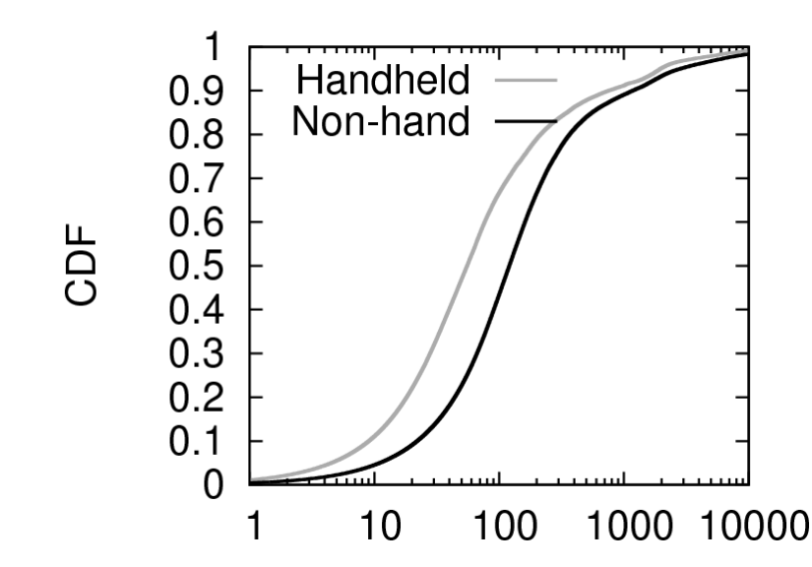
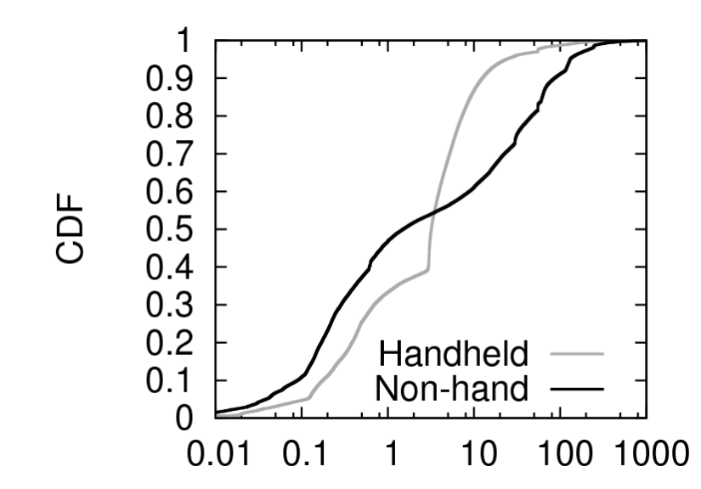
TCP Flow Characteristics
Size (KB)
Handheld median is
50% of non-handheld
Handhelds: more small flows & fewer large flows
Duration (sec)
Median duration is equivalent
Handhelds lack
long flows
Notes:
TCP is the most prevalent protocol for both types of devices
TCP accounts for 92% of handheld traffic and 74% of non-handheld traffic
UDP is used much less by handhelds, only 6% of packets, than non-handhelds, where 26% of packets are UDP
Median flows size for non-handhelds is 100KB, while for handhelds it is 50KB. Handheld median flow size is 50% of the non-handheld median flow size
Handhelds have more small flows and fewer large flows. The maximum flow size for handhelds is 630MB, while the maximum flow size for non-handhelds is 2GB

Slide 8
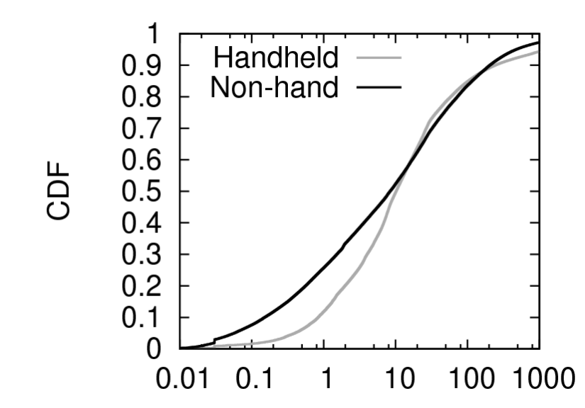
TCP Flow Characteristics
Throughput (Kbps)
Equivalent median
Handhelds have fewer low throughput flows
Other factors the same
Handhelds
Smaller flows caused by smaller content being served
Lack of long flows caused by short session durations
Lack of low throughput caused by fewer interactive sessions
Notes:
-Combining size and duration, we now look at the throughput of flows
-The median throughput is 10Kbps for both types of devices
-Handhelds have fewer low throughput flows: only 10% of handheld flows have a throughput less than 1Kbps, while 30% of non-handheld flows have a throughput less than 30%

Slide 9
Web Content
97% of handheld traffic is web (82% non-handheld)
82% of HTTP handheld traffic is consumed by
non-browser applications (10% non-handhelds)
Content details
  Source web hosts
  Content types
Notes:
We want to know, “Where does this traffic come from?”
We examine the content in detail based on the web host from which it is served, and the type of the content

Slide 10
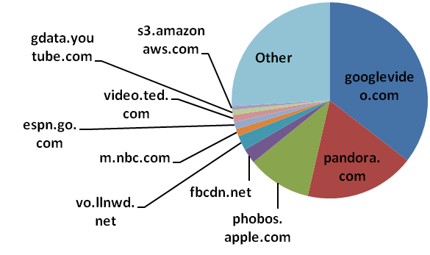
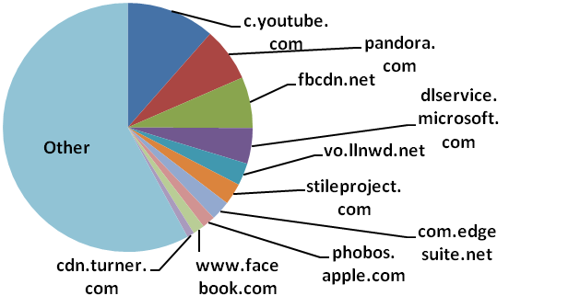
Top 10 Web Hosts
Handheld
Non-Handheld
74% of data from top 10
8 of 10 serve multimedia
42% of data from top 10
Content besides text and multimedia
Notes:
Determine top 10 hosts by data volume based on HTTP content-length
For handhelds, 74% of data comes from the top 10 hosts, only 26% comes from other hosts
Two hosts, googlevideo.com and pandora.com account for 52% of handheld data
For non-handhelds, 42% of data comes from the top 10 hosts, 58% comes from other hosts
Non-handhelds also have many more hosts from which they receive content
-For handhelds, hosts severing multimedia content account for 8 of the top 10 handheld hosts
-For non-hanelds, dlservice.microsoft.com is a top host by volume, a site which serves application downloads

Slide 11
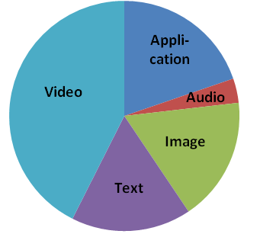
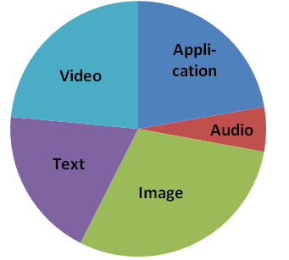
Web Content Types
  Handheld
  Non-
  handheld
  Largest content type by volume
  Handheld: video (42%), application (20%)
  Non-handheld: image (29%), video (25%)
Application data is primarily octet-stream
Look in depth at streaming video
Notes:
The top content type for handhelds is video, consistent with our findings of the top 10 hosts
The top content type for non-handhelds is images
The second most common content types are application for handhelds and video for non-handhelds
Of all application type data, octet-stream is the most common, accounting for over half of all application type data for both devices
-Octet-stream data is commonly associated with streaming media
-Non-handhelds have significant amounts of flash application data, which is also commonly used for streaming media; handhelds have no flash content because they did not support flash until very recently
- Since video is such a large fraction of web content, and overall traffic served to handhelds, we next look at streaming video content in detail

Slide 12
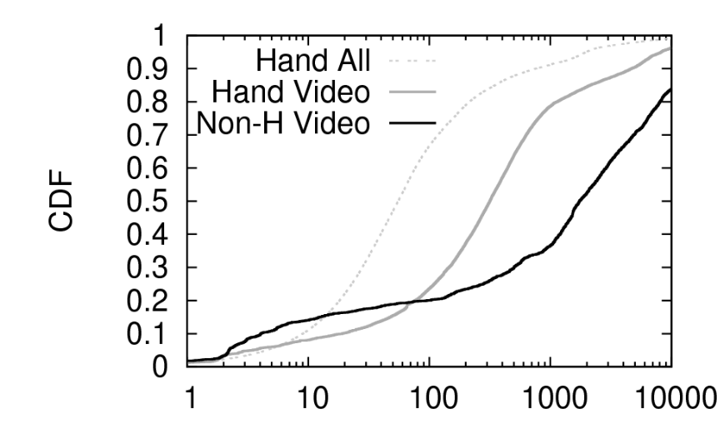
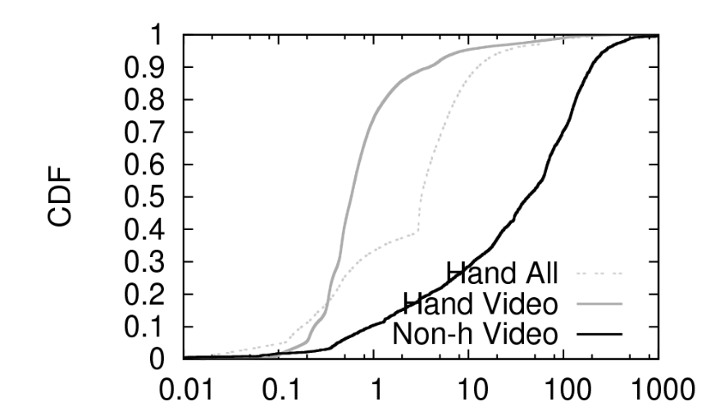
Streaming Video Flows
Size (KB)
Handheld video flows larger than all handheld flows, smaller than non-handheld video flows
Duration (sec)
Handheld video flows have a shorter median than all handheld flows and non-handheld video
Notes:
Handheld video flows are larger than handheld flows: the median size for all handheld flows is 50KB, while 50KB is the 20% percentile size of handheld video flows, 80% of handheld video flows are larger than 50KB
- Handheld video flows and smaller (400KB median) than non-handheld video flows (3MB median)
- Handheld video flows tend to be short, 80% < 1sec
- Median duration for handheld video flows is only 0.5sec, while median for all handheld flows is 10x longer at 5sec, and median for non-handheld video is 100x longer at 50sec

Slide 13

Streaming Video Flows
  Handheld video flows have high throughput
  Look in depth at a single YouTube video
  Handheld receives 7.3MB mp4
  Non-handheld receives 11.7MB flv
  Same resolution for both
Size of sample video is much larger than median video flow size
  Videos streamed over multiple, sequential connections
  Users watch only a fraction of videos
Notes:
Correspondingly, handheld flows have high throughput. Median 2Mbps, versus 0.6Mbps median for non-handhelds
To examine why handheld video flows are smaller than non-handheld video flows and shorter than all handheld flows, we perform some measurements with a single YouTube video
The handheld device receives a smaller, 7.3MB, mp4 file, while the non-handheld receives a larger, 11.7MB, flv file
The resolution is the same
The difference is a result of encoding. This partially explains the larger size of non-handheld video flows
The median video flows size for handhelds, 316KB, and non-handhelds, 1.7MB, is still much smaller than the size of the sample video
One reason for this discrepancy is that videos are streamed over multiple, sequential connections because of HTTP chunking
However, even if we combine the multiple flows for a single video, the flows are still too small; therefore, individuals must only watch a fraction of most videos

Slide 14
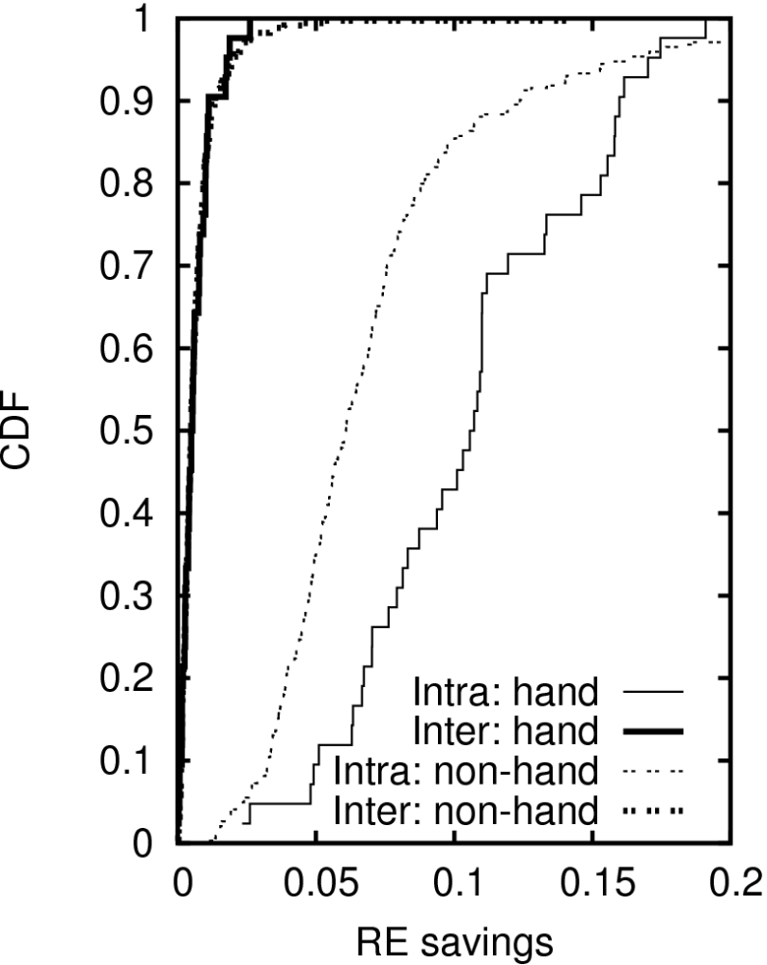
Content Similarity
Chunk-level redundancy every 1 million packets
< 2% inter-user similarity for most traces
5% to 25% intra-user similarity for half of traces
Greater amount of similarity in handhelds
Notes:
- Already talked about similarity between hosts and content-types, now we look at similarity of bytes of content
See what benefits a chunk-level redundancy elimination system like EndRE could provide
Idea is to remove 32-64KB chunks from packet payloads to reduce latency and increase throughput
- Look at both inter-user and intra-user similarity
Very low inter-user similarity, most similarity comes from intra-user
Overall, handhelds have more intra-user similarity that non-handhelds; median for handhelds is 11%, while median for non-handhelds is 6%
This can partially be explained by the fact that handhelds receive content from a narrow range of hosts

Slide 15
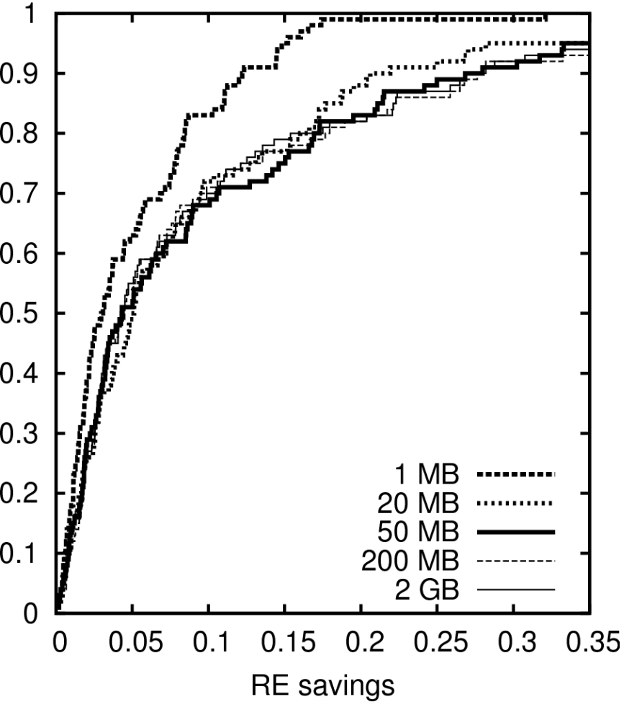
Content Similarity
Intra-user similarity for top 100 handhelds
Up to 50% similarity, median 5%
Find most similarity with only 50MB cache
Notes:
Since intra-user similarity is where most similarity comes from for handhelds, we look at this in detail.
First we look at how much similarity there is, we find up to 50% similarity in some traces
-Assuming a large cache, the median is 5%

Slide 16
High Level Findings
Category | Finding | Implication
TCP flows | Lack of low handheld flow rates | Power save assumptions need to change
Web content | 97% of handheld traffic is web | HTTP-specific network services likely helpful
Video flows | 40% of handheld traffic is video | QoS is necessary to support high throughputs
Content similarity | High handheld intra-user redundancy | Benefit from per-device caching mechanisms

Slide 17
Questions?
See Tech Report for even more details
http://www.cs.wisc.edu/techreports/2010/TR1679.pdf

Slide 18
Top 10 Web Hosts
  Top 10 hosts by number of requests
  30% of handheld requests (32% non-handheld)
  Greater diversity of services in top hosts by request
Notes:
- Equivalent number of requests served by top 10 hosts for both types of devices
- Greater diversity in services in top hosts by request: social networking, streaming media, advertising, search, and news

