Slide 1

Big Data
CS4HS @ MU, Session 6
Aaron Gember, UW-Madison

Slide 2

Big Idea #3
Data and information facilitate
the creation of knowledge.
People use computer programs to process information to gain insight and knowledge.
Computing facilitates exploration and the discovery of connections in information.
Computational manipulation of information requires consideration of representation, storage, security, and transmission.

Slide 3


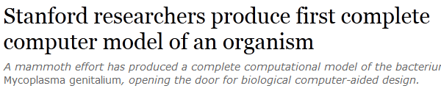
Big Data
Cloud Computing
Machine Learning

Slide 4
Outline
Example Problems
Challenges
Big Data Unplugged
Paradigms
Hands-on Visualization & Data Mining

Slide 5



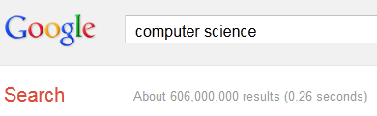
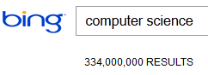
Example: Internet Search
Enormous amounts of content on the Internet
47 billion 17 billion 3.3 billion
Seek relevant results in less than a second

Slide 6


Example: Internet Search
Prior to searches (happens continuously):
Crawl the web to locate pages
Create index of pages
For each search (in fraction of a second):
Locate pages with keywords
Rank pages by relevance
Return results to user

Slide 7
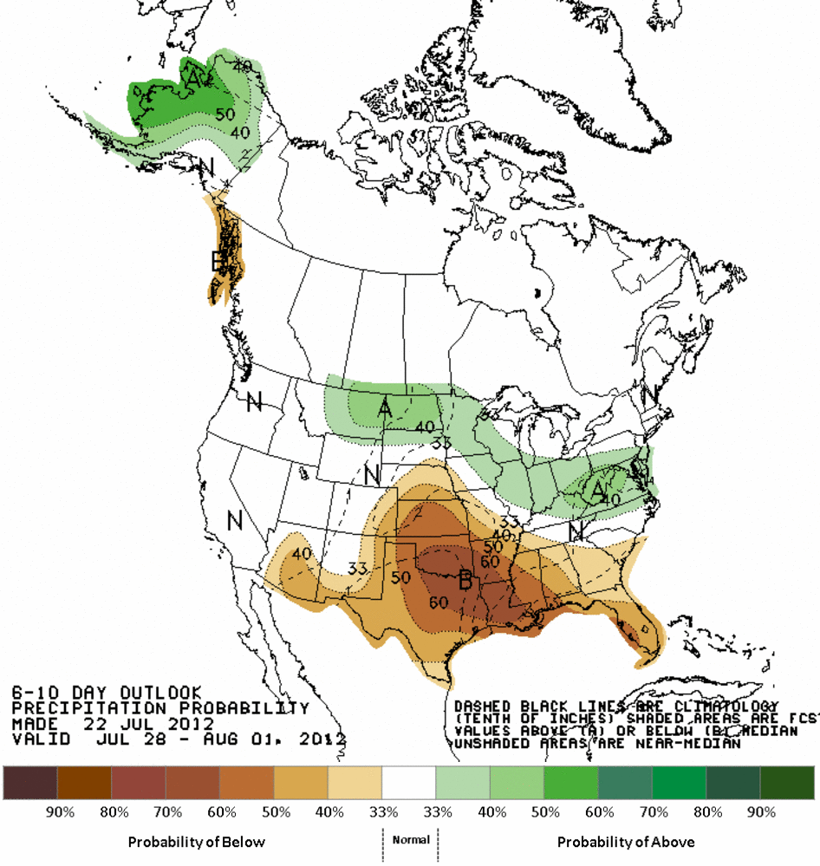
Example: Climate Analysis
Analyze current and
historical weather data
  Sensor readings from
  1000s of locations
  Satellite/radar images
  Geographic features
Visualize predictions
for many audiences

Slide 8
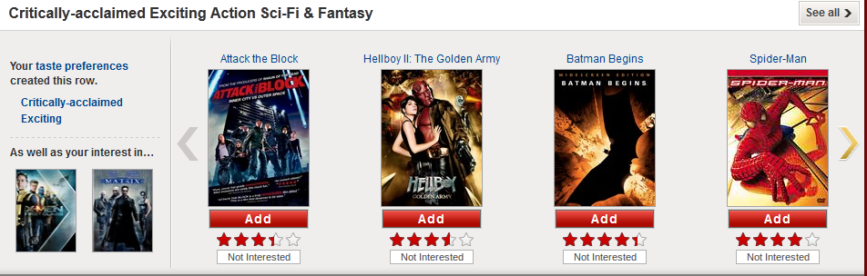
Example: Netflix Recommendations
Recommend movies from Netflix’s collection
Accuracy of predictions impacts subscriptions

Slide 9

Example: Netflix Recommendations
Many factors can influence viewing behavior
  Movie characteristics: cast, year, genre, duration
  Personal history: movies watched, queue
  Social: ratings, reviews
Recommendations include categories and movies, presented in a specific order

Slide 10


Challenge: Collection
Where does the data come from?
Input from humans, instruments/sensors, existing datasets, etc.
Potentially many sources
Transport data from source to repository
Notes:
Humans – census, DVD queue, ratings
Sensors – weather stations, radar
Existing data sets – IMDB, NWS records

Slide 11

Challenge: Organization
How is the data structured?
Data needs to be labeled, sorted, etc.
Relationships may exist between pieces
Exclude inaccurate or unknown data
Notes:
Relationships – movies staring same person
Clean – thermometer readings of -1000F should be excluded

Slide 12

Challenge: Storage
How do we store large volumes of data?
Need space for 100s of Terabytes of data (modern hard drive holds 1 TB)
Data needs to be efficiently accessed by servers doing computation
Notes:
Efficient access – transport from storage location to servers, speed of storage medium (read/write ops per second)

Slide 13

Challenge: Computation
How is the data processed to
obtain desired information?
Algorithms determine actions to perform
Need computers to run the algorithms
May be constrained by time, space, etc.
Notes:
Algorithms – text search, formulas, pattern matching

Slide 14



Challenge: Visualization
How is the data (or results) presented?
Seek clear, concise representation of the data
Emphasize desired information
May require many related visualizations

Slide 15

Big Data Unplugged
Word count
  Conceptually simple
  Relevant for Internet search
Count how many times each unique word occurs
Want speed and accuracy

Slide 16
Big Data Unplugged
Who held what data?
How was data passed?
What algorithm did each person execute?
How was the final result obtained?
How did you present the final result?

Slide 17
Paradigm: MapReduce
Leverage parallelization
Divide analysis into two parts
  Map task: given a subset of the data; extract relevant data and obtain partial results
  Reduce task: receive partial results from each
  map task; combine into final result

Slide 18
Paradigm: MapReduce
Used for Internet search
  Map task: given a part of the index; identify pages containing keywords and calculate relevance
  Reduce task: rank pages based on relevance
Infrastructure requirements
  Many machines to run map tasks in parallel
  Ability to retrieve and store data
  Coordination of who does what

Slide 19
Paradigm: Cloud Computing
Large collections of processing and storage resources used on demand
Sell resources (machines, GB of storage, etc.) for some period of time

Slide 20






Paradigm: Cloud Computing
Infrastructure-as-a-service
Platform-as-a-service
Storage-as-a-service

Slide 21

Paradigm: Cloud Computing
Benefits for users
  Only pay for what you use
  100 servers at $1/hour for 1 hour = $100
  1 server at $1/hour for 100 hours = $100
  Externally managed
Benefits for cloud providers
  Economies of scale (space, equipment, etc.)

Slide 22

Paradigm: Data Mining
Identify patterns and relationships in data
Used to rank, categorize, etc.
Commonly associated with artificial intelligence and machine learning

Slide 23

Paradigm: Data Mining
Categorization algorithms
  Rules > ZeroR: pick most common
  Trees > J48: decision tree
  Bayes > NaiveBayes: based on probabilities
Clustering algorithms

Slide 24
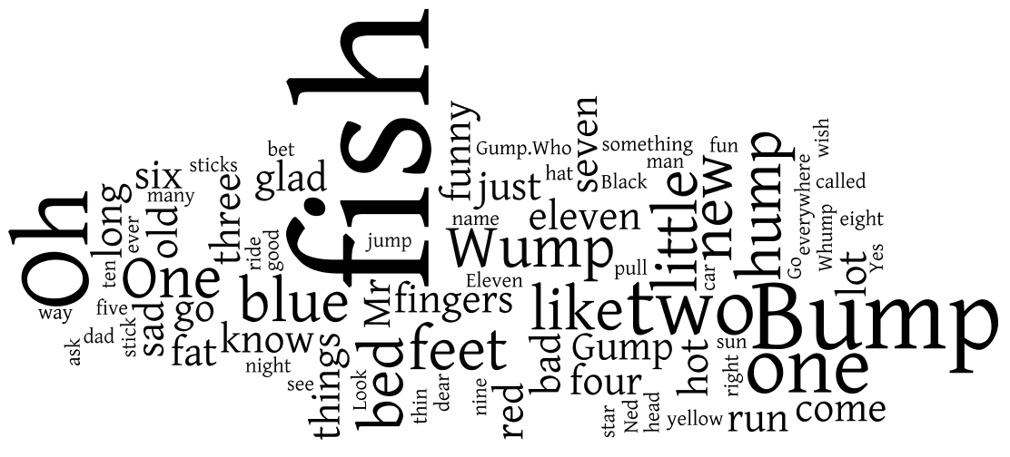
Paradigm: Visualization
Wide array of ways to view data (or results)
  Conventional: line, bar, pie charts
  Alternative: bubble chart, tree map, world map
  Text: tag cloud, word tree

Slide 25

Hands-On
Data Mining in Weka
  Computer > cshs2012 (Z:) > launch_weka
  Data in Z:/datasets
  Rules > ZeroR, Trees > J48, Bayes > NaiveBayes
Visualization using Many Eyes
  http://www-958.ibm.com
  Search for “one fish” datasets
  or play with any dataset

Slide 26
Resources
ManyEyes (http://www-958.ibm.com)
Weka (http://www.cs.waikato.ac.nz/ml/weka)
Datasets (http://archive.ics.uci.edu/ml/)
Google Insights for Search (http://www.google.com/insights/search)
WebMapReduce (http://webmapreduce.sourceforge.net/)
Amazon Web Services in Education (http://aws.amazon.com/education/)

