Slide 1
Obtaining In-Context Measurements of Cellular Network Performance
Aaron Gember, Aditya Akella
University of Wisconsin-Madison
Jeffrey Pang, Alexander Varshavsky, Ramon Caceres
AT&T Labs

Slide 2
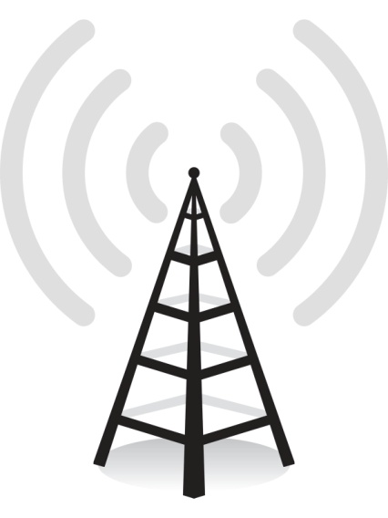
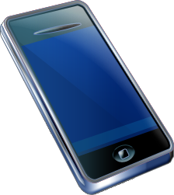



Performance During User Activity
Performance users likely experience?
when interacting with their device

Slide 3



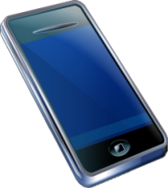

In-Context Measurements
Limit to specific contexts
Whether a user
is interacting
with their device
Device model & OS version
Time, place, & speed when the network is used
Want to accurately reflect the range of performance experienced by users
Representative
distribution
of contexts

Slide 4
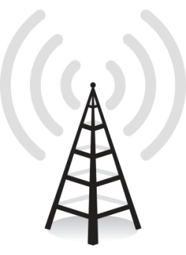

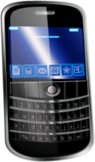





Use Cases
Evaluate effect of
network changes
Narrow cause of poor
network performance
Compare cellular
network providers

Slide 5
How do we capture
in-context measurements of cellular network performance?

Slide 6
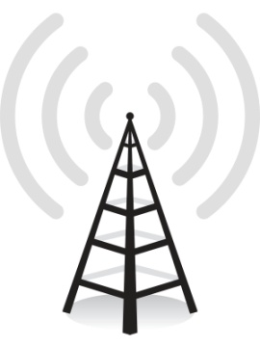




Existing Approaches
Network-based
Passive Analysis
Difficult to determine
or control context
Difficult to eliminate confounding factors
Field
Testing
Self-initiated
Reporting
Limited
range of contexts
May not accurately reflect usage patterns
Requires manual
user intervention
Most users only report problems

Slide 7


Our Contributions
Empirical Study
Measurement System
Network data from 20,000 subscribers
100s of controlled experiments
Crowdsource active
measurements
Deploy to 12 volunteers
What factors need
to be considered to capture in-context measurements?
Measurements depict performance experienced while user is active

Slide 8




Empirical Study
How does performance differ between
the times users actually use their devices
versus times the devices are unused?
What aspects of a device’s physical context contributes to the observed differences?
What is the allowable overlap between
user traffic and measurement probes?

Slide 9
Active vs. Idle Devices
How does performance differ between
the times users actually use their devices
versus times the devices are unused?
Flow records from 20,000 subscribers
  TCP keep-alives for specific service
  Active range: time between start and
  end of non-background flows
  Idle: > 30 minutes since last active range

Slide 10
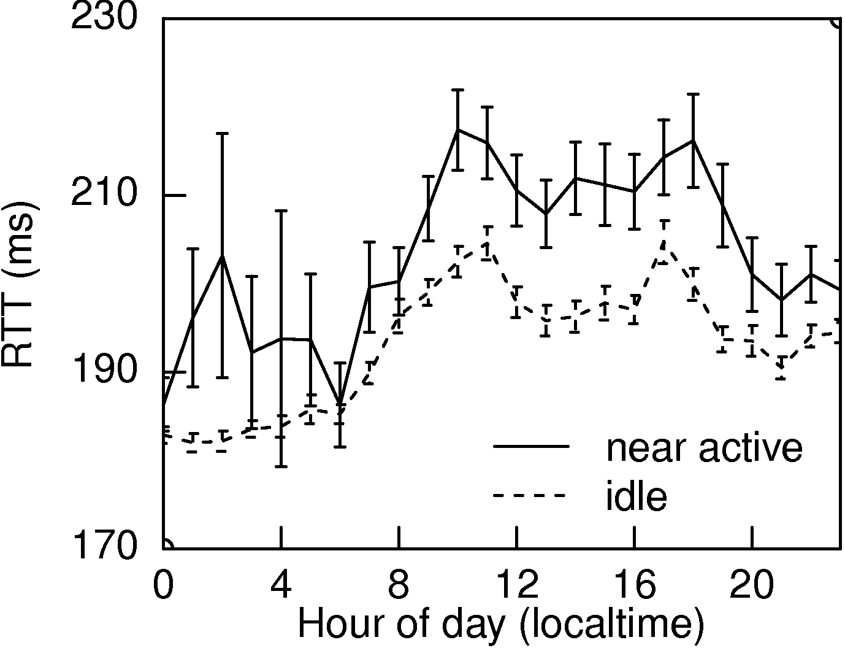
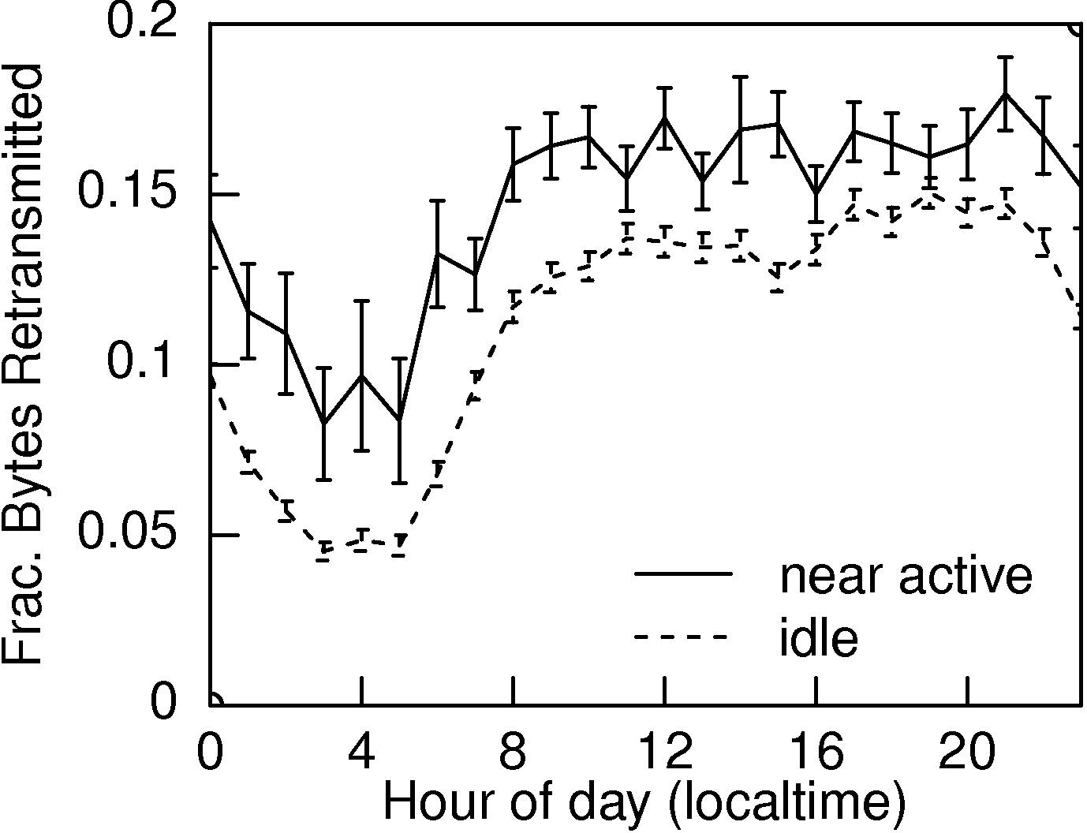
Active vs. Idle Devices
Latency
16ms lower
when idle
Loss
6% less
when idle
active
idle
active
idle
active
idle
active
idle
Measurements on idle devices
may overestimate performance
Notes:
If we account for differences geographic location, we see similar results: 30ms lower RTT on idle devices

Slide 11
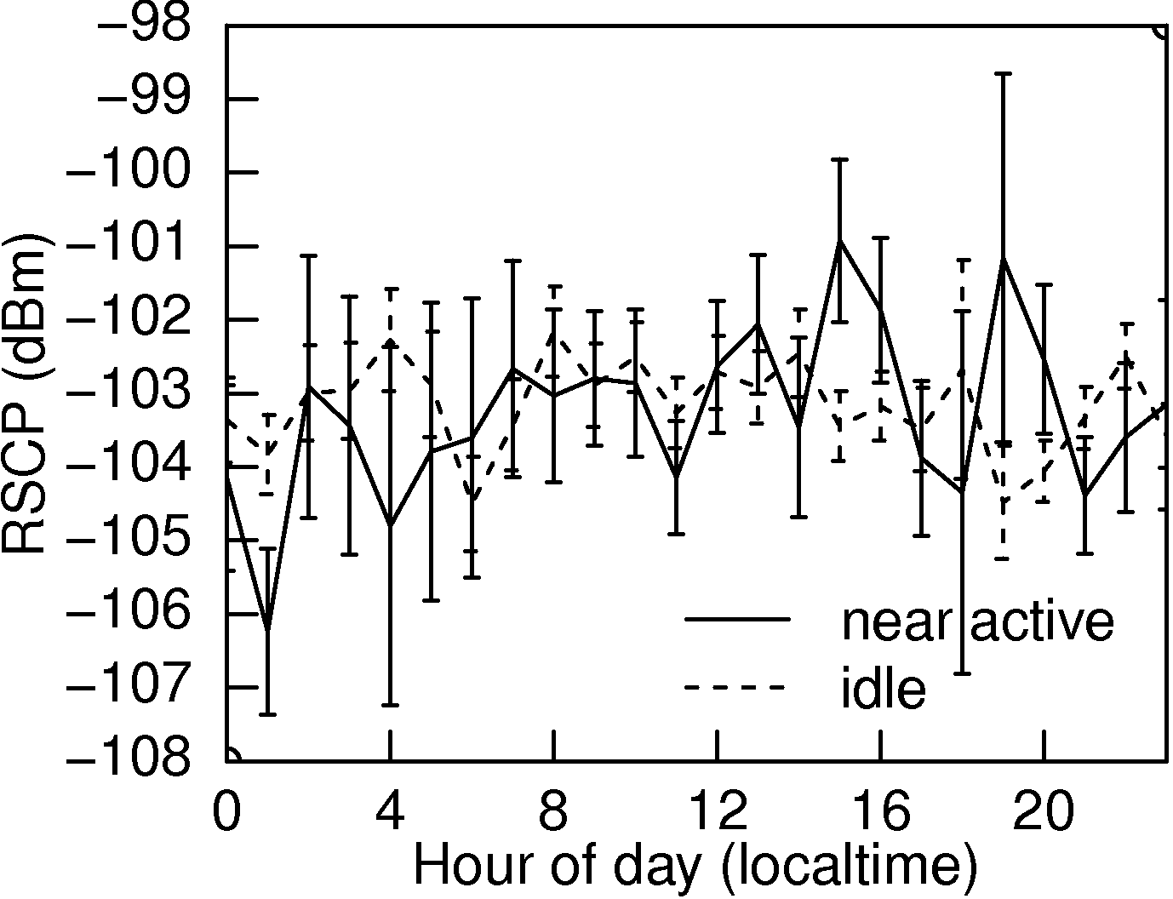
Active vs. Idle Devices
What causes the performance differences?
  Time of day
  Coarse geo-location
  Signal strength
  Other low-level
  factors
Signal Strength
No correlation
active
idle
active
idle

Slide 12

Impact of Low-Level Factors
Many low-level factors may affect performance
  Difficult to account for
  Determined by device’s physical context
What aspects of a device’s physical context contributes to the observed differences?
  Environment
  Device position
Notes:
Many low-level factors may affect the performance the network delivers to a device. These factors include: signal fading and interference, handover rate, cell sector traffic load, and back-haul capacity.

Slide 13

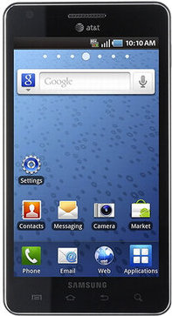
Impact of Physical Context
iPerf and ping from devices we control
  Vary environment (in/out, location,
  speed) and position relative to user
  ≥ 5 measurements in each position
  (round-robin) and environment

Slide 14
Impact of Environment
Location | Throughput | Latency
Indoors 1a | 1491 Kbps | 416 ms
Indoors 1b | 98 Kbps | 475 ms
Indoors 1c | 1842 Kbps | 412 ms
Location
  Three offices in
  the same building
Stationary vs. moving
  Walking outdoors: 950Kbps
  Stationary outdoors: 1540Kbps
Confirm prior results: environment changes
may cause performance differences

Slide 15
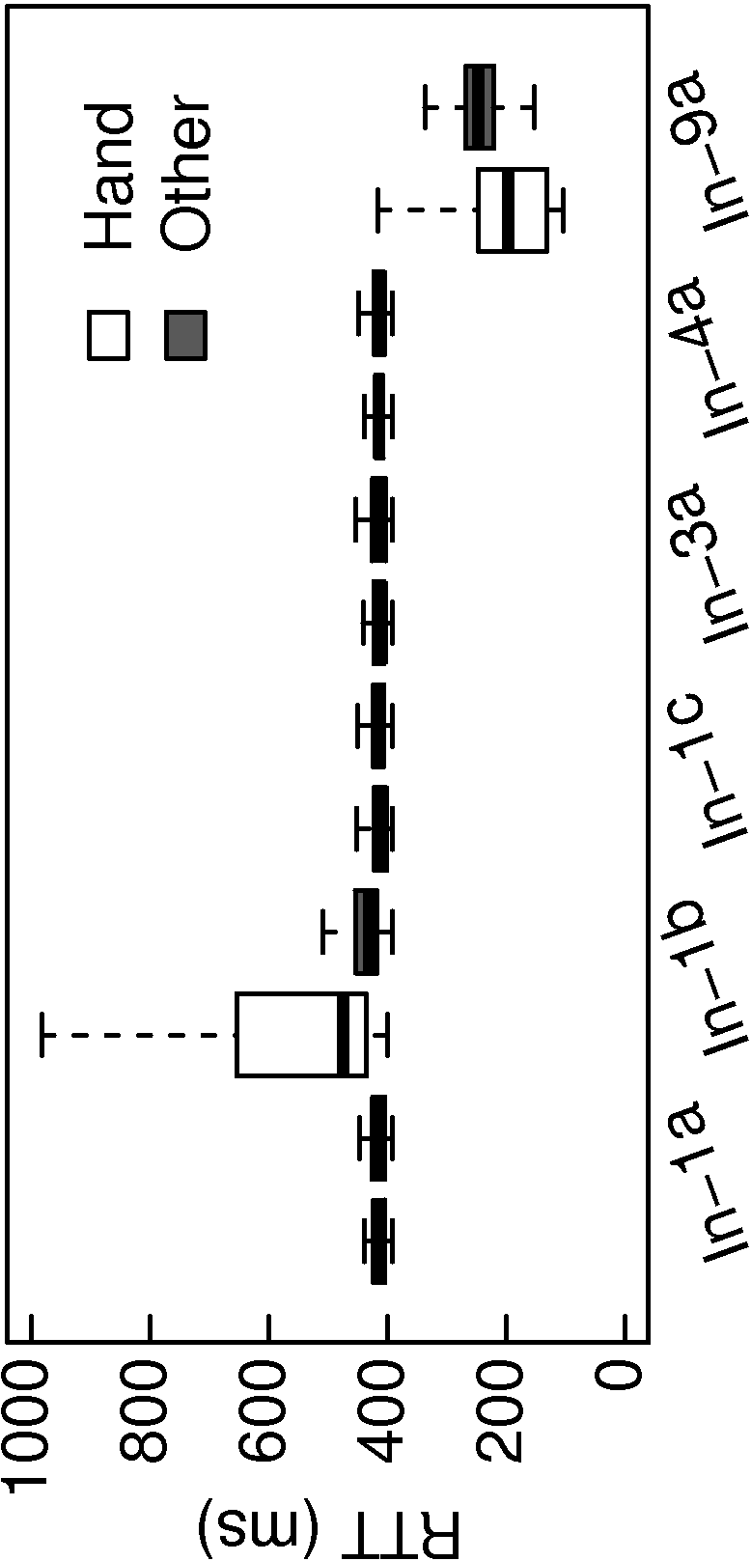
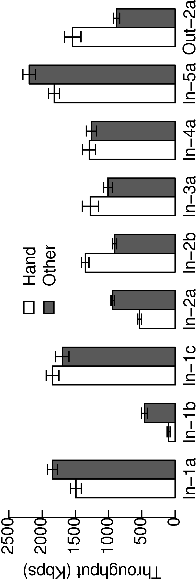
Impact of Device Position
Throughput
Latency
> 350Kbps difference
in some locations
> 15ms difference
in some locations
Devices in different positions may
experience difference performance

Slide 16
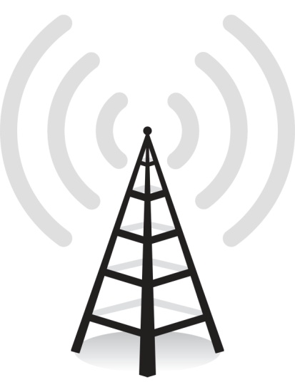
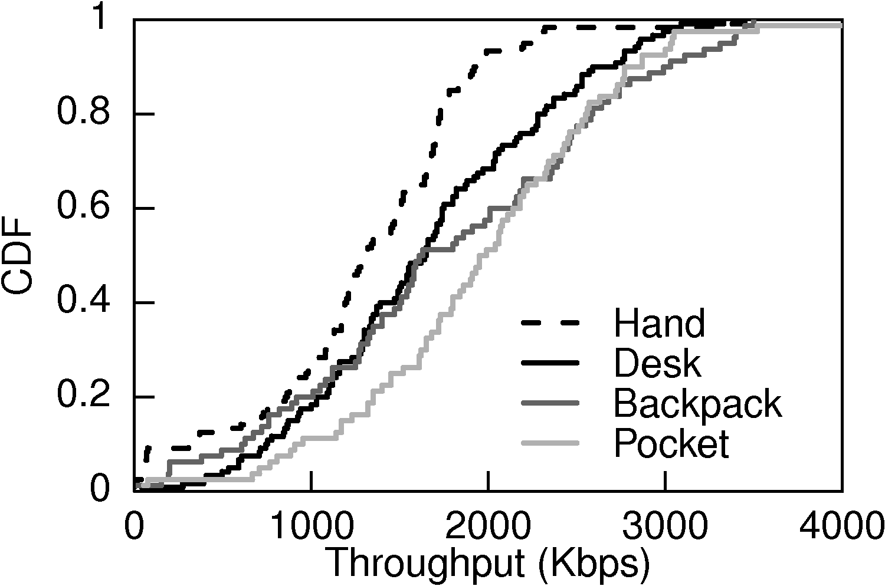
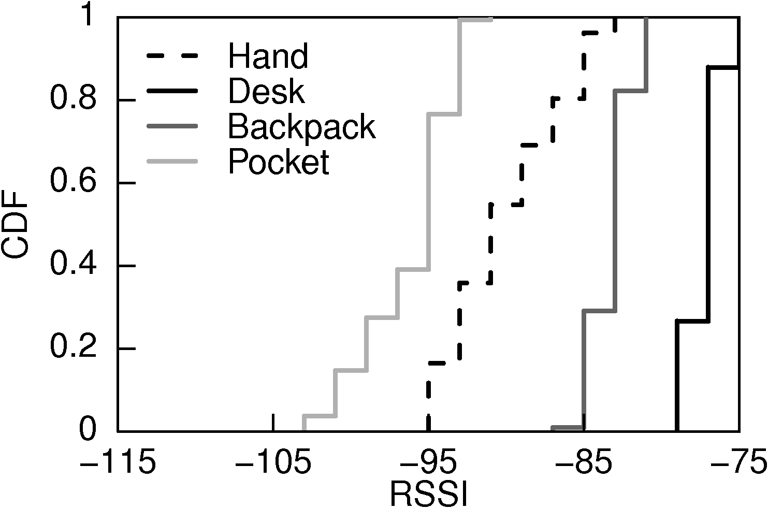
Impact of Device Position
What causes the performance differences?
  Cell sector
  Signal strength
  Small scale fading
Throughput
Signal stength
Hand
Loc 1a
Indoors
Pocket
Hand
Pocket

Slide 17
Summary of Guidelines
In-context measurements must be conducted:
Only on devices which are actively used
On devices in the same position and
environment where they are actively used
At times when only low-bandwidth,
non-jitter-sensitive user traffic is present

Slide 18
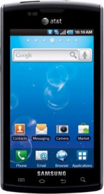
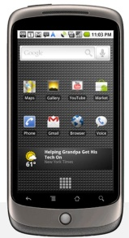
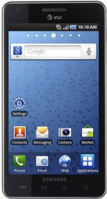
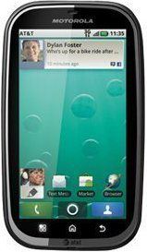
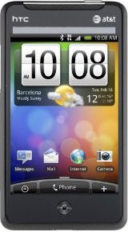

Measurement System
Crowdsource in-context active measurements
  Android-based prototype run by 12 volunteers
Throughput measurements gathered
  Ground Truth: screen on; no network activity
  In-Context: follows guidelines
  Random: every 2-4 hours

Slide 19
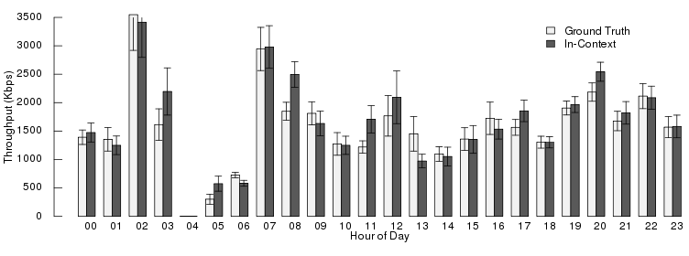
Measurement Accuracy
Do in-context measurements gathered by our system accurately quantify experienced performance?
Accurately quantify performance experienced
by users interacting with device
In-Context = Ground Truth for 18 hours
Notes:
For hours where average throughput differs between the two types of measurements, it was due to a single outlier or not enough measurements.

Slide 20
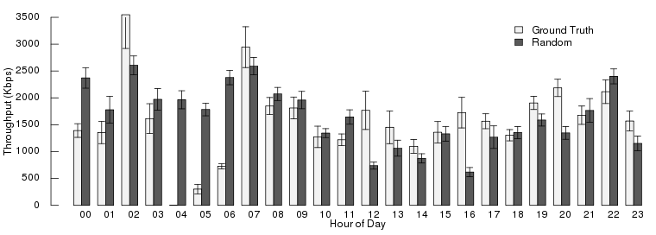
Measurement Accuracy
Analyses which ignore context will not accurately quantify experienced performance
Do random measurements
quantify experienced performance?
Random differs by > 1Mbps

Slide 21
Conclusion
Quantify performance experienced when users are interacting with their device in specific contexts
Empirical Study
Idle devices: 6% less loss;
16ms lower latency
Physical context change:
> 350Kbps difference;
> 15ms difference
Measurement System
Android-based prototype deployed to 12 volunteers
Measurements depict performance experienced while user is active

Slide 22


Related Work
Cellular measurement tools
  Mark the Spot, MobiPerf, 3G Test, WiScape
Automated active measurement systems
  NIMI, Scriptroute , DipZoom, ATEM, CEM
Cellular network performance studies
  Latency, TCP performance, fairness, etc.

Slide 23
Impact of Context
Which contextual factors are most
predictive of cellular network performance?
Movement speed
Indoors/outdoors
Location area
Connection type
Signal strength
Phone model
Hour of day
Cell sector
Month
Most Influential
Least Influential

Slide 24
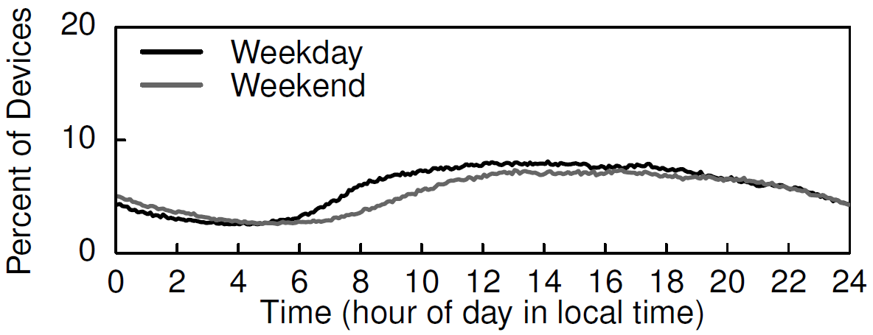
Measurement Opportunities

Slide 25
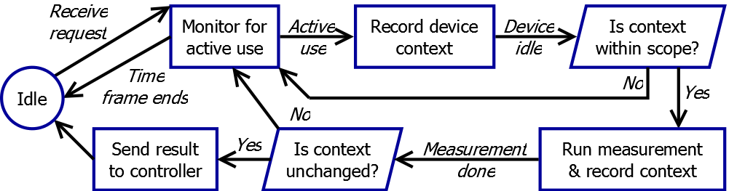
Measurement Service
Decision Process

Slide 26
Measurement Service Benchmarks
Device position change detection
Energy overhead
Event | Correct | False Negatives | False Positives
Desk → Hand | 7 | 0 | -
Web browsing | 5 | - | 2
Hand → Pocket | 7 | 0 | -
In pocket | 7 | - | 0
Pocket → Hand | 7 | 0 | -
Hand → Desk | 6 | 1 | -
Functionality | Energy Consumed in 1 Min
Idle | 0 Joules
Active Monitoring | 0.44 Joules
Environment Monitoring (with GPS) | 16.85 Joules
Environment Monitoring (no GPS) | 0.15 Joules

Slide 27








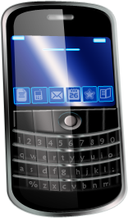
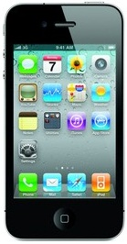
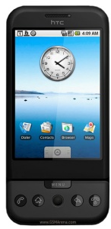

Measurement System Design

