Slide 1
Challenges in Unifying Control of Middlebox Traversals and Functionality
Aaron Gember, Theophilus Benson, Aditya Akella
University of Wisconsin-Madison

Slide 2
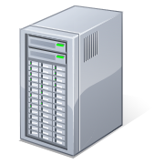
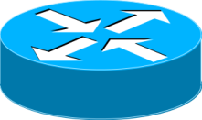





Components of Enterprise Networks
Middleboxes make up 40% of the network devices in large enterprises with over 200K hosts¹
Enterprises spent on average over1 million dollars over the last 5 years to acquire middleboxes¹
A Survey of Enterprise Middlebox Deployments, Justine Sherry and Sylvia Ratnasamy, 2012

Slide 3





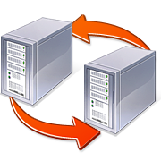

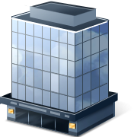
Importance of Middleboxes
Additional component traffic passes through for examination and/or modification
  Not a connection endpoint
  Not responsible for path selection
Ensure security
Optimize performance
Facilitate remote access

Slide 4
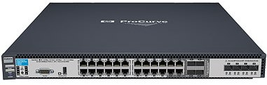

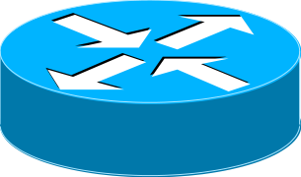

Deploying Middlebox Topologies
Determine objectives – conceptual
Select middleboxes, and ordering – logical
  Select traffic to examine
Plan wiring and network config – physical
HTTP
Flow Logger
IDS

Slide 5
Deployment Scenarios
Monitor all paths or specific link
On-path vs. Off-path
Enforcing traversals
  Physical chokepoint: wiring inline
  Logical chokepoints: routing hacks
  Software defined networking (SDN)

Slide 6
Enforcing Desired Traversals
With SDN, still difficult to expand – need control over middlebox to expand
Brittle networks: choke points
  Single point-of-failure
Limited flexibility
  Unable to differentiate based on traffic type
Difficult to expand

Slide 7
Configuring Middleboxes
Infrastructure dependence
  Distinct language for each vendor
  Hard to migrate between vendors
Topology dependence
  Tied to servers on path
  prevents mobility of server and middleboxes
Need unified control over middleboxes and network devices
67% of the outages are caused by misconfiguration of these middleboxes¹
A Survey of Enterprise Middlebox Deployments, Justine Sherry and Sylvia Ratnasamy, 2012

Slide 8
Benefits of Unification
Easier to verify middlebox configuration
Easier to migrate between infrastructure
Automation leads to flexibility
  Implement energy saving
  Implement bottleneck detection and scaling

Slide 9

Centralized Unified Control
High level Objectives
Control Plane
Physical Infrastructure
Configures physical infrastructure
  Routers + Switches: OpenFlow + NOX
  Middleboxes: ??????

Slide 10
Composing Middlebox Topologies
Operator specifies logical topology
Control plane determines path
Flow Logger
IDS
HTTP

Slide 11
Assumptions
Middlebox deployments are based on high level objectives
A network of SDN switches
  Programmatic control over network

Slide 12
Challenges
Abstractions for specifying high level constraints
  Simple yet flexible and powerful
  Oblivious to the separation between middleboxes and routers.
Common middlebox interface
  Extensible – support new middleboxes
  Support for vendor specific functionality
Control Plane
Control Plane

Slide 13
Strawman for Abstracting Configuration
Basic middlebox functionality
Middleboxes should expose:
  Ways to examine and match packets; e.g., regular-expression on payload, IP headers
  Transformations supported; e.g., encryption
  Way to forward; e.g., SSL tunnel, IP
Examine
Transform
Forward

Slide 14
Challenges of Considering Underlying Infrastructure
Map constraints to physical infrastructure.
  Configure physical infrastructure
Re-adjust configuration to reflect dynamics
  Network topology, middlebox features, and network load

Slide 15
Strawman for Considering Underlying Infrastructure
LP that matches constraints to exposed MB functionality
    Minimize latency (# of links) or Minimize resource utilization (# of MBs)
    Subject to high level constraints
  Input to LP
    High level goals
    Functionality supported by Middleboxes
    Network topology

Slide 16
State-of-the-Art
SDN, Policy-Switch, CloudNaaS
  Flexible interposition of middlebox
  No control over configuration
    Difficult to setup rules for flows without knowledge of middlebox transformations
MIDCOM
  Specify which traffic traverses a middlebox
  Doesn’t support specification of functionality

Slide 17
Summary
Discussed challenges of deploying middleboxes
  Enforcing traversals
  Configuration management
Described outline for unified control
  Presented advantages and challenges

