Slide 1



Integrating Verification and Repair into the Control Plane
Costin Raiciu
University Politehnica of Bucharest
Aaron Gember Jacobson
Colgate University
Laurent Vanbever
ETH Zurich
Hotnets 2017
THANKS TO:
Superfluidity H2020
NSF CCF-1637427
Notes:
Hi, I am Costin Raiciu, I finished my PhD at University College London and I am associate professor at the Politehnica of Bucharest. Today I would like to tell you about my vision to obtain provably correct networks.

Slide 2
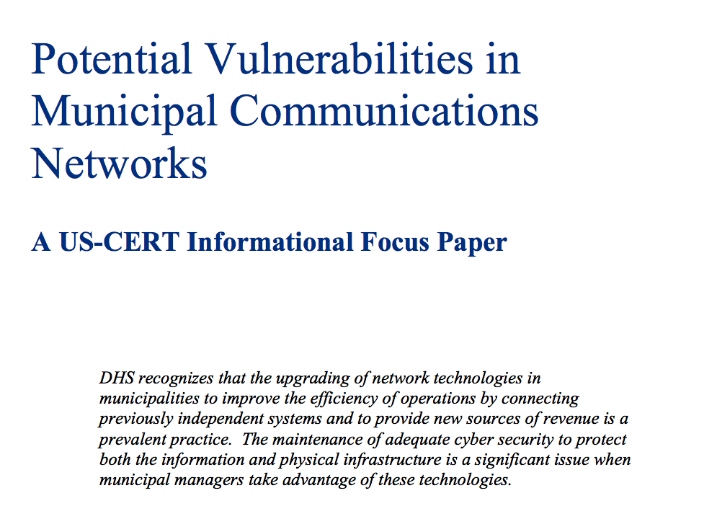
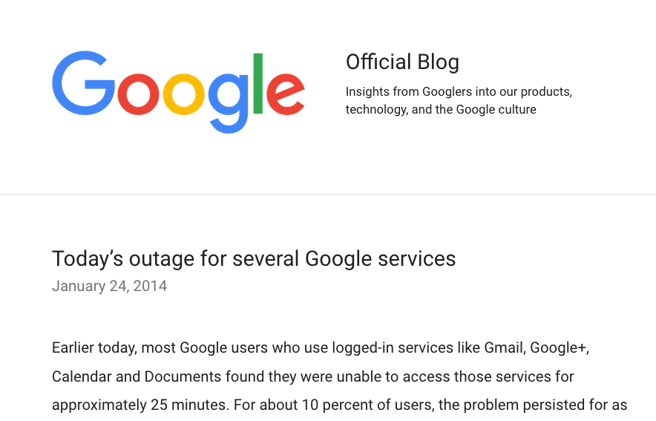

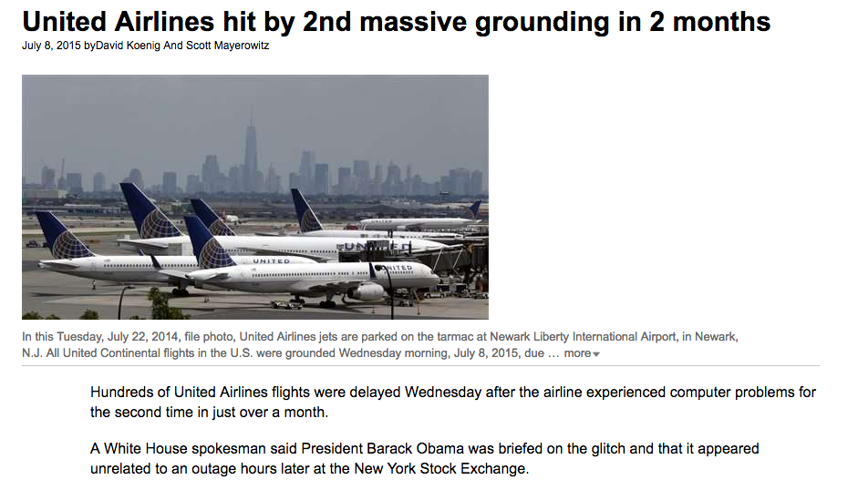
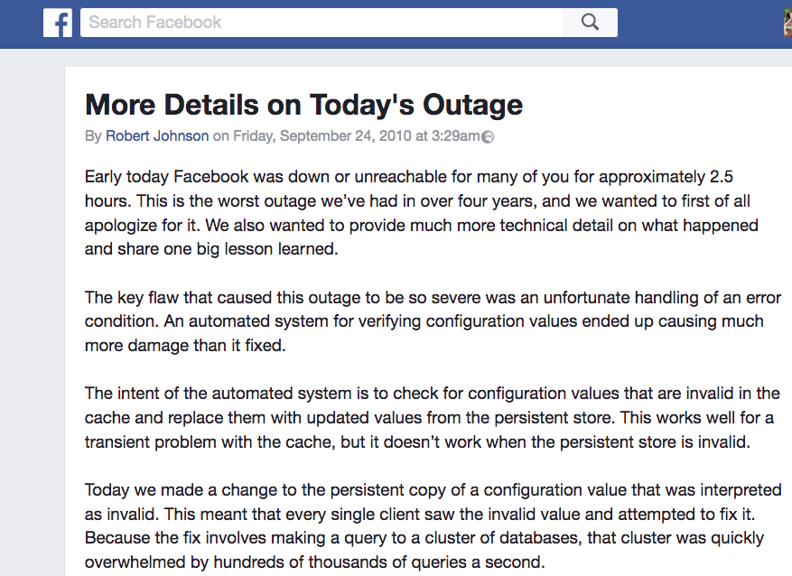
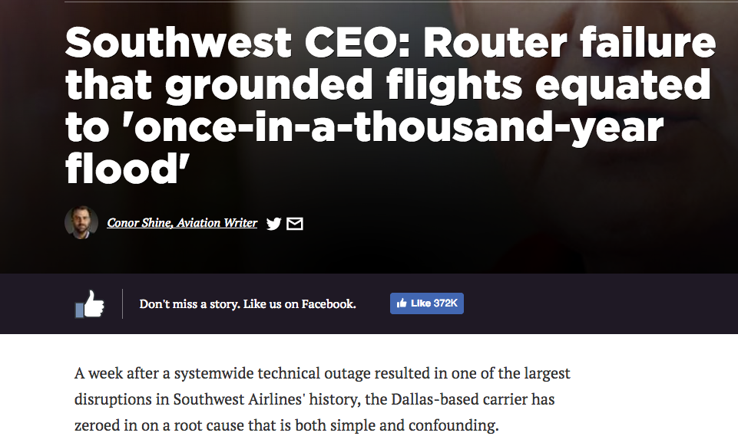
Incorrect networks ground airplanes
Incorrect networks affect millions of users
Incorrect networks affect people

Slide 3
GOAL: CORRECT NETWORKS
Network administrator specifies policy
Want network to always obey policy
A
B
X
D
C

Slide 4

Network operation 101
Network device
configure
Control plane
(BGP, OSPF)
network operator
update
route
update
Data plane
R₁
R₂
R₃
R₄
Notes:
Let’s have a closer look at one of these boxes: its functionality is split between a control plane and a data plane. The control plane includes routing protocols and network controllers that decides how the traffic should be handled by the network. The dataplane simply processes the traffic as quickly as possible, either in ASICs, programmable hardware or x86. When the user decides to change the configuration, the control plane generates new rules that it pushes to the data-plane. The control plane also reacts to triggers from neighboring routers, again updating the data plane.

Slide 5
Network configuration is difficult
Control plane
Control plane
Data plane
Data plane
?
Control plane
network operator
Data plane
Control plane
Data plane
Control plane
Data plane
Control plane
Control plane
Data plane
Data plane

Slide 6

Data plane verification
Control plane
Control plane
Create snapshot
Generate model
Check policy.
Data plane
Data plane
Control plane
network operator
Data plane
Control plane
Data plane
Control plane
+ Fast, accurate
- Faults installed, caught reactively.
- Is the data plane snapshot consistent?
- When an error is found, what is the root cause?
Data plane
Control plane
Control plane
Data plane
Data plane

Slide 7
Control plane verification
Control plane
Create model of control plane
Simulate proposed change
Generate data plane.
Verify against policy
Control plane
Data plane
Data plane
?
Control plane
network operator
Data plane
Control plane
Data plane
Control plane
+ Can pinpoint the root cause of errors
+ No problems with consistency
- Big gap to reality: vendor implementation quirks and bugs are not modeled.
Data plane
Control plane
Control plane
Data plane
Data plane

Slide 8
Goal: Accurate verification, provenance and automatic repair
Problem: today verification is a separate system that works before or after the control plane.
Proposal:
Integrate verification into the operation of the distributed control plane

Slide 9
OUR APPROACH
Configuration changes
Capture Control Plane I/Os
Route
updates
BGP instance
OSPF instance
Data plane
snapshot
RIB updates
Data Plane Verifier
BGP RIB
OSPF RIB
Bad FIB
updates
FIB updates
Trace Provenance
FIB
Root
cause
Block I/Os

Slide 10
A running example
Policy: A should reach P directly via R₂ when link is up.
eBGP
P
P
P
eBGP
eBGP
R₁
R₂
P, Ext
P, R₂
P, Pref=30, R₂
iBGP
P, Pref=30
iBGP
P, Pref=30, Ext
P, Pref=20, Ext
Network
A

Slide 11
A running example
Policy: A should reach P directly via R₂ when link is up.
eBGP
P
eBGP
eBGP
R₁
R₂
P, Ext
P, R₂
P, R₁
P, EXT
iBGP
P, Pref=50
iBGP
P, Pref=30, Ext
P, Pref=30, R₂
P, Pref=50, Ext
P, Pref=20, Ext
fault
50
Network
A

Slide 12
Building a global Happens-Before Graph
Router R₁
Router R₂
R₁ Log
R₂ Log
R₁ configuration change
R₁ configuration change
Config TTY0
Config TTY0
25s
R₁ update P ➡ R₁, LP=50 in BGP RIB
P: soft reconfiguration
4ms
R₁ install P ➡ Ext
in FIB
FIB: P Ext
R₁ localpref =50
0ms
R₁ localpref =50
R₁ send iBGP ad
P ➡ R₁, LP=50
Route: P via R₁
8ms
Route:P via R₁
R₁ recv iBGP ad
P ➡ R₂, LP=10
8ms
Messages
Same prefix
FIB: P via R₁
R₁ update P ➡ R₂, LP=10 in BGP RIB
fault
fault
Timestamps
Inferred HBRs
Notes:
Tested on CISCO routers; mechanisms available already; enable debug mode; syslog server.
Provenance: mention it earlier.

Slide 13
Dealing with faults
Router R₂
BGP instance
BGP RIB
P via R₁
P direct
Alert operator
Block update
Revert root cause
X
FIB

Slide 14
Consistent snapshots
Router 1 Log
Router 2 Log
Verifier view
Config TTY0
P: soft reconfiguration
Use HBG to check data plane consistency
Postpone checking FIB entries with no root cause.
FIB: P direct
✔
R₁ FIB: P direct
Route: P via R₁
R₁ localpref =200
Route: P via R₁
FIB: P via R₁
✖
R₂ FIB: P via R₁
✖
Config change
Loop!
R₁ FIB: P direct

Slide 15
Limitations
We will capture transient faults: too many?
  Wait a bit before alerting operator.
Probabilistic provenance – false root causes.
Undoing effects automatically may not always be safe or feasible.
  Route withdrawals due to link failures cannot be blocked or fixed.

Slide 16
What next?
Is passive mode useful / enough?
How to avoid policy specification?
What is a tolerable false positive/negative threshold?
Distributed verification
  Safe to check some properties locally?

Slide 17
A running example
eBGP
P
eBGP
eBGP
R₁
R₂
P, Ext
P, R₂
P, EXT
P, R₁
P, Pref=10, R₂
iBGP
P, Pref=10
iBGP
P, Pref=30, Ext
P, Pref=30, R₂
P, Pref=20
P, Pref=20, Ext
10

Slide 18
Building a Global Happens-Before Graph
Router R₁
R₂
R₂ configuration change
R₂ update P ➡ R₂, LP=10 in BGP RIB
R₂ send iBGP ad
P ➡ R₂, LP=10
R₁ recv iBGP ad
P ➡ R₂, LP=10
R₁ update P ➡ R₂, LP=10 in BGP RIB
R₁ install P ➡ Ext
in FIB
fault
Notes:
Tested on CISCO routers; mechanisms available already; enable debug mode; syslog server.
Provenance: mention it earlier.

