Slide 1




Pratyaastha: An Efficient Elastic Distributed SDN Control Plane
Anand Krishnamurthy, Shoban P. Chandrabose and Aaron Gember-Jackobson
Notes:
Thanks Anees. Today I will be talking about Pratyaastha, a system for optimally distributing control application state and network switches among SDN controllers to satisfy operator goals.

Slide 2



SDN Control Plane
Motivation
Architecture
Evaluation
Summary
Operator goals:
  Better Performance – Minimizing flow setup latency
  Lower Operating Cost – Efficient controller resource
  allocation
Notes:
At a high level, network operators running a software defined network have two important goals:-
They want to achieve good performance for applications running in the network. And minimizing flow setup latency is a key factor for getting good performance of SDN applications that depend on reactive model of rule installation.
They also want to efficiently allocate resources for the control plane to have lower operating cost.

Slide 3
Challenges faced by operators
Motivation
Architecture
Evaluation
Summary
Notes:
However, there a few challenges in current controller architectures in achieving the mentioned goals.
First, statically assigning switches to controller instances can lead to overload and inefficient resource utilization because of their inability to adapt to traffic load variations in the datacenter.
Next, accessing state of an SDN application from a distributed data store and accessing another controller instance to setup a flow in a switch increases flow setup latency and impacts the performance of applications running in the datacenter.

Slide 4




Challenges faced by operators
Motivation
Architecture
Evaluation
Summary
Static switch assignment
Controllers
Overload or
Inefficient Resource Utilization
Load shifts
State Storage and Access
Increases flow setup latency
Notes:
However, there are major challenges in current controller architectures in achieving the mentioned goals.
First, statically assigning switches to controller instances can lead to overload or inefficient resource utilization because of their inability to adapt to traffic load variations in the datacenter.
Next, accessing state of an SDN application from a distributed data store or accessing another controller instance to setup a flow in a switch increases flow setup latency and impacts the performance of applications running in the datacenter.

Slide 5
Pratyaastha - Architecture
Motivation
Architecture
Evaluation
Summary
Joint optimization of Inter-controller communication and Resource consumption
Notes:
To solve this, we propose Pratyaastha, which jointly minimizes the inter-controller communication and resource consumption.
SDN applications partition application state into pools at a suitable granularity and tag each state partition with the pertinent switches. We use this to construct the dependency graph between switches and application state partitions.
We track the memory used by each application state partition which adds to the memory requirements of a controller storing it.
We also measure the flow arrival rate from each switch which corresponds to the CPU requirements of a controller connected to it.
Virtual machines of various CPU, memory configurations are available for running controllers.
We impose additional costs to inter-controller communication when state partitions and pertinent switches are assigned to different controllers.
We periodically check if controllers are overloaded and if so we run the controller assignment algorithm.
Accurately solving the Integer Linear Program for a large topology is not scalable and hence we use an Artificial Intelligence search algorithm.
This gives the assignment of application state partitions and switches to controller instances as output,
And they are migrated accordingly.

Slide 6
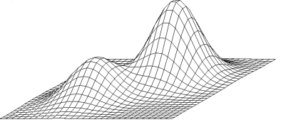

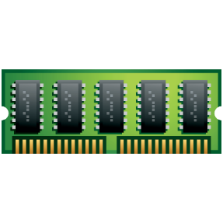

Pratyaastha - Architecture
Motivation
Architecture
Evaluation
Summary
Application state
Controller assignment algorithm
AS1
AS2
AS3
AS4
AI – Hill Climbing with simulated annealing
Flow arrival rate
VM configurations
Notes:
To solve this, we propose Pratyaastha, which jointly minimizes the inter-controller communication and resource consumption.
SDN applications partition application state into pools at a suitable granularity and tag each state partition with the pertinent switches. We use this to construct the dependency graph between switches and application state partitions.
We track the memory used by each application state partition which adds to the memory requirements of a controller storing it.
We also measure the flow arrival rate from each switch which corresponds to the CPU requirements of a controller connected to it.
Virtual machines of various CPU, memory configurations are available for running controllers.
We impose additional costs to inter-controller communication when state partitions and pertinent switches are assigned to different controllers.
We periodically check if controllers are overloaded and if so we run the controller assignment algorithm.
Accurately solving the Integer Linear Program for a large topology is not scalable and hence we use an Artificial Intelligence search algorithm.
This gives the assignment of application state partitions and switches to controller instances as output,
And they are migrated accordingly.

Slide 7
Pratyaastha - Architecture
Motivation
Architecture
Evaluation
Summary
Application state
Controller assignment algorithm
AS1
AS2
AS3
AS4
AI – Hill Climbing with simulated annealing
Flow arrival rate
Scaling and Migration
P1
P2
P3
P4
VM configurations

Slide 8
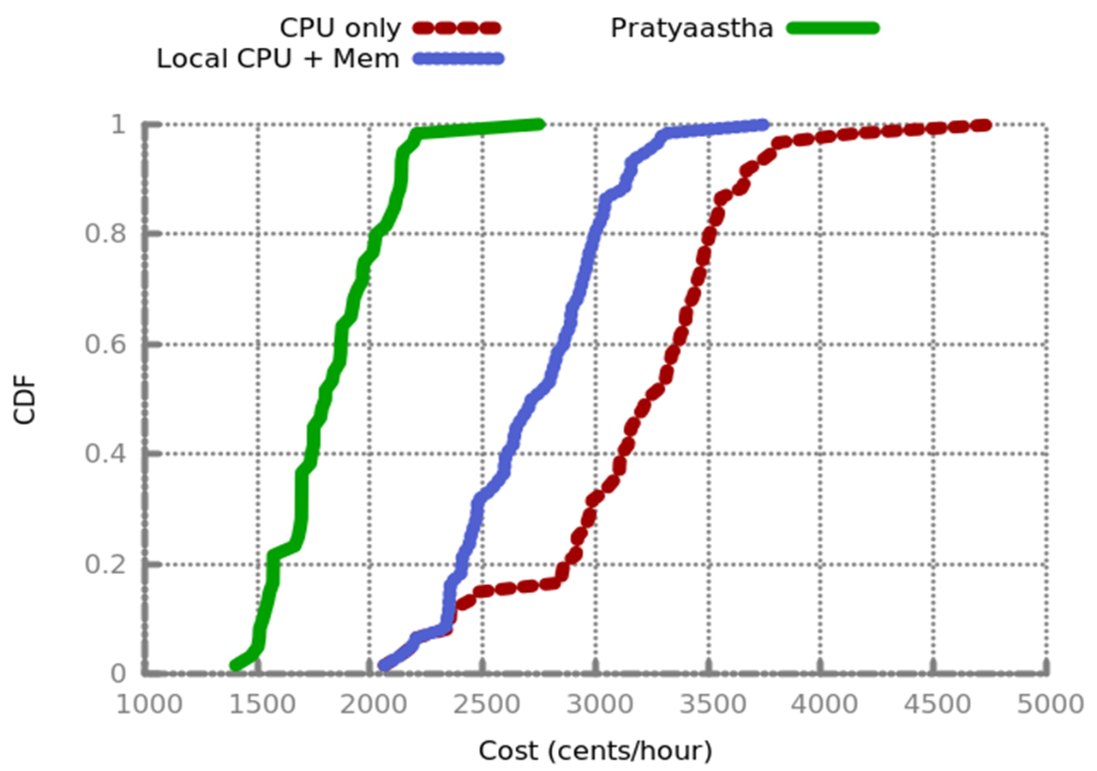
Evaluation
Motivation
Architecture
Evaluation
Summary
Topology and traffic from a private datacenter
33% and 42% decrease in cost when compared with ‘Local CPU + Mem’ and ‘CPU only’
respectively
44% decrease
in flow-setup latency
Notes:
We built a simulator and evaluated Pratyaastha with the topology and traffic from a private datacenter and cost from Amazon EC2 instances.
We compared Pratyaastha with two other controller-assignment approaches:- ‘CPU only’ a system which considers only the flow arrival rate during scaling and stores all state in a distributed
Datastore and ‘Local CPU + Mem’ which is similar to ‘CPU only’ except that some dynamic application state is stored locally.
Overall with Pratyaastha, we were able to get upto 33% and 42% decrease in operating costs and upto 44% decrease in flow-setup latency.

Slide 9
Summary
Motivation
Architecture
Evaluation
Summary
Novel assignment of application state partitions and switches to controller instances
Minimizes flow setup latency
Minimizes controller operating costs
Praytaastha: An Efficient Elastic Distributed SDN Control Plane
Notes:
To summarize, we proposed Pratyaastha, an elastic distributed SDN control plane for optimally distributing control application state and network switches to distributed controller instances to minimize flow setup latency and operating costs. With this, I conclude and I am happy to take questions. Thank you.

