Slide 1


Tiramisu: Fast Multilayer Network Verification
Anubhavnidhi “Archie” Abhashkumar*, Aaron Gember Jacobson#,
and Aditya Akella*
*University of Wisconsin-Madison, # Colgate University

Slide 2




Distributed Control Planes
Policies
Configuration Example
interface GigabitEthernet0/1
  ip address 1.0.1.1 255.255.0.0
  ip ospf cost 1
router ospf 10
  network 3.0.1.2 0.0.255.255 area 0
Y → Z
D
C
Y
Z
OSPF
1
OSPF
1
OSPF
1
OSPF
Z
E
B
Notes:
Vast networks use control planes that run multiple protocols to satisfy network policies
Protocols compute route that implement policies
Flow adheres the policy

Slide 3
Router Configurations are Complex
interface GigabitEthernet0/1
ip address 1.0.1.1 255.255.0.0
ip ospf cost 1
!
interface GigabitEthernet0/2
ip address 10.11.11.1 255.255.0.0
!
router bgp 300
neighbor 2.2.2.2 route-map COMM out
!
route-map COMM permit 10
set community 1:1 additive
set local-preference 150
!
router ospf 10
network 3.0.1.2 0.0.255.255 area 0
Multiple routing protocols
  BGP
  OSPF
  …
Multiple routing metrics
  ospf cost
  local preference
  …
Multiple filters
  Community
  …

Slide 4
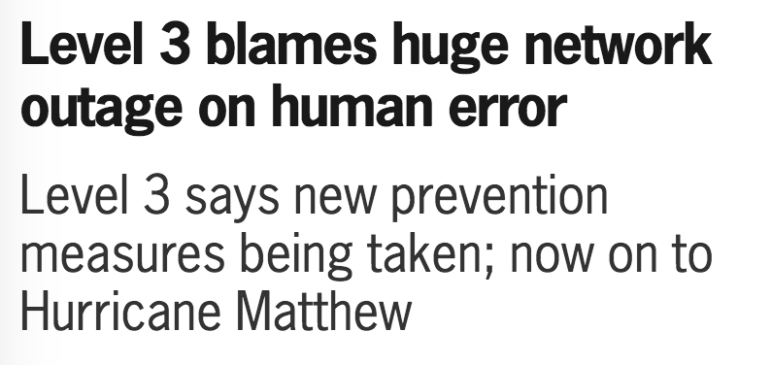
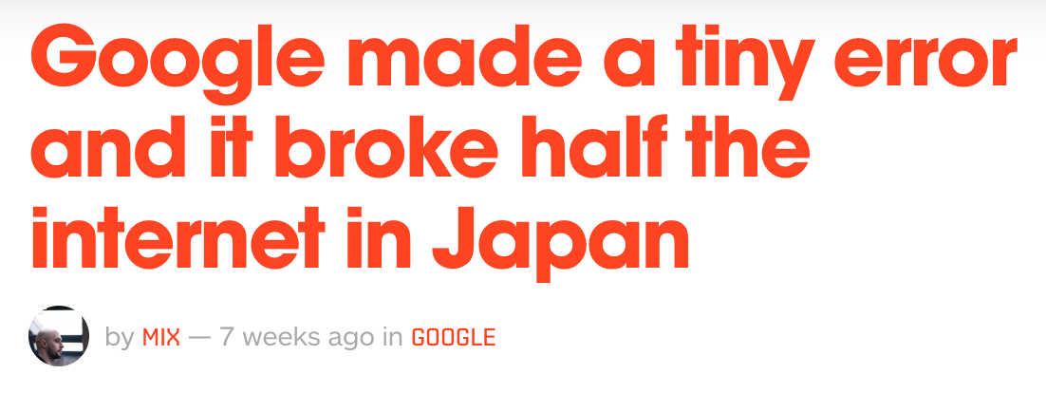
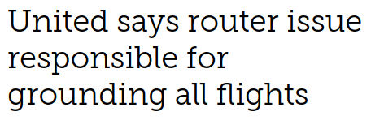
Configuration Complexity Make Errors Common
Policy violations manifest under failures
Verification tools can proactively check for failures

Slide 5
Multiple Network Verification tools
Minesweeper
(SIGCOMM ’17)
Plankton
(NSDI’20)
Tiramisu
(NSDI’20)
Batfish
(NSDI’15)
ARC
(SIGCOMM’16)
Coverage
Bagpipe
(OOPSLA’16)
ERA
(OSDI’16)
P-REX
(CONEXT’18)
Goal: A verification tool that has good coverage and good performance
Performance
Notes:
Add tiramisu with animnation

Slide 6

Performance VS Coverage
ARC (SIGCOMM’16)
  Graph algorithms
Minesweeper (SIGCOMM’17)
  Symbolic encoding
4
Network configurations
2
2
1
6
Routing Algorithms
SMT Constraints
0
Policies
Network
configurations
Weighted Graphs
Z3 solver
Notes:
First iBGP examples
ARC – cannot verify - Cannot model iBGP, community, local-preference, etc
\
Minesweeper – slow
Then Slide 9
Aaron: O(n) for dfs

Slide 7
Cross Layer Dependency
ROUTER C
ROUTER D
iBGP
iBGP
D
C
Dst | NextHop
E | B
B | B
D | D
Dst | NextHop
B | B
C | C
5
OSPF
OSPF
1
1
Y
Z
OSPF
E
B
iBGP
eBGP
eBGP
C → E
ROUTER B
IBGP uses OSPF computed route to reach next hop router
Dst | NextHop
E | E
C | C
D | D
Cross Layer Dependency: iBGP - OSPF
Notes:
Words to say green is depenedent on OSPF/orange

Slide 8
Cross Layer Dependency
ROUTER C
ROUTER D
iBGP
iBGP
Dst | NextHop
E | B
B | D
D | D
D
C
Dst | NextHop
E | B
B | B
D | D
Dst | NextHop
B | B
C | C
5
OSPF
OSPF
1
E
1
Y
Z
OSPF
E
B
iBGP
eBGP
eBGP
ROUTER B
Dst | NextHop
E | E
C | C
D | D

Slide 9
ARC and Minesweeper
ARC (SIGCOMM’16)
Minesweeper (SIGCOMM’17)
C_{ospf}
C_{ospf}
…….
192.0.0.0 ≤ out.prefix
out.prefix ≤ 192.1.0.0
out.valid ⇒ true
best.valid ⇒ out.lp = 120
best.valid ⇒ out.ad = 20
…….
…….
192.0.0.0 ≤ out.prefix
out.prefix ≤ 192.1.0.0
out.valid ⇒ true
best.valid ⇒ out.lp = 120
best.valid ⇒ out.ad = 20
…….
B_{ospf}
…….
192.0.0.0 ≤ out.prefix
out.prefix ≤ 192.1.0.0
out.valid ⇒ true
best.valid ⇒ out.lp = 120
best.valid ⇒ out.ad = 20
…….
E_{bgp}
B_{bgp}
  Insufficient feature coverage
    No IBGP, local preference, community, ….
  Poor performance
    replicate model for iBGP
Notes:
I have used iBGP as example, this extends to VLANs, etc.
Likewise Minesweeper specify poor performance – all policies require full model

Slide 10

Insights
Configurations
 | Model | Verification
ARC | Graph | Graph
Minesweeper | SMT | SMT
Configurations
Policy 3: Is C always unreachable/blocked from B?
Policy 1: Which path is preferred?
C→B << C→D→B
low coverage
Policy 2: Can C reach B with 1 link failure?
high performance
high coverage
low performance
Insight 2: Different properties require different levels of fidelity modeling of the control plane. Use property-specific algorithm for performance benefits
C
D
B
B
B
Insight 1: Decouple network encoding from verification algorithm
5
OSPF
OSPF
  Multilayer graph with
  vector of edge weights
NETWORK
MODEL
NETWORK
MODEL
S1
1
1
VERIFICATION
ALGORITHMS
OSPF
B
  Categories policies based on fidelity
PATH
ENUMERATION
QUANTITATIVE GRAPH PROPERTY
PATH
EXISTENCE
(CONNECTIVITY)
VERIFICATION
ALGORITHM-1
VERIFICATION
ALGORITHM-2
VERIFICATION
ALGORITHM-N
….
C→B : ospf cost = 1
C→D→B : ospf cost = 6
Min-cut = 2
low performance
high fidelity
high performance
low fidelity
Notes:
Italize the operators in <<

Slide 11
Tiramisu Overview
PATH
ENUMERATION
NUMERIC GRAPH PROPERTY
PATH
EXISTENCE
Algorithms
TPVP
ILP
TDFS
Graph
Model
Configurations
Traffic Propagation Graph (TPG)
Routing Adjacencies Graph (RAG)

Slide 12
Tiramisu Overview
Graph
Model
Configurations
Traffic Propagation Graph (TPG)
Routing Adjacencies Graph (RAG)

Slide 13

Traffic Propagation Graph (TPG)
iBGP
C
iBGP
D
OSPF
5
OSPF
1
1
Y
Z
OSPF
E
B
iBGP
eBGP
eBGP
E_{bgp}
B_{bgp}
C_{bgp}
D_{bgp}
<len:0>
Y
<len:0>
<len:0>
<len:1>
Z
B_{ospf}
C_{ospf}
D_{ospf}
<ospf:1>
<ospf:1>
<ospf:5>
<ospf:5>
<ospf:1>
E_{vlan:BE:out}
B_{vlan:BE:out}
B_{vlan:BD:out}
B_{vlan:BC:out}
C_{vlan:BC:out}
C_{vlan:CD:out}
D_{vlan:CD:out}
D_{vlan:BD:out}
E_{vlan:BE:in}
B_{vlan:BE:in}
B_{vlan:BD:in}
B_{vlan:BC:in}
C_{vlan:BC:in}
C_{vlan:CD:in}
D_{vlan:CD:in}
D_{vlan:BD:in}
Vertices: RIB of a routing processes and ingress/egress point of a switch/router
Edges: establish route dependency and traffic flow
Vector of edge weights: multiple route metrics
Notes:
Aaron: Intuition could be represented as detailed packet flow animation

Slide 14
Tiramisu Overview
PATH
ENUMERATION
Algorithms
TPVP
Graph
Model
Configurations
Traffic Propagation Graph (TPG)
Routing Adjacencies Graph (RAG)

Slide 15

TPVP - Tiramisu Path Vector Protocol
Griffin et al. (TON’2002) and Sobrinho (TON’2005) models stable paths problem as Simple Path Vector Protocol (SPVP) and routing algebra
TPVP is derived from SPVP and is modeled on routing algebra
  ⊕ operator to model path cost computation
  ⪯ operator to model preference relation and path selection
{ospf:5}
{ospf:5}
{ospf:5}
Node | ⊕ | ⪯
C_{ospf} | {ospf:1} ⊕_{ospf} {ospf:1} = {ospf:2} | {ospf:2} ⪯ _{ospf} {ospf:6}
Node | ⊕ | ⪯
C_{ospf} | {ospf:1} ⊕_{ospf} {ospf:5} = {ospf: 6} | {ospf:6} ⪯ _{ospf} {ospf:2}
Node | ⊕ | ⪯
C_{ospf} | {ospf:1} ⊕_{ospf} {ospf:5} = {ospf:6} | {ospf:6} ⪯ _{ospf} {}
Node | ⊕ | ⪯
C_{bgp} | {len:0} ⊕_{bgp} {ospf:1} = {len:0, ospf: 2} | {len:0, ospf:2} ⪯ _{bgp} {}
<ospf:1>
{ospf:2}
C_{bgp}
<len:0>
C_{ospf}
{}
<ospf:1>
{ospf:2}
{}
{ospf:6}
{len:0, ospf:2}
{ospf:1}
Notes:
This repeats till the path converges

Slide 16
TPVP - Tiramisu Path Vector Protocol
To verify path preference (P1 << P2), Tiramisu multiple instances of TPVP for different failure scenarios
Runs TPVP three times
D
C
1
OSPF
OSPF
S1
4
1
OSPF
B
P1: C→D→B : ospf cost = 2
P2: C→B : ospf cost = 4
Notes:
This repeats till the path converges

Slide 17
Tiramisu Overview
NUMERIC GRAPH PROPERTY
Algorithms
ILP
Graph
Model
Configurations
Traffic Propagation Graph (TPG)
Routing Adjacencies Graph (RAG)

Slide 18
ILPs - Integer Linear Programs
D
B
C
B
eBGP
<bt:c1>
eBGP
S1
min cut is 1
<at:c1>
B
    Reachability < K failures = Minimize link failures
    Longest path = Maximize path length
eBGP
Traffic flows in the direction opposite to route advertisement
Only depends on quantitative path property and not exact path
ILP constraints model reachability
  Tag/Community
Objective models the graph property
More details about the ILP and its corner cases are in the paper
Notes:
Have a text on that slide about advertisement is opposite to traffic

Slide 19
Tiramisu Overview
PATH
EXISTENCE
Algorithms
TDFS
Graph
Model
Configurations
Traffic Propagation Graph (TPG)
Routing Adjacencies Graph (RAG)

Slide 20
TDFS – Tiramisu Depth First Search
D
C
eBGP
<rt:c1>
eBGP
<bt:c1>
S1
Verify if src and dst are always unreachable
<at:c1>
B
eBGP
Can’t use vanilla graph algorithms to model tags
Conditions
  Block path: tag-blocking node → tag-adding node
  Allow path: tag-blocking node → tag-removing node → tag-adding node
Notes:
Have text Can’t use vanilla DFS

Slide 21
Tiramisu Overview
PATH
ENUMERATION
NUMERIC GRAPH PROPERTY
PATH
EXISTENCE
Algorithms
TPVP
ILP
TDFS
Graph
Model
Configurations
Traffic Propagation Graph (TPG)
Routing Adjacencies Graph (RAG)

Slide 22
Evaluation
Networks used
  Real networks: 4 universities and 34 datacenters
Evaluation
  Tiramisu verification performance
  Comparison with other state-of-the-art
Policy | Name | Algorithm
block | Always blocked | TDFS
bound | Always bounded length | ILP
pref | Path preference | TPVP
Notes:
Reduce to 3 policy

Slide 23
Evaluation – Tiramisu’s Performance
bound is slowest because it uses ILP
block is fastest because it uses TDFS
pref is slower than block as TPVP is more complex
Why does pref seem faster than ILP?
For large networks, pref is as long as bound
  Large networks → More candidate and longer paths → More calls to TPVP
Notes:
Preface it with a question – why does TPVP seem faster?

Slide 24
Evaluation: Tiramisu vs. Minesweeper (No failures)
block has the most speedup
pref has the least speedup (especially for large networks)
  Large networks → more and longer candidate paths → more calls to TPVP

Slide 25
Evaluation: Tiramisu vs. Minesweeper (All failures)
Same trend but significantly better speed up
Minesweeper uses same encoding for all policies
Tiramisu uses property specific algorithms
Notes:
Add thois text Emphasize minesweeper used general SMT encoding whereas we used property-specific verification algorithms

Slide 26
Summary
Tiramisu decouples encoding of the network from verification algorithms
Tiramisu uses a multilayer graph control plane model
Tiramisu uses
  TPVP to enumerate paths
  ILP to measure quantitative graph property
  TDFS to check path existence
Tiramisu achieves good performance without losing too much coverage
  No external advertisements

