Slide 1


Differential Network Analysis
Peng Zhang∗, Aaron Gember-Jacobson□, Yueshang Zuo∗, Yuhao Huang∗, Xu Liu∗, Hao Li∗
∗ Xi’an Jiaotong University □ Colgate University

Slide 2
“Change is the only constant in life.”
- Heraclitus

Slide 3
Change is the Only Constant in Life
Network
Config.
Facebook: 12.5 configuration changes per device per week
Two large universities: up to 55 stanzas change per router per month
Routes
Four Tier-1 ISPs: A median of 100K route updates per day
Links
A large service provider: A median of 18.5 link outages per day
CENIC research network: A median of 38.5 outages per link per year

Slide 4
Change is Risky
Each change poses a risk of network outages
Alibaba: Configuration update error accounts for 56% of network incidents in 2016 and 2017
Operators need to know whether changes in the control plane will cause (un)desired changes in end-to-end forwarding behavior
  Would a link failure break isolation?
  Would a configuration change reduce reachability?
  Would an external route withdrawal degrade load balancing?

Slide 5

Verify the Changes
Network configuration verifiers
  Batfish ^{[NSDI ’15]} , ARC ^{[SIGCOMM ’16]}, ERA ^{[OSDI ’16]}, Minesweeper ^{[SIGCOMM ’17]}, Tiramisu ^{[NSDI ’20]}, Plankton ^{[NSDI ’20]}, Hoyan ^{[SIGCOMM’20]}...
OSPF, BGP, ACLs, …
reachability no loops isolation …
snapshot (t)
network model (t)
properties (t)

Slide 6
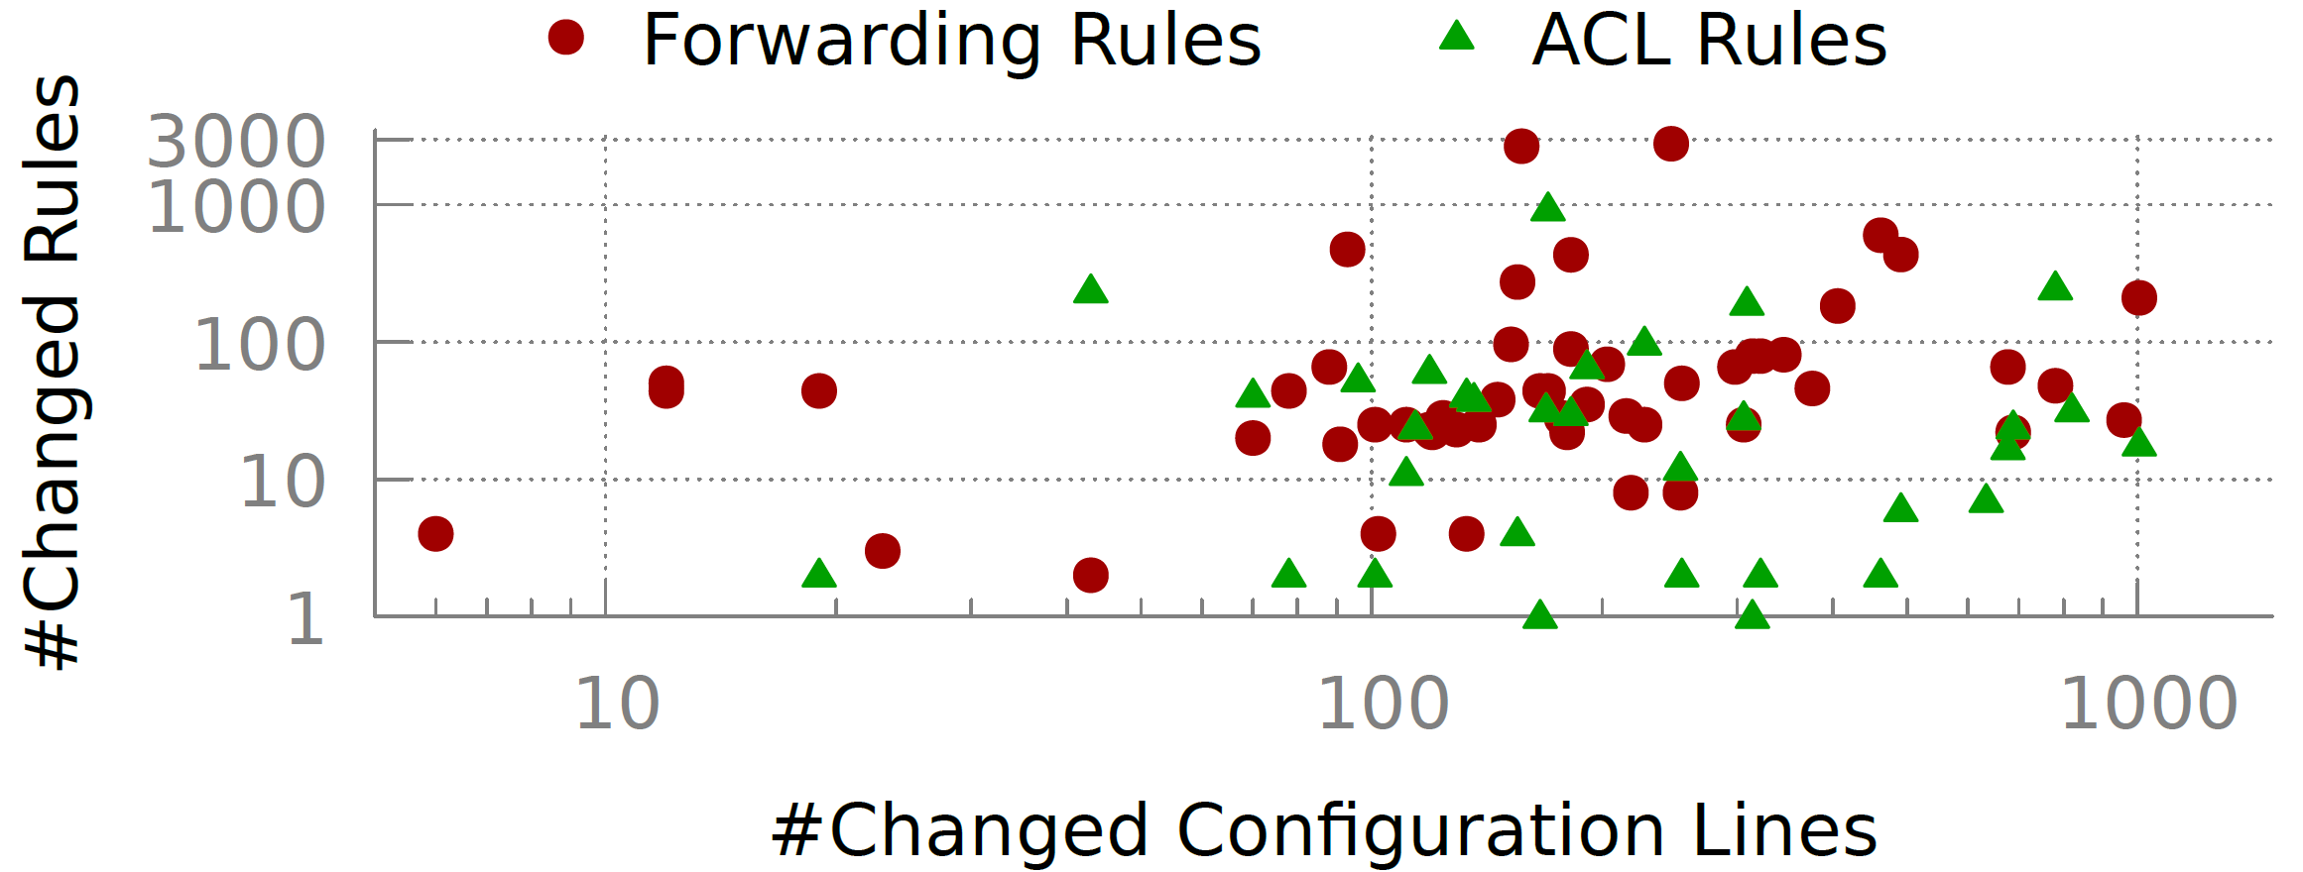
Limitation of “Snapshot" Verification #1
Input: a single snapshot instead of differences between snapshots
Observation: network changes are often small
  Example: a campus network with 28 routers and 50 links, running OSPF. On average, the network has 75K total lines of configuration, which generate 25K total forwarding rules.
228 lines of configuration (0.3%) are changed, causing 146 forwarding rules (0.6%) and 34 ACL rules (0.9%) to change, on average.

Slide 7
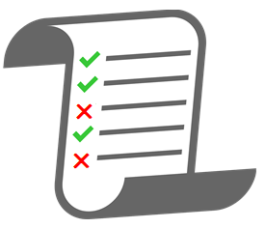
Limitation of “Snapshot" Verification #1
snapshot (t)
network model (t)
properties (t)
snapshot (t’)
network model (t’)
properties (t’)
Analyzing both snapshots (which differ only slightly) from scratch is wasteful

Slide 8
Limitation of “Snapshot" Verification #2
Input: difficult to determine which properties may be affected by a change and hence need to be checked
Specifying what to verify is as difficult as verification itself
  The network has run for several years by several generations of operating teams, accumulating a lot of homegrown configuration changes.
  Sometime operators may not dare to delete some configuration snippets, let alone knowing what the global intent is.

Slide 9
Limitation of “Snapshot" Verification #2
Workaround #1: narrow down properties with Config2Spec ^{[NSDI’20]}
  The set of inferred properties is still quite large: over 3k specifications for a national research and education network with 10 routers
  What if the configurations have errors?
Workaround #2: check all possible properties is wasteful
  Large space of all properties: O(1000*1000) reachability properties for a network with 1000 end points
  Only a small subset of properties are affected by a change

Slide 10
Differential Network Analysis (DNA)
A new control plane verification paradigm where “difference” instead of “snapshot” becomes the first-class citizens

Slide 11
DNA vs Traditional Network Verifiers
Traditional Network Verifiers
  Input: a snapshot of configurations, external routes, link/router state
  Output: operator-specified properties

Slide 12
DNA vs Traditional Network Verifiers
Differential Network Analysis (DNA)
  Input: differences of configurations, external routes, link/router state
  Output: differences of forwarding properties
intended
unintended

Slide 13
Achieving DNA
Use general-purpose
tools
Use domain-specific
algorithms
Refer to our HotNets paper on details why we choose this type of verification
Minesweeper
Bagpipe
Hoyan
ARC
Tiramisu
ERA
Analysis
Batfish (original)
Plankton
Batfish (current)
ShapeShifter
FastPlane
C-BGP
Simulation

Slide 14
Simulation-Based Verification
simulation-based verifier

Slide 15
Simulation-Based Verification
Control Plane
Properties
Stage 1:
Control Plane Simulation
Stage 2:
Data Plane Modeling
Stage 3:
Property Checking
FIBs
Model

Slide 16
DNA
Control Plane
Differences
Property
Differences
Stage 1:
Differential Control Plane Simulation
Stage 2:
Differential Data Plane Modeling
Stage 3:
Differential Property Checking
∆FIBs
∆Model

Slide 17
Walkthrough Example

Slide 18
Step 1: Differential Control Plane Simulation
Leveraging differential dataflow for automatic differential computation

Slide 19
Step 1: Differential Control Plane Simulation
Leveraging differential Datalog for better extensibility

Slide 20
Step 1: Differential Control Plane Simulation

Slide 21
Step 2: Differential Data Plane Modeling
Data Plane Model
(before change)
Data Plane Model
(after change)

Slide 22
Step 3: Differential Property Checking
Traversing the old forwarding graph
Data Plane Model
(after change)
Traversing the new forwarding graph
The difference of properties:

Slide 23
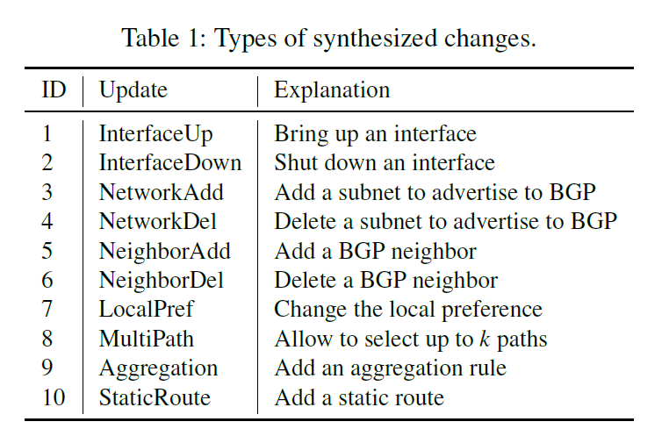
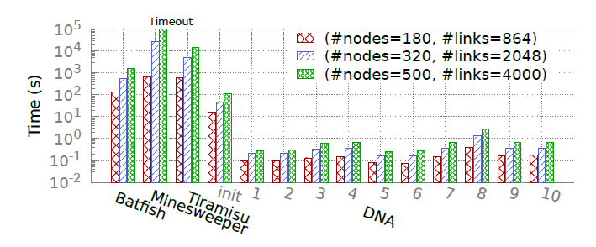
Experiment Results
Topology: fat tree with different number of nodes
Changes: 10 synthesized changes

Slide 24
Conclusion
INCV is important
  Network config. changes are frequent, risky, and often small
INCV is feasible
  RealConfig: incremental DP verification + incremental DP generation
INCV is beneficial
  RealConfig speeds-up the verification of change by up to 92×

Slide 25
Backup

