Slide 1
FinVault AI
On-Device Financial Intelligence. Private by Design.
Air-Gapped
Gemma 4 Powered
Zero Cloud
Confidential | April 2026

Slide 2
The Challenge: Financial Data at Risk
78% of financial firms cite data privacy as their #1 concern with AI adoption
Cloud-based AI tools require sending sensitive accounting data to third-party servers
Regulatory compliance (SOX, GDPR, CCPA) restricts data transfer to external APIs
Manual report generation takes 4–8 hours per analyst per week
Invoice processing backlogs average 12 days in mid-market firms
No existing solution combines AI intelligence WITH complete data isolation
The gap: No AI tool delivers intelligence + total data isolation for finance teams.
2

Slide 3
FinVault AI: Intelligence Without Compromise
📊
💬
📄
Report Generator
Data Query
Document OCR
AI-powered financial reports from your data. Executive summaries, expense breakdowns, trend analysis — generated in seconds, not hours.
Ask questions in plain English. Get precise answers with calculations. No SQL required. Your AI financial analyst, always available.
Scan invoices, work-orders, receipts. Tesseract extracts text, AI parses structured fields. Digitize your paper trail instantly.
100% Local | Zero Cloud | Air-Gapped Compatible
3

Slide 4
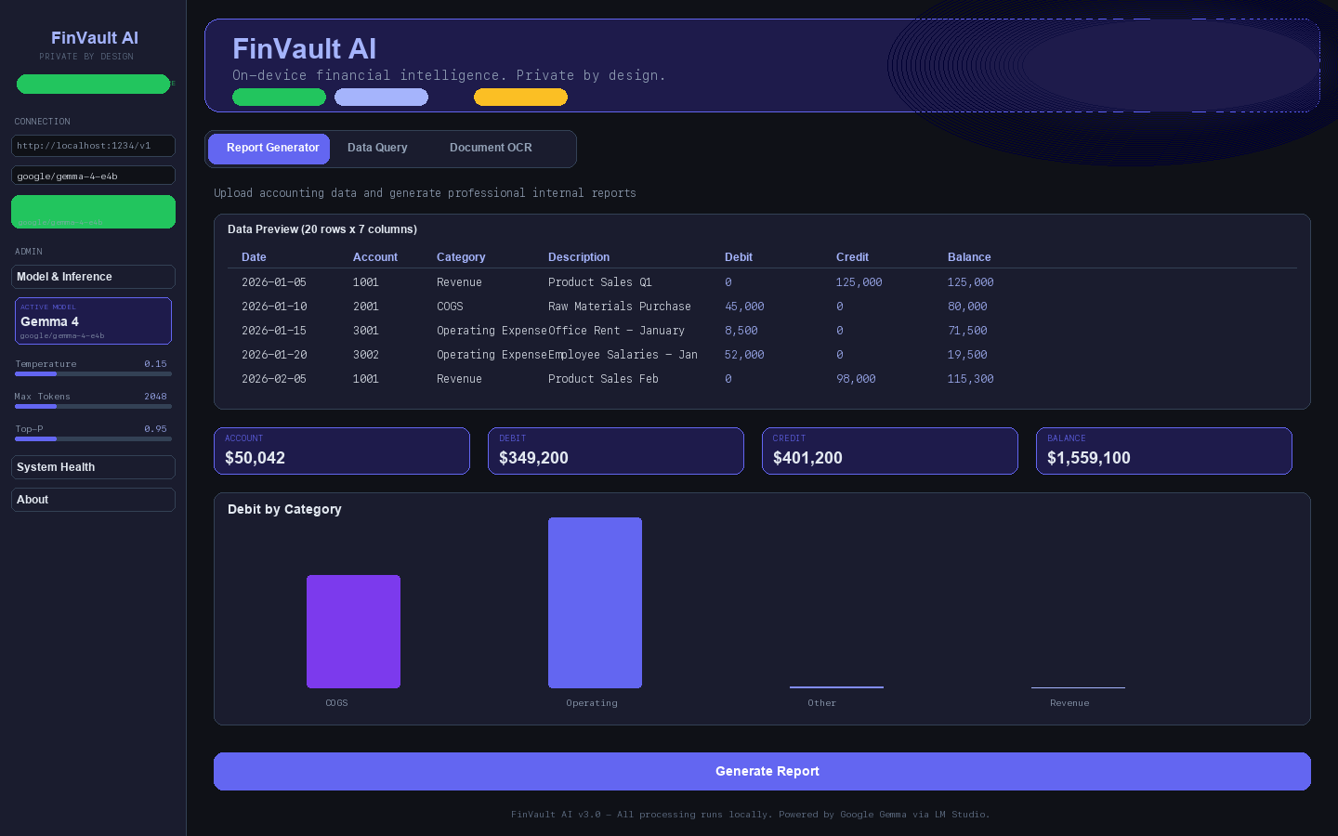
Intelligent Report Generation
Upload CSV/Excel accounting data
7 report types including Executive Summary, Expense Breakdown
Interactive charts and real-time metrics
Download reports for internal distribution
4

Slide 5
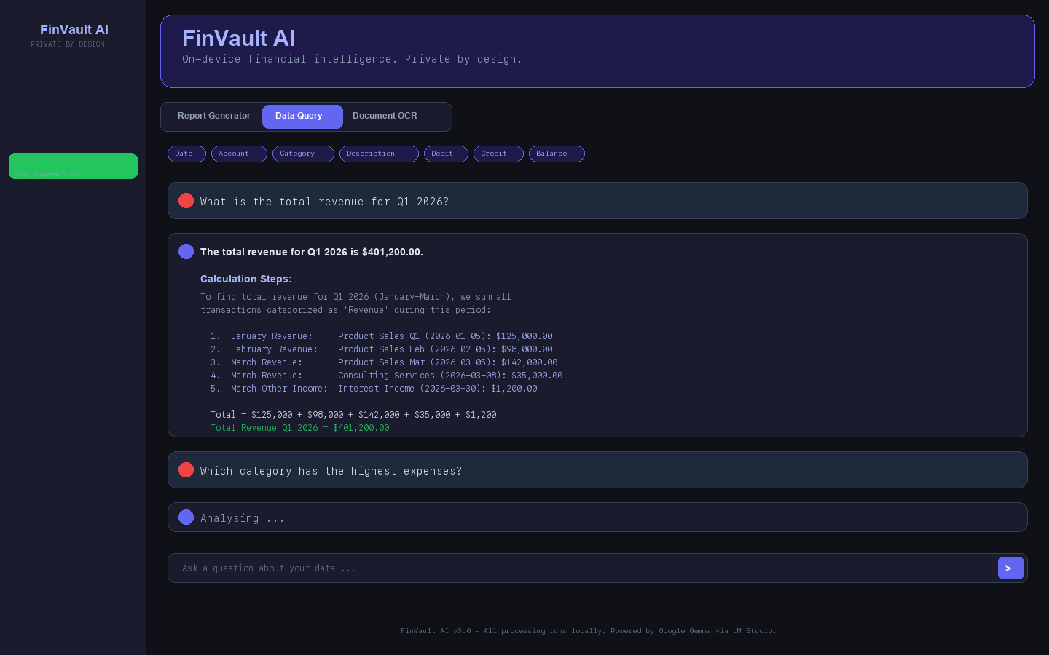
Natural Language Financial Analysis
Chat-style interface for intuitive interaction
Step-by-step calculations with source data references
Maintains conversation context for follow-up questions
Example: "What is Q1 revenue?" yields $401,200 with full breakdown
5

Slide 6
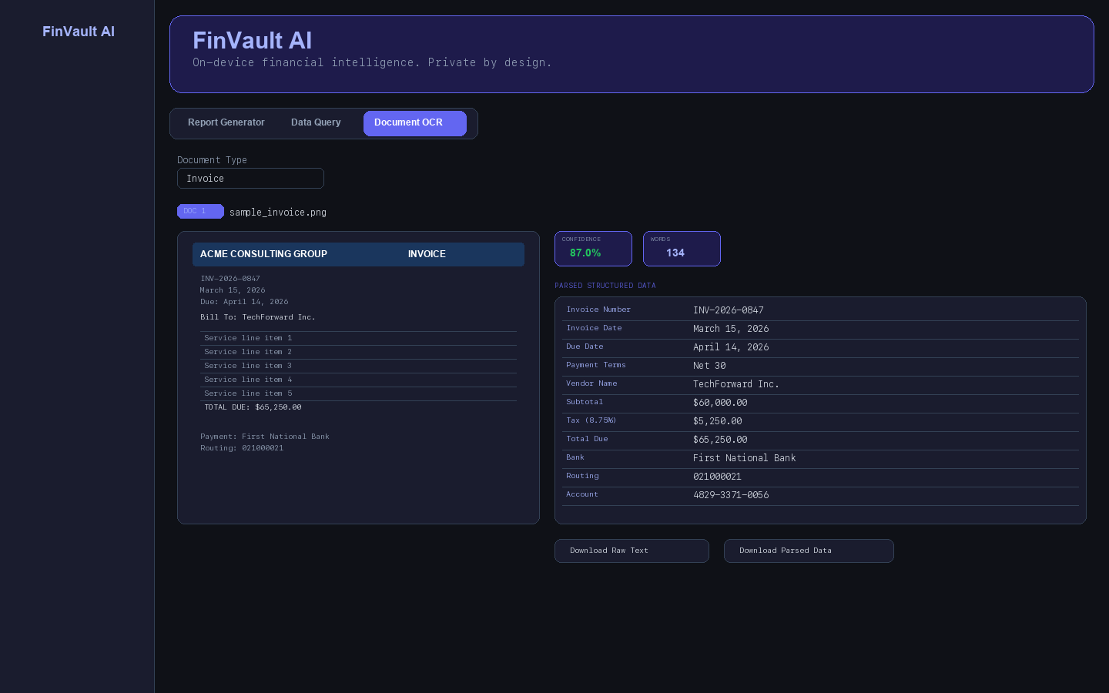
Automated Document Processing
Tesseract OCR extracts text at 87%+ confidence
AI parses structured fields: invoice number, amounts, line items
Supports invoices, work orders, receipts, purchase orders
Export raw text or parsed data
6

Slide 7
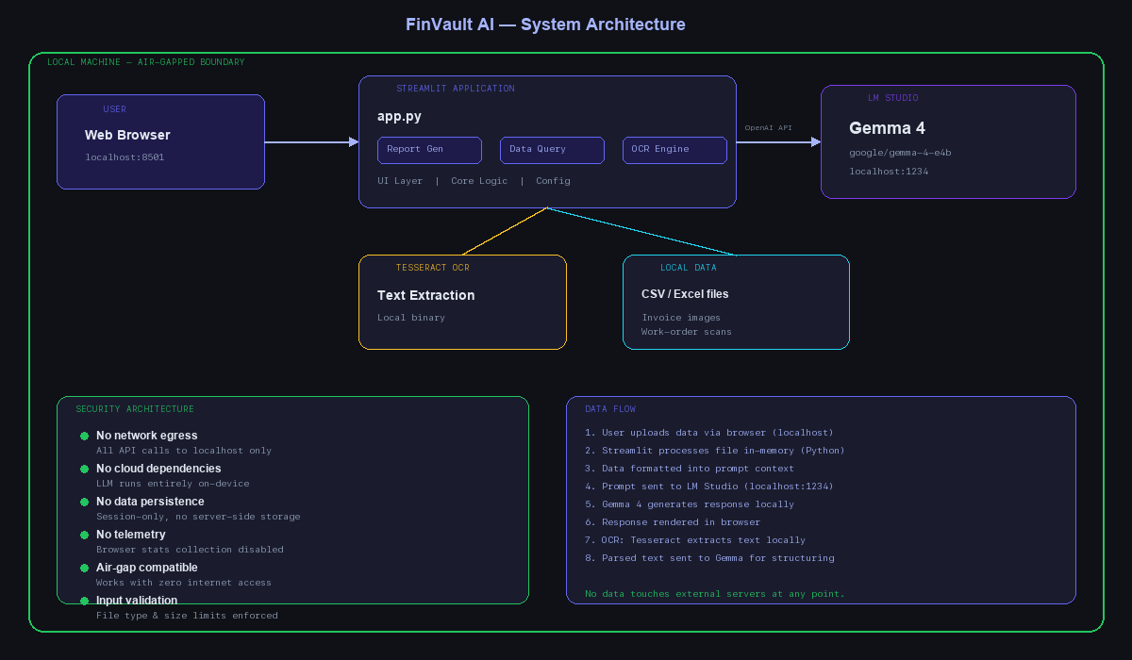
Secure Architecture: Nothing Leaves Your Machine
Google Gemma 4 runs locally via LM Studio
All API calls to localhost only
No internet connection required
Data exists only in browser session memory
7

Slide 8
Measurable Impact
85%
100%
12d → 2h
faster
private
turnaround
Report generation time vs. manual
Zero data leaves your network
Invoice processing turnaround
$0
SOX/GDPR
Air-gap
cloud cost
ready
compatible
No API fees, no subscriptions
Full regulatory compliance by design
Works in secure environments
8

Slide 9
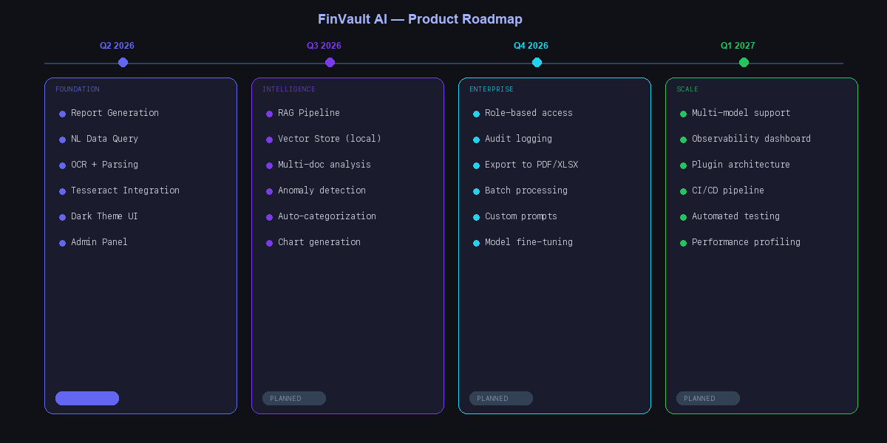
Product Roadmap
Q2 2026
Q3 2026
Q4 2026
Q1 2027
Core platform — Reports, Query, OCR
RAG pipeline, anomaly detection
Enterprise features, multi-user
Observability, advanced agents
9

Slide 10
FinVault AI
Your data. Your AI. Your machine.
On-device financial intelligence. Private by design.
Next Steps
Schedule a live demo | hello@finvault.ai
10

