Slide 1

STOCK MARKET PREDICTION APP(SMP-20)
GROUP DETAILS
Siddharth Jena(1705851)
Aakash Das(1705841)
Meghna Verma (1705854)
S. Subhashree Priyadarsini(1705861)

Slide 2
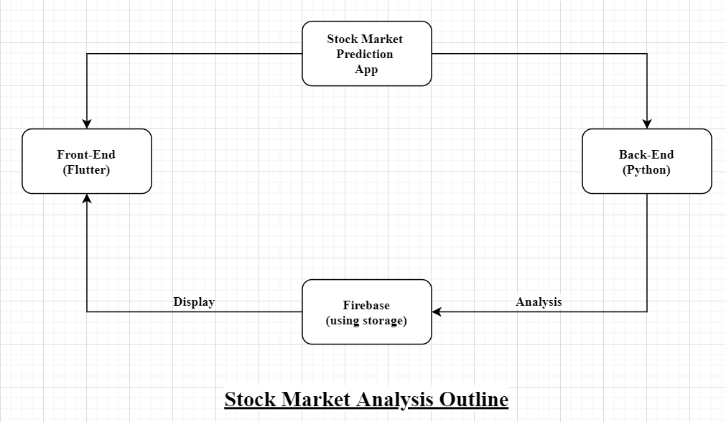
APP DESCRIPTION
The major components of this project’s architecture include-
Historical data analysis deep learning model
Sentimental analysis machine learning model
Firebase to store the output of the model
A computer server running the models periodically
User interface using flutter

Slide 3
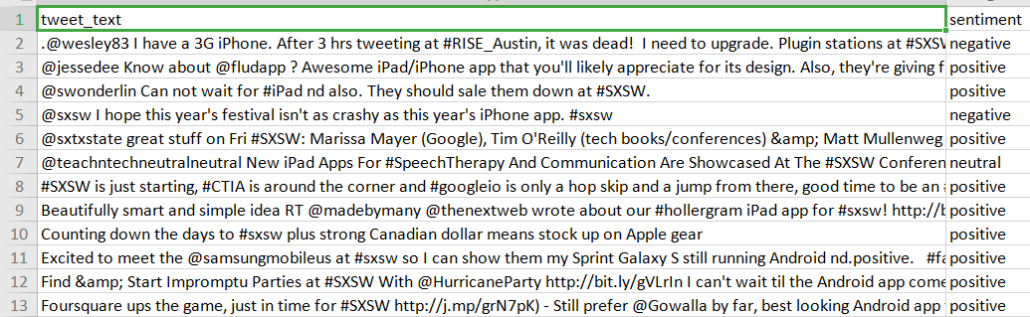
Resulting Dataset for sentimental analysis
DATA COLLECTION AND CLEANING
The data for Historical data analysis is collected through a python module named yfinance by Ran Aroussi. Stock data of the last 5 years is collected.
Future dates are automatically added to the dataset so that the model can predict the closing price for that date.
The dates were in string format that were converted to datetime format.
The data for sentimental analysis was collected from multiple sites from github.
The major challenge for the datasets of sentimental analysis was that there were too many complex emotions/ not enough neutral emotions/ not a proper balance of positive, negative and neutral emotions. Thus multiple datasets were joined and their labelling was changed accordingly so as to counter all the challenges.

Slide 4
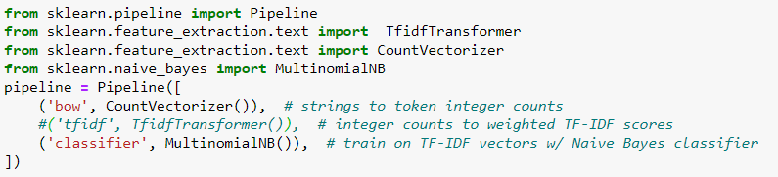
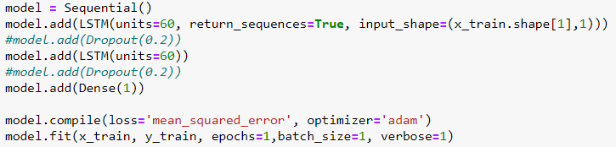
BACK-END: PYTHON(SMP-20)
This included creation of one model based on Long Short-Term memory Deep learning for historical data analysis and future price prediction and one model based on Multinomial Naive Bayes for Sentimental Analysis. Both the models were created on Jupyter notebook using Python 3.7
For Sentimental Analysis
For Historical Data Analysis
For automation, i.e. for periodical running of the python models so as to ensure an updated output is displayed everytime, the python scripts are made to run every 15 minutes everyday on a computer using task scheduler.

Slide 5
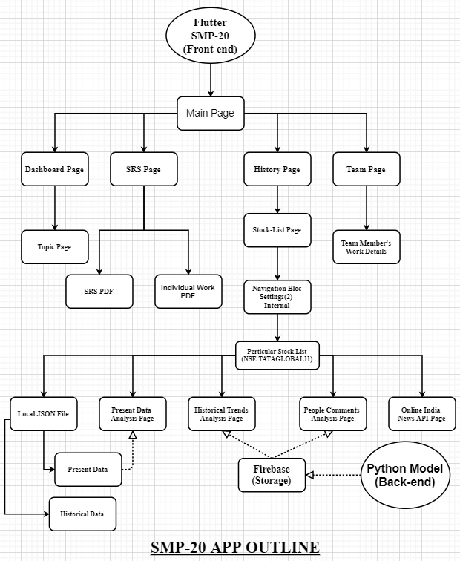
FRONT-END: FLUTTER(SMP-20)
Build a splash screen with app icon for android and iOS and change web icon also,this app fully run in android and iOS and web(partially due to lack of package).
Create a dahboard page with some swiped topic.
Back-end development between firebase and python connected with flutter.
Secondly created a database screen where we attached out Project Individual Report and SRS Document(Local asset as PDF Format)
Thirdly we design a particular stock list design which is also divided into 5 pages;
First one called JSON data where we attached present and historical JSON raw file according to positive, negative, and neutral statement analyzed by back-end.
Then, the next page is present data page where it analyzed locally by present JSON files.
Then the third and fourth page analyzed historical and people comments data from online by firebase-storage and back-end process.
And the last one page ; a online Indian news portal; which is updated by a outside API(collected from Internet randomly)
The 4th main page is the team page where the page display out team members picture and contribution in the project briefly.
The most important part of front end is 4 main part page was attached by curved bottom navigation and the stock list part was attached by navigation bloc.
The app-size also be minimized(i.e. 13.1 MB).

Slide 6
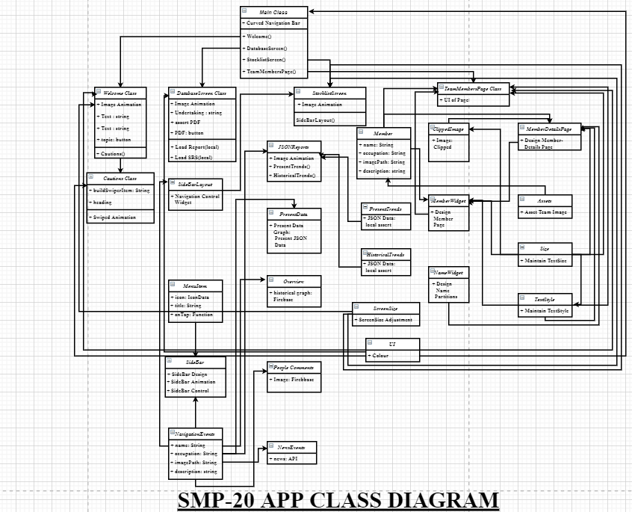
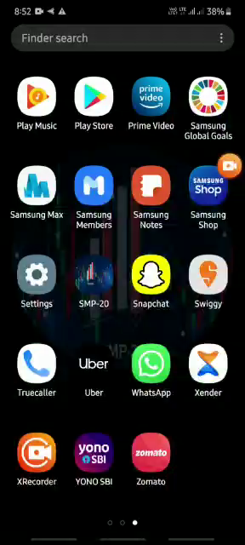
DIAGRAM & QUICK LOOK(SMP-20)

Slide 7
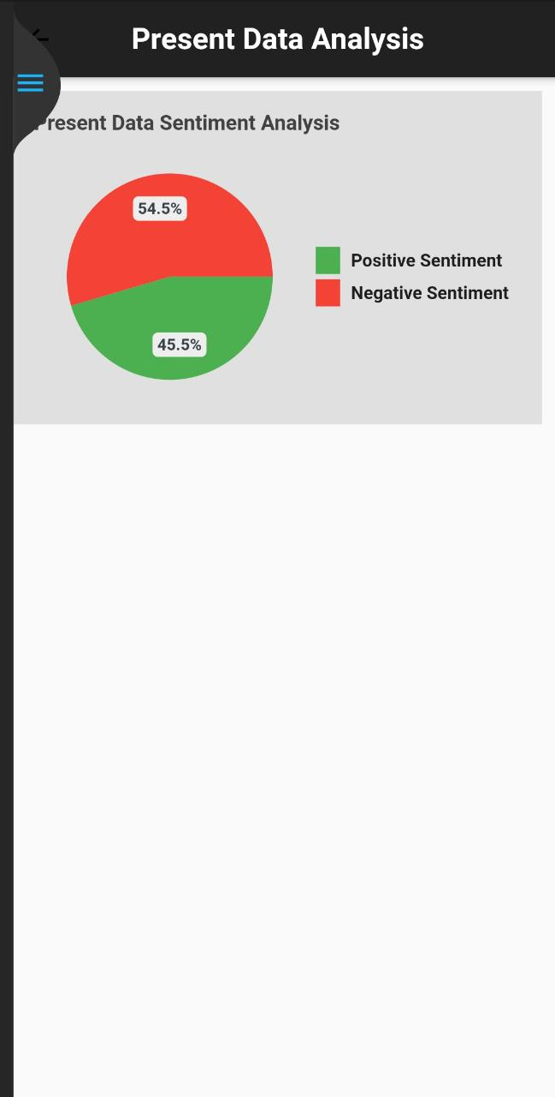
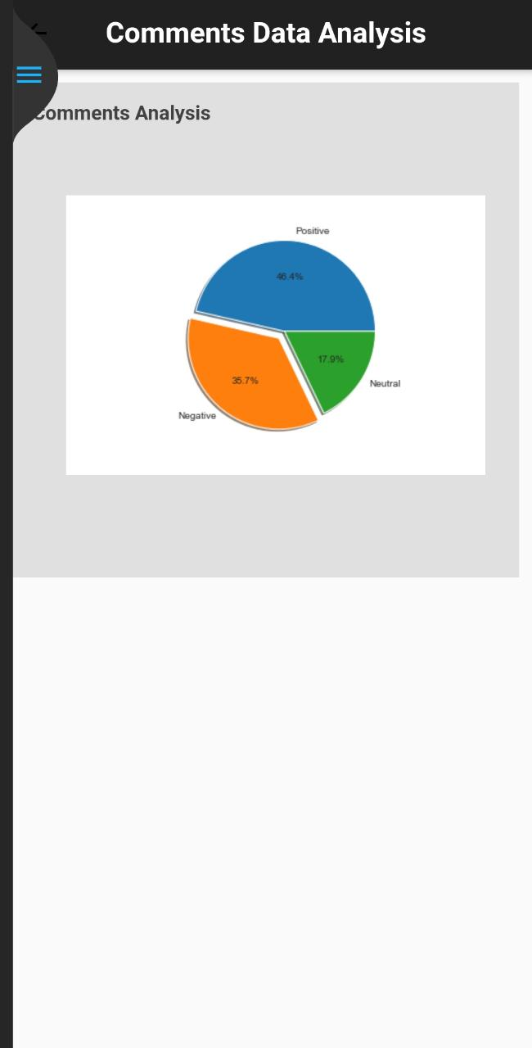
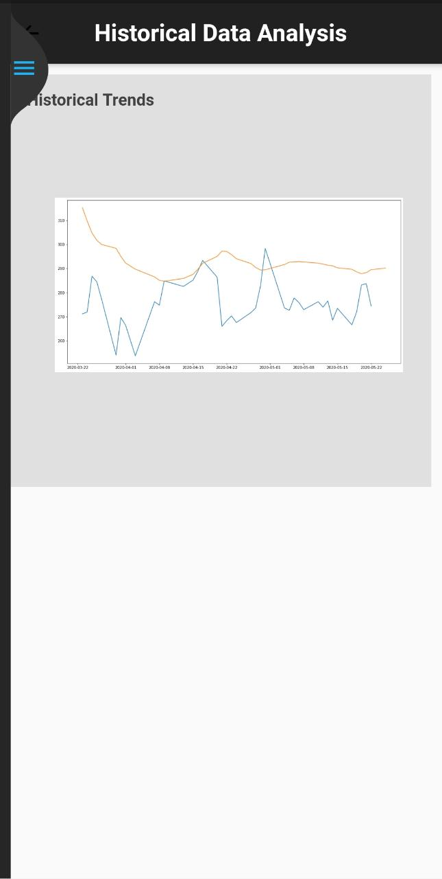
SENTIMENT ANALYIS IN ANDROID & iOS

Slide 8
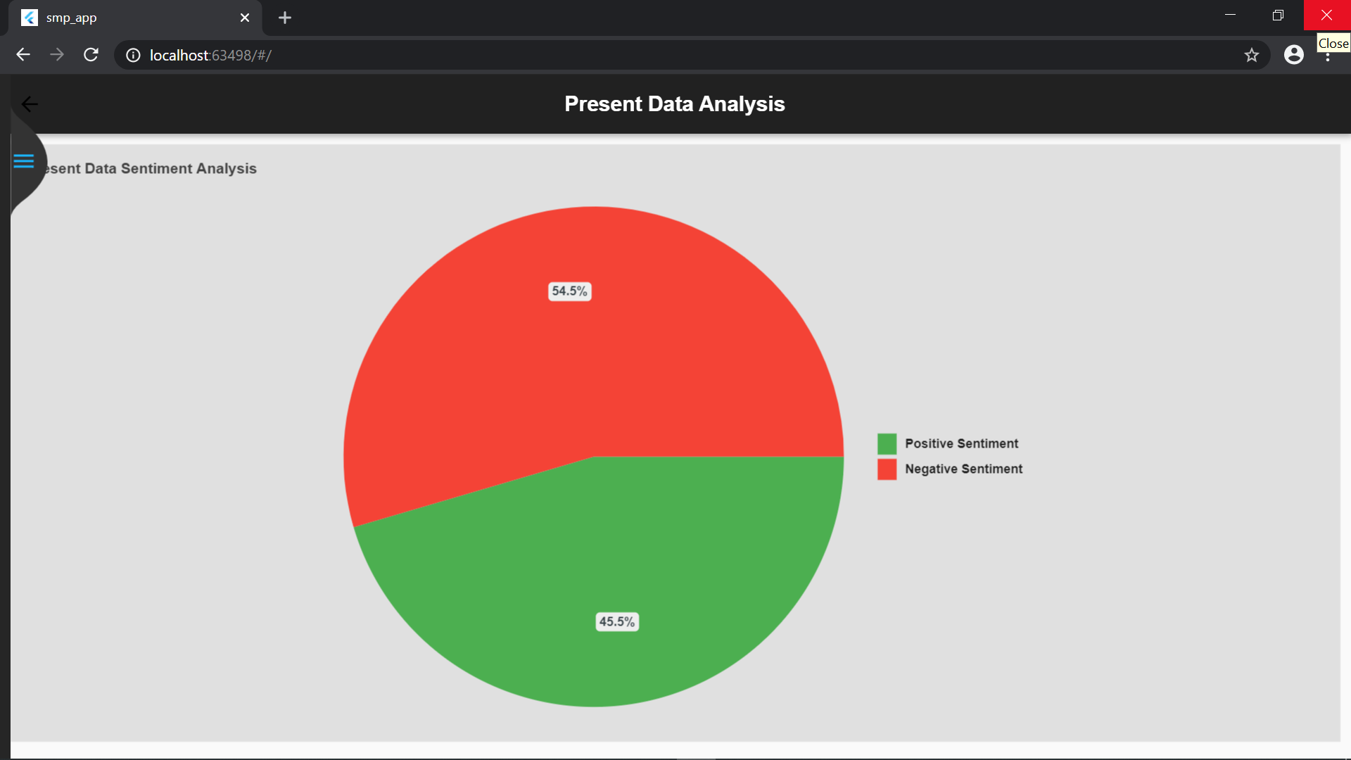
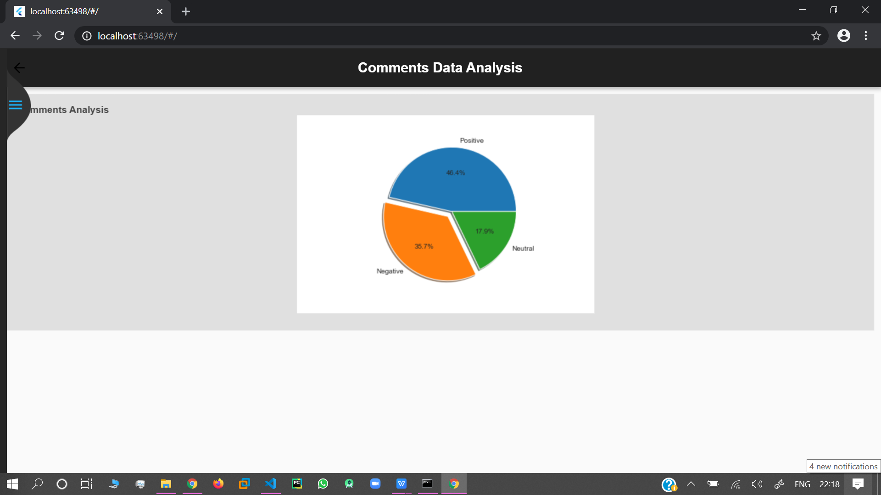
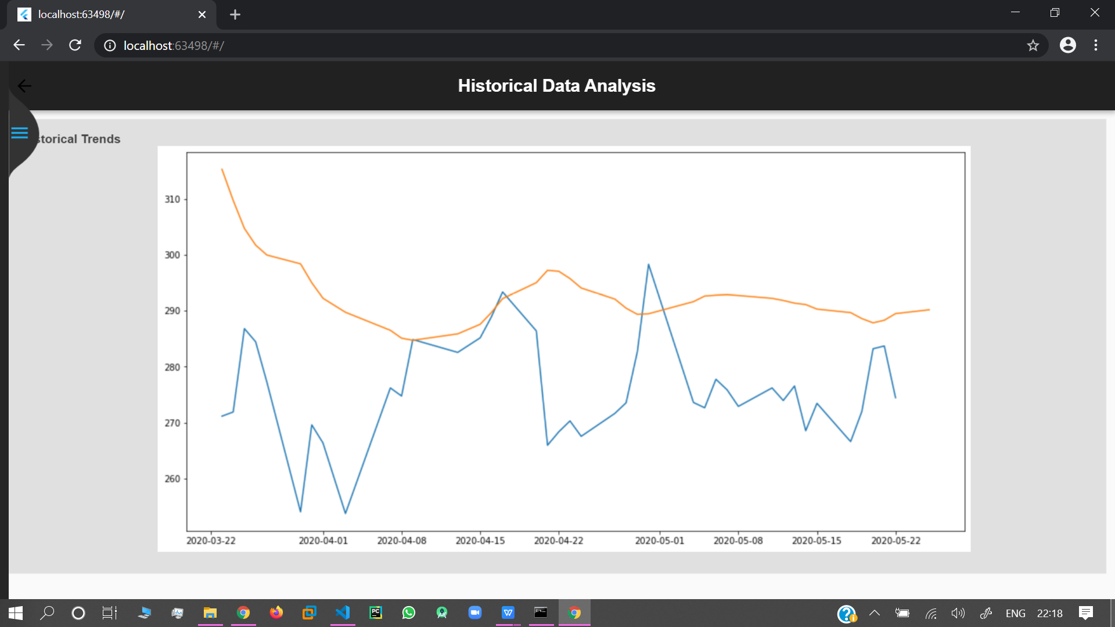
SENTIMENT ANALYIS IN WEB

Slide 9
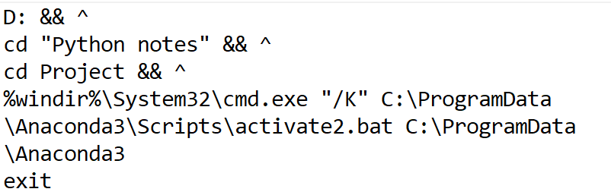
The batch file
AUTOMATION
The automation is done by making one computer as the server which runs the python script every 15 minutes everyday so as to keep the database updated.
It is done by making a batch file which executes both python scripts for historical data analysis and sentimental analysis and then scheduling the batch file for execution every 15 minutes using task scheduler
The scheduled task

Slide 10
FUTURE SCOPE & CONCLUSION
Improving the accuracy of the LSTM model so as to get much more accurate predictions which are being presently limited due to the low computational power.
Improving the sentimental analysis model by increasing the size of its dataset to make the analysis more accurate.
Add more stocks to the list of stocks to provide users with more choices.
CONCLUSION:
The major issue with this project is the randomness of the stock prices. Many of the applications using machine learning did not take this into account and depended on the model to give them accurate predictions. Instead we used sentimental analysis to understand the randomness of stock prices in terms of people’s sentiments towards the stock/company. Thus providing the historical analysis and sentimental analysis data to the user helped them to make a decision. The project does not give an absolute decision but instead leaves it up to the user to make the decision for himself/herself after showing them the stock’s relevant data.

