Slide 1
openFDA database
Are different adverse events reported in different countries?

Slide 2
Outline
Part 1: data analysis
Top ten reactions in five countries
Map showing for each country the rank of selected reactions
Country count for top five reactions
Part 2: machine learning
Question: if some country names are missing from the database, can we recover them using the list of reactions?
Part 3: improvements and bibliography
Improvements needed
Bibliography

Slide 3
Outline
Part 1: data analysis
Top ten reactions in five countries
Map showing for each country the rank of selected reactions
Country count for top five reactions
Part 2: machine learning
Question: if some country names are missing from the database, can we recover them using the list of reactions?
Part 3: improvements and bibliography
Improvements needed
Bibliography

Slide 4
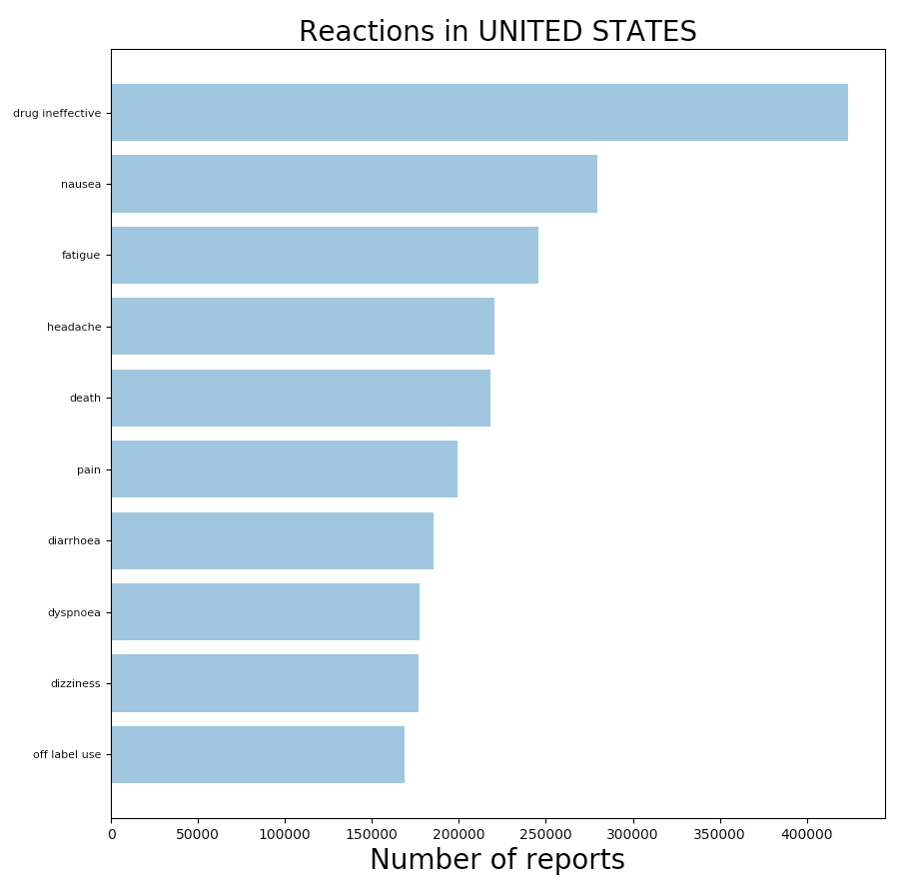
Top 10 reactions in 5 countries
Notes:
This figure displays the most freqent ten reactions (field reactionmeddrapt) for the United States. The total number of times a reactionmeddrapt field is found is displayed.
This figure is generated on line 168 of the code.

Slide 5
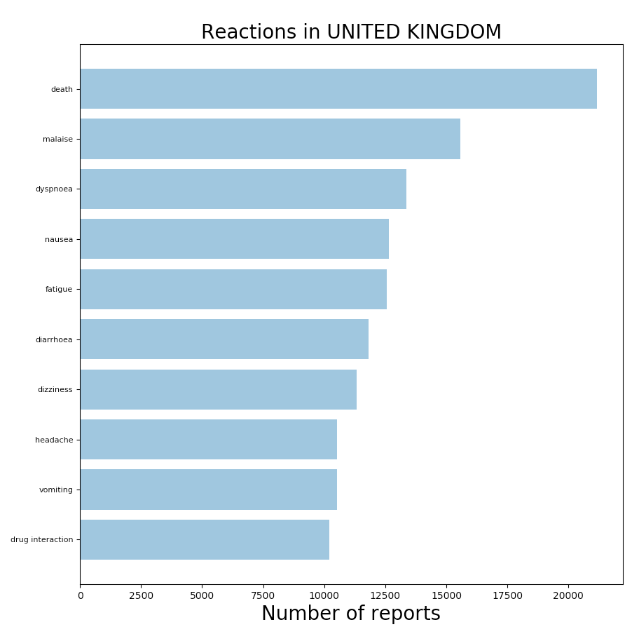
Top 10 reactions in 5 countries
Notes:
This figure displays the most freqent ten reactions (field reactionmeddrapt) for the United Kingdom. The total number of times a reactionmeddrapt field is found is displayed.
This figure is generated on line 169 of the code.

Slide 6
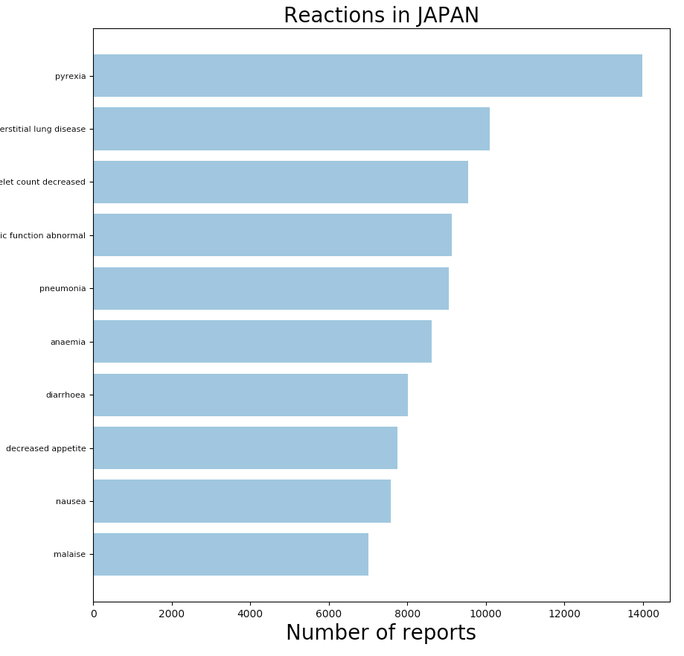
Top 10 reactions in 5 countries
Notes:
This figure displays the most freqent ten reactions (field reactionmeddrapt) for Japan. The total number of times a reactionmeddrapt field is found is displayed.
This figure is generated on line 170 of the code.

Slide 7
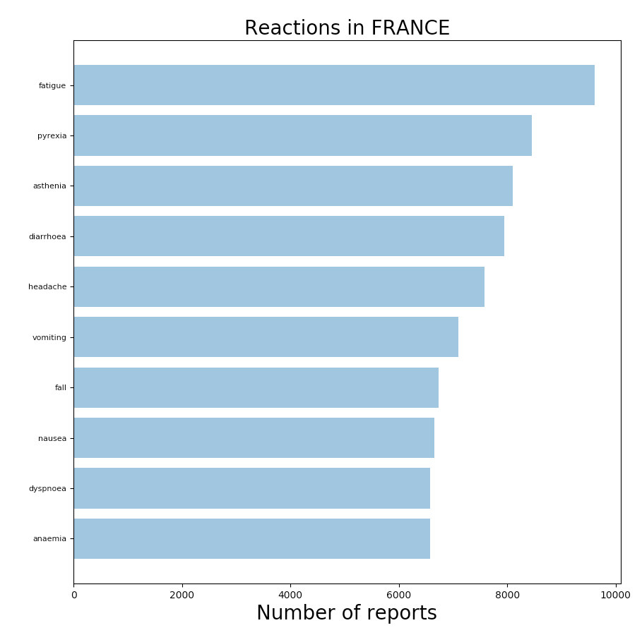
Top 10 reactions in 5 countries
Notes:
This figure displays the most freqent ten reactions (field reactionmeddrapt) for France. The total number of times a reactionmeddrapt field is found is displayed.
This figure is generated on line 171 of the code.

Slide 8
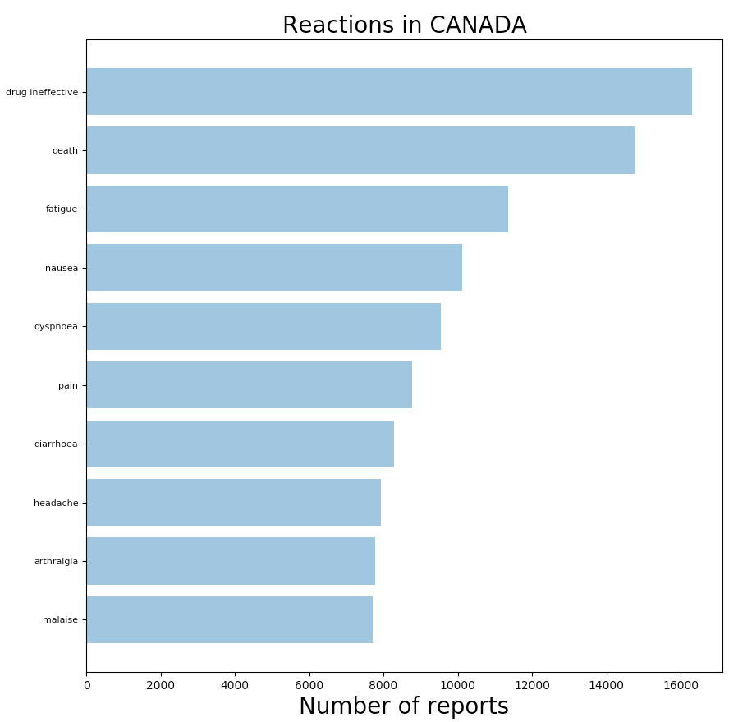
Top 10 reactions in 5 countries
Notes:
This figure displays the most freqent ten reactions (field reactionmeddrapt) for Canada. The total number of times a reactionmeddrapt field is found is displayed.
This figure is generated on line 172 of the code.

Slide 9
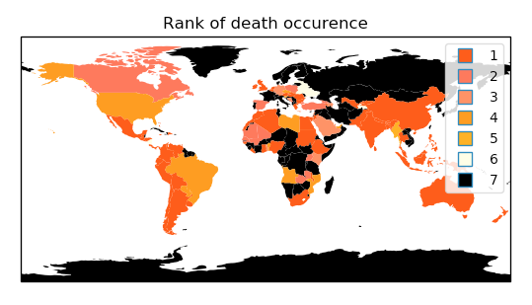
World map
or +
Notes:
This figure shows where death maps among the most frequent reactions for each country: from slide 2, we know that death is the fifth most frequent reaction for the United States, so the Unites States appear in light orange in this map. The UK appear in red on this map, because it comes first in slide 3. France appears in black, because ‘death’ is not even present in slide 5.
This figure is generated on line 216 of the code.

Slide 10
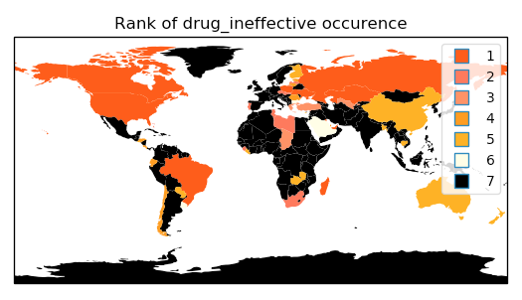
World map
or +
Notes:
Same as the previous slide, but the reaction that is looked at in this slide is ‘drug ineffective’ instead of ‘death’ in the previous slide.
This figure is generated on line 217 of the code.

Slide 11
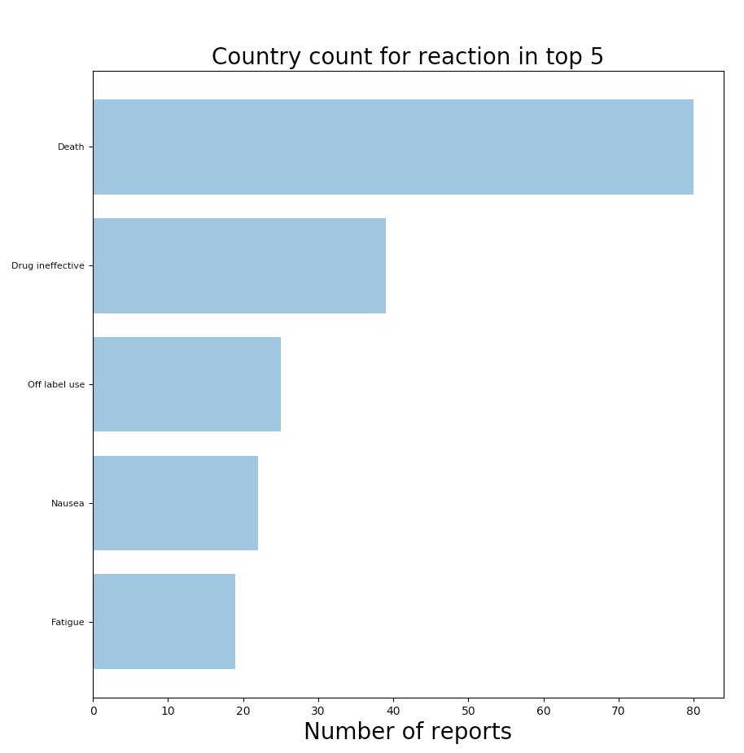
Country count for top five reactions
Number of countries
Notes:
In this slide, we display the number of countries for which a given reaction is among the top five reactions.
This figure is generated on line 242 of the code.

Slide 12
Outline
Part 1: data analysis
Top ten reactions in five countries
Map showing for each country the rank of selected reactions
Country count for top five reactions
Part 2: machine learning
Question: if some country names are missing from the database, can we recover them using the list of reactions?
Part 3: improvements and bibliography
Improvements needed
Bibliography

Slide 13
Machine Learning project
A quick bibliography reveals very few projects of machine learning on the openFDA database.
Question addressed: if we lose some country names can we recover them using the list of reactions? With which accuracy?
Because of computational power, we look at three countries only. It should be checked whether the approach can be generalised to more countries.

Slide 14
Workflow
We follow the steps of Emmanuel Ameisen, which can be found here: https://github.com/hundredblocks/concrete_NLP_tutorial/blob/master/NLP_notebook.ipynb
This workflow is close to the Natural Language Processing tutorial from scikit-learn. Besides, it includes a neural network section. Unfortunately, in our case, the neural network section is not applicable, because its goal is too far away from the goal of our project. We run the code anyway.
We try to replace the neural network section following Adrian Rosebrock’s post: how to get started with Keras?

Slide 15
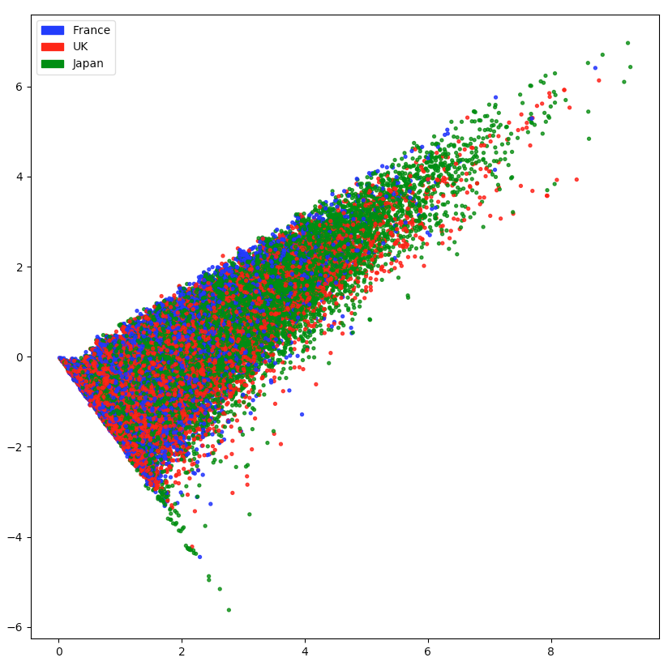
PCA component 2
PCA component 1
Notes:
The first two PCA components for each country are plotted one against the other, after embedding using CountVectorizer. Emmanuel Ameisen explains that these should appear separated if we want our data to allow a proper model calibration.
This figure is generated on line 394 of the code.

Slide 16
LogisticRegression
A logistic regression classifier is applied to our data after embedding (CountVectorizer), and the scores retrieved are as follows: accuracy = 0.821, precision = 0.821, recall = 0.821, f1 = 0.821
This is quite good, and shows that if we lose the country names, we can recover them pretty accurately.
According to the scikit learn tutorial for natural language processing, we should also test a Naïve Bayes model (multinomialNB), test several parameters with GridSearchCV. We have not done so at this stage.

Slide 17
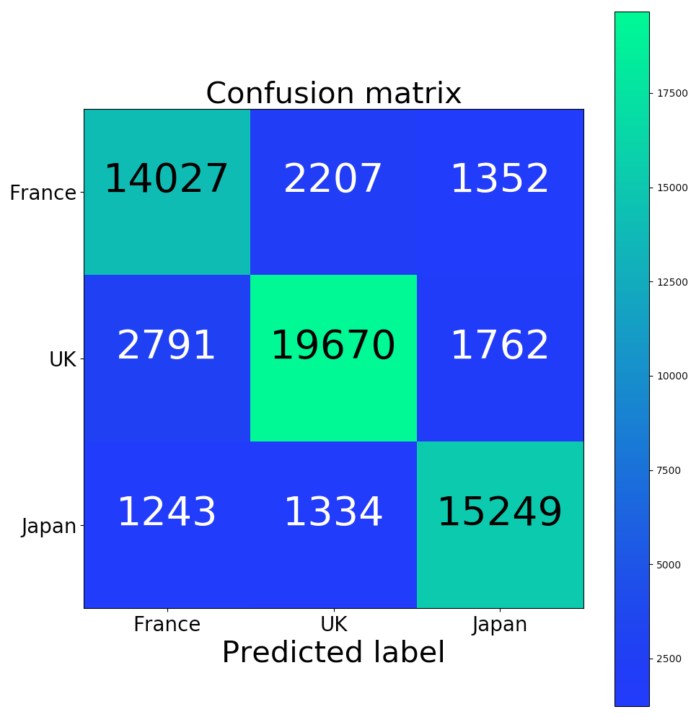
Notes:
This is a nice display of the confusion matrix.
This figure is generated on line 456 of the code.

Slide 18
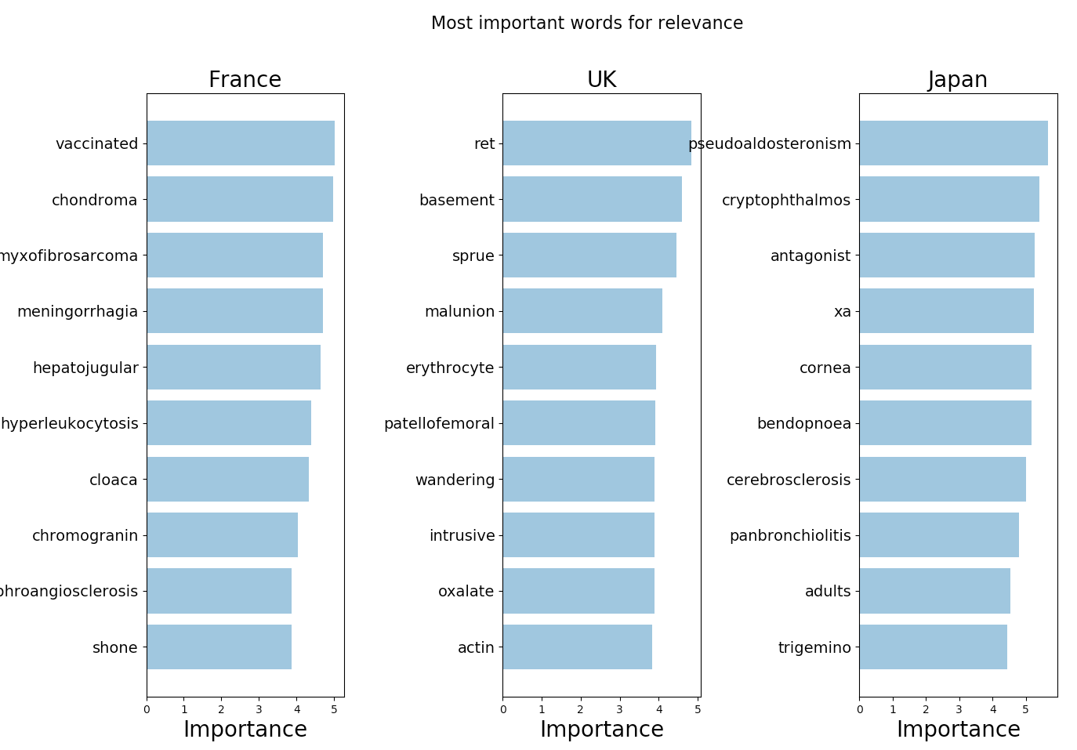
Notes:
These are the most important words for our model, which allow it to differentiate between our three countries of interest.
This figure is generated on line 526 of the code.

Slide 19
Improved embedding
In the next four slides, an improvement is brought to the workflow, and TfidfVectorizer is used instead of Vectorizer for word embedding

Slide 20
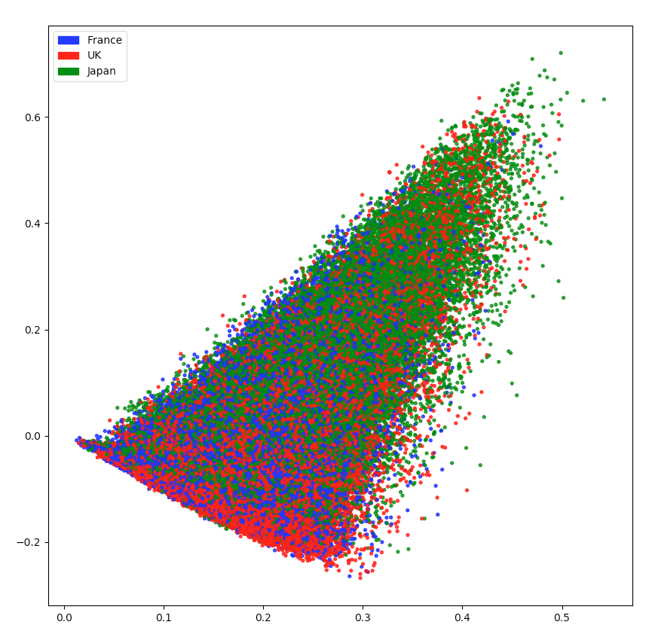
PCA component 2
PCA component 1
Notes:
Same as slide 13, the embedding is now performed using Tfidf.
This figure is generated on line 542 of the code.

Slide 21
Scores after LogisticRegression
The new scores after embedding with Tfidf slightly increase with respect to the previous one. The improvement is comparable to what Emmanuel Ameisen has posted: accuracy = 0.822, precision = 0.822, recall = 0.822, f1 = 0.822

Slide 22

Notes:
Same as slide 15, but TfidfVectorizer is now used for embedding
This figure is generated on line 559 of the code.

Slide 23
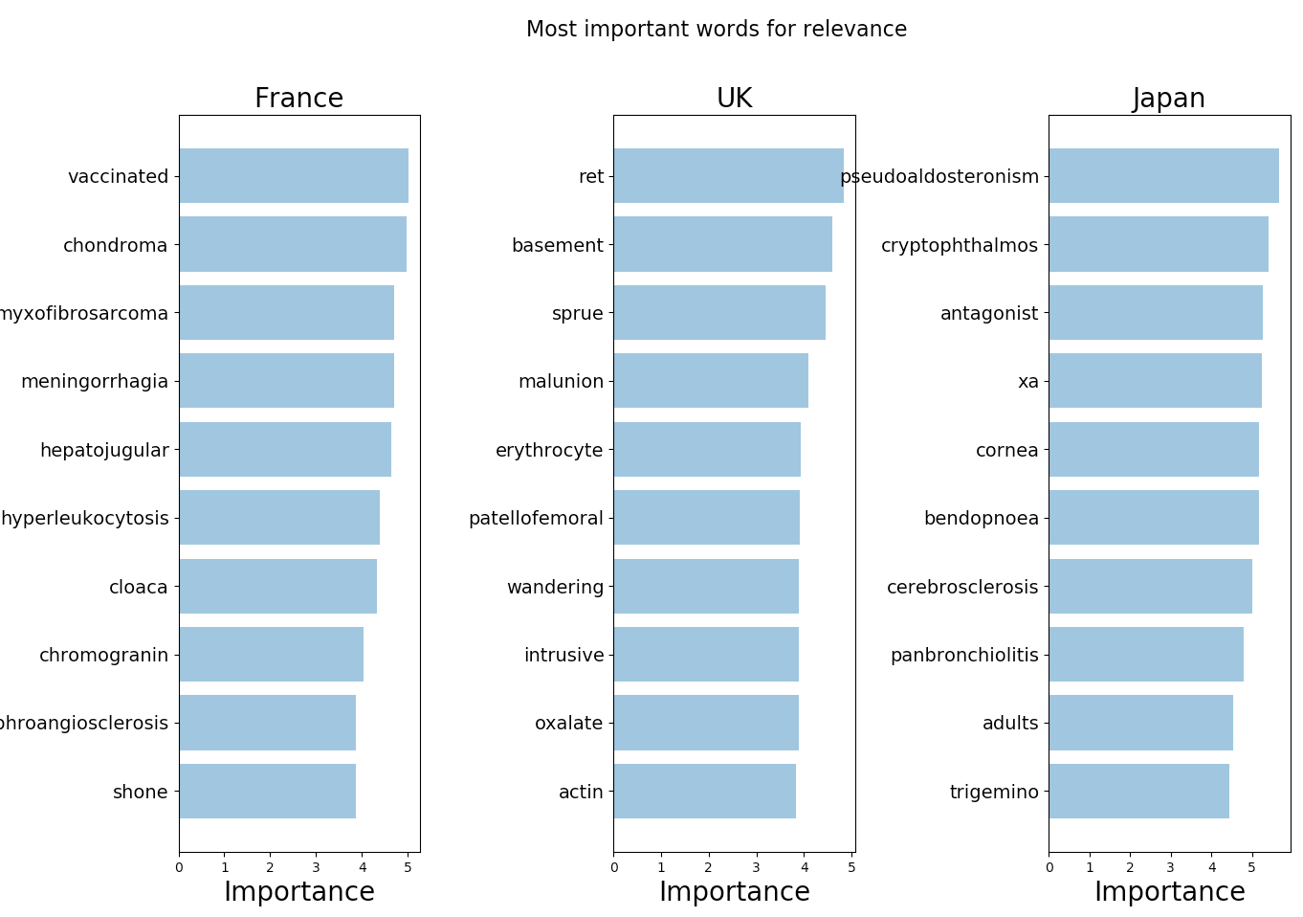
Notes:
Same as slide 16, but TfidfVectorizer is now used for embedding
This figure is generated on line 574 of the code.

Slide 24
Word2Vec for embedding
Emmanuel Ameisen uses word2Vec in his workflow, which makes sense, because he is analysing real sentences. With this neural network; he gets a small improvement.
In our case, we are analysing concatenated sequences of reactions, which do not look like real sentences at all. So the Word2vec model as such is not appropriate.
It could make sense to recalibrate the word2vec model on our dataset. However, the Mikolov et al., 2013 paper shows that computational times are out of reach for my computer (2 days for 140 CPU).

Slide 25
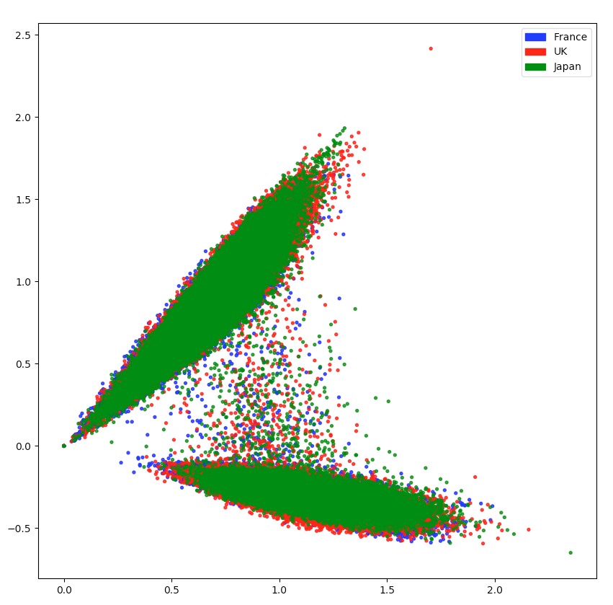
PCA component 2
PCA component 1
Notes:
Same as slide 13, the embedding is now performed using Word2vec.
I do not understand why we see two distinct clusters of point. It would be interesting to investigate this observation more in depth.
This figure is generated on line 617 of the code.

Slide 26
Scores after LogisticRegression
Since the model is inappropriate for our case study, we get results much worse than before, which was expected: accuracy = 0.644, precision = 0.652, recall = 0.644, f1 = 0.645

Slide 27
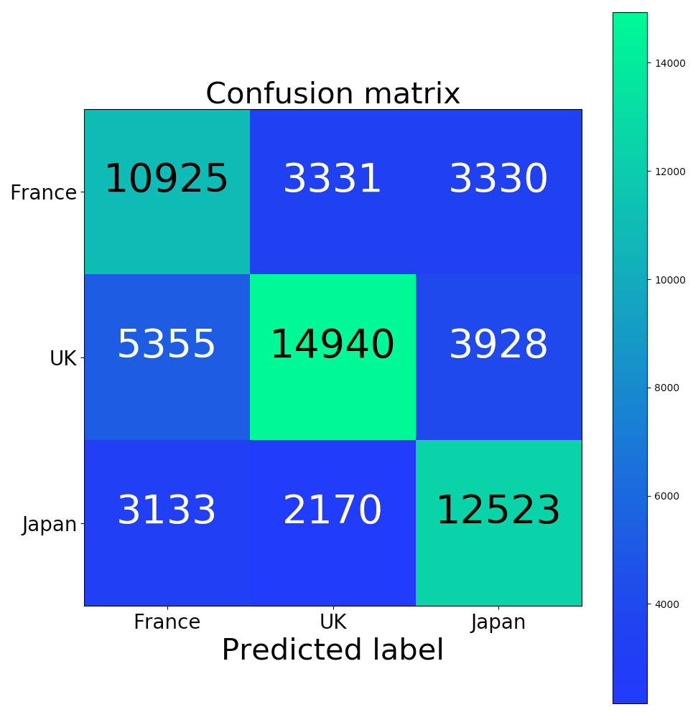
Notes:
Same as slide 20, but the embedding is retrieved using Word2vec
This figure is generated on line 636 of the code.

Slide 28
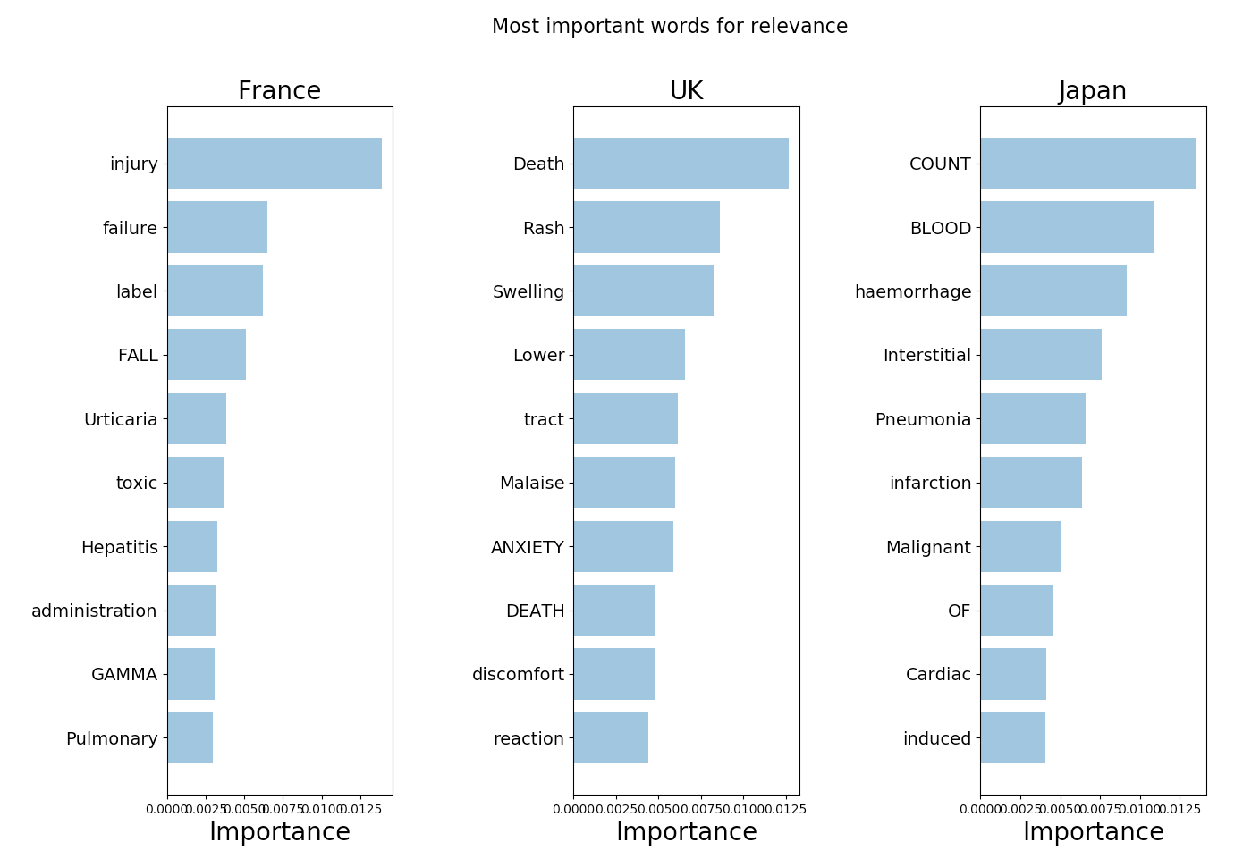
Notes:
Same as slide 21, but the embedding is retrieved with Word2vec
This figure is generated on line 742 of the code.

Slide 29
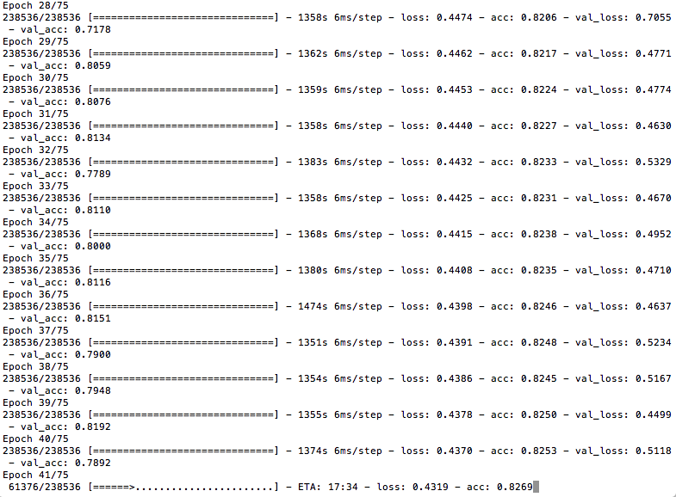
Adrian Rosebrock’s post about Keras
Neural network:
model = Sequential()
model.add(Dense(1024, input_shape=(3072,), activation="sigmoid"))
model.add(Dense(512, activation="sigmoid"))
model.add(Dense(len(lb.classes_), activation="softmax"))

Slide 30
Outline
Part 1: data analysis
Top ten reactions in five countries
Map showing for each country the rank of selected reactions
Country count for top five reactions
Part 2: machine learning
Question: if some country names are missing from the database, can we recover them using the list of reactions?
Part 3: improvements and bibliography
Improvements needed
Bibliography

Slide 31
Improvements are needed
There are several version of each report. In the earlier files, the file number comprises 7 digits, a dash, and the version number. In the later reports, the file number comprises 8 digits, and the version number is in a separate field. We should make sure that we keep the latest version of the file. This effort has not been done at this stage.
We could decide not to trust sources which are consumers or non-health professional, as well as lawyers (see slide 31)
Duplicates are not removed from the table. The openFDA documentation explains that reports sent to a company are requested to be submitted by law to the database, but can independently be submitted again by the person who has sent the report to the company. To avoid all possible duplicates, we could remove from our analyses records without a companynumb field. In practice, as illustrated by screen captures of the openFDA graphical interface, the number of these records is small (4000 compared 80000 in 2015, see slides 32 and 33)
The country names used to generate our maps do not all match with the country names in the openFDA files, which do not all match with the country names in the country codes table. This should be fixed.

Slide 32
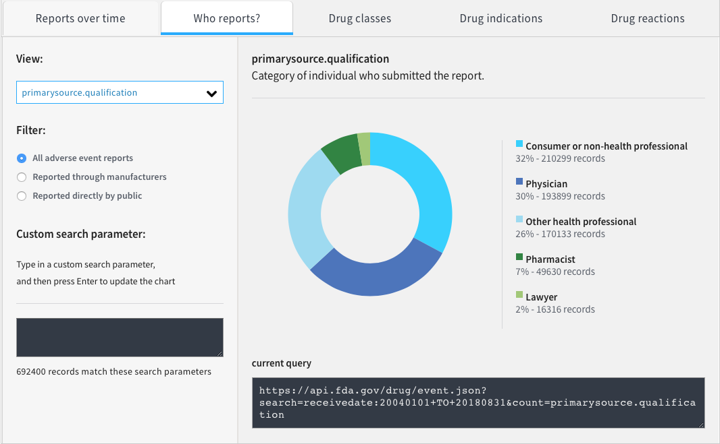
Duplicates: interactive chart

Slide 33
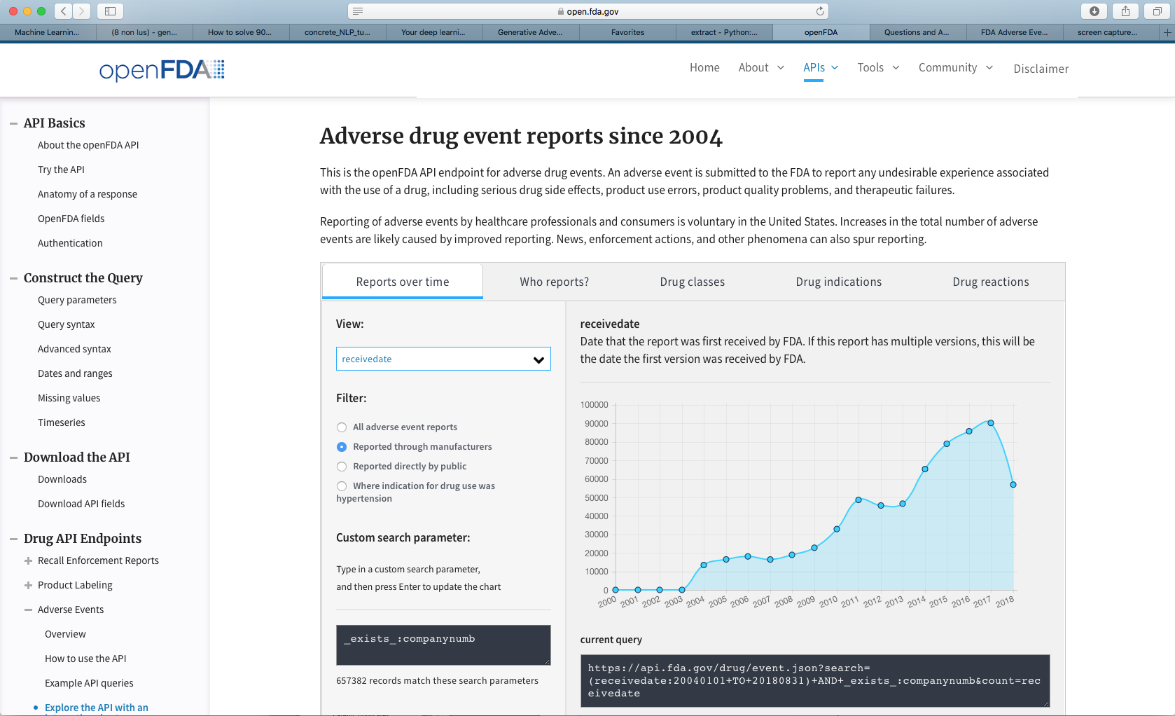
Duplicates: interactive chart

Slide 34
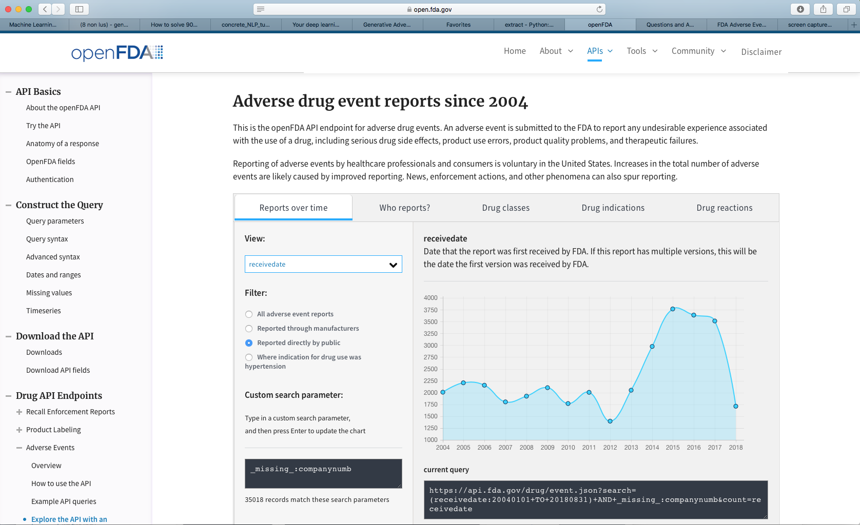
Duplicates: interactive chart

Slide 35
Bibliography (1)
What do people do with openFDA?
A lot of database analysis, little machine learning.
Google scholar:
https://academic.oup.com/jamia/article/23/3/596/2908999
Papers quoting the above, most importantly: https://dx.doi.org/10.18632%2Foncotarget.12813, https://doi.org/10.1080/10641963.2016.1254224, https://doi.org/10.1089/adt.2016.742, https://dx.doi.org/10.18632%2Foncotarget.18504, https://dx.doi.org/10.18632%2Foncotarget.12951, https://dx.doi.org/10.1016%2Fj.ijrobp.2017.02.006,
Google:
https://semanticommunity.info/Data_Science/Data_Science_for_OpenFDA

Slide 36
Bibliography (2)
What do people do with openFDA?
I like:
Paper from the Nature group using machine learning: https://www.ncbi.nlm.nih.gov/pmc/articles/PMC5703951/
https://fda.fa17.rcdilorenzo.io/
I have not looked at:
https://github.com/akamlani/openfda
https://github.com/FDA/openfda
https://github.com/FDA/open.fda.gov
https://github.com/STSILABS/open-fda

Slide 37
Bibliography (3)
According to Sebastian Wurst (medium, Hype and Reality of Artificial Intelligence in Healthcare), machine learning has sucessfully led to:
Medical diagnosis: 17% better than nurses, 14% better than GP
Diagnose autism for baby from brain scan with 81% accuracy
Skin cancer detection with 91% accuracy
Suicidal person with 93% accuracy
Breast cancer with 99% acuracy
Use EHR data to predict future diseases wth 93% accuracy
Can save 45% of doc time for GP

Slide 38
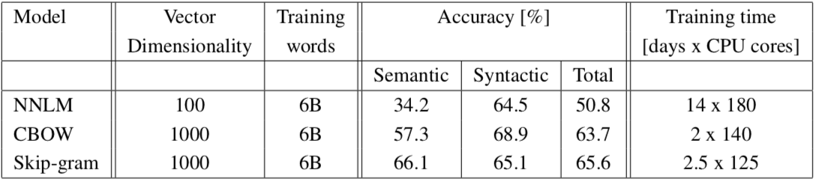
Further ideas of improvement (1)
Recalibrate word2vec for our specific purpose? Mikolov et al., 2013 show that computational times are out of reach for my computer.
Use keras tutorial from Adrian Rosebrock to build our neural network (pyimageserach)

Slide 39
Further ideas of improvement (2)
Scikit-learn ‘working with text data’:
Use multinomialNB instead of LogisticRegression
Play with parameters using GridSearchCV
Follow ‘where to from there’ recommendations
Other potentially interesting tools for NLP:
spacy (NLP is fun, Adam Geitgey)
Use several of SVM, Decision trees, random forest, Gradient boosted trees (Vik Paruchuri, Medium)
Others in Robbie Allen, Medium, 200 of the Best Machine Learning NLP

Slide 40
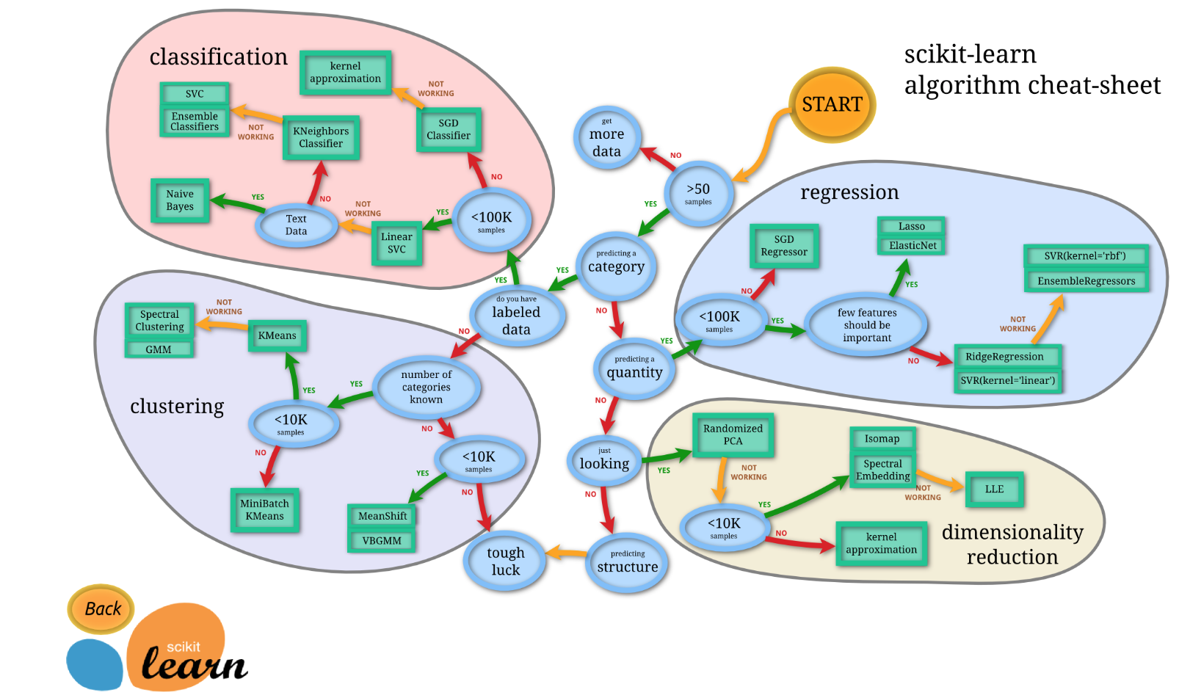

Slide 41
Conclusion
Question adressed: are different adverse events reported in different countries?
As requested, we have downloaded the openFDA database, and extracted fields of interest
We produced plots to better understand the data
Machine learning project: can we recover the country names from the reactions?
Many improvements can be brought!

