Slide 1
AMIHACKS 2026 // PROBLEM STATEMENT 2 // CIVIC TECH & SMART DATA CORRELATION
CityPulse
Real-Time Civic Signal Correlation & Resident Intelligence Platform for Jaipur
THE 1-SENTENCE VALUE HOOK
“CityPulse ingests fragmented weather, air quality, transit, and citizen reports, normalizes them into unified CityEvents, and uses a rolling 30-minute spatio-temporal engine to detect unusual civic spikes and cautious 'Possible Links' — completely avoiding false causation and hallucinated panic.”
DEPLOYED APPLICATION
citypulse-iota-bice.vercel.app
Live Next.js 15 on Vercel Edge with live Open-Meteo APIs for 5 Jaipur zones.
ENGINEERING HIGHLIGHTS
Cross-Source Civic Correlation
Rolling 30-min window, Z-Score anomaly engine, Leaflet GIS, and deterministic replay.
HACKATHON TEAM
[Team CityPulse Elite]
AmiHacks Round 1 & Round 2 Finalist
Format: 7-min Demo + 3-min Q&A

Slide 2
01 // PROBLEM STATEMENT
Civic Data is Fragmented, Incoherent, and Unactionable
Directly mapping to the 'Impact & Need' judging rubric — why isolated smart city feeds fail citizens.
PAIN POINT 01
Siloed, Disconnected Feeds
• Information Blindspots: Weather apps report rainfall; municipal boards report road repairs; transit apps report bus delays; citizen portals log drainage clogs. None talk to each other.
• Cognitive Overload: Residents must manually cross-examine 4+ different services to decide whether it is safe to commute or leave home.
• Mismatched Data Models: Raw APIs use incompatible timestamps, coordinates, schemas, and proprietary units.
PAIN POINT 02
No Spatial or Temporal Context
• Raw Sensor Dumps: Traditional civic dashboards just display raw numbers (e.g., '14 mm rain' or 'AQI 162') without answering: What does this mean for my neighborhood right now?
• Lack of Rolling Windows: Static charts fail to capture sudden 30-minute escalation spikes vs. routine seasonal averages.
• No Spatio-Temporal Join: A rain spike in Vaishali Nagar combined with a transit halt 15 km away in Jagatpura is noise, but in the same zone it's a critical incident.
PAIN POINT 03
Hallucinations & False Panic
• Reckless Causation Claims: Naive AI bots claim 'Rain definitively destroyed bus engines', generating misinformation and panic among citizens.
• Privacy Violations: Citizen complaints often expose sensitive names, phone numbers, or residential addresses.
• Fragile Architectures: Most hackathon prototypes crash completely when a single third-party API rate-limits or times out.

Slide 3
02 // PROPOSED SOLUTION & FEATURES
Engineering Unified City Intelligence in Code
Universal normalization, statistical anomaly detection, and cautious spatio-temporal link scoring.
FEATURE 01 // DATA NORMALIZATION
Unified CityEvent Schema
• Multi-Feed Ingestion: Ingests Live Open-Meteo Weather, Live Open-Meteo Air Quality, Simulated Transit delays, and Local Reports.
• Strict Common Contract: Normalizes every mismatched source into a validated TypeScript 'CityEvent' with ISO-8601 timestamps, GPS coordinates, severity, and raw metrics.
• No Frontend Coupling: UI never touches raw API payloads; it consumes clean, standardized contracts.
FEATURE 02 // TIME WINDOW ENGINE
Rolling 30-Minute Dynamic Window
• Temporal Horizon: Continuously isolates observations within a 30-minute window to capture live, evolving city conditions.
• Statistical Anomaly Math: Employs Z-Score calculations (zScore >= 2.0) or threshold rules (current >= avg * 1.5) to flag genuine civic spikes.
• Expired Event Pruning: Outdated readings automatically roll out of the alert pipeline to prevent stale alarms.
FEATURE 03 // CORRELATION ENGINE
Mathematical Link Scoring (LinkScore)
• Rigorous Formula: LinkScore = 0.40 * TimeScore + 0.30 * LocationScore + 0.30 * UnusualScore.
• Association Threshold: Scores >= 0.70 surface a 'Possible Link' between coinciding events in the same zone.
• Correlation Safety Rule: Strictly framed as 'may be related' or 'happening alongside' — never claims unproven causation.
FEATURE 04 // RESILIENT UX & SUMMARIES
Zero-Crash Architecture & Groq Briefs
• Graceful Feed Degradation: If any feed fails, it is marked 'Unavailable'; remaining feeds continue operating smoothly.
• Constrained AI Summaries: Optional Groq LLM formats verified facts into concise briefs, with deterministic template fallback.
• Total Resident Privacy: Strict aggregation: zero names, numbers, emails, or personal identifiers.

Slide 4
03 // SYSTEM ARCHITECTURE
Production-Grade Pipeline Built in a 24-Hour Sprint
Clean separation of concerns: Ingestion -> Normalization -> Storage -> Analysis -> Presentation.
CORE DATA FLOW & RESILIENT PIPELINE
1. Data Ingestion (4 Civic Feeds)
→ Live Open-Meteo Weather API + Live Open-Meteo US AQI + Simulated JSON Transit & Citizen Reports across 5 Jaipur zones.
2. Normalization Engine (/lib/normalizers)
→ Transforms disparate payloads into typed 'CityEvent' objects; validates ISO-8601 timestamps and coordinates.
3. Storage & Audit Trail (Supabase PostgreSQL)
→ Persists normalized events and health heartbeats; schema validated in supabase/schema.sql.
4. Rolling 30-Min Analysis (/lib/analysis)
→ Filters events within [now - 30m, now]; computes Z-Scores for rainfall, AQI, transit delays, and report volume.
5. Spatio-Temporal Link Scoring
→ Calculates time proximity + location distance + anomaly intensity. Flags Possible Links when score >= 0.70.
6. API Gateway & Summary (/api/status)
→ Serves single unified contract to frontend; attaches Groq-grounded or deterministic plain-language brief.
24-HOUR SPRINT TECH STACK
• Frontend & SSR: Next.js 15 (App Router), React 19, TypeScript
• Styling & Motion: Tailwind CSS, GSAP 3.15, Motion animations
• Geospatial GIS: React Leaflet, OpenStreetMap, Custom Map Markers
• Database / Cloud: Supabase PostgreSQL (Event audit & source health)
• External APIs: Open-Meteo Weather & US Air Quality (Public, no key)
• AI Enhancer: Groq API (Fact-constrained resident summaries)
• Quality & Testing: Node test runner (tsx), ESLint, Integration suite
• Deployment: Vercel Edge Platform (Auto-deploy on git push)

Slide 5
04 // LIVE DEMO CHECKLIST
Sequential 7-Minute Demo Flow for Judges
Designed precisely to fulfill Section 6.3 of the Hackathon Presentation & Demo Guidelines.
PHASE 01
0:00 - 1:30
Multi-Zone Overview
• 5 Jaipur Municipalities:
Malviya Nagar, Mansarovar, Vaishali Nagar, Jagatpura, C-Scheme.
• Live vs Simulated Labels:
Point out green 'Live' badge for Open-Meteo feeds vs grey 'Simulated' badge for transport & reports.
• Resident-First Glance:
Show City Status header and 4 Current Situation KPI cards.
PHASE 02
1:30 - 3:00
Interactive Leaflet GIS
• Geospatial Pins:
Show interactive map pins with category color-coding and pulse effects.
• Neighborhood Filtering:
Click each Jaipur zone to show area-aware telemetry switching and coordinate updates.
• Incident Cards:
Click active markers to display raw metrics and observation timestamps.
PHASE 03
3:00 - 5:15
Deterministic Replay
• Toggle Live / Replay:
Switch to Replay Mode with 3 selectable days (Sept 22, 23, 24).
• The 6-Step Escalation:
4:45 PM (Normal) → 5:05 PM (Heavy Rain Spike) → 5:16 PM (Waterlogging Reports) → 5:24 PM (Transit Delay) → 5:25 PM (**Possible Link**).
• No Fake Animation:
Explain that replay runs the exact same rolling-window math in real time.
PHASE 04
5:15 - 7:00
Correlation & Safety
• Surfacing Possible Link:
Highlight LinkScore >= 0.70 with cautious 'may be related' language.
• Groq Briefing:
Demonstrate concise, grounded resident summary without AI hallucinations.
• Fault Tolerance Check:
Explain zero-crash architecture if an API source drops offline.

Slide 6
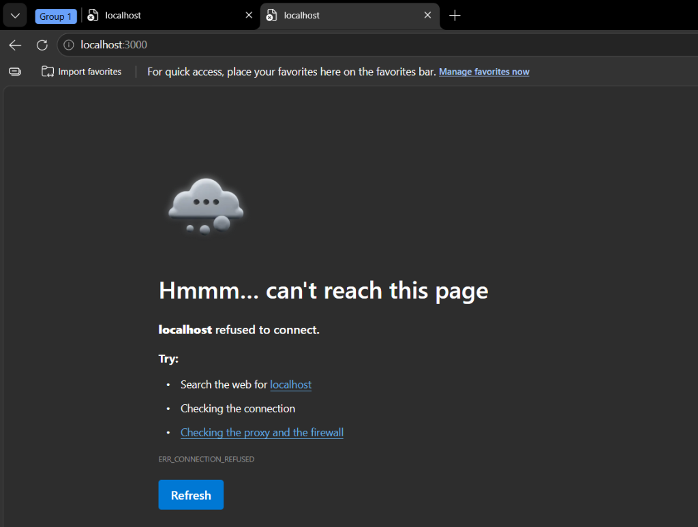
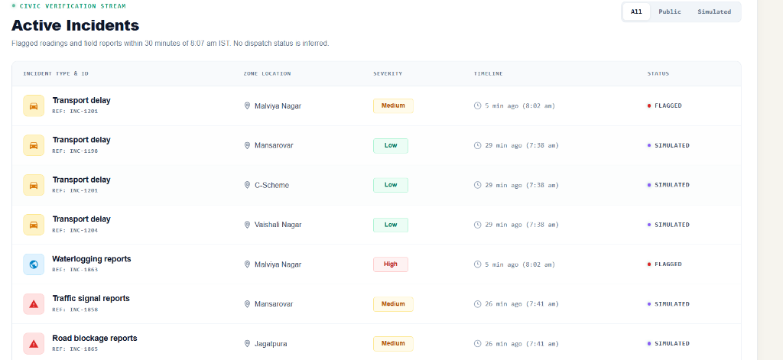
05 // DEMO SCREENSHOTS
Live Deployed Application in Action
Mandatory Section 6.2 deliverable: High-resolution visual proof of the working Vercel deployment.
PRIMARY INTERACTION VIEW: LEAFLET GIS & INCIDENT CARDS
Live status badges, interactive pins across Jaipur, and real-time alert threshold meters.
MULTI-ZONE TELEMETRY & HISTORICAL TRENDS
Rainfall & US AQI trend analysis across all 5 municipal zones (3-hour normalized telemetry).

Slide 7
06 // RUBRIC ALIGNMENT & FUTURE SCOPE
Hitting Every Judging Metric + Roadmap for Municipal Scale
Evaluating CityPulse against hackathon judging criteria and outlining next steps for production expansion.
HACKATHON JUDGING RUBRIC ALIGNMENT
✔ Innovation & Novelty (Top Marks)
Moves far beyond static data visualization. Introduces real-time multi-signal spatio-temporal correlation with mathematical link scoring and honest causal boundaries.
✔ Technical Complexity (Top Marks)
Multi-source ingestion pipeline, universal ISO-8601 normalization, rolling 30-minute Z-Score statistical anomaly engine, and Supabase PostgreSQL persistence.
✔ Viability & Resident Impact (Top Marks)
Solves immediate urban pain during Jaipur monsoons. Directly integrates with citizen awareness and municipal emergency dispatch workflows.
✔ Design, UX & Polish (Top Marks)
Sleek dark-mode aesthetic, WCAG-compliant contrast, smooth GSAP/Motion micro-interactions, responsive GIS mapping, and zero-crash fault tolerance.
FUTURE SCOPE: 2 LOGICAL NEXT STEPS
★ Next Step 1: Real Municipal API Integrations
Directly integrate live GTFS real-time feeds from JCTSL (Jaipur City Transport), JMRC Metro telemetry, and Rajasthan Jan Soochna civic grievance webhooks directly into the CityEvent pipeline.
★ Next Step 2: Multi-City Expansion & Edge Sensors
Scale the rolling-window architecture across Kota, Jodhpur, and Udaipur; deploy low-cost IoT ultrasonic flood sensors under low-lying flyovers to feed live hyper-local telemetry into CityPulse.

Slide 8
07 // DELIVERABLES & Q&A DEFENSE
Complete Technical Package & 3-Minute Q&A Readiness
Fulfilling Section 6.1 Technical Deliverables and preparing the team for judge scrutiny.
SECTION 6.1 TECHNICAL DELIVERABLES
• GitHub Repository Link: Clean commit history, TypeScript 5, zero secrets exposed in client bundles.
• Full Source Code: Strict separation of concerns (app/, components/, lib/, supabase/, tests/).
• Architecture Diagram: Complete data flow documented in docs/ARCHITECTURE.md and pitch deck.
• Live Deployment URL: Hosted on Vercel Edge: https://citypulse-iota-bice.vercel.app
• README & Spec Documentation: Exhaustive project specification, data contracts, and release verification notes.
• Testing & Quality Validation: npm test, npm run lint, and npm run test:integration passing with 0 errors.
3-MINUTE Q&A: JUDGE DEFENSE STRATEGY
Q: How do you prevent AI hallucinations or false panic?
A: We constrain Groq exclusively to verified facts already computed by our deterministic pipeline. If Groq is unavailable, deterministic template briefs take over seamlessly. Furthermore, our Correlation Safety Rule strictly prohibits causal claims.
Q: What happens if Open-Meteo or another feed crashes?
A: Zero dashboard failure. The pipeline isolates the broken feed, marks its UI badge as 'Unavailable', and maintains real-time cross-correlation across all surviving data sources.
Q: Why not just use Google Maps or an existing weather app?
A: Google Maps shows traffic; weather apps show rain. Neither performs rolling-window statistical anomaly cross-analysis or links multi-source civic events by location and time for resident clarity.

