Slide 1
Hackathon
Intent Admission: verifying origin and consent before execution
A running admission path checks who triggered an intent and whether consent exists, then gives the executor a signed, single-use assertion.
source:
draft-jiang-oauth-intent-admission
Jiang Yuning
IETF126 - Hackathon - Talk
1
Notes:
Open with the high level story: before an agent request becomes a real action, the executor needs evidence about origin and consent.

Slide 2
Why this matters
Problem
An unsafe intent can look normal if the executor only sees the forwarded request.
user-facing device
legit app
malicious app
intent forwarded with
no origin / consent check
high-impact
action on a spoofed / unauthorized intent
Intent Client
relay / network
Execution Endpoint
Attack path
Missing evidence
Impact
A co-resident app fabricates or triggers an intent that appears to come from the user or a trusted agent.
After forwarding, the executor cannot reconstruct who really triggered the intent or whether valid consent was present.
The result can be an unauthorized purchase, data disclosure, account change, or other irreversible side effect.
What we built — one admission path:
Intent request
→
Admission Point
→
Executor
what it wants · claimed context
check origin · consent · policy
accept only a valid pass
IETF126 - Hackathon - Talk
2
Notes:
This slide gives the attack picture. The core risk is spoofed origin or missing consent on a high-impact action.

Slide 3
Technical solution: admit once, verify again
Solution
Capture origin and consent at the point where they are verifiable, then carry a signed assertion to the execution endpoint.
Admission Point
Execution Endpoint
Intent Originator
1 authenticate origin
2 evaluate policy
3 obtain consent if required
IAA
verify signature
check audience & expiry
reject replay
act or refuse
user · app · agent
signed JWT
bound to intent
Do not trust self-declared source
Intermediaries can forward, not forge
Endpoint remains the final gate
The IAA is self-protecting: signed, bound to the intent, and re-verified before action.
IETF126 - Hackathon - Talk
3
Notes:
Technical solution: the Admission Point checks origin, policy, consent, and issues a signed assertion. The Execution Endpoint re-verifies it before acting.

Slide 4
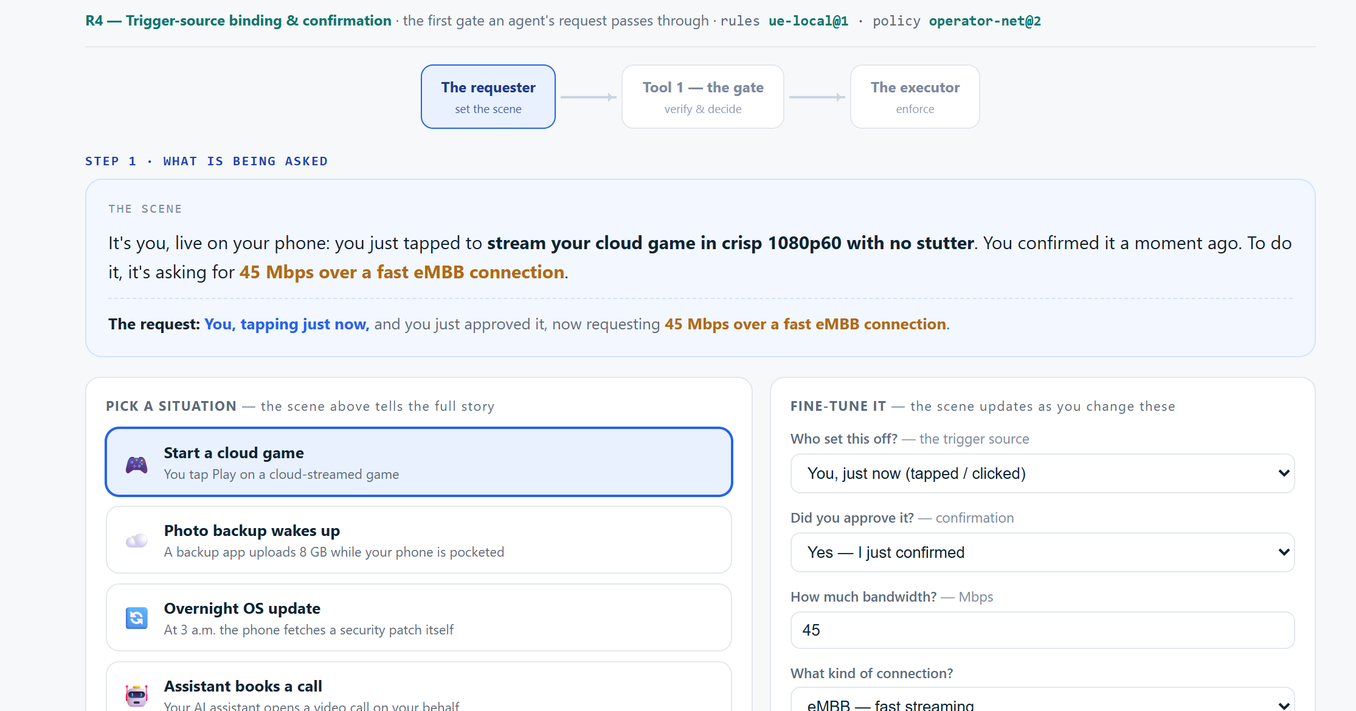
Implementation: submit an intent with live context
Demo
Five scenarios stand in for different originators. The demo does not rely only on the selected story: it also shows live host evidence.
What to notice
• Scenario selects the request context
• Consent is explicit or absent
• Host evidence is shown before admission
Origin and consent are checked before the request reaches execution.
IETF126 - Hackathon - Talk
4
Notes:
Demo page one: show choosing the scenario and the live capture area. Emphasize that origin evidence is captured before the request goes out.

Slide 5
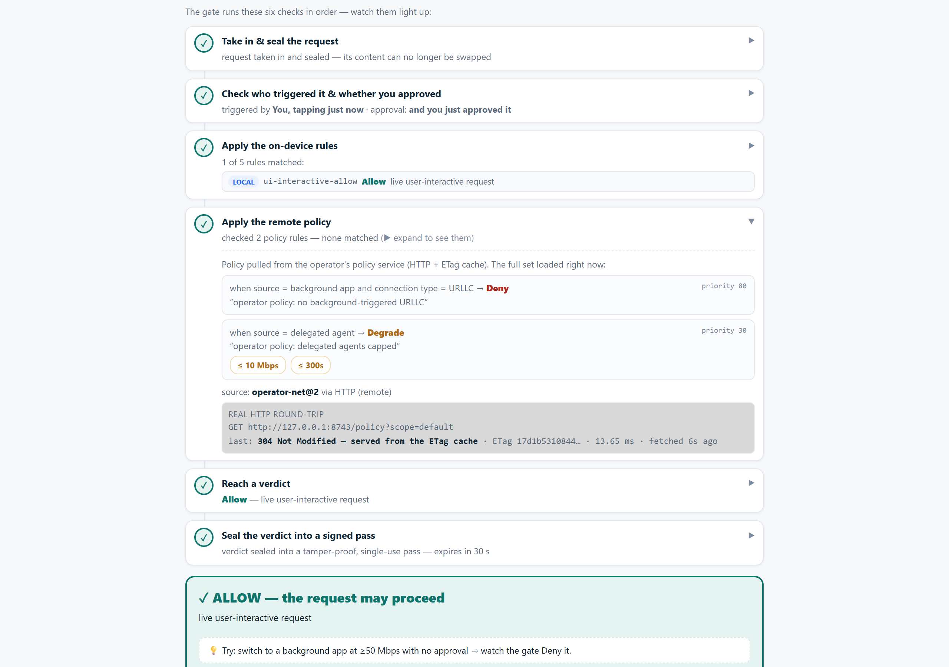
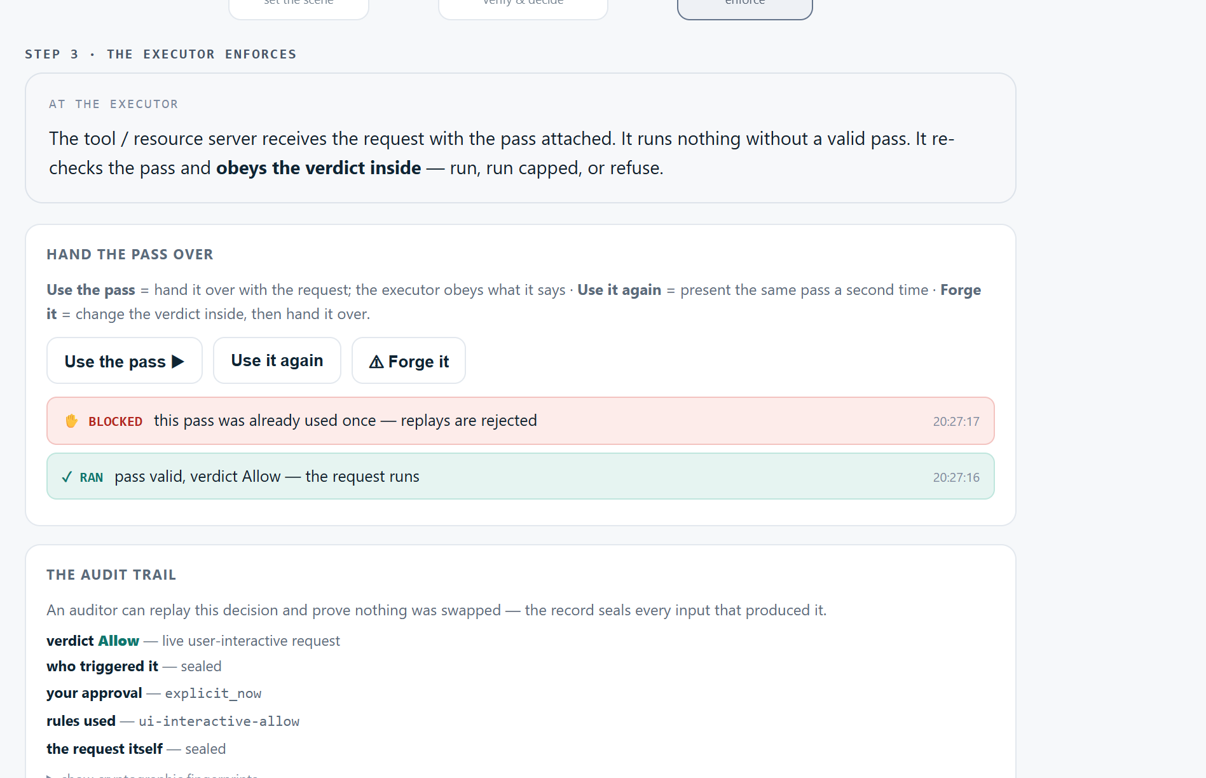
Implementation: decide, seal, and re-check
Demo
The demo runs the admission checks, signs the result, and then verifies the assertion at the executor.
Admission Point: policy and verdict
Execution Endpoint: run or refuse
Replay is rejected. Editing the verdict breaks the signature. A background high-risk request is denied by policy.
IETF126 - Hackathon - Talk
5
Notes:
Demo page two: point out the policy fetch, verdict, signed pass, replay rejection, and executor enforcement.

Slide 6
Thank you
Thank you
Why this helps
Continue the conversation
• Origin and consent are captured where those signals are still verifiable.
• The assertion is signed, bound to the intent, and protected against replay or repurposing.
• The executor can independently verify the admission decision before any high-impact action.
Feedback: outcomes, host signals, claim names, proof-of-possession, and what belongs in the assertion.
draft-jiang-oauth-intent-admission
draft-jiang-intent-security
oauth-intent-admission-draft
Windows: intent-admission-demo-windows.exe
Direct demo binaries:
macOS: intent-admission-demo-macos
Linux: intent-admission-demo-linux
IETF126 - Hackathon - Talk
6
Notes:
Close. Mention that the feedback requested is practical: outcome vocabulary, host signals, and assertion contents.

