Slide 1
Hackathon
One Request, Many Credentials: a Heterogeneous Credential Verifier
Detecting each credential's type, routing it to the right verifier, and combining the results into one decision
source: draft-jiang-wimse-heterogeneous-credential-01
Jiang Yuning
IETF126 - Hackathon - Talk
1

Slide 2
Why this matters
Problem
One request, many credential types
The receiver still needs one decision
An agent or workload may present a workload identity token, OAuth token, VC/VP, X.509 certificate, EAT, or API key in the same request. Each credential has its own verifier and trust semantics.
The relying party must identify each credential's type, determine the right verifier, interpret different outputs consistently, and decide how to handle the request.
What we built — one processing path:
Receiver / RP
→
Credential set processing
→
Decision policy
receives the request + credential set
identify type · choose verifier · verify · normalize result
allow · constrain · step-up · deny
A mixed credential set becomes one explainable handling decision.
IETF126 - Hackathon - Talk
2

Slide 3
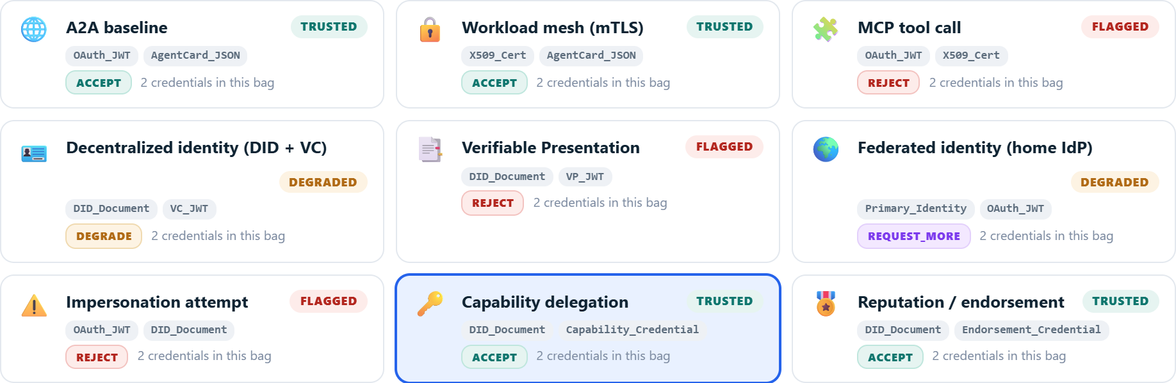
Implementation: nine request credential sets
Demo
Nine sample request credential sets show different credential mixes. Selecting one runs the processing path and shows the outcome: accept, reject, degrade, or request-more.
2 credentials in set
2 credentials in set
2 credentials in set
2 credentials in set
2 credentials in set
REQUEST_MORE
2 credentials in set
2 credentials in set
2 credentials in set
2 credentials in set
Each run first identifies the credential type, then routes it to the right verifier. Signature and status checks are real; the final decision is produced from normalized results.
set enumeration → type identification → verifier determination → result normalization → decision policy
IETF126 - Hackathon - Talk
3

Slide 4
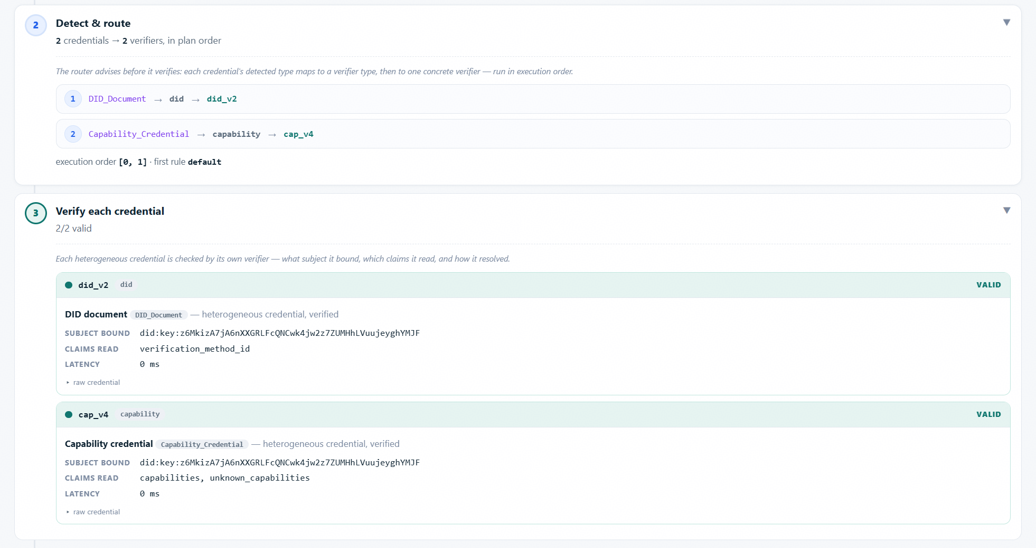
Implementation: identify credential types
Demo
The type identification step happens after the credential set is enumerated and before verifier selection.
The demo exposes the identified types for each credential.
set enumeration → type identification → verifier determination → result normalization → decision policy
IETF126 - Hackathon - Talk
4

Slide 5
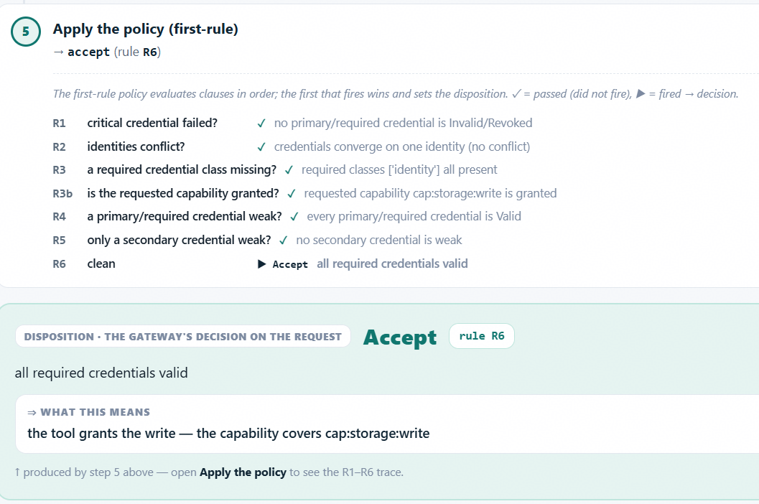
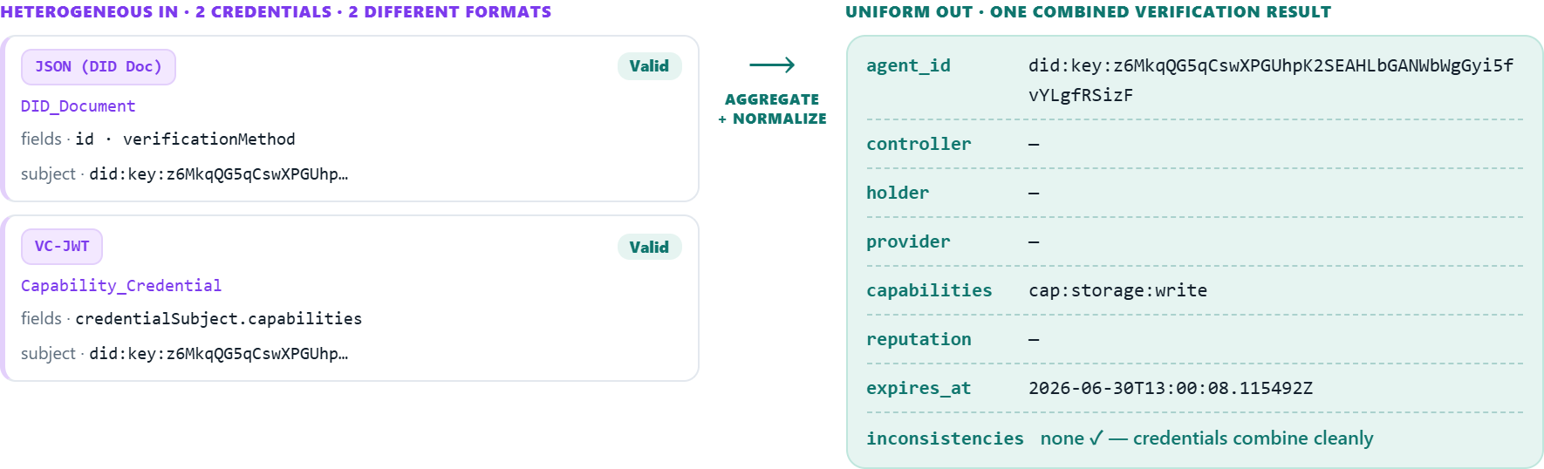
Implementation: native checks, common results
Demo
Credentials keep their native formats. Each verifier reports a common result — valid, invalid, or indeterminate — and the decision policy reads the combined result set.
The run checks EdDSA signatures, JWKS keys, X.509 chains, and status lists. An indeterminate credential is not counted as valid.
set enumeration → type identification → verifier determination → result normalization → decision policy
IETF126 - Hackathon - Talk
5

Slide 6
Thank you
Thank you
Why this helps
Continue the conversation
Feedback: outcomes, indeterminate results, and vocabulary for opaque credential types.
draft-jiang-wimse-heterogeneous-credential
draft repo — agent-security-labs/wimse-heterogeneous-credential-draft
Makes the full credential set visible, including credentials carried by value or by reference.
Routes each credential to the right verifier, then normalizes the results into one comparable model.
Enables cross-credential decisions, instead of each deployment using its own logic.
Windows — tool2-demo-windows.exe
Direct demo binaries:
macOS — tool2-demo-macos
Linux — tool2-demo-linux
IETF126 - Hackathon - Talk
6

