Slide 1

Application Development
And why it’s really, really cool
Brian Ross
brian.ross@ms.com

Slide 2





Who am I?
1994-1999
2000-2004
2004-2010
2010-2013
2013 - present
Notes:
Talk about early interests before college, too!

Slide 3
What do I do?
Architecture Lead for Wealth Management Field & Client Technology
Responsible:
  Application Design
  Technology Selection
  Putting all the pieces together
  Improving the way application developers work

Slide 4
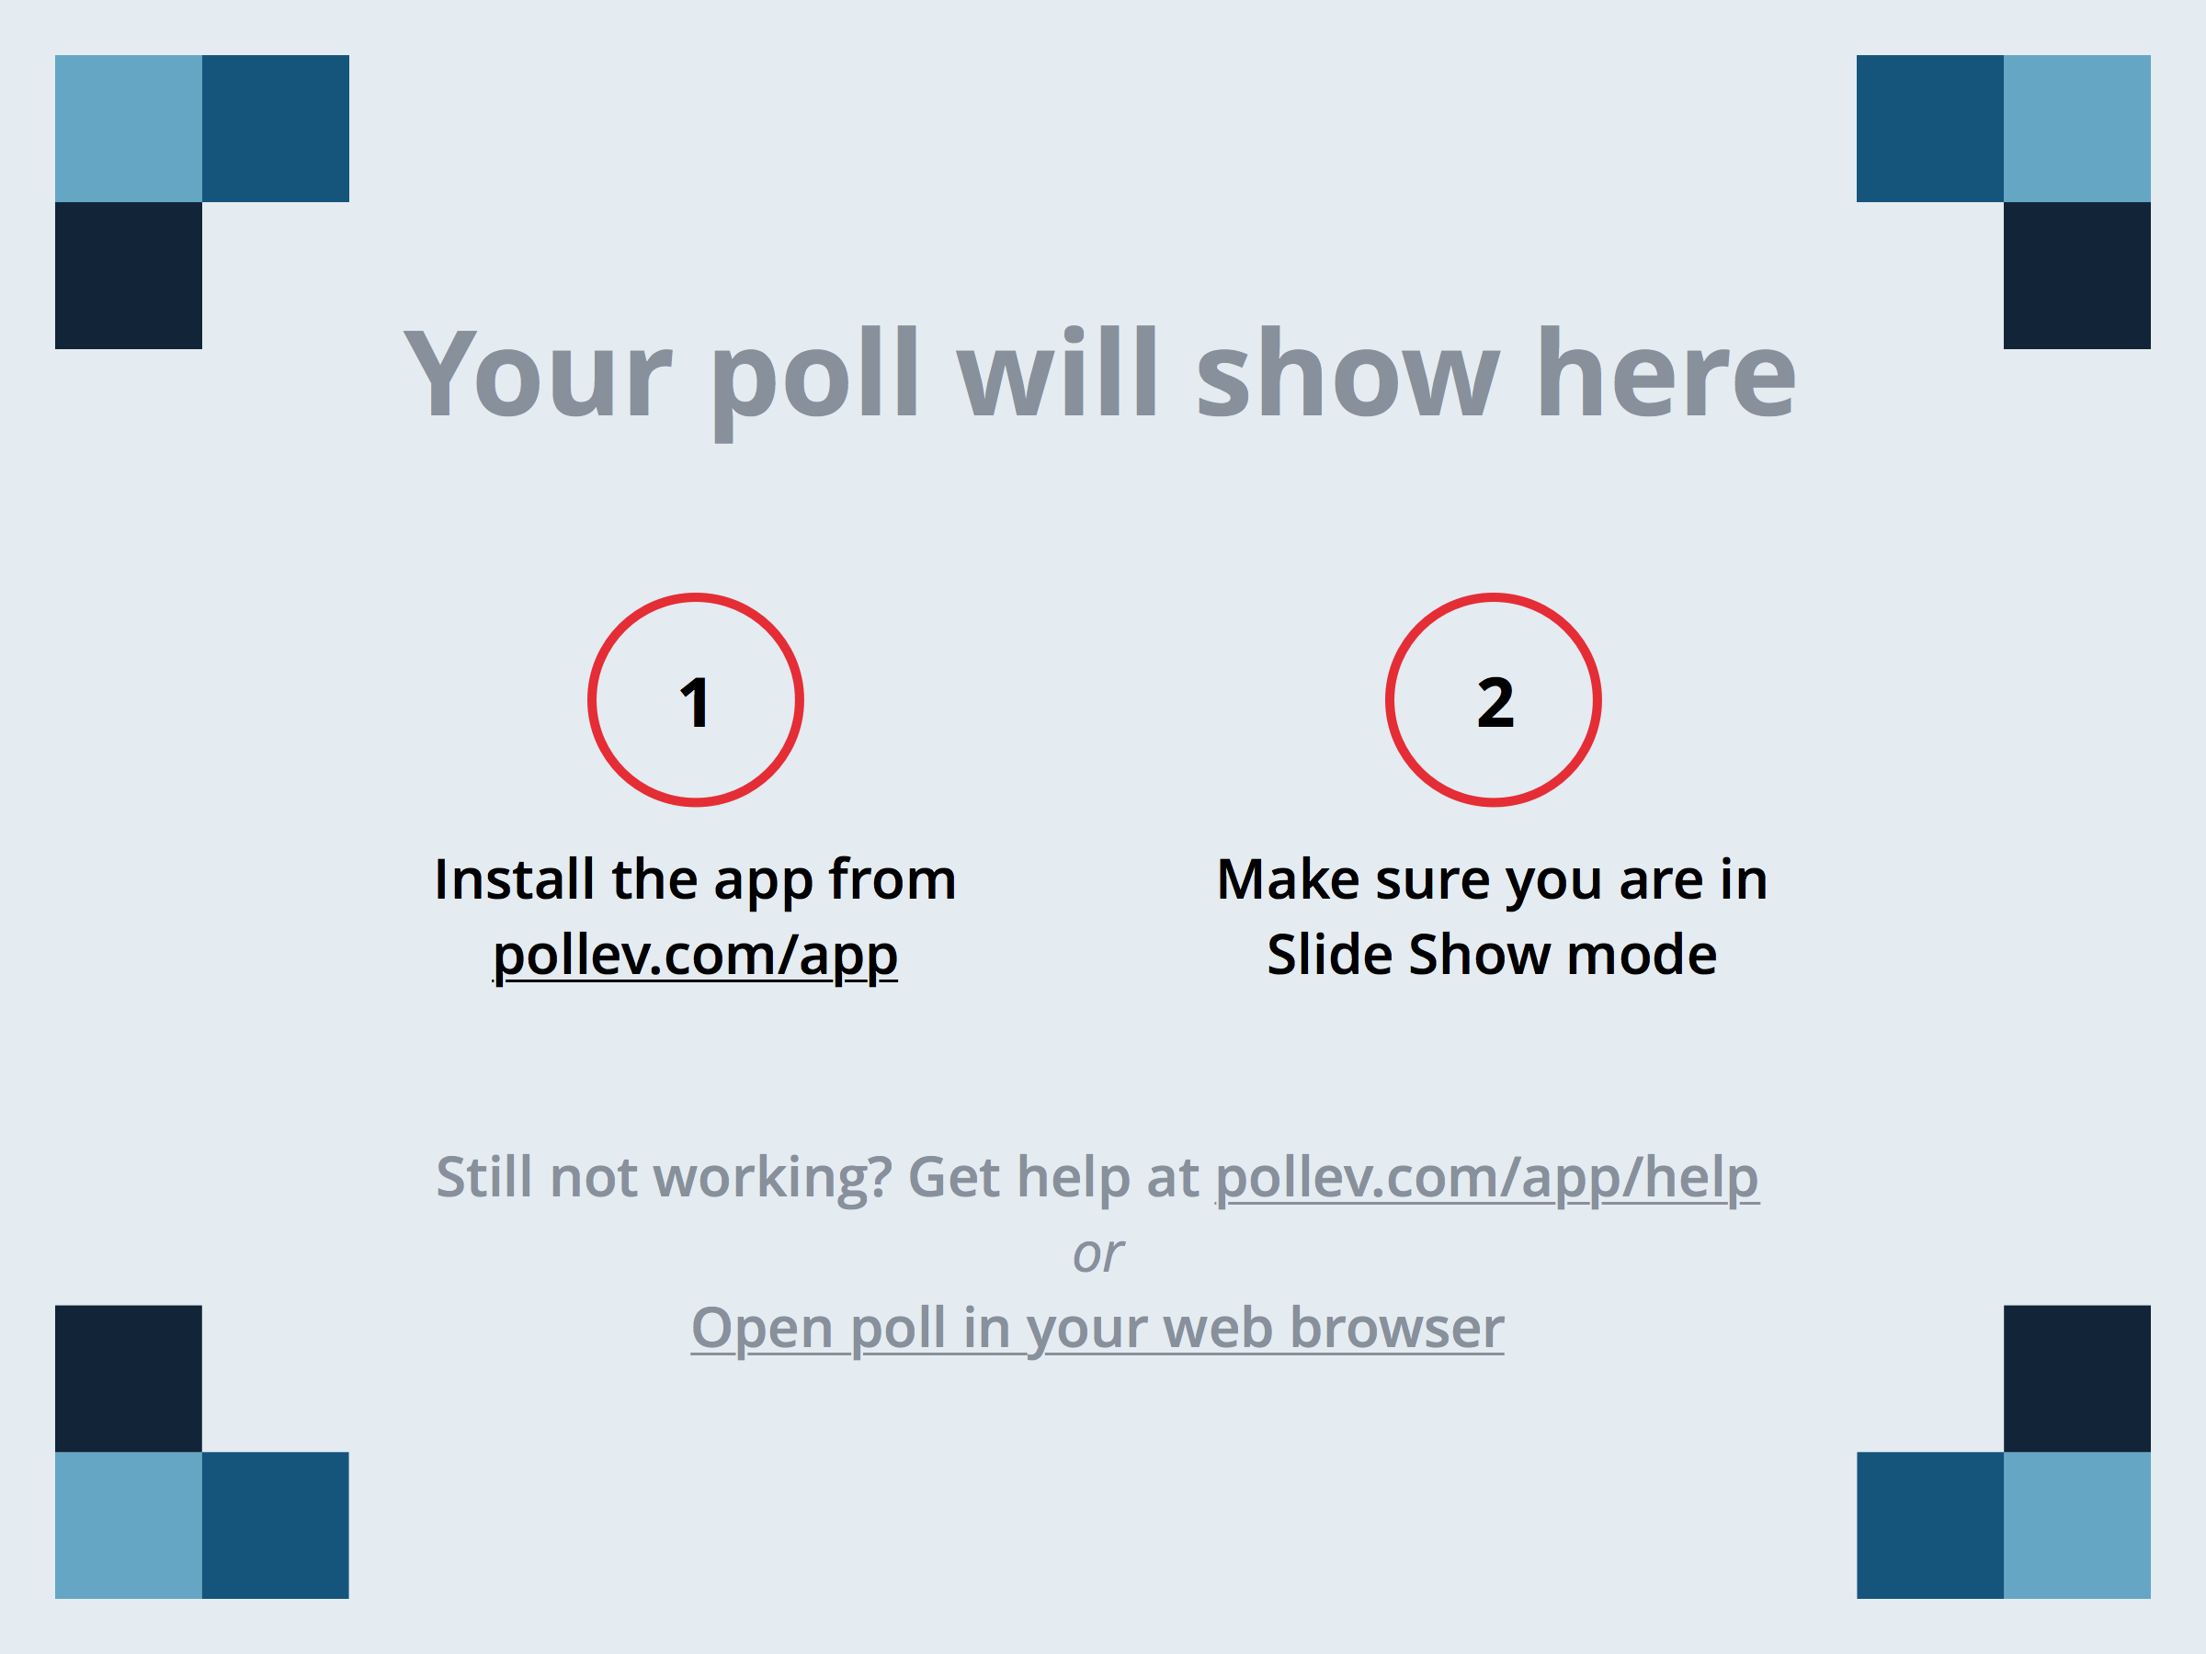
What is Computer Science?
Notes:
What is Computer Science About?
https://www.polleverywhere.com/multiple_choice_polls/Cfe83gbX3s9bIMn

Slide 5



What is Computer Science?
It’s about Science
It’s about Computers
It’s about Magic
Notes:
Ask the audience

Slide 6

Lumos
Science tries to determine what is true
  2 of the 3 main characters in Harry Potter have names that begin with “H”
Computer Science tries to determine how to solve problems
  Start with 0
  For each character
    If the name begins with “H”, add 1

Slide 7
Controlling Complexity
Solving complex problems is…complex
We need ways to make it manageable
It’s more difficult than cars and spaceships…because it isn’t real

Slide 8
Black Box Abstraction
Drawing boxes to suppress detail
Count “H”s
Find “H”s
Find Characters with Names starting with x
H
Harry, Hermione
Count Items in List
2
Notes:
Start with car analagy

Slide 9
Let’s Build Something
In which I build a Web version of iTunes before your very eyes!

Slide 10

Will they pay me to be a wizard?
1,018,000
jobs in 2012
22%
job growth rate until 2022
$93,350 median salary
Statistics according to the Bureau of Labor Statistics

Slide 11
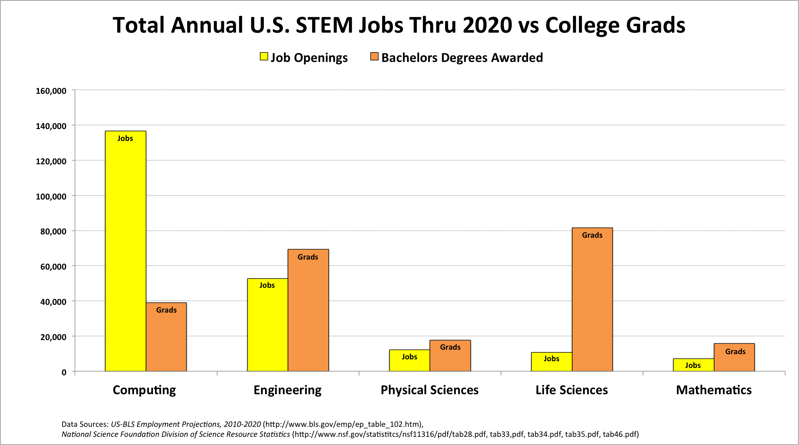
Will they pay me to be a wizard?

Slide 12
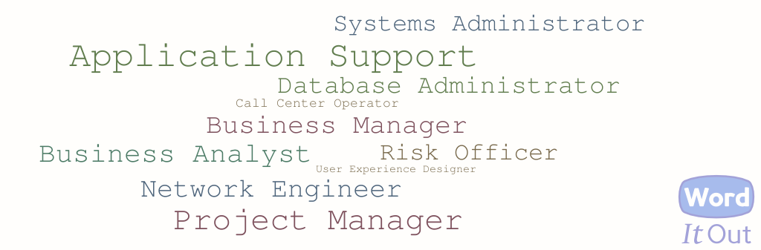
What other jobs are there in the Castle?

Slide 13
And we’re done
Thanks!
Brian Ross
brian.ross@ms.com
For the curious, the demo used:
Programming language: Javascript
Server-side Frameworks: Node.js, RESTify
Web Application Framework: AngularJS
Cloud Hosting: Microsoft Azure: http://npower1.azurewebsites.net/app
Get the code at: https://github.com/agent613/npower2015
Learn more coding yourself at http://www.code.org

