Slide 1

Application Development
And why it’s really, really cool
Brian Ross
brian.ross@ms.com

Slide 2





Who am I?
Notes:
Talk about early interests before college, too!

Slide 3
What do I do?

Slide 4

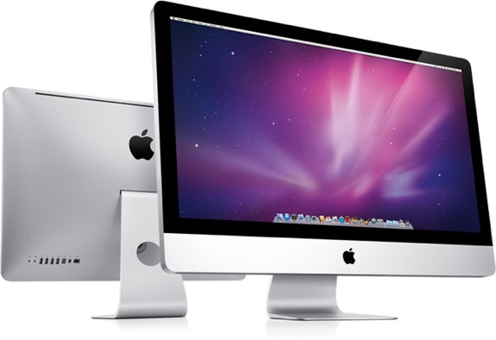

What is Computer Science?
It’s about Science
It’s about Computers
It’s about Magic
Notes:
Ask the audience

Slide 5
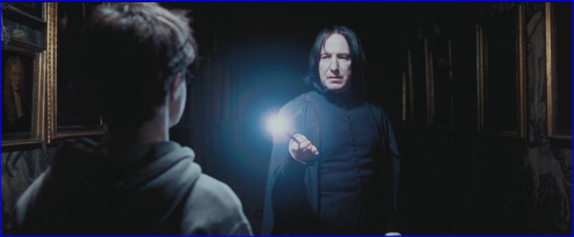
Lumos
Science tries to determine what is true
2 of the 3 main characters in Harry Potter have names that begin with “H”
Computer Science tries to determine how to solve problems
Start with 0
For each character
If the name begins with “H”, add 1

Slide 6
Controlling Complexity
Solving complex problems is…complex
We need ways to make it manageable
It’s more difficult than cars and spaceships…because it isn’t real

Slide 7
Black Box Abstraction
Drawing boxes to suppress detail
Count “H”s
Find “H”s
Find Characters with Names starting with x
H
Harry, Hermione
Count Items in List

Slide 8
Let’s Build Something

Slide 9
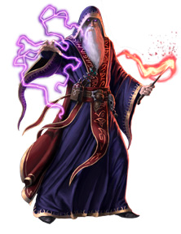
Will they pay me to be a wizard?
Something about how in demand this prof is

Slide 10
What other jobs are there in the Castle?

Slide 11
And we’re done
Thanks!
Brian Ross
brian.ross@ms.com
For the curious, the demo used:
Programming language: Scala
Web Service Framework: Spray
Web Application Framework: AngularJS

