Slide 1
SSIS Deployment and SQL Agent
Ray Barley

Slide 2
SSIS Deployment and SQL Agent Best Practices
SSIS Package Parameters - parameter / value pairs used by a single SSIS package
SSIS Project Parameters – parameter / value pairs shared between all SSIS packages in an SSIS project; e.g. ServerName in Connection Manager, EmailAddresses for errors and notifications
SSIS Catalog Deployment (SSISDB database)
Store SSIS projects / execute SSIS packages from the Catalog
Create Environments in SSIS Catalog; configure Project to get Project Parameter values from environment

Slide 3
SSIS Deployment and SQL Agent Best Practices
Execute SSIS Package in SQL Agent job step
Retrieve SSIS package from the SSIS Catalog
Select Environment for SSIS Project Parameters
Set Project Parameter values from Environment
Set SSIS Package Parameter values

Slide 4
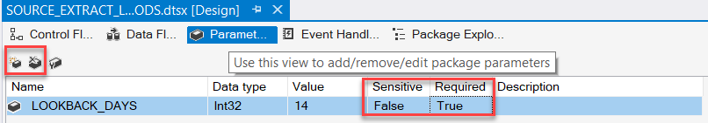
SSIS Package Parameters
Click Paramet… tab
Click leftmost icon to Add package parameter(s)
Select package parameter and click center icon to delete it
If Required = True, you must specify a value when you deploy
If Required = False the value in the package is used when you deploy; you can override that
If Sensitive = True the value will be encrypted
Package parameter is a variable that you use in the package

Slide 5
SSIS Package Parameter Example
-- Stored procedure to get BEGIN_FUND_DATE
CREATE OR ALTER PROCEDURE [dbo].[GET_BEGIN_FUND_DATE]
@P_LOOKBACK_DAYSINT
,@P_BEGIN_FUND_DATE DATEOUTPUT
AS
BEGIN
SET @P_BEGIN_FUND_DATE = DATEADD(day
,@P_LOOKBACK_DAYS * -1
,GETDATE()
);
END
GO

Slide 6
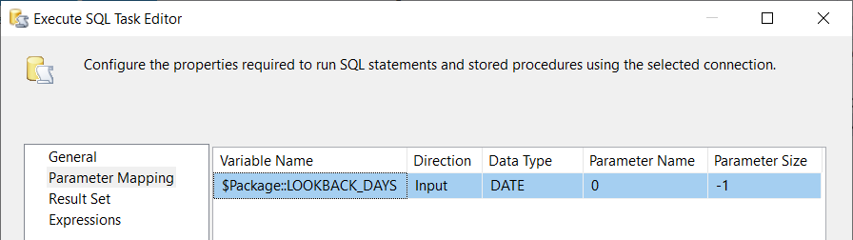
SSIS Package Parameter Example
Execute SQL Task has a query with a placeholder (?)
Specify the Package Parameter for the Variable Name in the Parameter Mapping page of the Execute SQL Task
Save result in SSIS variable BEGIN_FUND_DATE type datetime
SELECT
DATEADD(day
, ? * -1
, GETDATE())

Slide 7
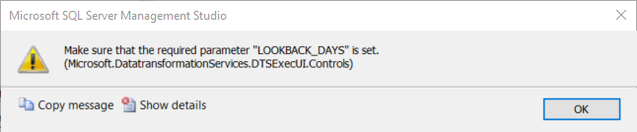
Add SSIS Package to SQL Agent Job Step
Add SSIS package to new step in SQL Agent job
Warning message to remind you to set a value for the Required package parameter

Slide 8
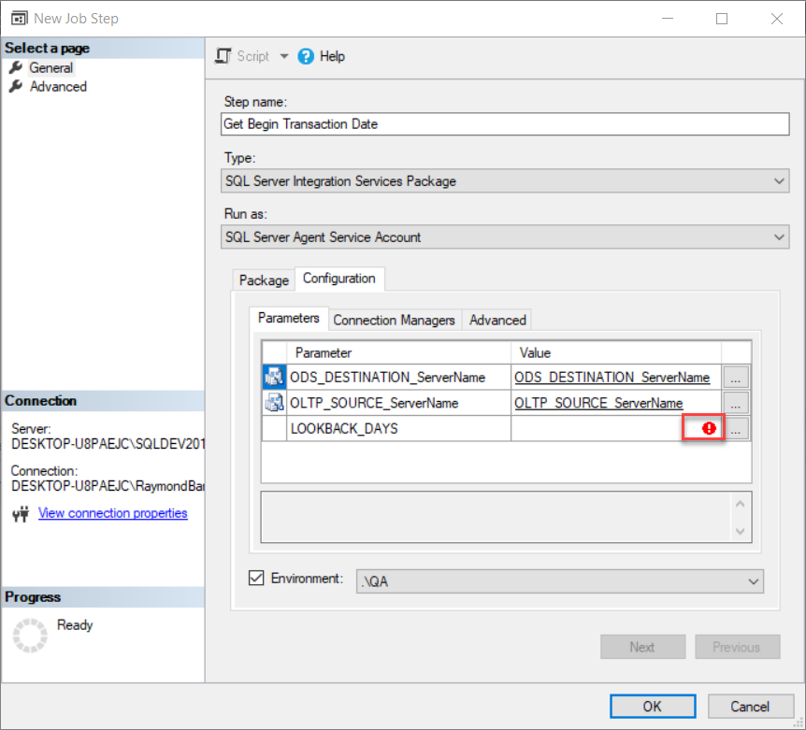
Set Package Parameter Value in Configuration

Slide 9
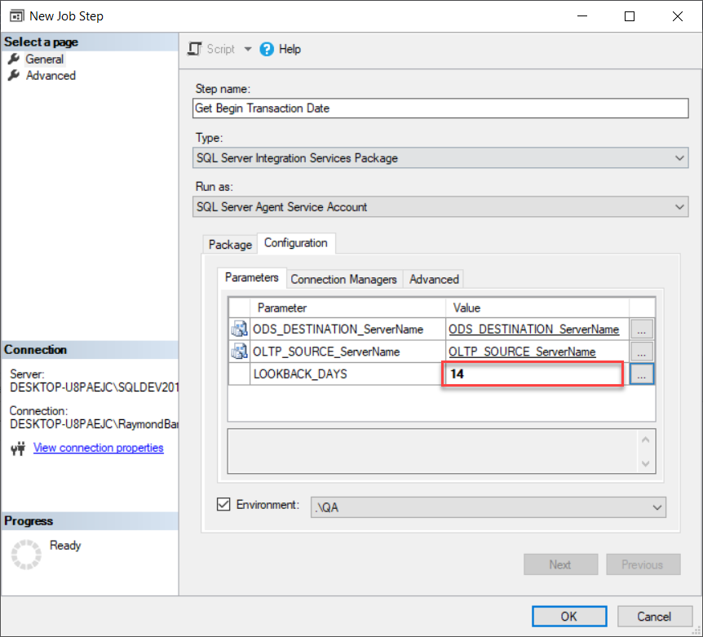
Set Package Parameter Value in Configuration

Slide 10
SSIS Project Parameters
Example: ServerName is OLE DB Connection Manager
Need to specify a different ServerName value for the connection manager in each stage: development, QA and PROD

Slide 11
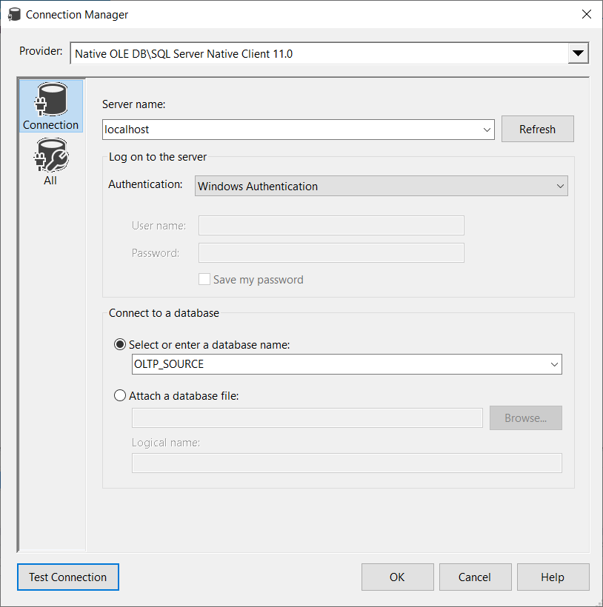

Slide 12
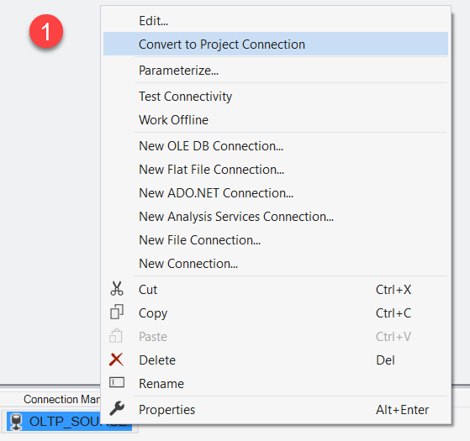
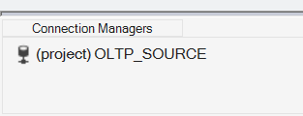
Convert Connection to Project Connection
Right-click connection …
(project) indicates Project connection

Slide 13
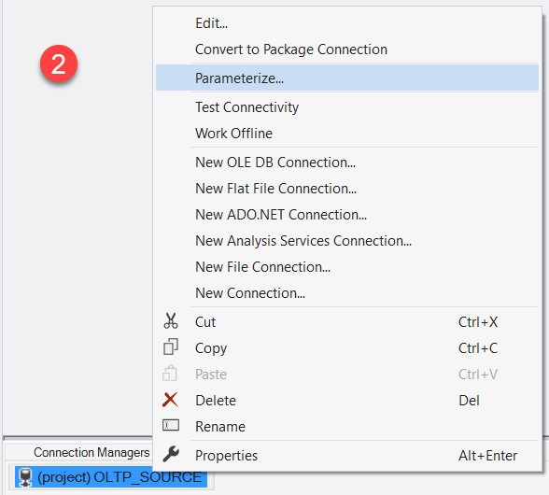
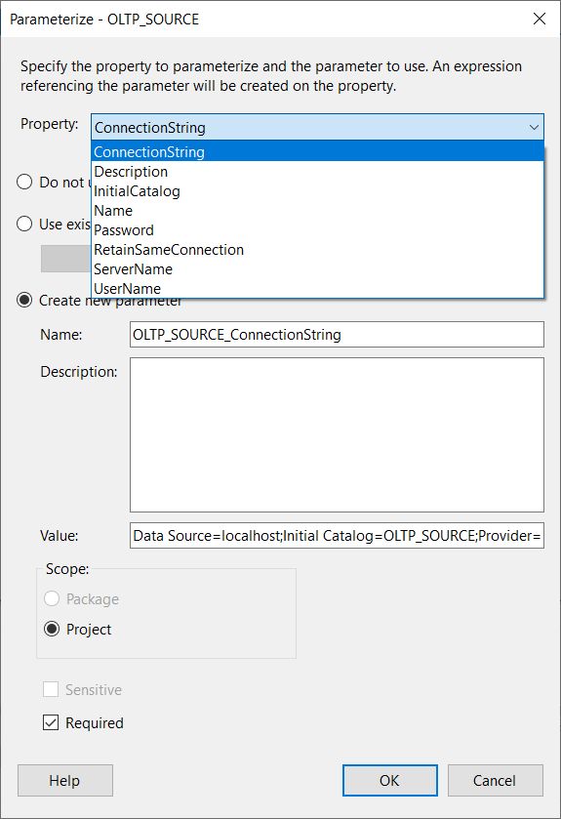
Parameterize Project Connection
Right-click connection …

Slide 14
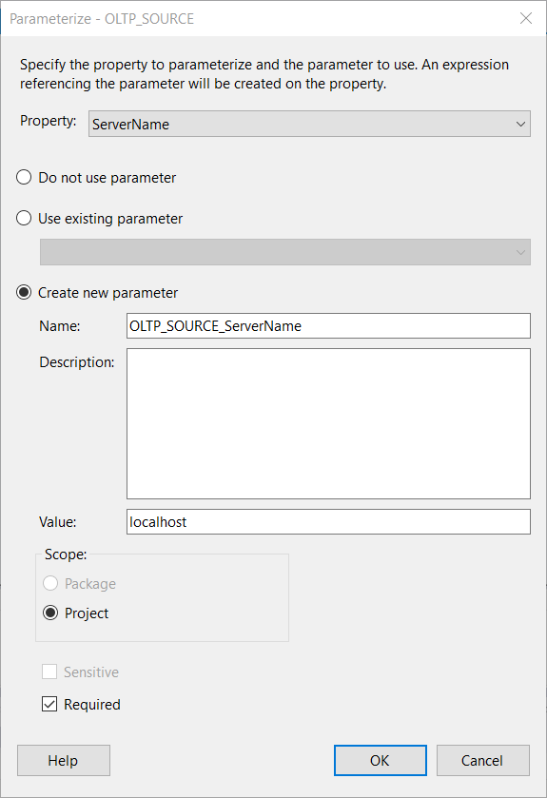
Parameterize Project Connection
Select Property to Parameterize
Create a new parameter in the SSIS package
Specify initial value of ServerName; e.g. used in development
Set Scope to Project (automatic)
Check Required; forces value to be specified when adding to a SQL Server Agent job step

Slide 15
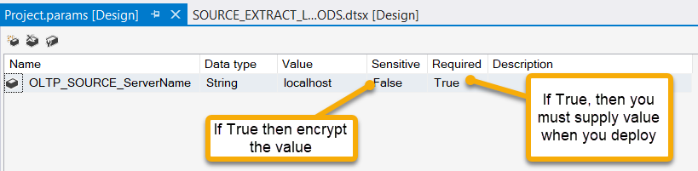
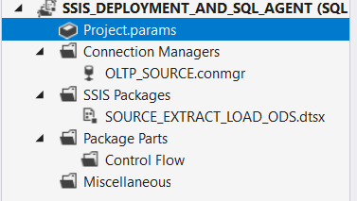
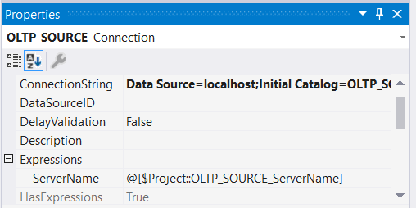

Parameterize
Double-click Project.params in the Solution Explorer to display the list of Project parameters
ServerName gets its value from an expression which is the Project parameter
fX icon indicates an expression
is used

Slide 16

Deploy to SSIS Catalog (HIDDEN )
Build project
Get .ISPAC file from PROJECT FOLDER\bin\Development
TO DO: I can’t connect to SSIS service; how do I deploy from ISPAC?

Slide 17
Deploy to SSIS Catalog
Right-click SSIS project in Solution Explorer
Select Deploy
Walk through the Deployment Wizard

Slide 18
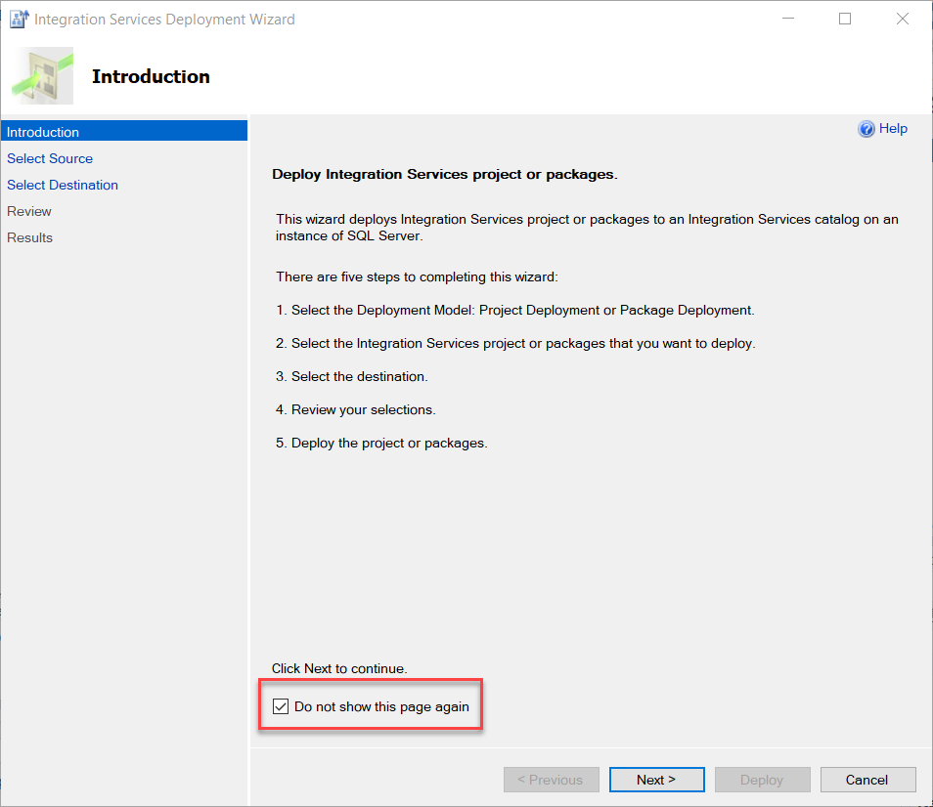
Deployment Wizard – Introduction

Slide 19
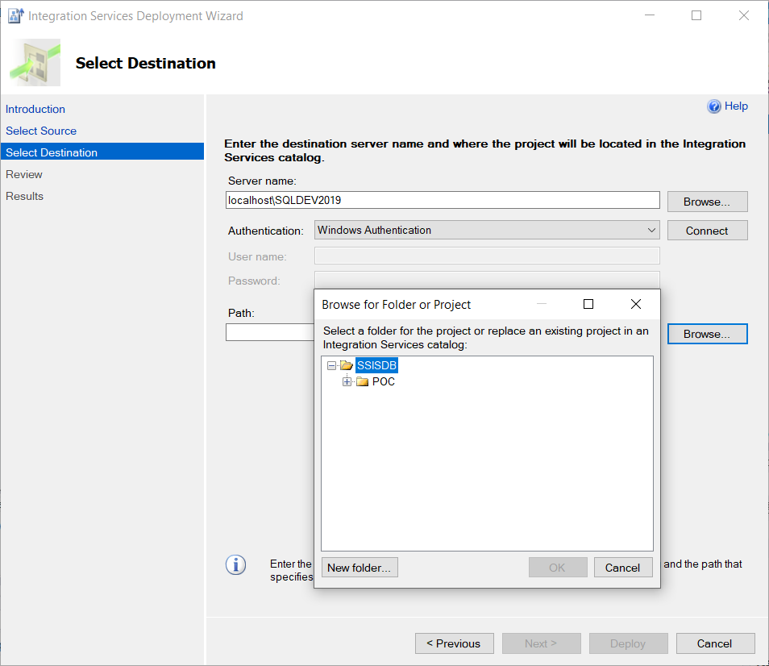
Deployment Wizard – Destination
Enter Server name
Click Connect
Enter Path (navigate to the folder in the SSIS catalog; you can create a new folder)

Slide 20
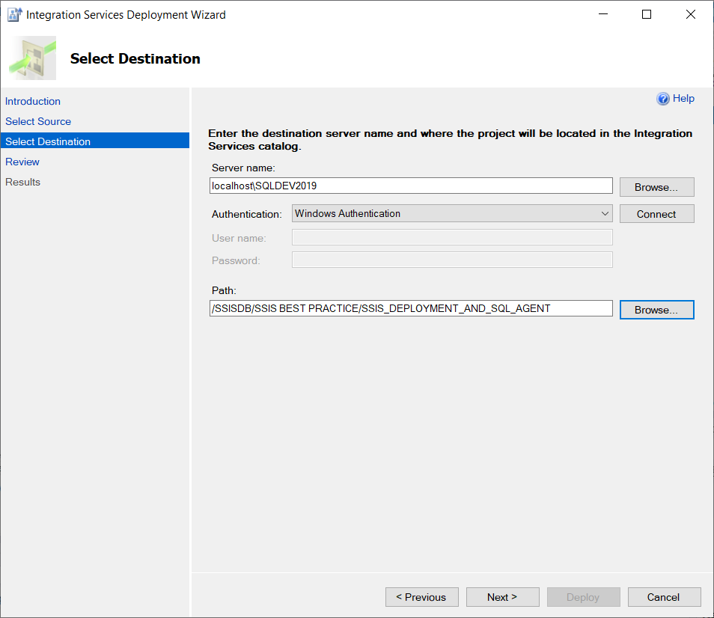
Deployment Wizard - Destination

Slide 21
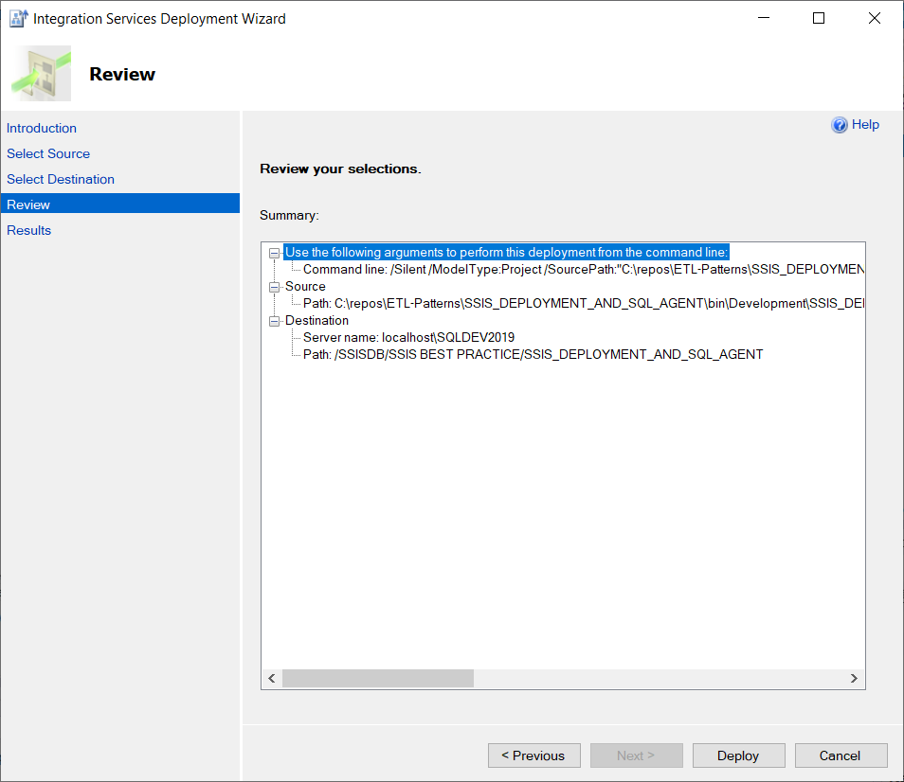
Deployment Wizard - Review
Click Deploy

Slide 22
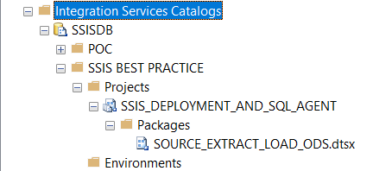
SSIS Catalog Deployment
Open SQL Server Management Studio (SSMS)
Expand Integration Services Catalog
Expand SSISDB
Expand SSIS BEST PRACTICE folder
Expand SSIS_DEPLOYMENT_AND_SQL_AGENT SSIS project
Expand packages

Slide 23
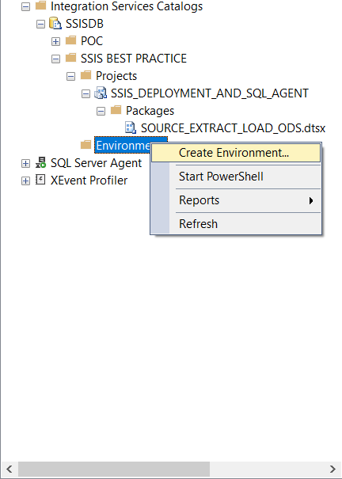
Create Environment

Slide 24
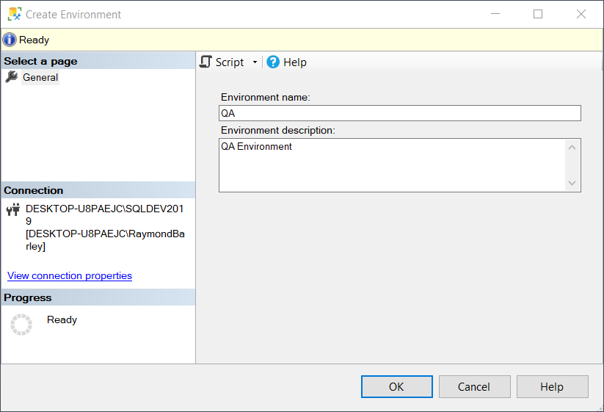
Create Environment - QA
Enter Environment name
Enter Environment description
Click OK

Slide 25
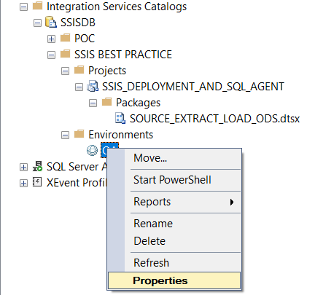
Set Properties for Environment

Slide 26
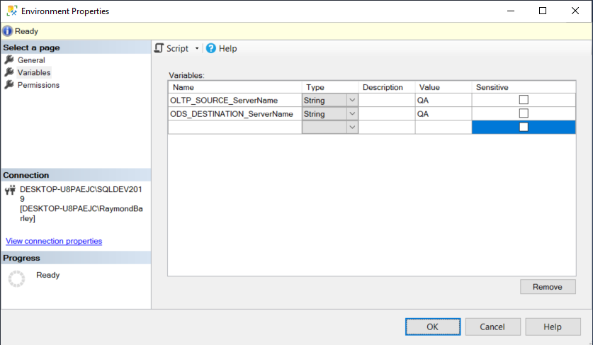
Set Values for Project Parameters

Slide 27

Make Values Sensitive
Values not shown and will be encrypted in the SSIS Catalog

Slide 28
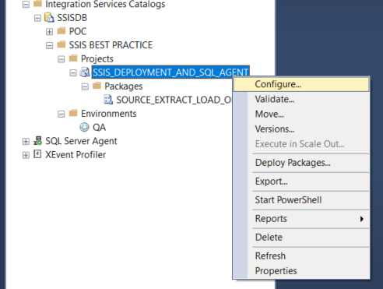
Configure Project to Use Environment

Slide 29
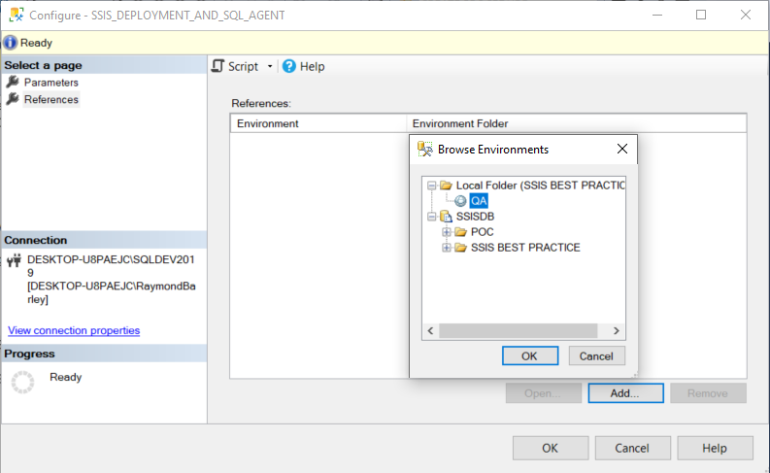
Add Reference to Environment

Slide 30
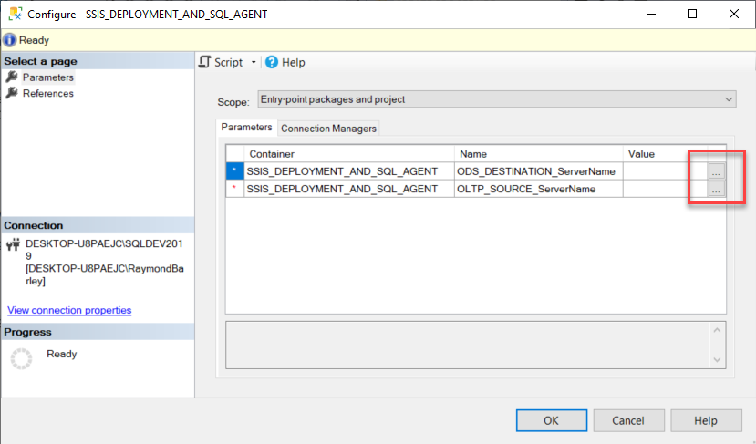
Configure Project Parameters to Use Environment Variable Values

Slide 31
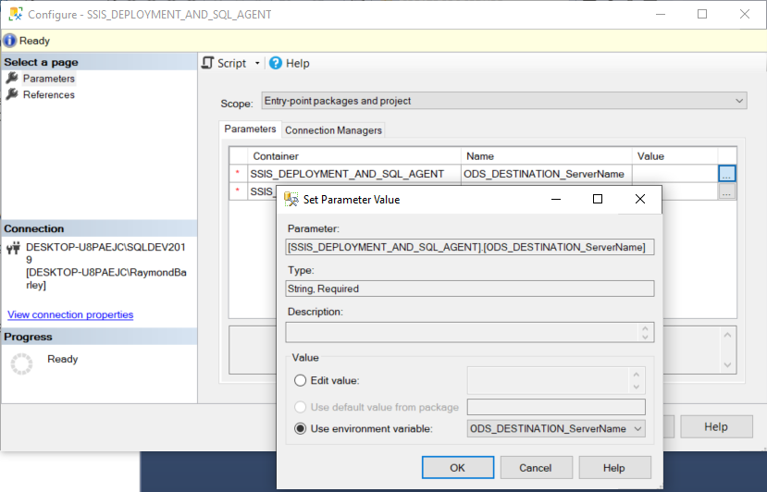
Configure Project Parameters to Use Environment Variable Values

Slide 32
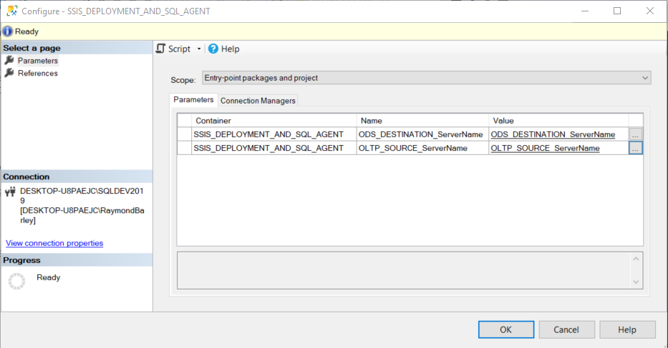
Parameter Mapping to Environment Variables

Slide 33
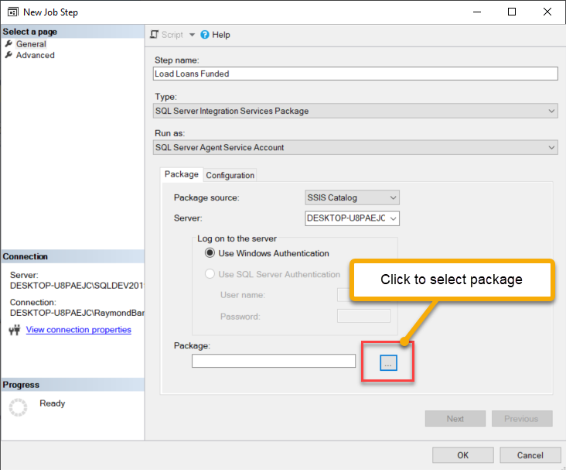
Add Job Step to Execute SSIS Package
Select Run as
Specify Server; e.g. SERVERNAME or SERVERNAME\INSTANCENAME
Specify SSIS package to execute from the SSIS Catalog

Slide 34
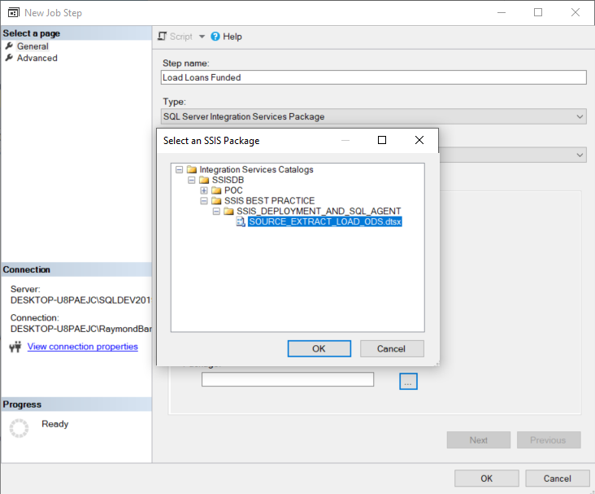
Navigate to Package in SSIS Catalog

Slide 35
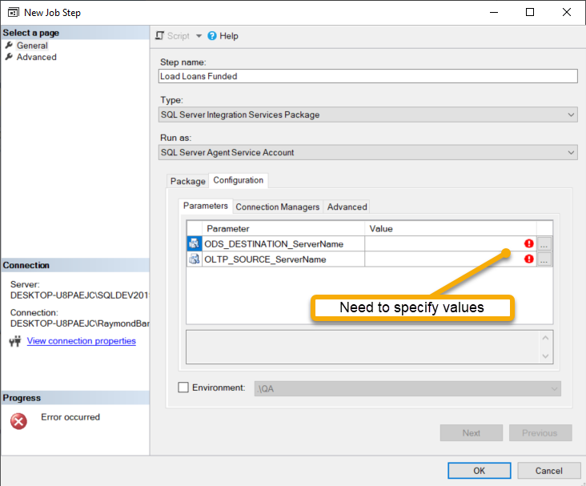
Set Job Step Configuration
Select Run as
Specify Server; e.g. SERVERNAME or SERVERNAME\INSTANCENAME
Specify SSIS package to execute from the SSIS Catalog

Slide 36
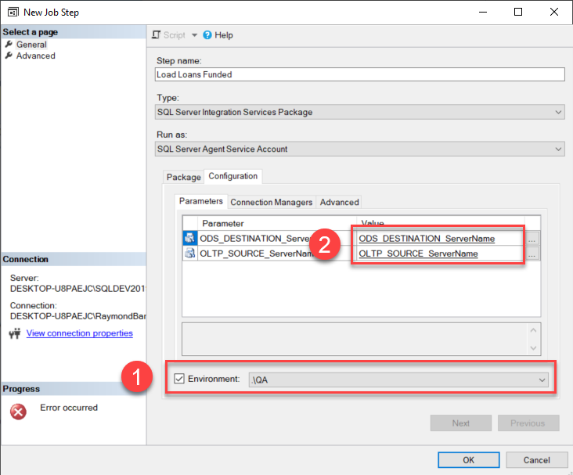
Set Job Step Configuration
Click Environment check box and select environment from drop down list
Parameter values are automatically mapped from the QA Environment

