Slide 1
SSIS Project Parameters
Ray Barley

Slide 2
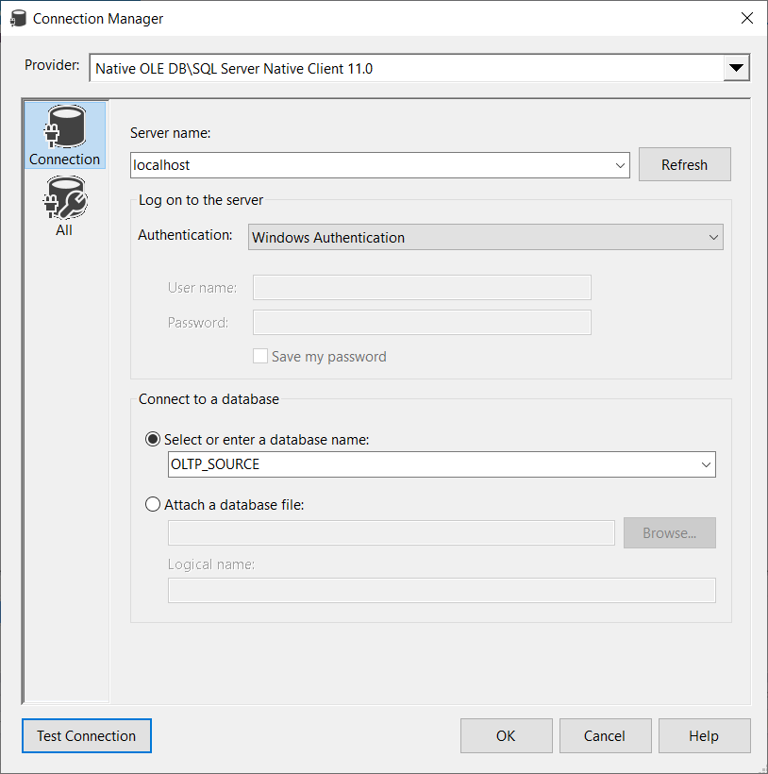

Slide 3
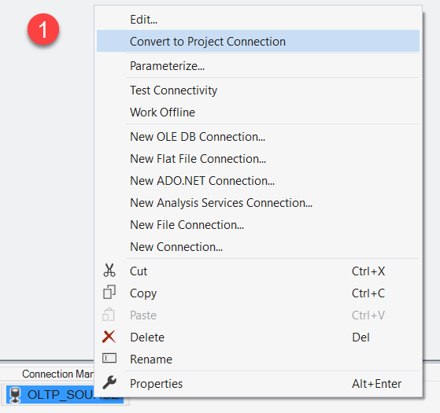
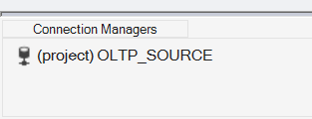
Convert Connection to Project Connection
Right-click connection …
(project) indicates Project connection

Slide 4
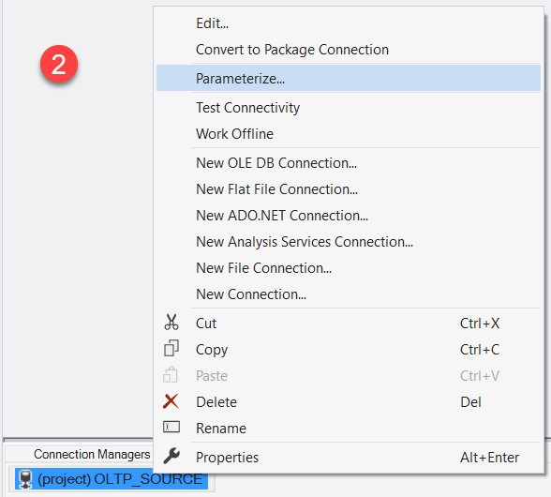
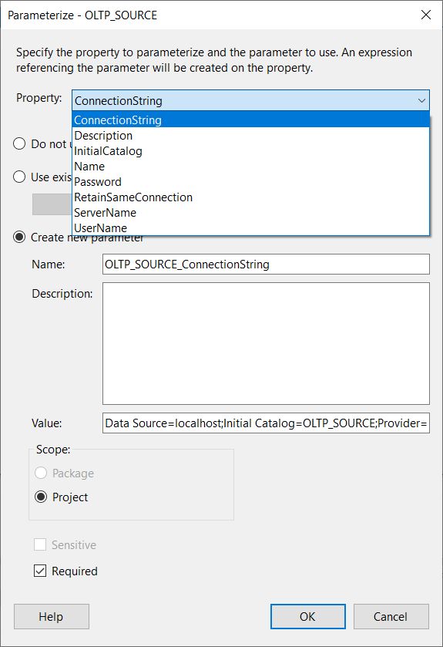
Parameterize Project Connection
Right-click connection …

Slide 5
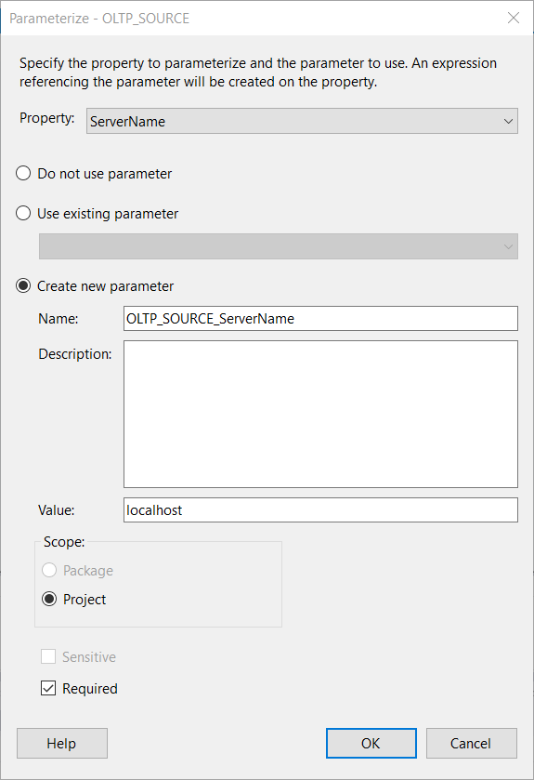
Parameterize Project Connection
Select Property to Parameterize
Create a new parameter in the SSIS package
Specify initial value of ServerName; e.g. used in development
Set Scope to Project (automatic)
Check Required; forces value to be specified when adding to a SQL Server Agent job step

Slide 6
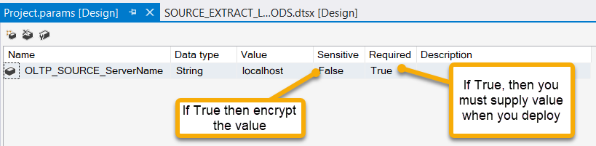
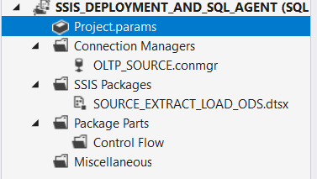
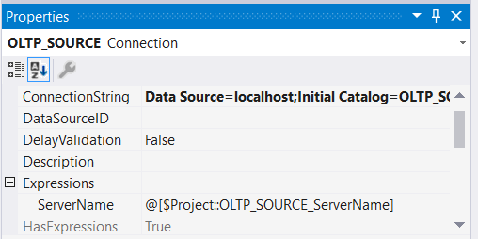

Parameterize
Double-click Project.params in the Solution Explorer to display the list of Project parameters
ServerName gets its value from an expression which is the Project parameter
fX icon indicates an expression
is used

Slide 7

Deploy to SSIS Catalog (HIDDEN )
Build project
Get .ISPAC file from PROJECT FOLDER\bin\Development
TO DO: I can’t connect to SSIS service; how do I deploy from ISPAC?

Slide 8
Deploy to SSIS Catalog
Right-click SSIS project in Solution Explorer
Select Deploy
Walk through the Deployment Wizard

Slide 9
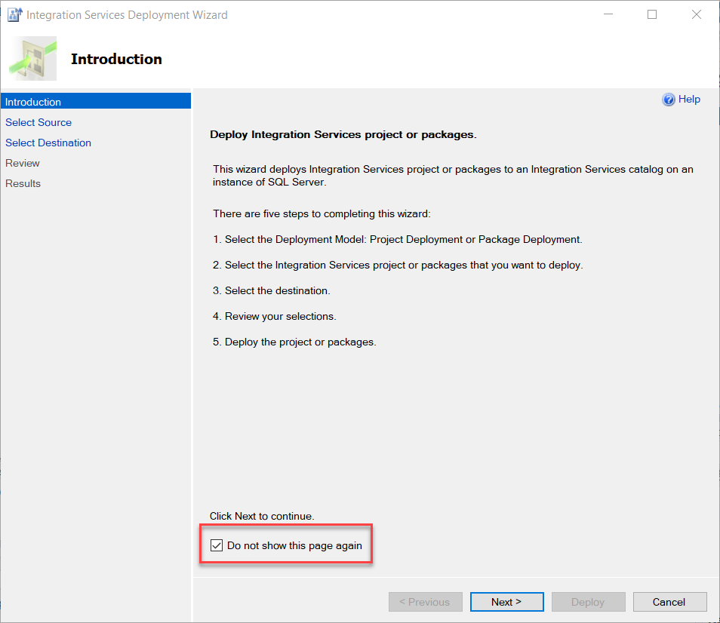
Deployment Wizard – Introduction

Slide 10
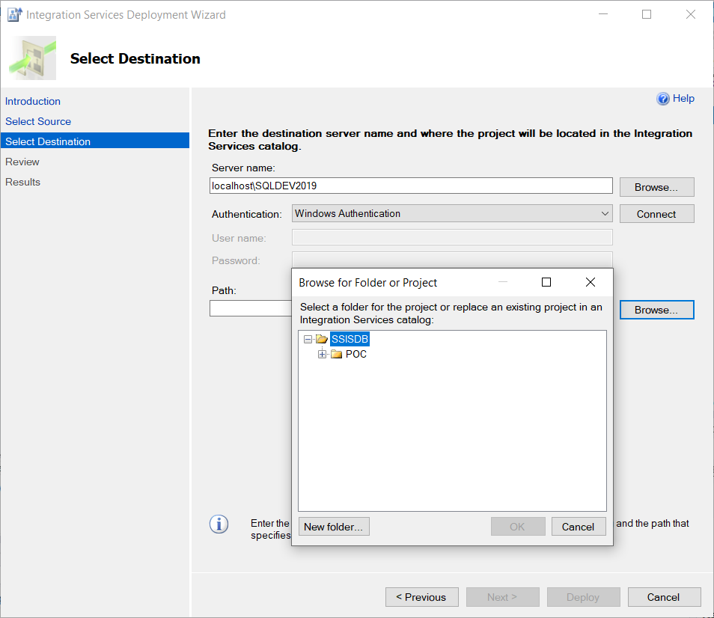
Deployment Wizard – Destination
Enter Server name
Click Connect
Enter Path (navigate to the folder in the SSIS catalog; you can create a new folder)

Slide 11
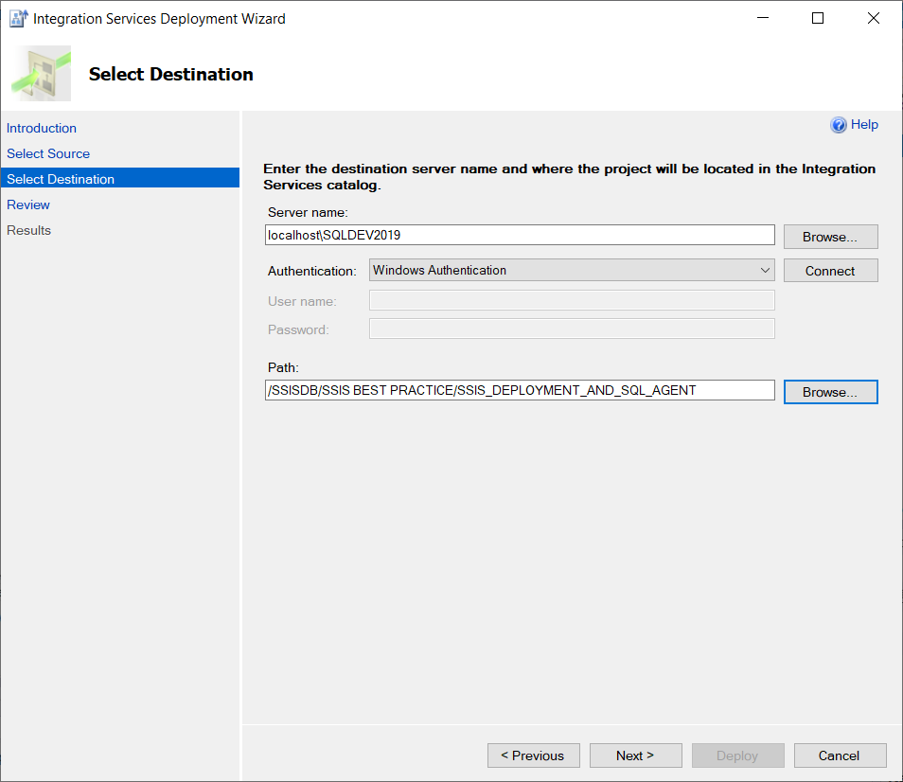
Deployment Wizard - Destination

Slide 12
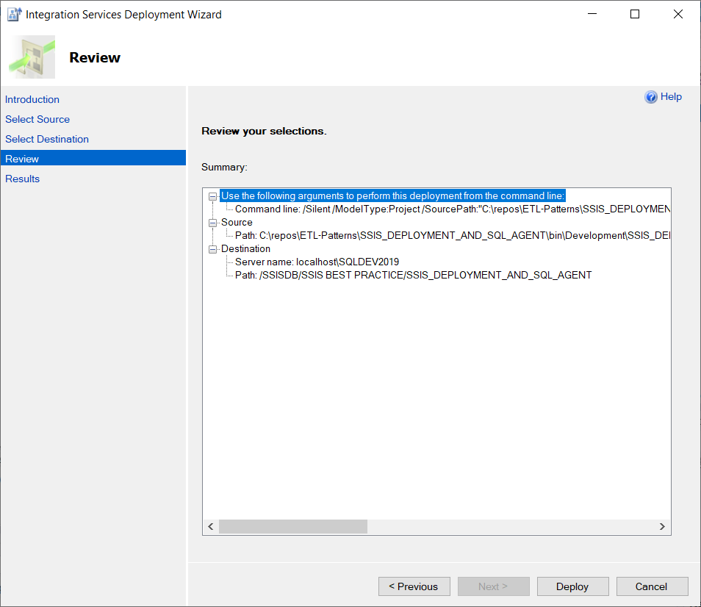
Deployment Wizard - Review
Click Deploy

Slide 13
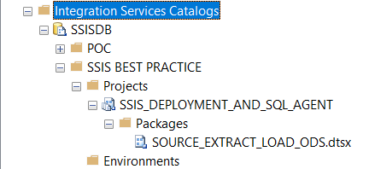
SSIS Catalog Deployment
Open SQL Server Management Studio (SSMS)
Expand Integration Services Catalog
Expand SSISDB
Expand SSIS BEST PRACTICE folder
Expand SSIS_DEPLOYMENT_AND_SQL_AGENT SSIS project
Expand packages

Slide 14
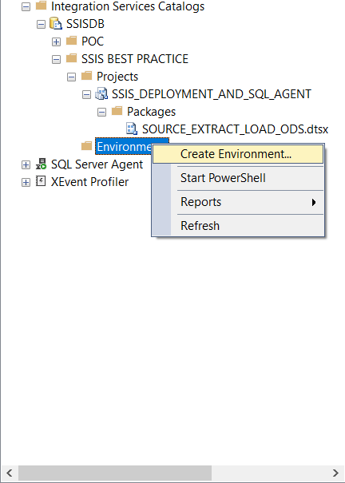
Create Environment

Slide 15
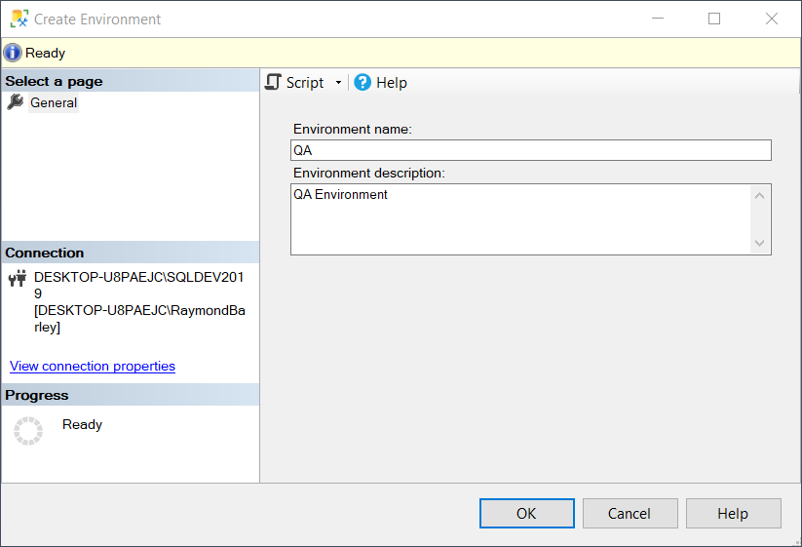
Create Environment - QA
Enter Environment name
Enter Environment description
Click OK

Slide 16
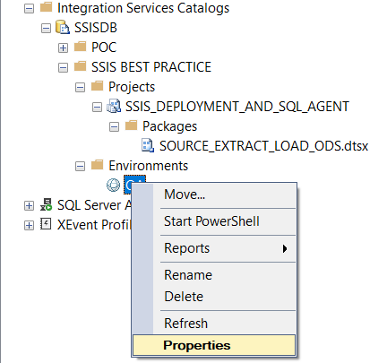
Set Properties for Environment

Slide 17
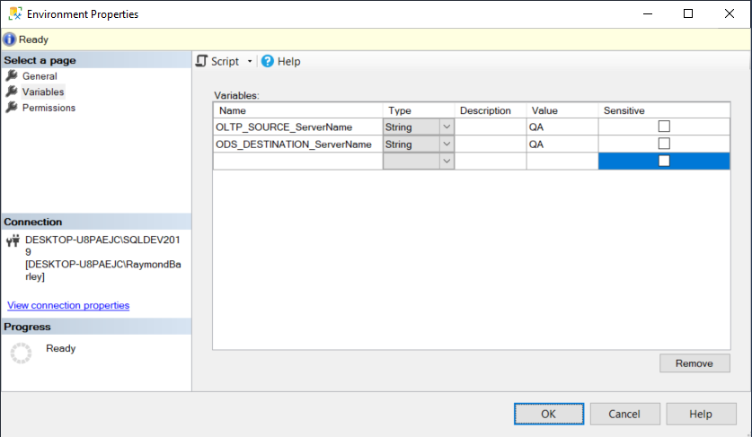
Set Values for Project Parameters

Slide 18

Make Values Sensitive
Values not shown and will be encrypted in the SSIS Catalog

Slide 19
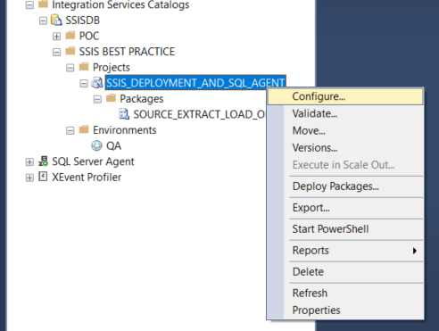
Configure Project to Use Environment

Slide 20
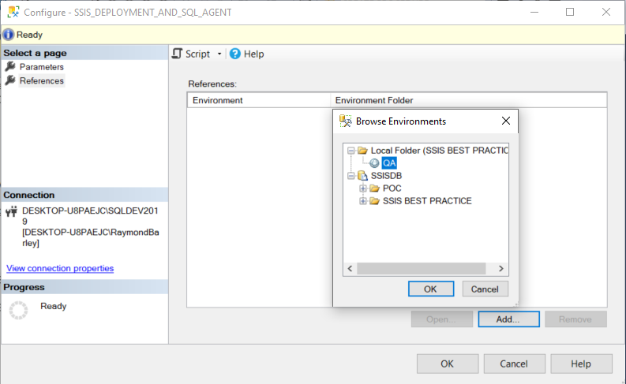
Add Reference to Environment

Slide 21
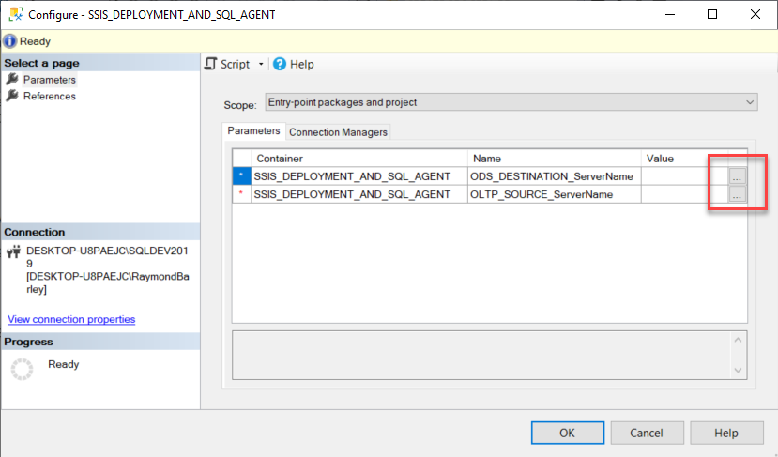
Configure Project Parameters to Use Environment Variable Values

Slide 22
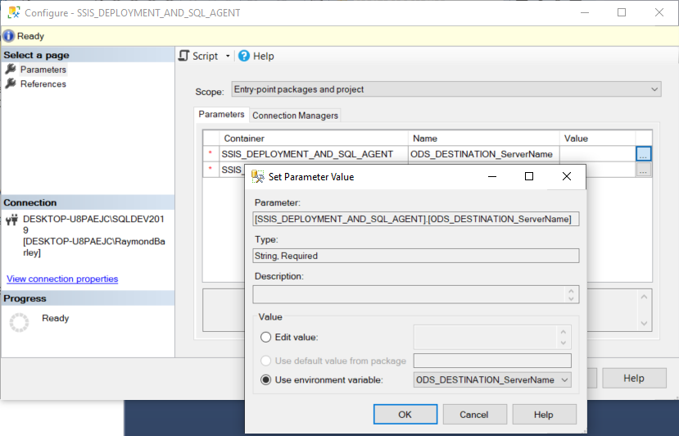
Configure Project Parameters to Use Environment Variable Values

Slide 23
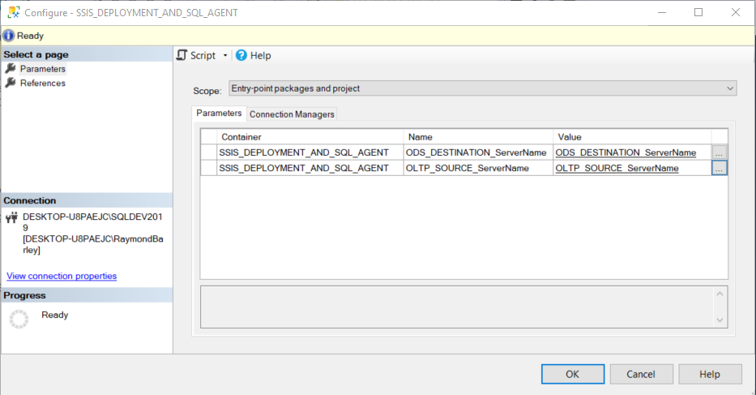
Parameter Mapping to Environment Variables

Slide 24
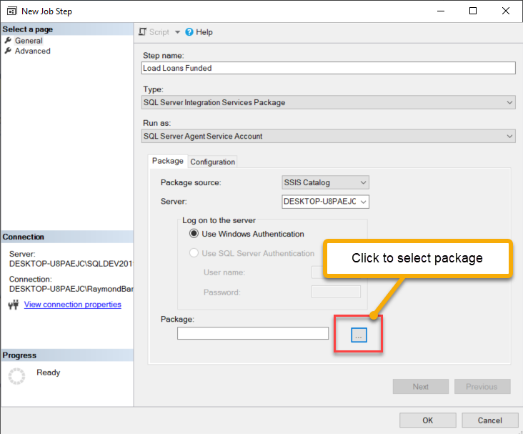
Add Job Step to Execute SSIS Package
Select Run as
Specify Server; e.g. SERVERNAME or SERVERNAME\INSTANCENAME
Specify SSIS package to execute from the SSIS Catalog

Slide 25
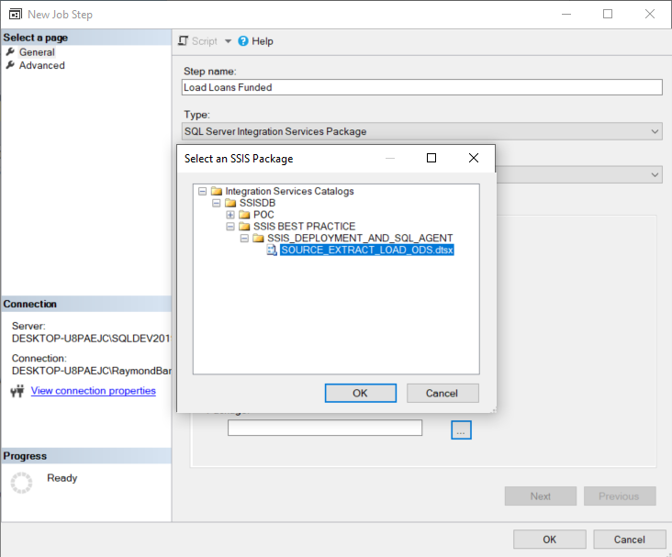
Navigate to Package in SSIS Catalog

Slide 26
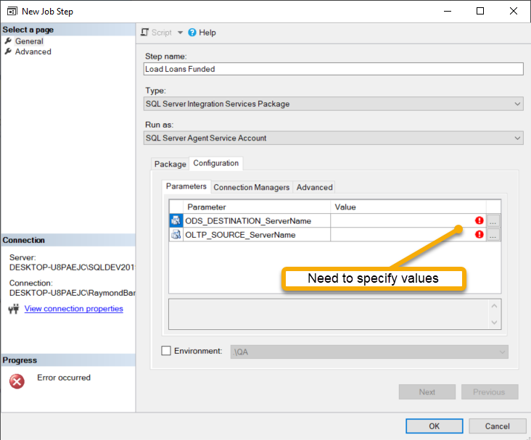
Set Job Step Configuration
Select Run as
Specify Server; e.g. SERVERNAME or SERVERNAME\INSTANCENAME
Specify SSIS package to execute from the SSIS Catalog

Slide 27
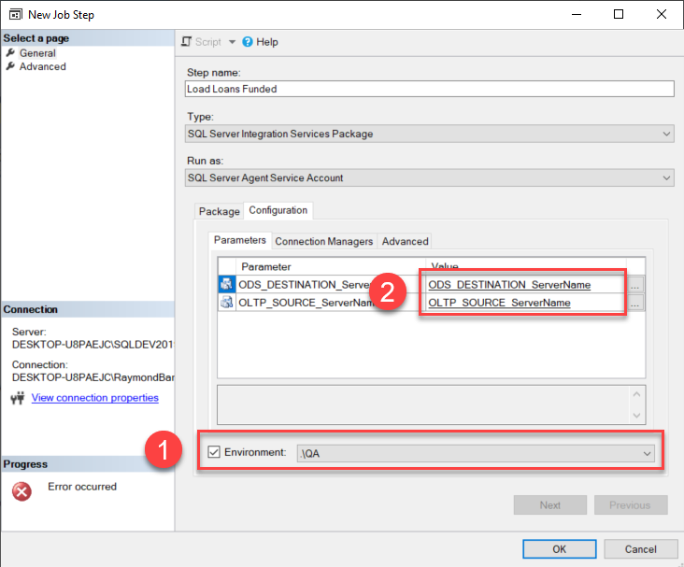
Set Job Step Configuration
Click Environment check box and select environment from drop down list
Parameter values are automatically mapped from the QA Environment

