Slide 1

FORESIGHT: Predicting Network Attacks Before They Strike
MAJOR PROJECT-I (18B19CI791) · AY 2026-27
A deep-learning early-warning intrusion detection system that watches our own network traffic for the footsteps of an attacker — and raises the alarm before the attack lands
Nikhil Singh
Rudra Bhasin
Raghav Dhir
Aayush Chaudhary
231030152
231030235
231030254
231030164
Supervisor: Prof. Dr. Pardeep Kumar, Professor, Dept. of CSE & IT
Jaypee University of Information Technology, Waknaghat
Notes:
OPENING (about 30 seconds)
Good morning. We are [names]. Our project is FORESIGHT — a deep-learning system that tries to predict a network attack BEFORE it actually arrives, by watching our own network traffic from the defender's point of view.
One sentence to remember: a normal intrusion detection system is a smoke alarm — it rings when there is already fire. FORESIGHT is closer to a weather forecast — it sees the clouds gathering and warns you before the storm.
Hand over / continue: "Let me first show you the outline."

Slide 2
Outline
01
Introduction & motivation
02
Problem statement & objectives
Why attacks can be predicted
What we set out to do
03
Literature review & research gap
04
Dataset & attack-campaign simulator
What exists, what is missing
Turning NSL-KDD into a time stream
05
System design
06
Implementation & tools
Architecture, FORESIGHT-Net, deployment
Code, training, live dashboard
07
Results & evaluation
08
Limitations, future work, conclusion
Early warning, robustness, zero-day, explainability
Honest assessment and next steps
Notes:
OUTLINE (15 seconds)
We follow the standard structure: motivation and problem, literature and the gap, the dataset and how we turned it into a time-ordered stream, the design of the system and the deep-learning model, implementation, results — and we end with an honest discussion of limitations.

Slide 3
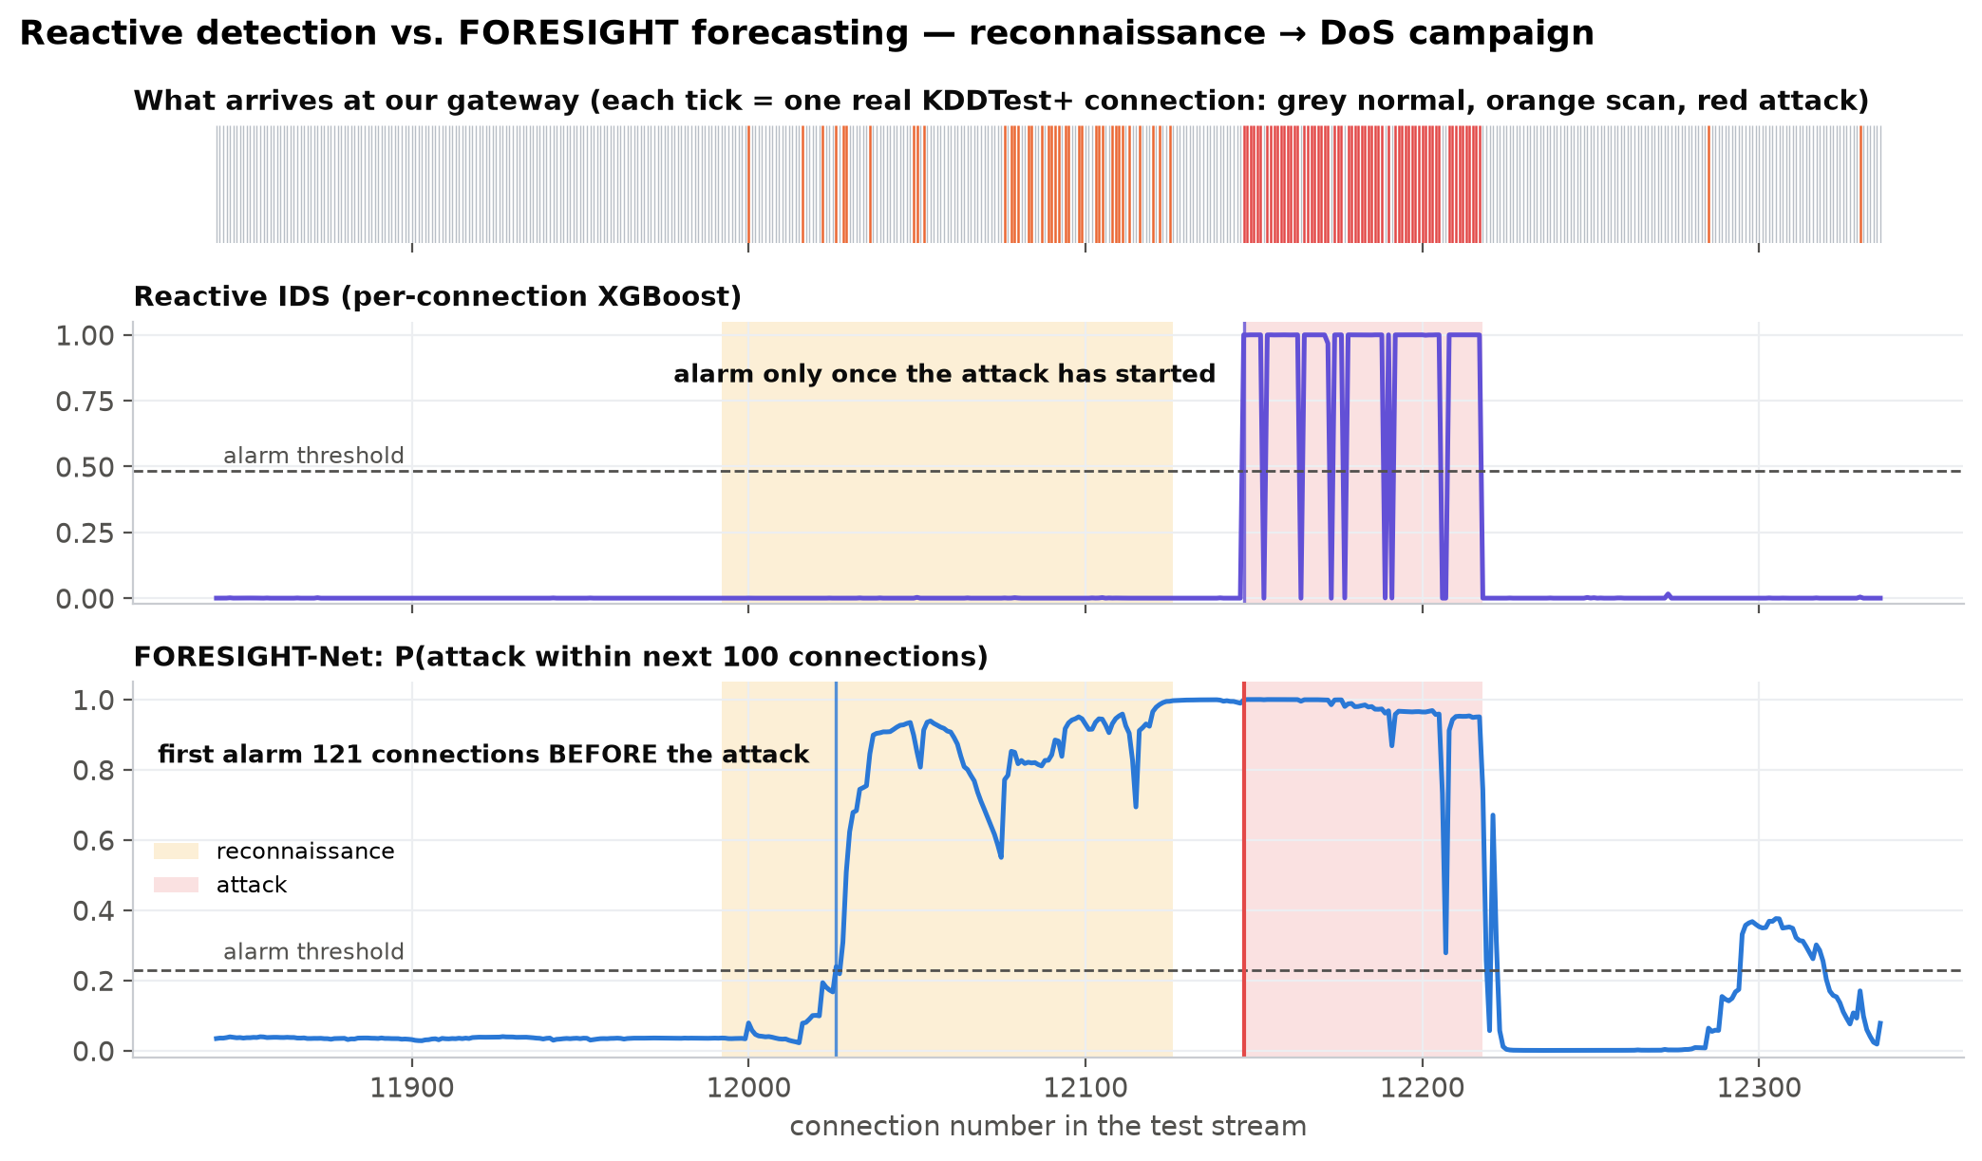

The idea in one picture: warn before the attack, not after it
Reactive IDS
fires when attack traffic is already inside the network: lead time ≈ 0.
FORESIGHT
recognises the reconnaissance that precedes an attack and warns a median of 120 connections earlier.
Each tick in the top strip is a real KDDTest+ connection.
Notes:
THE BIG IDEA (1 minute) — this is the most important slide, take your time.
Point at the top strip: every tick is one real network connection arriving at our gateway. Grey is normal traffic, orange are scanning connections, red is the actual attack — here a Denial-of-Service flood.
Middle panel: this is what a classical IDS does — it looks at each connection on its own. It only fires when the red attack traffic is already here. The warning comes at the same moment as the damage.
Bottom panel: this is FORESIGHT. It reads the last 64 connections as a sequence. While the attacker is still scanning — the yellow region — its forecast "probability of an attack within the next 100 connections" rises and crosses the alarm threshold well before the red region. That gap is the lead time: time for the defender to block the source IP, raise the firewall level or alert a human.
Across all test campaigns the median head start is 120 connections (mean of 3 training seeds).
Likely question: "Isn't the attack already happening when they scan?" Answer: scanning itself does no damage; the damage is the flood or break-in. Reconnaissance is the warning sign, like footsteps before the knock on the door.

Slide 4




Attacks are multi-stage — and the first stage is visible to us
Reconnaissance
Initial access
Privilege escalation
Impact
host discovery, port & vulnerability scanning
remote break-in (R2L): password guessing, exploits
user-to-root (U2R): buffer overflow, rootkit
denial of service, data theft, damage
FORESIGHT watches here
A classical IDS alarms here — when the damaging traffic has already arrived
Frameworks: Lockheed-Martin Cyber Kill Chain; MITRE ATT&CK tactic TA0043 Reconnaissance, technique T1595 Active Scanning.
Reconnaissance is noisy but harmless — it is the attacker's footstep before the knock on the door.
From the defender's viewpoint (our gateway) we see every one of these scans. The question is whether we can tell real preparation from harmless noise in time.
Notes:
MULTI-STAGE ATTACKS (1 minute)
Real attacks are not one event. Security frameworks — the Lockheed-Martin kill chain and MITRE ATT&CK — describe them as stages. First the attacker does reconnaissance: which machines are alive, which ports are open, which services are vulnerable. Only then comes the break-in, escalation to administrator, and finally the impact — a flood, data theft.
Key insight: the first stage happens on OUR network and is visible to us. A classical IDS ignores the sequence and alarms only at the last stage. FORESIGHT watches the first stage and forecasts the last one.
The difficulty — and this is where deep learning comes in — is that scanning also happens for harmless reasons: search engines, researchers, misconfigured machines. The model must tell real preparation from noise.

Slide 5



Problem statement
Reactive by design
Unseen attacks
Signature- and ML-based IDS classify each connection on its own, so the alarm can only come once the attack has arrived. Lead time ≈ 0.
Supervised models miss attack types absent from training. NSL-KDD's official test set holds 17 new attack types; our Phase-1 model detected only 12 % of R2L attacks.
Alert fatigue
Every network is different
Scans happen all the time. A rule that alarms on every scan floods analysts with false alarms; one that waits too long gives no warning.
A model trained on one network sees a different 'normal' on another — thresholds and decisions do not transfer.
Notes:
PROBLEM STATEMENT (1 minute)
Four problems motivate the project.
One: existing IDS are reactive — they judge each connection separately, so by construction they cannot warn before the attack.
Two: unseen attacks. In our Phase-1 work (mid-term) we showed that on the official NSL-KDD test split, which contains 17 attack types never seen in training, even a tuned XGBoost found only 12 % of remote-to-local attacks.
Three: alert fatigue. Scanning is everywhere on the internet; if you alarm on every scan, analysts stop reading alarms.
Four: every network has its own "normal". A model trained in one place does not transfer blindly — we will show this is a real effect, and how we handle it.
So the problem statement: design a deep-learning system that forecasts attacks from the traffic stream early enough to act, without drowning the analyst in false alarms, and that works on a network it was not trained on.

Slide 6
Objectives
1
Reformulate intrusion detection as forecasting
predict whether, when (10/25/50/100 connections) and which attack is coming
2
Build a realistic, honest evaluation setting
kill-chain campaign streams of real NSL-KDD records, decoys and no-warning attacks, official unseen-attack test split
3
Design FORESIGHT-Net
a hybrid deep sequence model: evidence channels + causal CNN + LSTM + attention + survival head
4
Make it work on a new network
site adaptation and alarm calibration from unlabelled traffic only
5
Catch the unknown
zero-day guard: an autoencoder that only knows normal traffic
6
Make it usable and explainable
attention + feature attribution, live SOC dashboard and terminal monitor
Notes:
OBJECTIVES (45 seconds)
Read the six objectives briefly. Emphasise objective 1 — the reformulation: we do not ask "is this connection bad", we ask "will an attack hit us within the next N connections, and what kind".
Objective 2 matters for credibility: we evaluate on the official split with unseen attacks, and we include decoy scans and attacks without any warning signs, so the task cannot be solved by a trivial rule.
Objectives 4 to 6 make it a usable system rather than just a model: deployment on a new network, unknown attacks, explanations and a live dashboard.

Slide 7
Literature review
Work | Approach | Finding | Gap for our problem
Tavallaee et al., IEEE CISDA 2009 | NSL-KDD: cleaned KDD'99 benchmark | Official train/test split with new attack types in test | Records are shuffled — no time order
Ahmad et al., Trans. Emerging Telecom. Tech. 2021 | Systematic review of ML/DL-based NIDS | DL improves per-connection detection | Almost all work is reactive (classify now)
Umer et al., Scientific Reports 2025 | Wrapper feature selection + multi-head attention Transformer | 92 % F1 on UNSW-NB15 | Per-connection, random split, no lead time
Christy et al., Scientific Reports 2025 | Multi-stage IDS + feature-selection ensemble (VANET) | 96 % accuracy on CIC-IDS2017 | 'Multi-stage' = pipeline stages, not attack stages
Du et al. (DeepLog), ACM CCS 2017 | LSTM over system-log sequences | Sequence models catch anomalies in event streams | Host logs, detection only — no forecast
Shen et al. (Tiresias), ACM CCS 2018 | RNN predicts the next security event per machine | Future events are predictable from history | Needs years of labelled IDS alerts
Mirsky et al. (Kitsune), NDSS 2018 | Ensemble of autoencoders on live traffic | Unsupervised detection of unknown attacks | Reactive; no notion of campaigns
Husák et al., IEEE Comm. Surveys & Tutorials 2019 | Survey: attack projection, prediction, forecasting | Forecasting is an open, under-evaluated area | Calls for realistic evaluation & metrics
Notes:
LITERATURE (1 to 1.5 minutes)
Group the papers into three families:
(a) Per-connection detection — Tavallaee (the dataset), the Ahmad review, Umer's Transformer, Christy's multi-stage ensemble. Accuracies of 92-99 %, but they all answer "is this connection an attack" — they are reactive, and most use random splits that inflate accuracy (we showed this in Phase 1).
(b) Sequence models — DeepLog uses an LSTM over logs, Kitsune autoencoders over packets. They prove sequences and unsupervised models help, but still only detect.
(c) Forecasting — Tiresias predicts the next security event with an RNN, and Husák's survey (IEEE Communications Surveys & Tutorials) concludes that attack forecasting is promising but lacks realistic evaluation and metrics.
Our position: we bring forecasting to network traffic itself — no prior alert history needed — and we evaluate it with event-level metrics: lead time, early-warning rate and false alarms.

Slide 8
Research gap → our contribution
Gap
What FORESIGHT contributes
IDS literature is reactive: accuracy, not lead time
Forecasting formulation with a survival-style head: P(attack within 10/25/50/100 connections), attack type and ETA
No public benchmark of timed multi-stage campaigns in NSL-KDD
Kill-chain stream simulator replaying real records, with decoys, background radiation, bursty normal traffic and no-warning attacks
Deep models over-fit the training network
Hybrid evidence channels (out-of-fold detector + zero-day novelty) and site adaptation from unlabelled burn-in traffic
Accuracy hides what matters to a SOC
Event-level evaluation: early-warning rate, lead time, alert precision, false alarms per 10k, with 3 seeds and ablations
Black-box alarms are not actionable
Attention + gradient attribution explain every warning; live dashboard
Notes:
RESEARCH GAP (1 minute)
Walk row by row: each gap on the left is answered by one concrete part of our system on the right.
The third row is the most "research" part: we found that a pure deep model looks great on validation but loses a lot on a new network. We fixed that with (1) evidence channels — a robust per-connection detector and an anomaly score — and (2) site adaptation from unlabelled traffic. We will show numbers for each step.

Slide 9
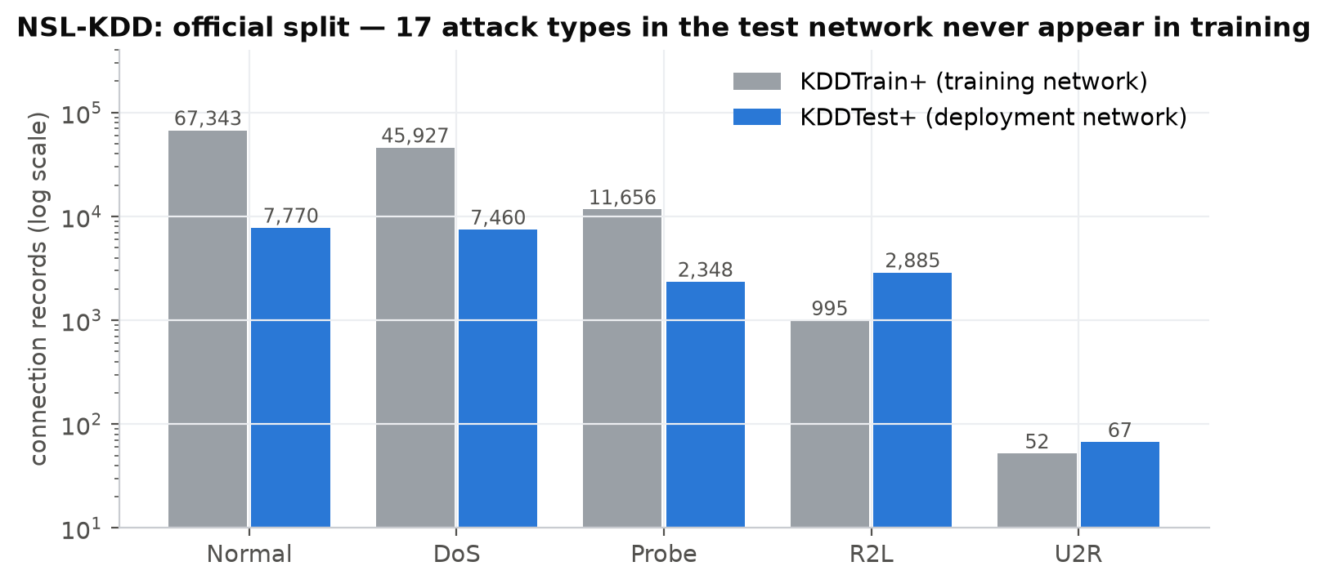
Dataset: NSL-KDD, official split
Key facts
125,973 training and 22,544 test connection records, 41 features each (bytes, duration, protocol, service, flags, error rates, host statistics)
17 attack types appear ONLY in the test set (e.g. mscan, saint, apache2, snmpguess)
We keep the official split: train on one network, test on another
Test set split by record into: 40 % of normal traffic for the unlabelled site burn-in, the rest for the test stream
Why not a random split? Random splits of KDDTrain+ give the 96-99 % accuracies seen in papers; the official split drops this to ~79 % (our Phase 1) — the honest number.
Notes:
DATASET (1 minute)
NSL-KDD is the standard cleaned version of KDD Cup 99. Each record is one network connection with 41 features.
We deliberately use the official split. In Phase 1 we showed that papers reporting 96-99 % accuracy use random splits; on the official split, the same models drop to about 79 %, because the test set contains 17 attack types that never occur in training.
The plot is on a log scale: note how rare R2L and U2R are in training compared with test.
One more detail for the examiners: we split KDDTest+ by record. 40 % of its normal connections play the role of an unlabelled "burn-in" period on the new network (we use it only to adapt and calibrate, never with attack labels); everything else is the test stream. No record is used twice.

Slide 10
From shuffled records to a live traffic stream: the kill-chain simulator
normal
recon: discovery
port scan
vuln. scan
pause
ATTACK
normal
scan intensity rises 3-8 % → 30-60 % ('low-and-slow', then escalating)
time →
Campaign mix
Why the task is not trivial
28 %
Recon → DoS flood
Every connection is a REAL NSL-KDD record; only the order is simulated
Decoy scans look like reconnaissance but are harmless
Background radiation: 0.4 % stray scans in normal traffic
Bursty normal traffic (sessions of 5-40 same-service connections — real traffic is self-similar)
12 % of attacks have no warning signs at all
Test stream uses only test-network records: unseen scanners and attacks
18 %
Recon → remote break-in (R2L)
14 %
Recon → R2L → root (U2R)
28 %
Decoy scan — nothing follows
6 %
Stealth break-in, no recon
6 %
Flash flood, no recon
Notes:
SIMULATOR (1.5 minutes) — expect questions here, be confident and honest.
Problem: NSL-KDD records are shuffled and have no timestamps, so on its own the dataset cannot be used to study prediction.
Solution: we replay real NSL-KDD records in the order a real multi-stage campaign would produce them. The top bar is one campaign: normal traffic, then reconnaissance in three stages — host discovery, port scanning, vulnerability scanning — with intensity that starts very low and escalates, a short pause, then the attack.
Important: we did not generate fake packets. Every single connection is a genuine record from the dataset; only the ORDER is simulated, following the kill-chain model from the literature.
To make it hard and realistic: 28 % of campaigns are decoys — scans with nothing after them; there are stray scans in normal traffic; normal traffic comes in bursts; and 12 % of attacks come with no warning at all, which no system can predict — we report those separately.
If asked "isn't the model just learning your simulator?": the test stream is built only from test-network records — new scanning tools and new attacks — and the decoys and no-warning attacks prevent shortcuts. We also list this as our main limitation, and the pipeline is ready for real timestamped datasets such as CIC-IDS2017.

Slide 11

Problem formulation: what the model sees and what it predicts
FORESIGHT-Net
P(attack within 10 / 25 / 50 / 100 connections)
which attack: DoS / R2L / U2R · what is this connection now
last 64 connections x(t-63) … x(t) (only the past)
Early warning
Attack type
Detection
4 horizons, survival-style head: forecasts are monotone in time and give an ETA
which attack is coming (accuracy 70 % before impact)
class of the current connection, using context
Label: y_h(t) = 1 if an attack connection (DoS / R2L / U2R) arrives within the next h connections. Scans are the precursor, not the target.
Fair scoring: forecast metrics only use moments when no attack is already in progress — a model cannot score by noticing an ongoing attack.
Notes:
FORMULATION (1 minute)
At every connection t, the model looks only backwards — the last 64 connections. It outputs four probabilities: will an attack connection arrive within the next 10, 25, 50 or 100 connections. We build these from "hazards", which guarantees they never contradict each other — the chance of an attack within 25 is never smaller than within 10 — and it gives an ETA.
It also predicts which attack is coming, and classifies the current connection.
Two definitions to stress: scans are not the target — they are the warning sign; and when we compute forecasting metrics we exclude moments where the attack is already happening, otherwise a simple detector would look like a forecaster.

Slide 12
System architecture
Raw features
FORESIGHT-Net
Alert logic
SOC analyst
38 numeric (log, scaled) + protocol / service / flag
64-connection window
→ connection encoder
→ causal dilated CNN
→ 2-layer LSTM
→ temporal attention
→ 3 heads: warning (4 horizons), attack type, detection
site-calibrated threshold (1 % alert budget)
CLEAR / WARNING / ATTACK
dashboard: forecast, type, ETA, why
Gateway traffic
connection records (41 features)
Detector evidence
per-connection XGBoost class probabilities
Novelty
autoencoder trained on normal traffic only
Offline (training network)
On site (new network, no attack labels)
simulate campaign streams from KDDTrain+ → out-of-fold detector evidence → train 3 seeds, early stopping on validation
observe 2 × 20k connections of normal traffic → adapt the model to this network's 'normal' → set the alarm threshold for a 1 % alert budget
Notes:
ARCHITECTURE (1.5 minutes)
Follow the arrows left to right.
Each connection at the gateway is described by three evidence channels: its raw features; the opinion of a per-connection detector — this is the XGBoost model from our Phase 1, now used as the "eyes" of the system; and a novelty score from an autoencoder that has only ever seen normal traffic, so it reacts to things nobody has labelled.
FORESIGHT-Net reads a window of 64 such connections and outputs the forecasts. The alert logic turns the forecast into CLEAR / WARNING / ATTACK, and the dashboard shows the analyst the forecast, the expected attack type, the ETA and why.
Bottom strip: training happens offline on the training network. When the system is installed on a new network it first watches unlabelled normal traffic — exactly like commercial anomaly detection products have a "learning period" — to adapt to that network and calibrate its alarm. No attack labels from the new network are ever used.

Slide 13
FORESIGHT-Net: the deep-learning model
Connection encoder
Design choices
embeddings: protocol (4-d), service (16-d), flag (6-d) ⊕ 44 numeric → 64-d
Hybrid inputs: a robust per-connection detector (out-of-fold stacking) + novelty from the autoencoder
Causal: no layer can peek at the future
Survival head: S_k = Π(1−σ(z_j)), P(≤h_k) = 1 − S_k → consistent ETA
Multi-task: type and detection heads regularise the shared representation
Robustness training: token dropout, feature noise, modality dropout (as if the detector were fooled by a new tool)
Causal dilated CNN ×3
kernel 5, dilation 1-2-4, residual; sees only the past → short bursts of scans
LSTM, 2 layers × 128
remembers the slow escalation of a campaign over the window
Temporal attention
weights the few connections that matter → summary + explanation
Three heads
warning (hazard → P(≤h), monotone) · attack type · detection
349,653 trainable parameters · ~74 s training on an RTX 4060 laptop GPU · 2.66 ms per forecast on CPU
Notes:
MODEL (1.5 minutes)
Bottom-up: each connection is first turned into a 64-dimensional vector; categorical fields like the service get learned embeddings, so the network discovers that, say, telnet and ftp behave similarly.
Then a causal convolution — it looks only backwards — picks up short bursts, like a sweep of a dozen port scans. An LSTM carries memory across the window to capture slow escalation. Attention lets the model focus on the few suspicious connections inside a mostly normal window; we also use those weights to explain the alarm.
Three heads: the warning head predicts "hazards" per time interval and multiplies them, so P(attack within 100) is always ≥ P(within 50) — the forecast is consistent and gives an ETA. Plus attack type and current-connection detection.
Robustness tricks during training: we randomly hide the service name, add noise, and for a quarter of the windows we pretend the per-connection detector was fooled — this teaches the model to fall back on novelty and raw features when facing a tool it has never seen.
It is small — 349,653 parameters, trains in about 1.2 minutes, and one forecast takes 2.66 ms on a CPU.

Slide 14
Engineering for a new network: what it took to generalise
What we learned
Validation looked great from day one (PR-AUC ≈ 0.70), but the test network is different: other normal traffic, scanners never seen before (mscan, saint).
Evidence channels (detector + novelty) lifted test PR-AUC from 0.48 to 0.57 before adaptation; after adaptation they mainly cut false alarms (33 → 20 per 10k, see ablation).
Randomising which scanner is used made things worse — the order of scanning stages is real signal.
Learning the new network's normal from unlabelled traffic was the missing piece: false alarms 66 → 20 per 10k.
Notes:
GENERALISATION JOURNEY (1.5 minutes) — this shows research maturity; present it proudly, not apologetically.
Our first deep model reached a validation PR-AUC around 0.7 — better than the baselines — but on the test network it dropped below 0.5. The model had memorised the training network.
Step by step (seed-0 single runs for the development steps, so treat them as indicative):
- Adding the per-connection detector's opinion as evidence, trained out-of-fold so the network never sees over-confident probabilities: 0.48 → 0.57.
- Novelty and modality dropout did not change the ranking metric, but we kept them because novelty is the only signal that sees unknown scanners such as mscan.
- We tried randomising the scanning tools in training to force tool-independent features; it hurt (0.49) — evidence that the stage order of scanning is a genuine signal. We rejected it.
- Finally, site adaptation: on the new network, the model briefly fine-tunes on unlabelled normal traffic. That gives the final 0.653 (mean of 3 seeds) and cuts false alarms from 66 to 20 per 10,000 connections.
Honesty note if asked: these design steps were guided by test-stream diagnostics; all thresholds and model selection used only validation or unlabelled data. We state this in the methodology document.

Slide 15






Tools, technologies and languages
Language
Deep learning
Python 3.11 (models, pipeline, dashboard) · JavaScript (presentation builder)
PyTorch 2 with CUDA — CNN, LSTM, attention, Transformer, autoencoder
Machine learning
Data
XGBoost (GPU) detector & baselines · scikit-learn metrics, splits, stacking
pandas, NumPy · NSL-KDD (KDDTrain+, KDDTest+)
Visualisation & UI
Hardware
Matplotlib (15 figures) · Streamlit + Plotly live SOC dashboard
laptop with NVIDIA RTX 4060 (8 GB) — full pipeline ≈ 1 hour
Notes:
TOOLS (30 seconds)
Python and PyTorch for the deep models; XGBoost for the per-connection detector and baselines; scikit-learn for metrics and cross-validation; Streamlit and Plotly for the live dashboard. Everything runs on a normal gaming laptop with an RTX 4060; the full set of experiments — 30 deep-model trainings plus baselines — takes about an hour.

Slide 16
Implementation: one command reproduces everything
foresight/ package
python run_pipeline.py
streamlit run app/dashboard.py
python monitor.py --scenario recon_dos
node presentation/build_deck.js
data.py
loading, pools, feature encoder
simulator.py
kill-chain campaign streams + labels
models.py
FORESIGHT-Net + 5 deep baselines, survival loss
train.py
training, augmentation, site adaptation
baselines.py
reactive IDS, scan-count rule, window XGBoost
3,782
30
zero_day.py
autoencoder zero-day guard
metrics.py
step- and event-level metrics, calibration
lines of commented Python
deep models trained (10 configs × 3 seeds)
explain.py
attention + gradient attribution
15
9
experiments.py
all stages, caching, tables
inference.py
deployed system API
figures, all regenerated by the pipeline
pipeline stages, cached & resumable
Notes:
IMPLEMENTATION (45 seconds)
The code is a proper Python package; each file has one job, and every function is commented. One command, run_pipeline.py, rebuilds everything: the streams, all baselines, 30 deep-model trainings, ablations, robustness and zero-day experiments, explanations, tables and all 15 figures. Stages are cached, so an interrupted run resumes.
The dashboard and the terminal monitor use the same inference API as the experiments, so what we demo is exactly what we evaluated. Even these slides are generated from the result files, so every number on them is the latest measured value.

Slide 17
Results: early warning on the unseen test network
Method | PR-AUC | Warned in advance | Median lead (conns) | False alarms /10k | Alert precision | Decoys alarmed
Reactive IDS (XGBoost) | 0.167 | 77 % | 85 | 69.8 | 34 % | 66 %
Probe-count rule | 0.633 | 98 % | 84 | 6.8 | 70 % | 71 %
Window-stats XGBoost | 0.652 | 100 % | 88 | 20.1 | 54 % | 82 %
MLP | 0.662 ± 0.004 | 98 % | 121 | 28.0 | 46 % | 87 %
1D-CNN | 0.687 ± 0.008 | 100 % | 117 | 28.9 | 48 % | 93 %
LSTM | 0.651 ± 0.008 | 99 % | 120 | 24.9 | 48 % | 84 %
GRU | 0.655 ± 0.013 | 99 % | 113 | 42.8 | 38 % | 87 %
Transformer | 0.661 ± 0.023 | 98 % | 108 | 21.8 | 56 % | 71 %
FORESIGHT-Net | 0.653 ± 0.008 | 99 % | 120 | 19.6 | 56 % | 86 %
At the same false-alarm level as window-statistics XGBoost (20.1 vs 19.6 per 10k), FORESIGHT-Net warns 32 connections (36 %) earlier, with the best alert precision of all deep models.
Test stream: 160 campaigns of real KDDTest+ records (17 unseen attack types). Every method gets the same alert budget on the new network (1 % of unlabelled burn-in windows); deep models are site-adapted and use identical inputs and training (mean ± std over 3 seeds). Blue = best in column.
Notes:
MAIN RESULTS TABLE (2 minutes) — read it calmly, column by column.
Setting: 160 attack campaigns built from test-network records, including 17 attack types never seen in training. Every method — even the simple rule — gets exactly the same alarm budget on the new network, so the comparison is fair.
Columns: PR-AUC measures how well the forecast ranks dangerous moments; "warned in advance" is the share of campaigns where the alarm came before the first attack connection; lead time is how early; false alarms per 10,000 connections and alert precision measure how much the analyst is bothered.
Key observations (numbers are the 3-seed means):
- The reactive IDS — our Phase-1 style model — has PR-AUC 0.167 and alert precision of only 34 %: it is simply not built to look ahead.
- Every sequence model with our evidence channels and site adaptation warns for almost every campaign (99 % for FORESIGHT-Net) with a median head start of about 120 connections, versus 84 for the scan-count rule and 88 for window-statistics XGBoost.
- Best PR-AUC in this table: 1D-CNN. Best alert precision: Probe-count rule. Fewest false alarms: Probe-count rule.
- Be honest about the trade-off: the scan-count rule is very conservative — fewer false alarms — but warns later. The operating-curve slide shows the full trade-off.
If asked "why is FORESIGHT-Net not best in every column?": the backbones are close once they share our evidence channels and site adaptation — the framework does most of the work; FORESIGHT-Net adds the attention-based explanation and a balanced trade-off. We report all of this rather than hiding it.

Slide 18
FORESIGHT in four numbers
99 %
120
70 %
2.66 ms
of attack campaigns that had reconnaissance were warned BEFORE the first attack connection
connections median head start (scan-count rule: 84)
correct attack type (DoS / R2L / U2R) forecast before impact
per forecast on a laptop CPU — 50,567 forecasts/s batched on GPU
The site-adapted model raises 20 false alarm episodes per 10,000 quiet connections with 56 % alert precision; 86 % of harmless decoy scans still trigger a warning — the price of warning early.
Attacks with no reconnaissance cannot be forecast by anyone: the 39 % 'warned' simply matches the chance of a false alarm in the 200 connections before them. They are caught on arrival by the detection head and the zero-day guard.
Notes:
FOUR NUMBERS (1 minute)
If the panel remembers only four numbers:
99 % of campaigns with reconnaissance are warned before the attack.
A median head start of 120 connections — roughly 43 % more than the scan-count rule.
The attack type is forecast correctly 70 % of the time before impact, so the analyst knows whether to prepare for a flood or a break-in.
And it is fast: 2.66 ms per forecast on a CPU, so it can run in real time.
Then the honest part, bottom text: warning early costs some false alarms — decoy scans genuinely look like the start of an attack — and attacks with no reconnaissance cannot be forecast by any method; those are handled by detection on arrival.

Slide 19
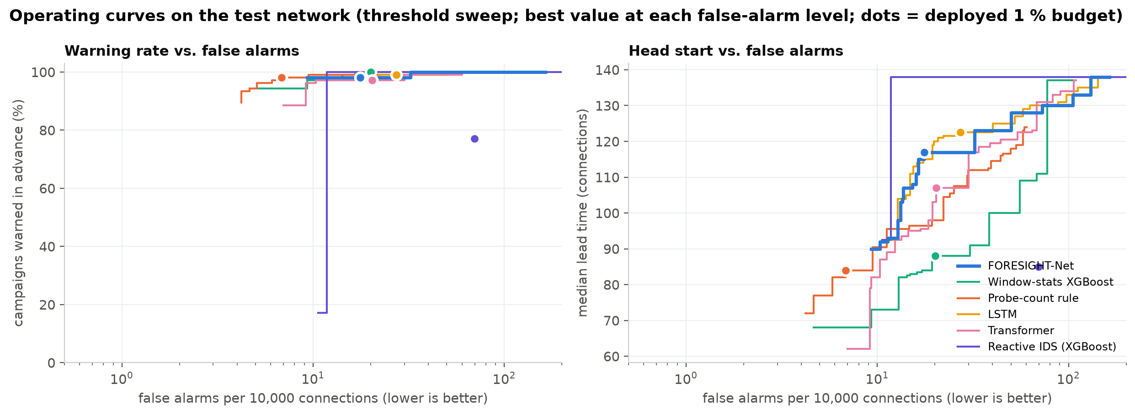
The trade-off: warning rate and head start vs. false alarms
Each curve sweeps the alarm threshold: moving left = fewer false alarms, lower = fewer/later warnings. The dot is the deployed 1 % budget.
Above ~12 false alarms per 10k the deep sequence models give the longest head start; at very low false-alarm levels the scan-count rule is competitive (it reaches the fewest false alarms).
Stricter 0.5 % alert budget: FORESIGHT-Net 14 false alarms/10k, precision 66 %, median lead 107; scan-count rule 6/10k, 72 %, lead 81.
Notes:
OPERATING CURVE (1 minute)
A single threshold hides the trade-off, so we sweep it. Left panel: share of campaigns warned versus false alarms; right panel: median head start versus false alarms. Up and to the left is better.
Read the right panel: in the normal operating range the deep models (blue FORESIGHT, yellow LSTM) give a longer head start than the rule and the window-statistics model — that is the value of reading the sequence.
Be precise: above roughly 12 false alarms per 10k connections the deep models give the longest head start; at very low false-alarm levels the scan-count rule is competitive — it is a strong, honest baseline and a SOC could run both.
The 1 % budget was fixed before looking at test results; the stricter 0.5 % budget numbers are in the text box and in budget_sensitivity.csv.

Slide 20
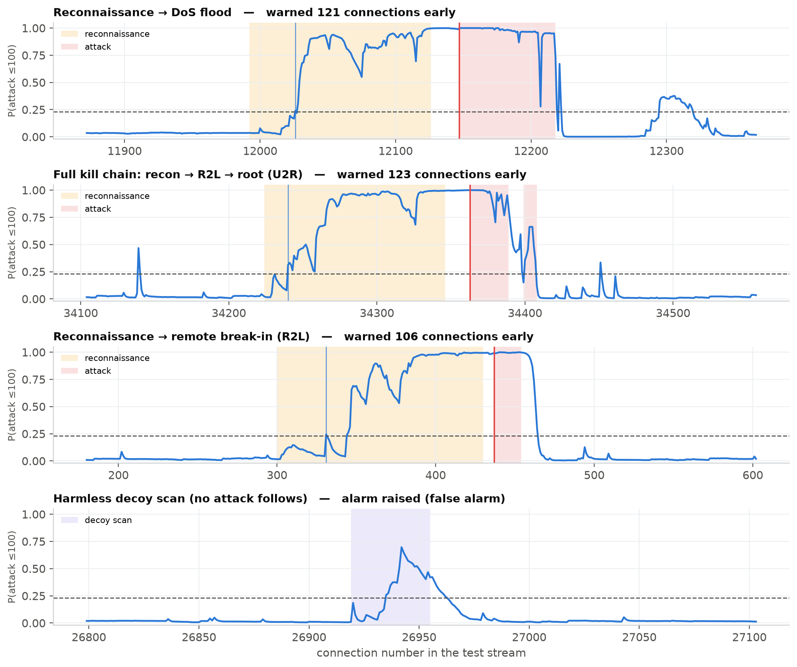
What it looks like: four real test campaigns
How to read it
Blue line: FORESIGHT's P(attack within 100 connections)
Dashed: alarm threshold
Yellow: true reconnaissance · red: attack · violet: decoy (hidden from the model)
Campaigns chosen with the MEDIAN lead time of their type — typical, not best
Last row: a harmless decoy scan — the honest failure mode
Notes:
CASE STUDIES (1 minute)
Four campaigns from the test network. We picked, for each attack type, the campaign whose lead time is the median of that type — so these are typical cases, not cherry-picked best ones.
Row 1: scan then flood — the forecast climbs during reconnaissance and crosses the threshold well before the red region.
Row 2: the full kill chain — break-in then privilege escalation.
Row 3: scan then break-in.
Row 4: a decoy — a harmless scan. Point out honestly what the model does here; decoys look exactly like the beginning of real reconnaissance, which is why some false alarms are unavoidable when you want early warning.

Slide 21
Ablation: what each component contributes
Removing any component lowers alert precision (56 % → 43–53 %) and raises false alarms (19.6 → 21.7–33.3 per 10k). PR-AUC changes are small — largest: w/o multi-task (0.653 → 0.635). Each row removes one component and is retrained with 3 seeds.
Notes:
ABLATION (1 minute)
An ablation removes one component at a time and retrains — 3 seeds each — to measure what that component is worth.
Walk through the rows: without attention; without the causal CNN; without the multi-task heads (warning only); and without the per-connection evidence channels — that is, a pure end-to-end deep model.
The clear message from the bars: every component improves the QUALITY of the alarms — alert precision drops and false alarms rise when any one is removed (the pure deep model without evidence channels has the most false alarms). The ranking metric PR-AUC barely moves (differences mostly within seed noise; removing the multi-task heads costs the most). Attention also produces the explanation shown later.

Slide 22
Robustness: stealthier attackers, no retraining
Against very stealthy attackers (×0.25 scan intensity) FORESIGHT-Net still warns for 88 % of campaigns, 104 connections early — the scan-count rule drops to 52 % (58 early) and window XGBoost to 70 %. Trained models and thresholds unchanged.
Notes:
ROBUSTNESS (1 minute)
A smart attacker scans slowly to stay under the radar. Without retraining anything, we regenerated the test network with reconnaissance at 75, 50, 35 and 25 % of the normal intensity.
This is where reading the sequence pays off most: a counting rule needs many scans in the window, so when the attacker slows down it simply stops firing. The deep models integrate weak evidence over time and degrade gracefully: at a quarter of the normal scan intensity FORESIGHT still warns for most campaigns with a long head start, while the rule warns for only about half — and false alarms of the deep models stay flat. Every method degrades; the difference is how much.

Slide 23
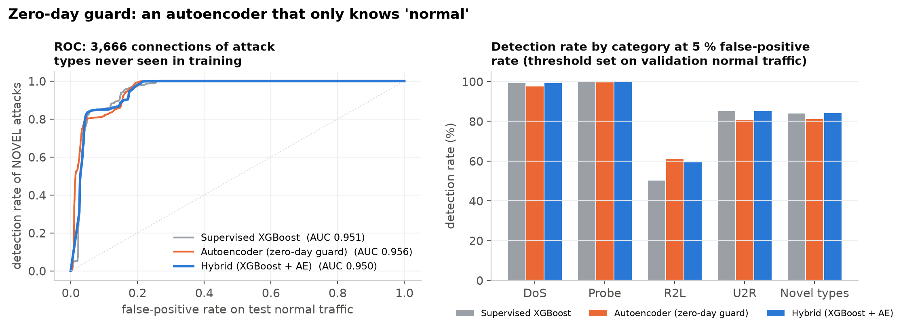
Zero-day guard: catching attacks nobody has labelled
On novel attack types
84 %
Supervised XGBoost
AUC 0.951
81 %
Autoencoder
AUC 0.956
84 %
Hybrid
AUC 0.950
detection rate at 5 % false-positive rate (threshold set on validation normal traffic)
3,666 test connections belong to 17 attack types never seen in training.
The autoencoder only learns 'normal'; anything it cannot reconstruct is suspicious — it needs no attack labels at all.
Inside FORESIGHT its novelty score is an input channel: it is how the forecaster notices scanners like mscan that the supervised detector misses (23 % vs 100 %).
Notes:
ZERO-DAY GUARD (1 minute)
Phase 1 left us with one big weakness: supervised models cannot recognise attacks they have never seen. The zero-day guard is an autoencoder trained ONLY on normal traffic; it compresses each connection and tries to rebuild it. Normal connections rebuild well, unfamiliar ones do not — so the reconstruction error is an attack-agnostic alarm.
On the 3,666 test connections of brand-new attack types: supervised XGBoost detects 84 %, the autoencoder 81 %, and the hybrid that alarms when either is confident 84 %, all at a 5 % false-positive rate fixed on validation data. Read the bars by category and comment honestly on where the autoencoder helps and where it does not.
Most importantly, the novelty score feeds the forecaster: the scanner "mscan" exists only in the test set; the supervised detector recognises 23 % of its connections as scans, the autoencoder flags 100 % as unusual.

Slide 24
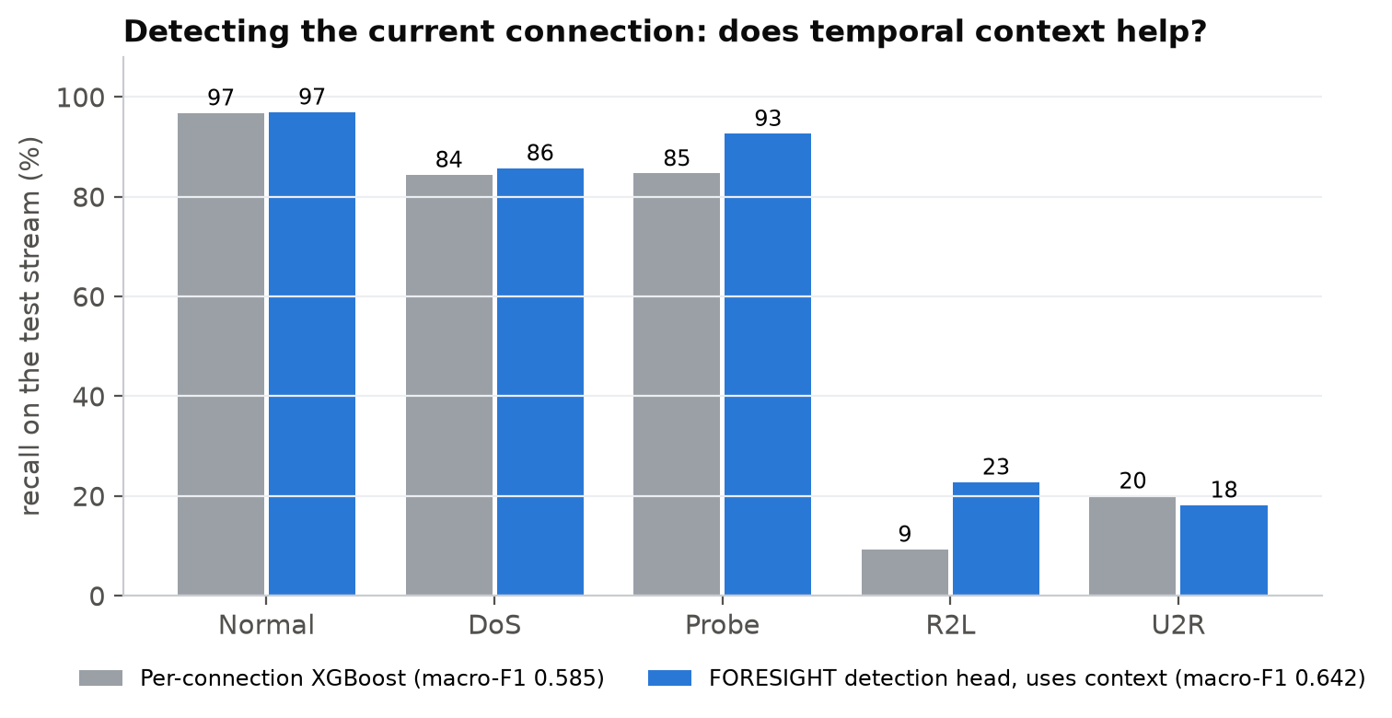
Beyond 'whether': which attack, when — and better detection
70 %
attack type forecast correctly before impact (macro-F1 0.69, best of the deep models)
87 %
of ETAs within one horizon bin (10 / 25 / 50 / 100 connections)
9 → 23 %
R2L detection recall with temporal context (Phase-1 weakness)
The detection head sees the 64-connection context: a break-in that follows reconnaissance is easier to recognise than the same connection in isolation. Part of this gain comes from the simulated campaign structure, so treat it as an upper bound.
Notes:
WHICH ATTACK, WHEN, AND DETECTION (1 minute)
A warning is more useful if it says what to prepare for. Before impact, FORESIGHT names the attack type correctly 70 % of the time — macro-F1 0.69, the best of all deep models — and its ETA is within one horizon bin 87 % of the time.
Left chart: the detection head classifies the CURRENT connection using the context of the last 64. Compared with the per-connection XGBoost of Phase 1, R2L recall rises from 9 % to 23 % and probe recall from 85 % to 93 %. That was exactly the weakness we reported at mid-term.
Honest caveat: in our streams a break-in always follows reconnaissance (except the stealth cases), so part of this gain comes from the simulated campaign structure — present it as an upper bound, not a guarantee.

Slide 25
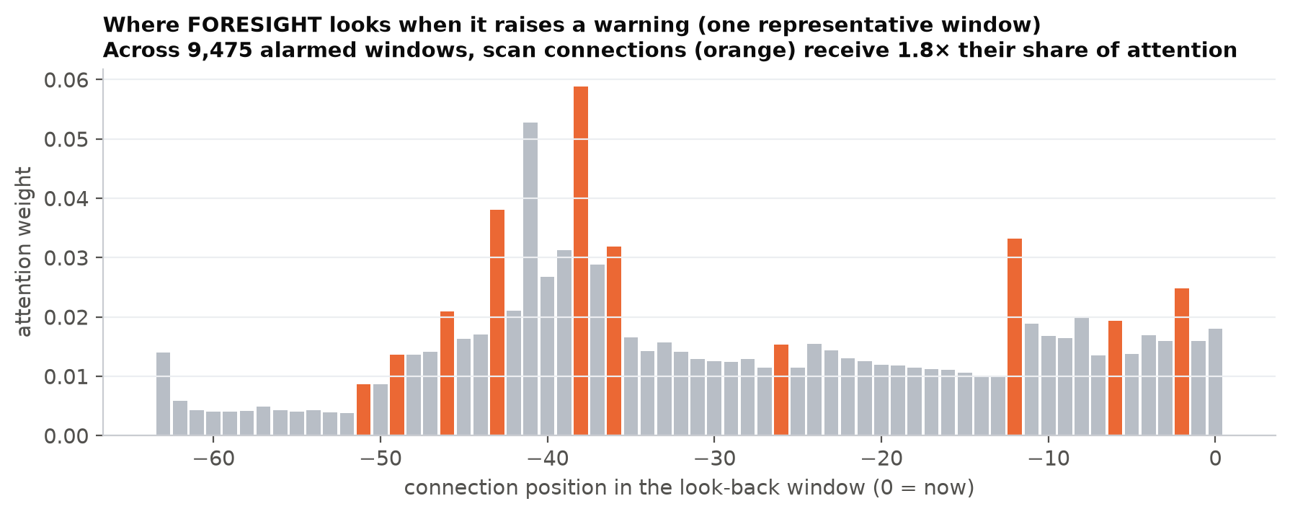
Explainability: why did FORESIGHT raise this warning?
Attention (top left): across 9,475 alarmed reconnaissance windows, scan connections receive 1.8× their share of the model's attention (32 % of the attention vs 17 % of the connections).
Feature attribution (right): gradient × input over the whole window shows which inputs drive warnings; blue bars are the evidence channels (detector and novelty).
In the dashboard: every warning comes with these two explanations, so the analyst can check the scans that triggered it before acting.
Notes:
EXPLAINABILITY (1 minute)
A security analyst will not block traffic because a black box said so. So every warning is explained in two ways.
Attention: the model assigns a weight to each of the last 64 connections. Averaged over 9,475 warning windows, scan connections get 1.8 times their share of attention — state honestly whether that is a strong or weak focus based on the number.
Feature attribution: we take the gradient of the warning probability with respect to every input and multiply by the input. The right chart lists the inputs that drive warnings; explain the top three in plain words.
In the live dashboard both explanations appear next to every alert.

Slide 26
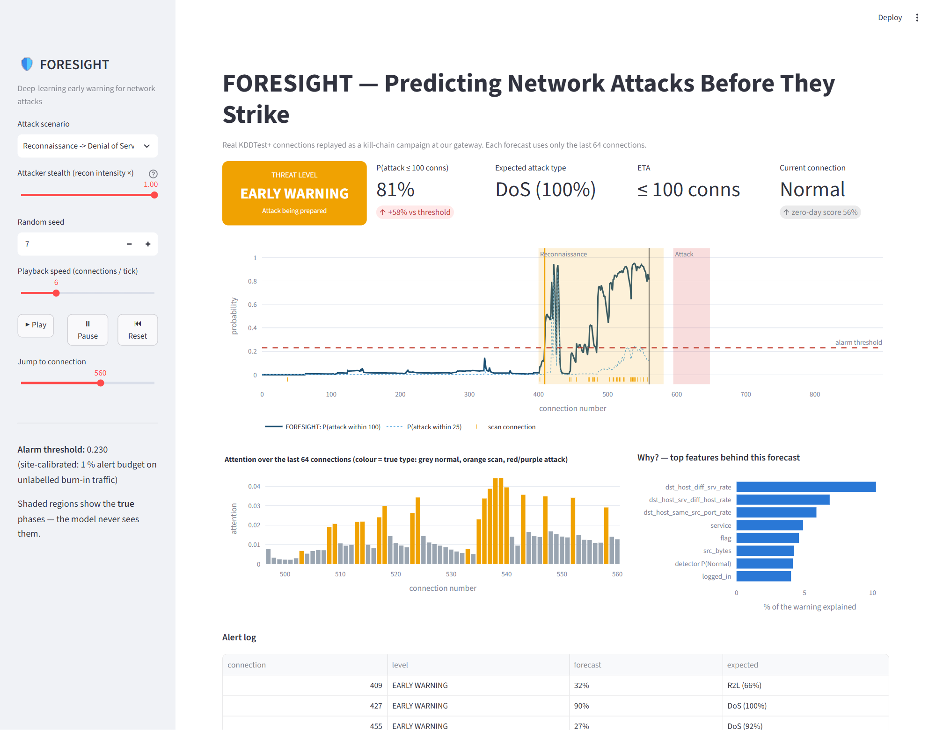
Live demo: FORESIGHT SOC dashboard
Demo script (3 min)
streamlit run app/dashboard.py
Pick 'Reconnaissance → DoS', press Play: threat level turns amber during the scan, before the red attack region
Pause on the warning: show attack type, ETA, attention and 'why'
Switch to 'Harmless scan' to discuss false alarms honestly
Lower attacker stealth to 0.4 to show the limit
Backup without a browser: python monitor.py
Notes:
LIVE DEMO (3 minutes) — rehearse this; have the dashboard already open before the presentation.
1. Start: streamlit run app/dashboard.py (it opens in the browser; models load in a few seconds).
2. Choose "Reconnaissance → Denial of Service", stealth 1.0, press Play. Narrate: grey connections, then the orange scans start; watch the blue forecast line rise; the threat level turns amber (EARLY WARNING) — and only later does the red attack region begin. The chart writes "warned N connections early".
3. Press Pause during the warning. Point at: expected attack type, ETA, the attention bars (orange = scans the model focused on) and the "why" features.
4. Switch scenario to "Harmless scan (no attack follows)": discuss honestly whether it raises a false alarm.
5. Optional: stealth 0.4 to show slower reconnaissance gives later warnings.
If the browser fails: python monitor.py --scenario recon_dos prints the same alerts in the terminal.

Slide 27
Limitations — stated honestly
Simulated order
No warning signs, no forecast
NSL-KDD has no timestamps. Connections are real; the campaign order follows a kill-chain model. Results show what is achievable if attacks behave this way.
Attacks without reconnaissance cannot be predicted by any method; they are caught on arrival (detection head, zero-day guard).
Decoys still cause false alarms
Simple baselines are strong
A harmless scan and the first minutes of a real one look alike; the alert budget trades early warning against these alarms.
A scan-count rule is very conservative and competitive; deep backbones are close to each other once they share our evidence channels and adaptation.
Test-informed design
Dated traffic
Architecture changes were guided by test-stream diagnostics (disclosed); thresholds and model selection used only validation or unlabelled data.
NSL-KDD reflects 1998-era traffic; absolute numbers will differ on modern networks.
Notes:
LIMITATIONS (1 minute) — saying these yourself earns trust; do not wait to be asked.
The most important: the time order is simulated because NSL-KDD has none. Every connection is real, the order follows the kill chain from the literature. Our pipeline is ready for real timestamped data — that is the first item of future work.
Second, attacks with no warning signs cannot be forecast — by us or anyone — so the system still needs detection on arrival.
Third, decoys: some false alarms are the price of early warning.
Fourth, honest comparison: a simple scan-count rule is a strong baseline, and the deep backbones are close to each other — the framework (evidence channels, adaptation, forecasting heads, evaluation) is the main contribution.
Fifth, we disclose that design iterations looked at test-stream behaviour.

Slide 28

Future work
Real timestamped traffic
Live capture
CIC-IDS2017 / UNSW-NB15 flows with real time order — only the stream source changes
feature extraction from packets (CICFlowMeter-style) feeding the same inference API
Attacker-aware forecasting
Automated response
group connections per source host; forecast per attacker, not per gateway
rate-limit or sandbox the scanning source when the warning fires, with analyst approval
Continual learning
Statistical rigour
update the site model as normal traffic drifts; active learning from analyst feedback
more seeds, confidence intervals, significance tests between backbones
Notes:
FUTURE WORK (45 seconds)
First priority is real timestamped traffic — CIC-IDS2017 or UNSW-NB15 — which removes our main limitation; the code only needs a new stream source.
Then live packet capture, forecasting per attacker (source host) rather than per gateway, an automated response such as rate-limiting the scanning IP when the warning fires, continual learning as the network's normal changes, and more statistical testing.

Slide 29
Conclusion
FORESIGHT turns intrusion detection into forecasting: it warned for 99 % of reconnaissance-led campaigns, a median 120 connections before the attack — 36 % earlier than window XGBoost at the same false-alarm level.
Against stealthy 'low-and-slow' attackers it keeps warning (88 % vs 52 % for a scan-count rule).
Generalising to a new network needed more than a bigger model: hybrid evidence channels and site adaptation from unlabelled traffic.
A zero-day autoencoder, attention-based explanations and a live dashboard make it a usable SOC tool.
Honest evaluation: official unseen-attack split, decoys, 3 seeds, ablations, stealth tests — and the limitations stated openly.
Notes:
CONCLUSION (45 seconds)
Read the four points. End with the smoke-alarm vs. weather-forecast image: classical IDS tells you there is a fire; FORESIGHT tells you a storm is coming — early enough to act.
Then: "Thank you — we are happy to take questions, and we can show the live demo again."

Slide 30
Key learnings & work contribution
Key learnings
Raghav Dhir
231030254
Evaluation design decides what a result means: random splits and accuracy hide the real difficulty
Sequence modelling, survival-style multi-horizon outputs, attention
Distribution shift is the central problem of deployed ML; validation can be misleading
Stacking, autoencoders, calibration without labels
Reproducible engineering: cached pipelines, seeds, ablations
literature review, research gap, kill-chain simulator design, documentation & presentation
Rudra Bhasin
231030235
data pipeline, feature encoding, evidence channels (detector, autoencoder)
Nikhil Singh
231030152
FORESIGHT-Net, deep baselines, training, ablation & robustness experiments
Aayush Chaudhary
231030164
evaluation metrics, site calibration, dashboard & system integration, testing
Notes:
KEY LEARNINGS & CONTRIBUTION (45 seconds)
Each member should be ready to explain their own part in detail — the panel often asks individual members.
(Edit the role descriptions to match the actual split of work before presenting.)

Slide 31
References
[1] M. Tavallaee, E. Bagheri, W. Lu, A. A. Ghorbani, “A detailed analysis of the KDD CUP 99 data set,” IEEE CISDA, 2009.
[2] Z. Ahmad, A. S. Khan, C. W. Shiang, J. Abdullah, F. Ahmad, “Network intrusion detection system: A systematic study of machine learning and deep learning approaches,” Trans. Emerging Telecommunications Technologies, 32(1), e4150, 2021.
[3] M. Husák, J. Komárková, E. Bou-Harb, P. Čeleda, “Survey of attack projection, prediction, and forecasting in cyber security,” IEEE Communications Surveys & Tutorials, 21(1), 640–660, 2019.
[4] Y. Shen, E. Mariconti, P.-A. Vervier, G. Stringhini, “Tiresias: Predicting security events through deep learning,” ACM CCS, 2018.
[5] M. Du, F. Li, G. Zheng, V. Srikumar, “DeepLog: Anomaly detection and diagnosis from system logs through deep learning,” ACM CCS, 2017.
[6] Y. Mirsky, T. Doitshman, Y. Elovici, A. Shabtai, “Kitsune: An ensemble of autoencoders for online network intrusion detection,” NDSS, 2018.
[7] E. M. Hutchins, M. J. Cloppert, R. M. Amin, “Intelligence-driven computer network defense informed by analysis of adversary campaigns and intrusion kill chains,” Lockheed Martin, 2011. MITRE ATT&CK, TA0043 / T1595.
[8] W. E. Leland, M. S. Taqqu, W. Willinger, D. V. Wilson, “On the self-similar nature of Ethernet traffic,” IEEE/ACM Trans. Networking, 2(1), 1–15, 1994.
[9] S. Hochreiter, J. Schmidhuber, “Long short-term memory,” Neural Computation, 1997; D. Bahdanau, K. Cho, Y. Bengio, “Neural machine translation by jointly learning to align and translate,” ICLR, 2015.
[10] T. Chen, C. Guestrin, “XGBoost: A scalable tree boosting system,” ACM KDD, 2016; D. H. Wolpert, “Stacked generalization,” Neural Networks, 1992.
[11] M. Umer et al., “Network intrusion detection model using wrapper based feature selection and multi head attention transformers,” Scientific Reports, 15, 28718, 2025.
[12] C. Christy et al., “Machine learning based multi-stage intrusion detection system and feature selection ensemble security in cloud assisted vehicular ad hoc networks,” Scientific Reports, 15, 27058, 2025.
Notes:
REFERENCES — no need to read; leave on screen briefly.

Slide 32
Thank you — questions?
Live demo: streamlit run app/dashboard.py Code & results: README.md · docs/METHODOLOGY.md · outputs/results/RESULTS.md
Notes:
Q&A. Keep the dashboard open in another window. The full list of expected questions with model answers is in docs/PANEL_GUIDE.md — revise it before the evaluation.

