Slide 1
DP Build and Deployment
Digital Platform Engineering
2016

Slide 2
Build_and_Deployment_DP
Continuous Delivery
Code and commit
Write code and push to Stash
Build
WSO2 ESB artifacts
Compile and package
WSO2 Dev Studio/Maven
Automate
Jenkins
Install and Deploy on a real box
IBM UrbanCode Deploy (But we are moving to Docker soon, but not production ready yet)

Slide 3
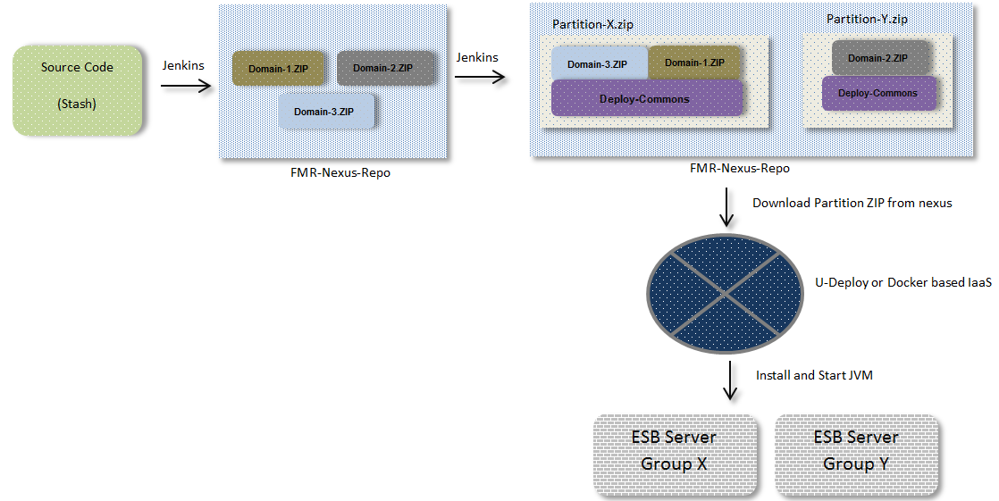
Build_and_Deployment_DP
Continuous Delivery

Slide 4
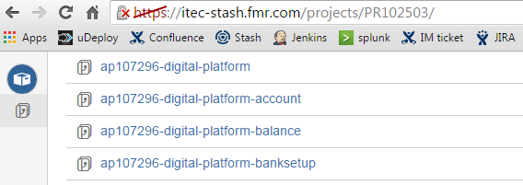
Build_and_Deployment_DP
Compiling and Packaging
Let’s have a quick deep look in..
What we compile
WSO2 ESB XML configurations, Java code
Every business domain should maintain a separate
project directory to keep their source code.

Slide 5
Build_and_Deployment_DP
Compiling and Packaging Cnt.
Quick zoom in to a business domain project
Project Structure for brokerage domain:
fmr-dp-brokerage
fmr-dp-brkg-core
fmr-dp-brkg-app
fmr-dp-brkg-dist
Core module has the actual source code.
App module contains the first compiled output, which is a
deployable achieve for WSO2 ESB runtime.(aka CAR file)
Dist module
Creates the aggregated business domain ZIP
file fmr-dp-brkg-dist.zip
Use maven/assembly descriptors to package.
Domain zip will contain the .CAR file/s and any JARs etc.
And this zip file is a maven GAV that published into internal
FMR nexus repo.

Slide 6
Build_and_Deployment_DP
Compiling and Packaging Cnt.
Dist module
Creates the aggregated business domain ZIP
file fmr-dp-brkg-dist-1.0.0.1.zip
Use maven/assembly descriptors to package.
Domain zip will contain the .CAR file/s and any JARs etc.
And this zip file is a maven GAV that published into internal
FMR nexus repo.
JARs
CARs
Files

Slide 7
Build_and_Deployment_DP
Compiling and Packaging Cnt.
Now we have a business domain zip file, available in nexus.
Now we come to final step of packaging:
Partition level packaging
Partition is a virtual representation of one or more
domain distributions.
Example:
dpbrkg-partition folder contains following files
- fmr-dp-brkg-dist-1.0.0.1.zip
- wso2 esb runtime binary.zip
- some other utility files
NOTE: We append Jenkins build number to the maven version.
So we know what exactly we are deploying. This also gives reliable
backouts to old versions in production incidents.
And yes, dpbrkg-partition also uses maven assembly descriptors to
create the final ZIP file that get installed into the box.

Slide 8
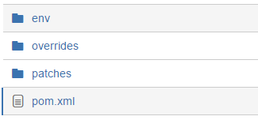
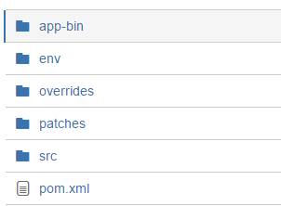
Build_and_Deployment_DP
Compiling and Packaging Cnt.
Inside a partition directory
Every partition directory inherits a master copy

Slide 9
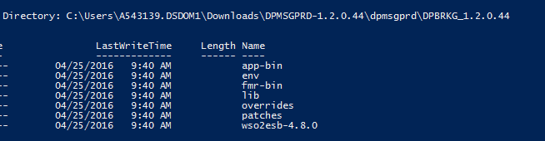
Build_and_Deployment_DP
Compiling and Packaging Cnt.
Inside an aggregated partition ZIP file.
The build scripts:
unzip the domain.zip and copy them to overrides
download vendor app zip(wso2esb-4.8.0.zip) and unzip
And copy other utility files into a directory structure that will be used
by uDeploy/Docker.
This is the final ZIP that get downloaded by the IaaS platform to install
into the agents

Slide 10
Build_and_Deployment_DP
Quick Demo

