Slide 1

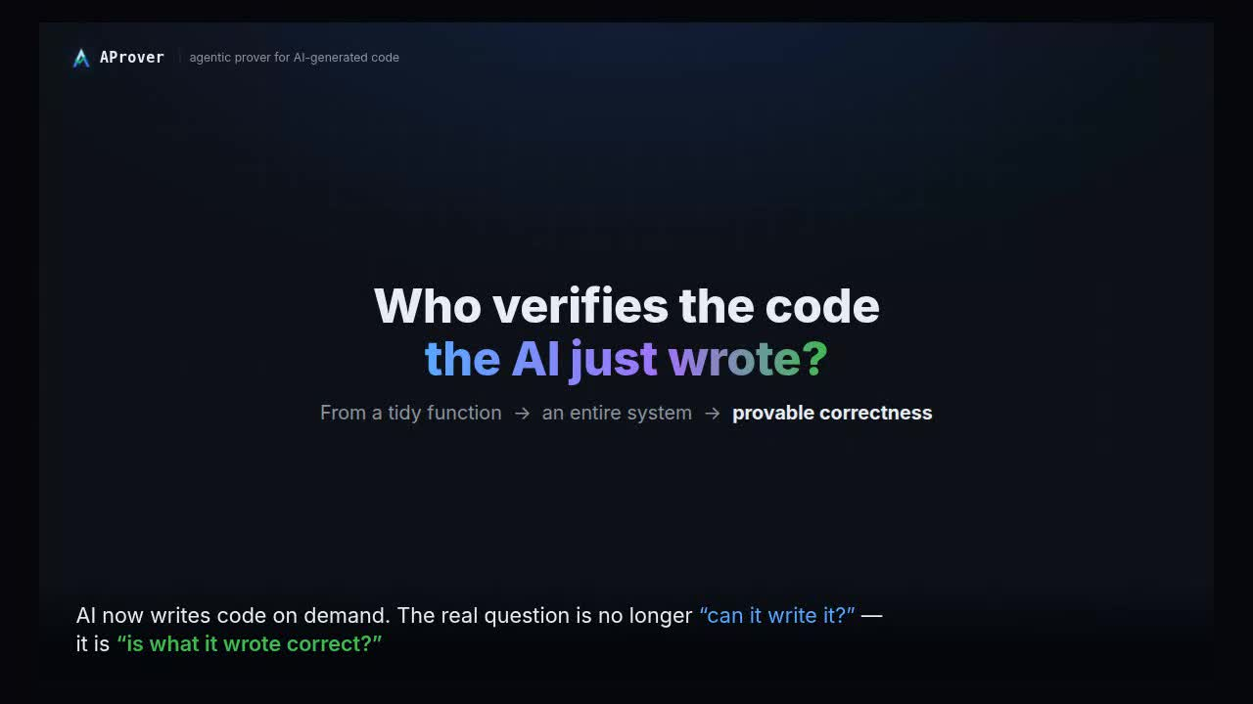
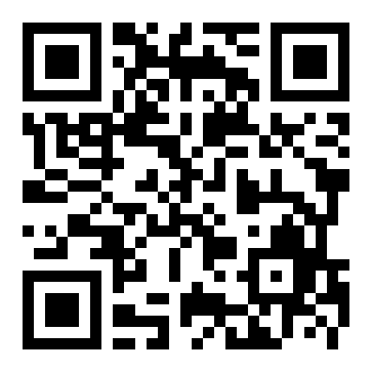
AProver · agentic prover for AI-generated code
AI writes the code.
AProver proves it correct.
AProver — verifying AI-generated software
● looping
Agents propose — specifications, counterexample verdicts, refinements. Conventional tools dispose — every soundness-relevant claim passes a formal check before it counts.
Bugs are confirmed, not guessed.
EXPLORE THE PROJECT
github.com/agentic-prover/aprover
Paper · Agentic Model Checking — arXiv:2605.21434
59 confirmed memory-safety bugs · every one ASan-verified
OSS-Fuzz 50 u-boot 32 · gpac 10 · libbej 4 · libredwg 2 · libheif 1 · libarchive 1
↗ scan to open
open-source 9 libmikmod 4 · adplug 3 · libmodplug 2
▶ embedded · embargoed, coordinated disclosure

