Slide 1
FIELD NOTE · AI & THE VALUE CHAIN
The System,
Not the Task
Sangeet Paul Choudary’s Reshuffle — and what it means for how we build software.
A job is a bundle of tasks AI unbundles, then rebundles around what stays scarce: judgment · orchestration · verification.
A synthesis of Reshuffle (2025) · internal explainer
Notes:
SCRIPT — say this: “Thanks, everyone. I want to talk about how AI is going to change the way we build software — but I’m going to get there in a roundabout way, because I think the obvious framing is wrong. This is built on a book called Reshuffle, by Sangeet Paul Choudary. His core claim is simple and a little provocative: the real impact of AI isn’t automation — it’s coordination. We’ll unpack what that means, look at the examples he uses, and then map the whole thing onto our development lifecycle. The one line to hold in your head the entire time is at the bottom of this slide: a job is a bundle of tasks that AI pulls apart, then puts back together around whatever is still scarce — judgment, orchestration, and verification. Keep that picture. Everything comes back to it.” GUIDANCE: • ~45 sec. Warm open; don’t rush the bottom line — it’s the spine of the whole talk. • One sentence credentialing Choudary is plenty; don’t over-explain the book.

Slide 2
WHY THIS MATTERS TO US
Most teams ask the wrong question about AI
THE QUESTION TO STOP ASKING
THE QUESTION TO ASK INSTEAD
“What can AI automate in our pipeline?”
“What new system of building software can AI coordinate?”
Leads to faster typing, generated tests, autocompleted tickets — real, but first-order. It optimises the existing relay and quietly invests in the phase whose value is about to fall.
Leads to re-architecting how intent becomes a running system — and to repositioning people at the constraints that survive: specification, judgment, orchestration and verification.
RESHUFFLE → SDLC
01
Notes:
SCRIPT — say this: “Let me start with the question most teams are actually asking — the one on the left: ‘what can AI automate in our pipeline?’ It’s reasonable, and it gives you real wins: faster code, generated tests, auto-drafted tickets. But it’s shallow, and here’s the risk — it makes you better at the process you already have, and it quietly pours effort into the exact part of the work that’s about to lose its value. The question I want us leaving this room asking is on the right: ‘what new system of building software can AI coordinate?’ That one leads somewhere completely different — to redesigning how an idea becomes a running system, and to moving our best people onto the parts of the work that survive. Everything I show you from here is meant to earn that right-hand question.” GUIDANCE: • This is the thesis slide. Pause after reading the right-hand question aloud. • If someone pushes back that the automation wins are real — agree. Say they’re first-order, not the ceiling.

Slide 3
01
Coordination,
not automation
The reframe at the heart of the book
Notes:
SCRIPT — say this: “So — first idea. Coordination, not automation.” GUIDANCE: • Divider. ~5 seconds; just name the section and move on.

Slide 4
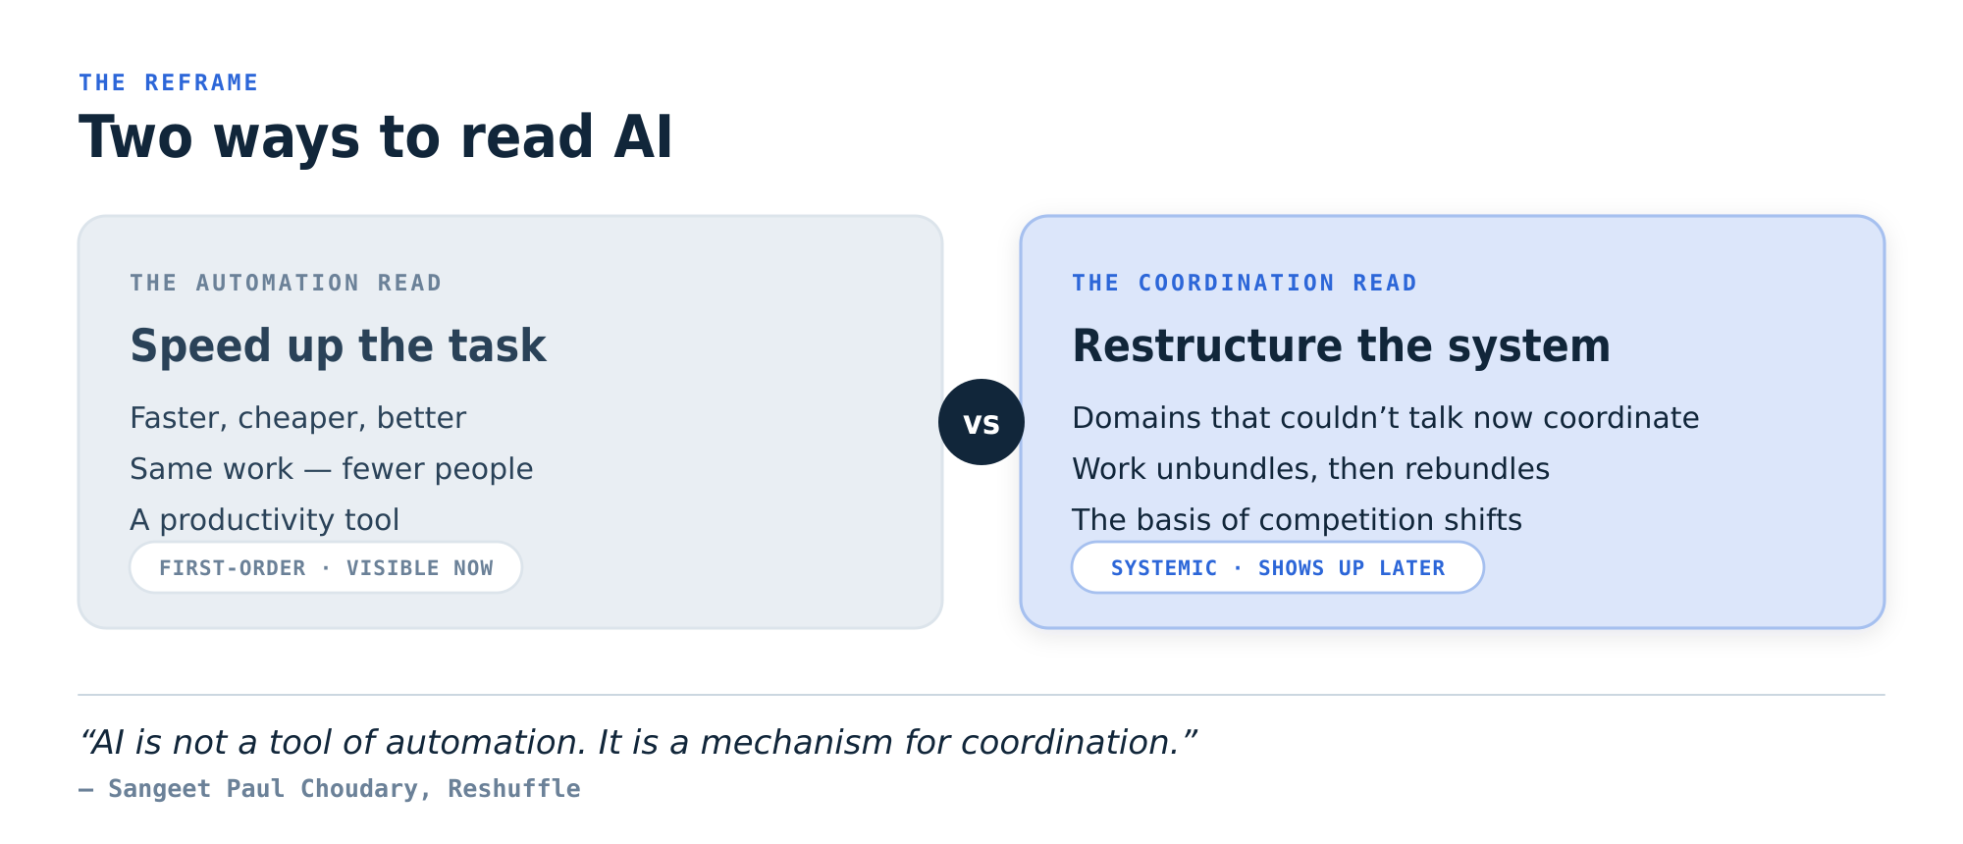
01 · THE REFRAME
We are misreading AI — just like the container in 1956
The automation read is mostly priced in already. The coordination read — systemic, slower to appear — is where the surprise lives.
RESHUFFLE → SDLC
02
Notes:
SCRIPT — say this: “Here’s the reframe. Choudary says we’re reading AI the way people read the shipping container in 1956 — as a faster way to do the work we already do. On the left is what he calls the ‘intelligence distraction’: how smart is it, what can it take over, how many people can we save. All real — all first-order. The deeper story is on the right: AI restructures the system around the task. It lets parts of the business that never talked to each other suddenly coordinate — and that’s what reshuffles where the value sits. His line is blunt: AI is not a tool of automation, it’s a mechanism for coordination. The automation read is mostly priced in already; the coordination read is where the surprises — and the advantage — are going to come from.” GUIDANCE: • Land the phrase “intelligence distraction.” • Flag that the container is set up here and paid off in the examples section.

Slide 5
02
The concepts
Four interlocking ideas — constraints, unbundling, coordination without consensus, engine vs tool
Notes:
SCRIPT — say this: “To make that concrete, here are the four ideas that do all the heavy lifting in the book.” GUIDANCE: • Divider. Name the four ideas, then move on.

Slide 6
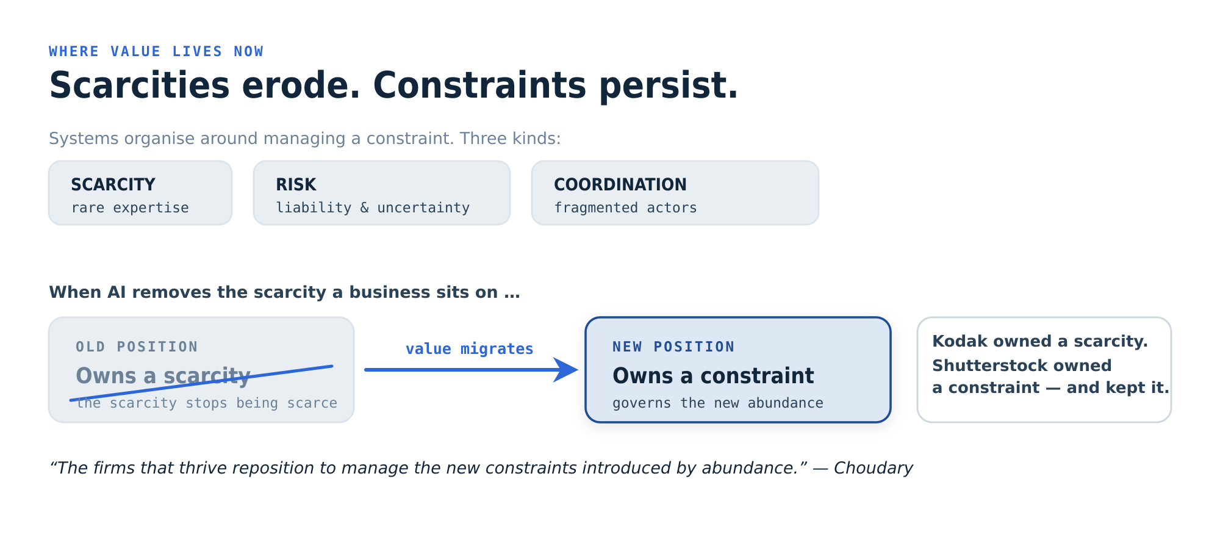
02.1 · SYSTEMS ORGANISE AROUND CONSTRAINTS
Value doesn’t vanish — it migrates to the next constraint
RESHUFFLE → SDLC
03
Notes:
SCRIPT — say this: “First idea: every job, every team, every company exists to manage some constraint. Choudary names three — scarcity, like rare expertise; risk, like liability and uncertainty; and coordination, getting fragmented groups aligned. Whoever sits on the binding constraint captures the value. Now here’s the move: when AI removes a constraint — makes expertise cheap, makes execution easy — the value doesn’t disappear. It migrates to the next constraint in the system. So the right question is never ‘what new skill should I go learn?’ It’s ‘where did the constraint just move, and how do I reposition onto it?’ Watch that word — migrates. It’s the whole game.” GUIDANCE: • Hammer the word “migrates.” • Promise that Kodak vs Shutterstock, coming up, is the proof of this.

Slide 7
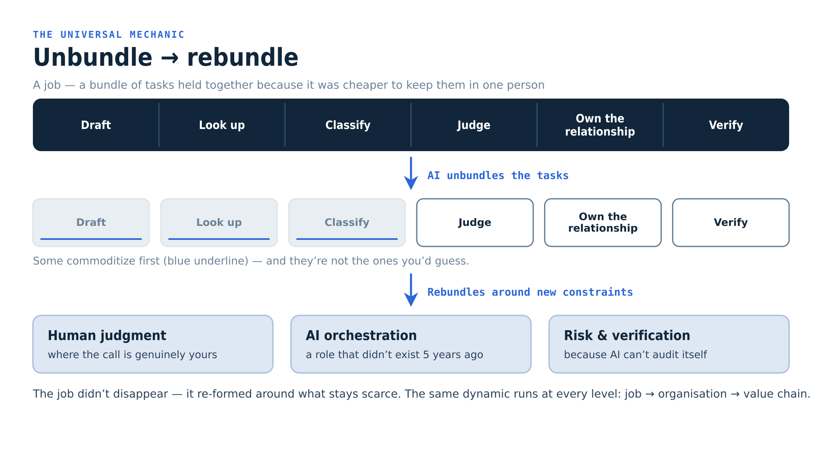
02.2 · THE UNIVERSAL MECHANIC
Unbundle → rebundle: the engine of the whole book
Same dynamic at every level: job → organisation → value chain. The job doesn’t disappear. It re-forms around what stays scarce.
RESHUFFLE → SDLC
04
Notes:
SCRIPT — say this: “Second idea — and this is the engine of the whole book. A job isn’t really one thing; it’s a bundle of tasks. Draft something, look something up, classify it, make a judgment, own the relationship, verify the result. We bundled those into one role historically because it was cheaper to keep them in one person. AI pulls that bundle apart into separate pieces that can each be done, checked, or replaced on their own — and the ones that commoditize first are not the ones you’d expect. The job doesn’t vanish; it re-forms — it rebundles — around the three things still scarce: human judgment, orchestrating the AI, and risk and verification. Hold onto those three; they come back almost word-for-word when we talk about software roles. And the same pattern runs at every level — the job, the team, the whole value chain.” GUIDANCE: • The engine of the talk — slow down here. • Stress: the first tasks to commoditize aren’t the obvious ones. • Plant the three constraints; they recur on the operating-model slide.

Slide 8
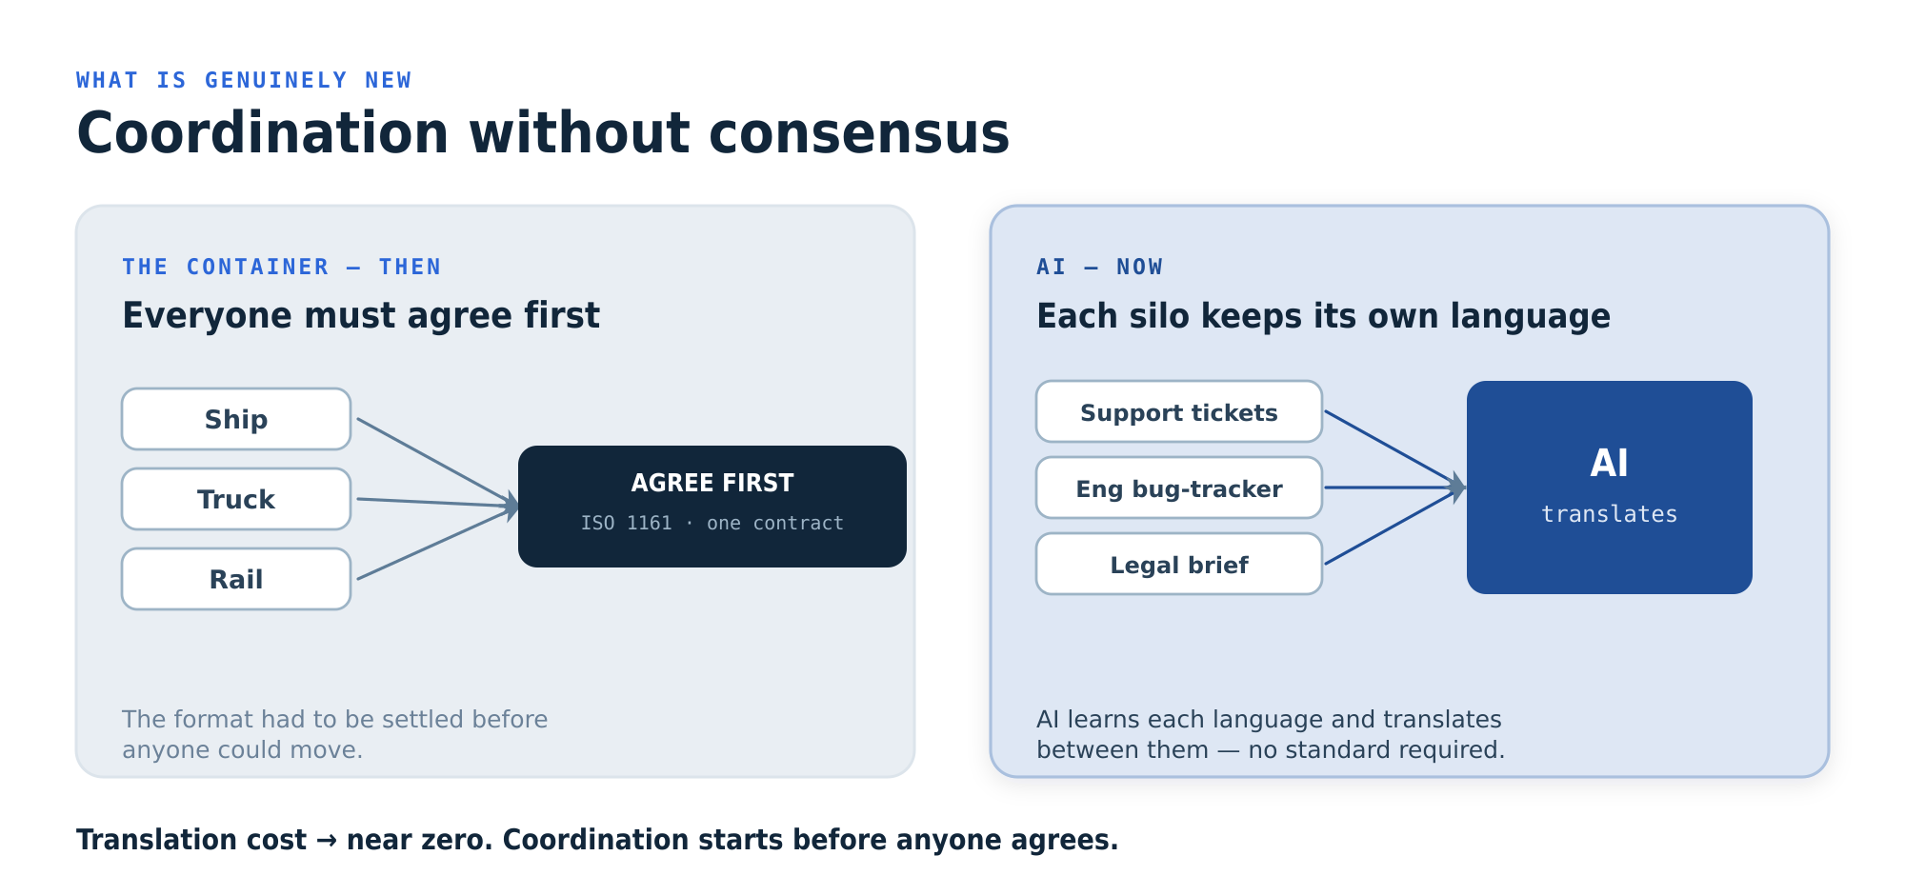
02.3 · WHAT IS GENUINELY NEW
AI coordinates the silos before anyone agrees
RESHUFFLE → SDLC
05
Notes:
SCRIPT — say this: “Third idea — and this is the part with genuinely no historical precedent. The shipping container only worked once everybody agreed on one standard first — same box, one shared contract — before anything could move. AI doesn’t need that. It learns each group’s language and translates between them without making anyone standardize. Support keeps writing tickets the way they write tickets, engineering keeps its bug tracker, legal keeps its briefs — and AI moves the meaning across the gaps. Translation cost basically drops to zero, which means coordination can start before anyone agrees on anything. Internally that’s huge: teams that have talked past each other for years can suddenly work together — with no big standardization project first.” GUIDANCE: • This is the novel idea — give it weight. • Make it real: name two actual silos in our org that don’t talk well today.

Slide 9
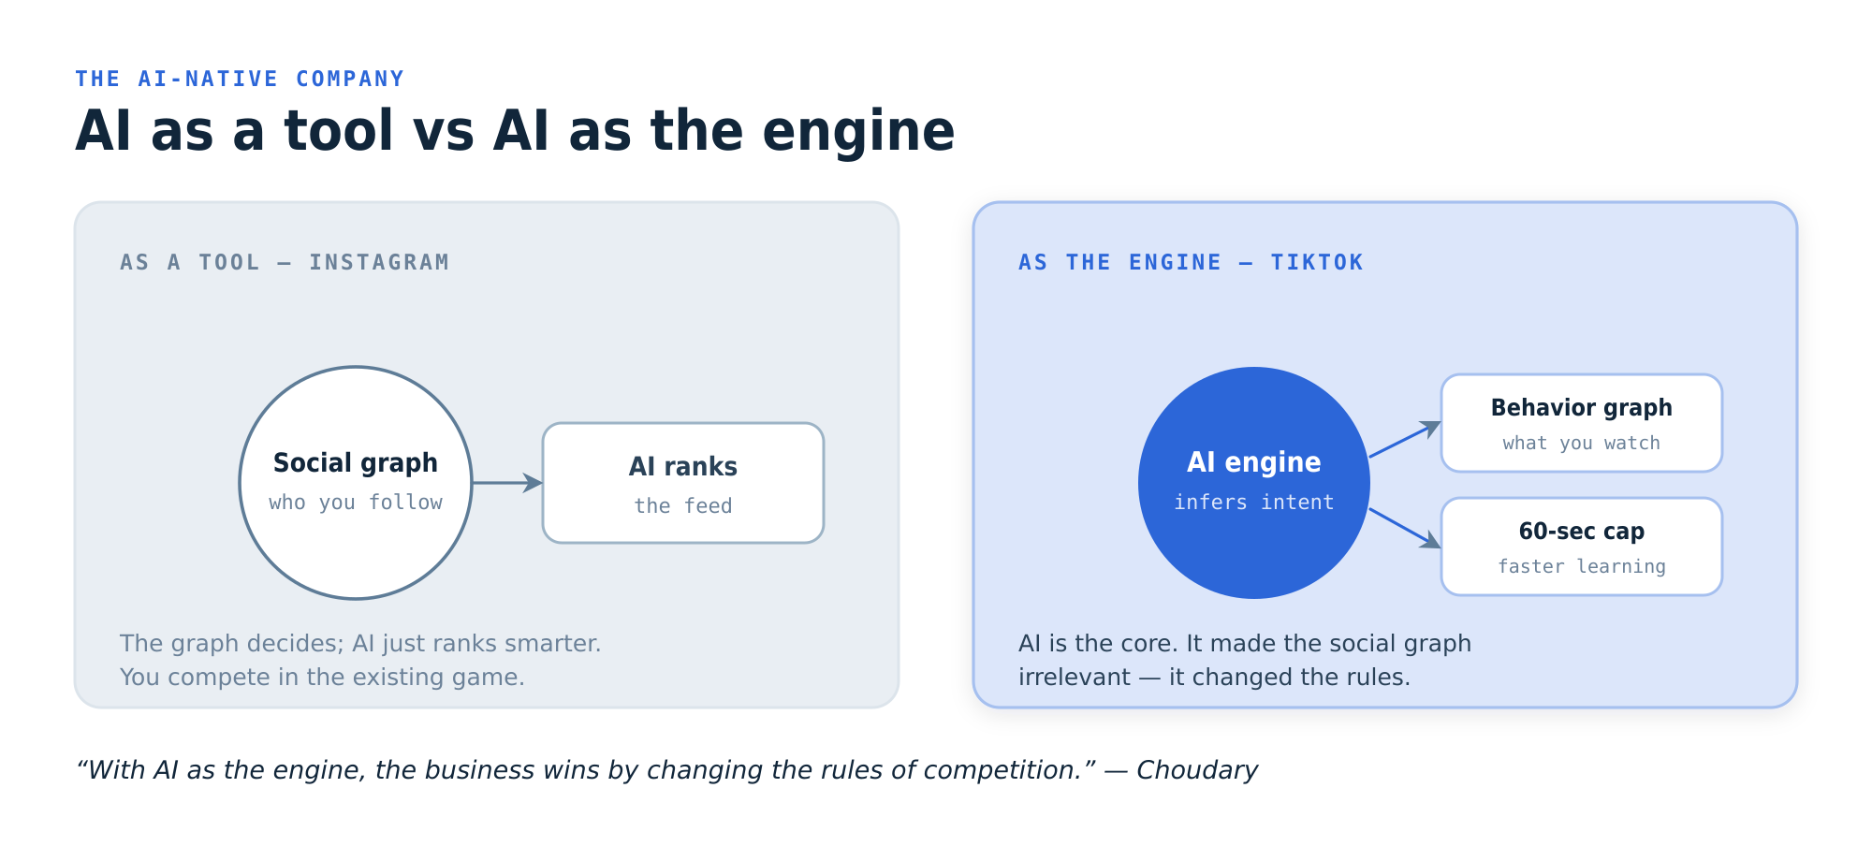
02.4 · THE AI-NATIVE COMPANY
AI as a tool makes you faster. AI as the engine changes the game.
RESHUFFLE → SDLC
06
Notes:
SCRIPT — say this: “Fourth idea: there’s a world of difference between using AI as a tool and using it as the engine. Most companies bolt it onto what they already do, to go faster — that’s a tool. The winners rebuild the system around it — that’s the engine. The cleanest example is TikTok versus Instagram. Instagram used AI to rank a feed, but your social graph — who you followed — still ran the show. TikTok made AI the engine: it watched what you actually watched, built a behavior graph, and made the social graph irrelevant. They didn’t beat the incumbents’ moat — they changed the rules so the moat didn’t matter. The warning for us: bolting AI onto our current process is the tool trap.” GUIDANCE: • Keep TikTok crisp — everyone already knows the story. • Name our own “tool trap” risk out loud so it lands.

Slide 10
03
The evidence
The examples the book turns on — the lens he points at every industry
Notes:
SCRIPT — say this: “Quick tour of the examples he uses — because they’re the lens we’re about to point at ourselves.” GUIDANCE: • Divider. These are the proof points; set them up and move.

Slide 11
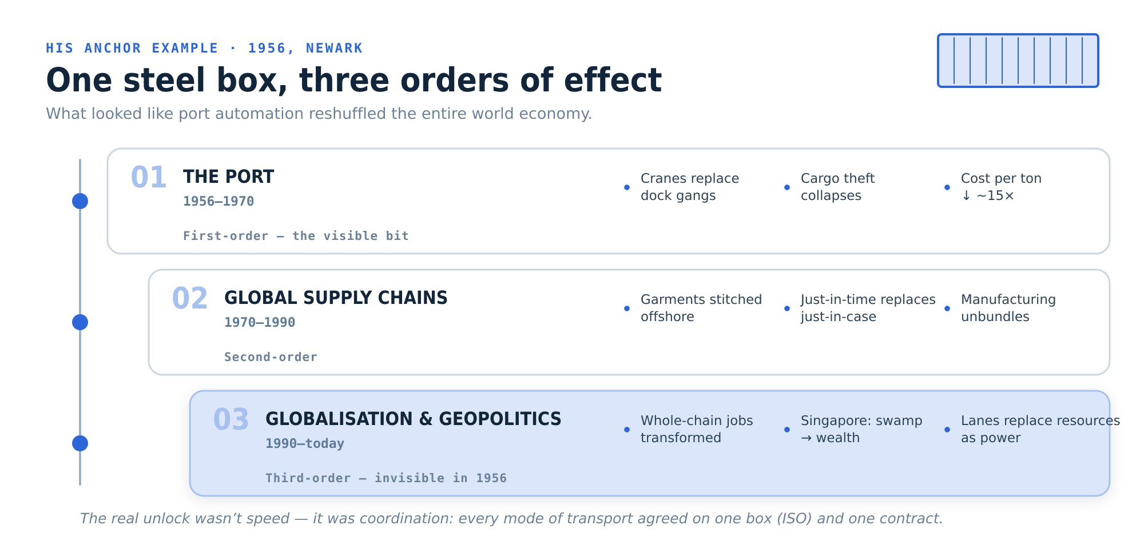
03 · THE ANCHOR EXAMPLE
Everyone saw port automation. They missed the real story.
RESHUFFLE → SDLC
07
Notes:
SCRIPT — say this: “Start with the anchor. 1956, Newark — a man named Malcolm McLean ships fifty-eight standardized steel boxes on a converted tanker. Everyone watching saw port automation: faster cranes, fewer dockworkers. They completely missed it. The real unlock wasn’t speed — it was coordination. Once every ship, train, and truck agreed on the same box and one contract, the whole chain became predictable, and an entire new economy got built on that reliability. Look at the three orders of effect: first the port, then global supply chains, then full-blown globalization — Singapore going from a swamp to one of the richest places on earth, control of shipping lanes replacing control of resources. None of that was visible in 1956. Choudary’s bet is that AI is the container — and we are standing in 1956.” GUIDANCE: • Storytelling beat — let the 1956 image breathe. • End hard on “we are standing in 1956.”

Slide 12
03 · VALUE MIGRATION
Same shock, opposite outcome
KODAK — OWNED A SCARCITY
SHUTTERSTOCK — OWNED A CONSTRAINT
Value lived in physical imaging — film, paper, chemistry. Digital killed film; the smartphone killed the print. The scarcity stopped being scarce, and value walked through layers Kodak didn’t own: storage & search, then sharing & editing, then attention.
Followed the constraint customers actually felt: workflow, rights clearance, compliance, brand governance. When AI then commoditised image generation, it was already sitting at the constraint that just got louder — governing infinite images.
The lesson: Scarcities erode; constraints shift but persist — and the firm positioned at the constraint inherits the value as it migrates.
RESHUFFLE → SDLC
08
Notes:
SCRIPT — say this: “Here’s the example that makes ‘follow the constraint’ concrete. Two companies, same shock — the thing they sold stopped being scarce — and opposite endings. Kodak owned a scarcity: film, paper, chemistry. Digital killed film, the smartphone killed the print, and the value walked right past them — to storage, then sharing, then attention — through layers they didn’t own. Shutterstock started in a similar place but did the opposite. Instead of defending the library, they moved to the constraint customers actually felt: rights, compliance, workflow, brand governance. So when AI made image generation basically free, they were already sitting on the constraint that just got louder — governing infinite images. The lesson is the whole talk in one line: scarcities erode, but constraints persist, and whoever sits at the constraint inherits the value as it moves.” GUIDANCE: • The cleanest proof of “follow the constraint.” • If someone asks “are we Kodak or Shutterstock?” — lean in; that’s the discussion you want.

Slide 13
03 · THE PATTERN REPEATS
Engine beats tool — and the mechanic is everywhere
TikTok vs Instagram. Instagram used AI to rank a feed its social graph still governed (tool). TikTok made AI the engine — a behaviour graph from what you watch — and made the social graph irrelevant. It didn’t beat the moat; it changed the rules.
WALMART
SHEIN
AIRBUS
MUSIC
A barcode-native architecture reorganised everything from shelves to supply chain.
Drinks the firehose of social media, scraping trends to reinvent apparel.
Evolving digital twins changed how it designs, builds and supports aircraft.
Distribution unbundled the song; curation rebundled it into the playlist.
RESHUFFLE → SDLC
09
Notes:
SCRIPT — say this: “And this isn’t a one-off — the same pattern shows up everywhere he looks. Walmart built a barcode-native architecture and let that one standardized interface reorganize the entire company. Shein drinks from the firehose of social media to reinvent how clothes get designed. Airbus runs evolving digital twins that changed how it builds and supports aircraft. Even music: digital distribution unbundled the song from the album, and then algorithms rebundled songs into playlists. The point is this is a general mechanic — not a tech-industry quirk. Which raises the obvious question: what does it do to how we build software?” GUIDANCE: • Fast montage — don’t dwell on any one. • Bridge hard into “what about us?” to open the SDLC section.

Slide 14
04
Mapping the reshuffle
to the SDLC
Stop asking what AI can automate in our pipeline. Ask what new system of building software it can coordinate.
Notes:
SCRIPT — say this: “Which is the part we actually care about. Let’s map the whole thing onto our SDLC.” GUIDANCE: • Divider. Signal clearly: this is the payload of the talk.

Slide 15
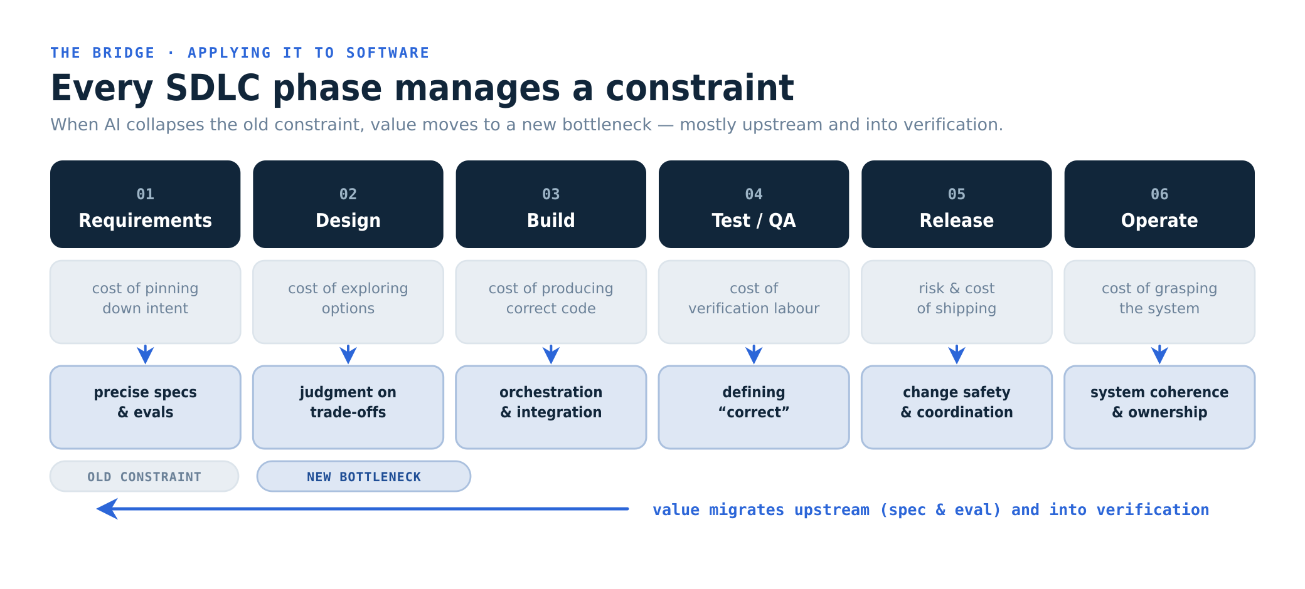
04 · THE BRIDGE
Read each phase as a constraint, not a task
RESHUFFLE → SDLC
10
Notes:
SCRIPT — say this: “Here’s the move. Take our lifecycle and, for each phase, stop asking what task it performs and ask what constraint it exists to manage. Requirements exists because pinning down intent is hard. Build exists because producing correct code is expensive. Test exists because verification is costly. Now collapse each of those constraints with AI, and watch the value drain out of the old center of each phase and pool somewhere new. And notice where the new bottlenecks land — they cluster in two places: upstream, in knowing exactly what to build; and at verification, in deciding what ‘correct’ even means. The next slide is the same thing as a table you can take with you.” GUIDANCE: • The key analytical move — go phase by phase, slowly. • Point physically at the two clusters: upstream and verification.

Slide 16
04 · PHASE BY PHASE
Where value moves in each phase
Phase | Old constraint | New bottleneck — value goes here | Who owns it
Requirements | Pinning down intent into a spec | Specs & evals precise enough for an agent | Product + spec owner
Design | Exploring options; irreversibility | Judgment on trade-offs & interfaces | Architects
Build | Cost of producing correct code | Orchestrating components into a whole | Devs as orchestrators
Test / QA | Cost of verification labour | Defining what “correct” means (the oracle) | Verification owner
Release | Risk & cost of shipping | Coordinating safe change at volume | Platform / SRE
Operate | Understanding a live system | Keeping the system coherent | Owning teams
Net: value migrates upstream (spec & eval) and into verification.
RESHUFFLE → SDLC
11
Notes:
SCRIPT — say this: “This is the take-home. Left column: the constraint each phase used to manage. The blue column in the middle: where the value goes once AI collapses that constraint. Right column: who naturally owns that new work. Read the blue column straight down — specs and evals, judgment on trade-offs, orchestrating components, defining what ‘correct’ means, coordinating safe change, keeping the system coherent. Now notice what is not on that list: ‘typing code faster.’ That’s the entire point. The net, at the bottom: value migrates upstream into the spec, and downstream into verification.” GUIDANCE: • The take-home table — slow down. • Read the blue column aloud; pause on “not typing faster.”

Slide 17
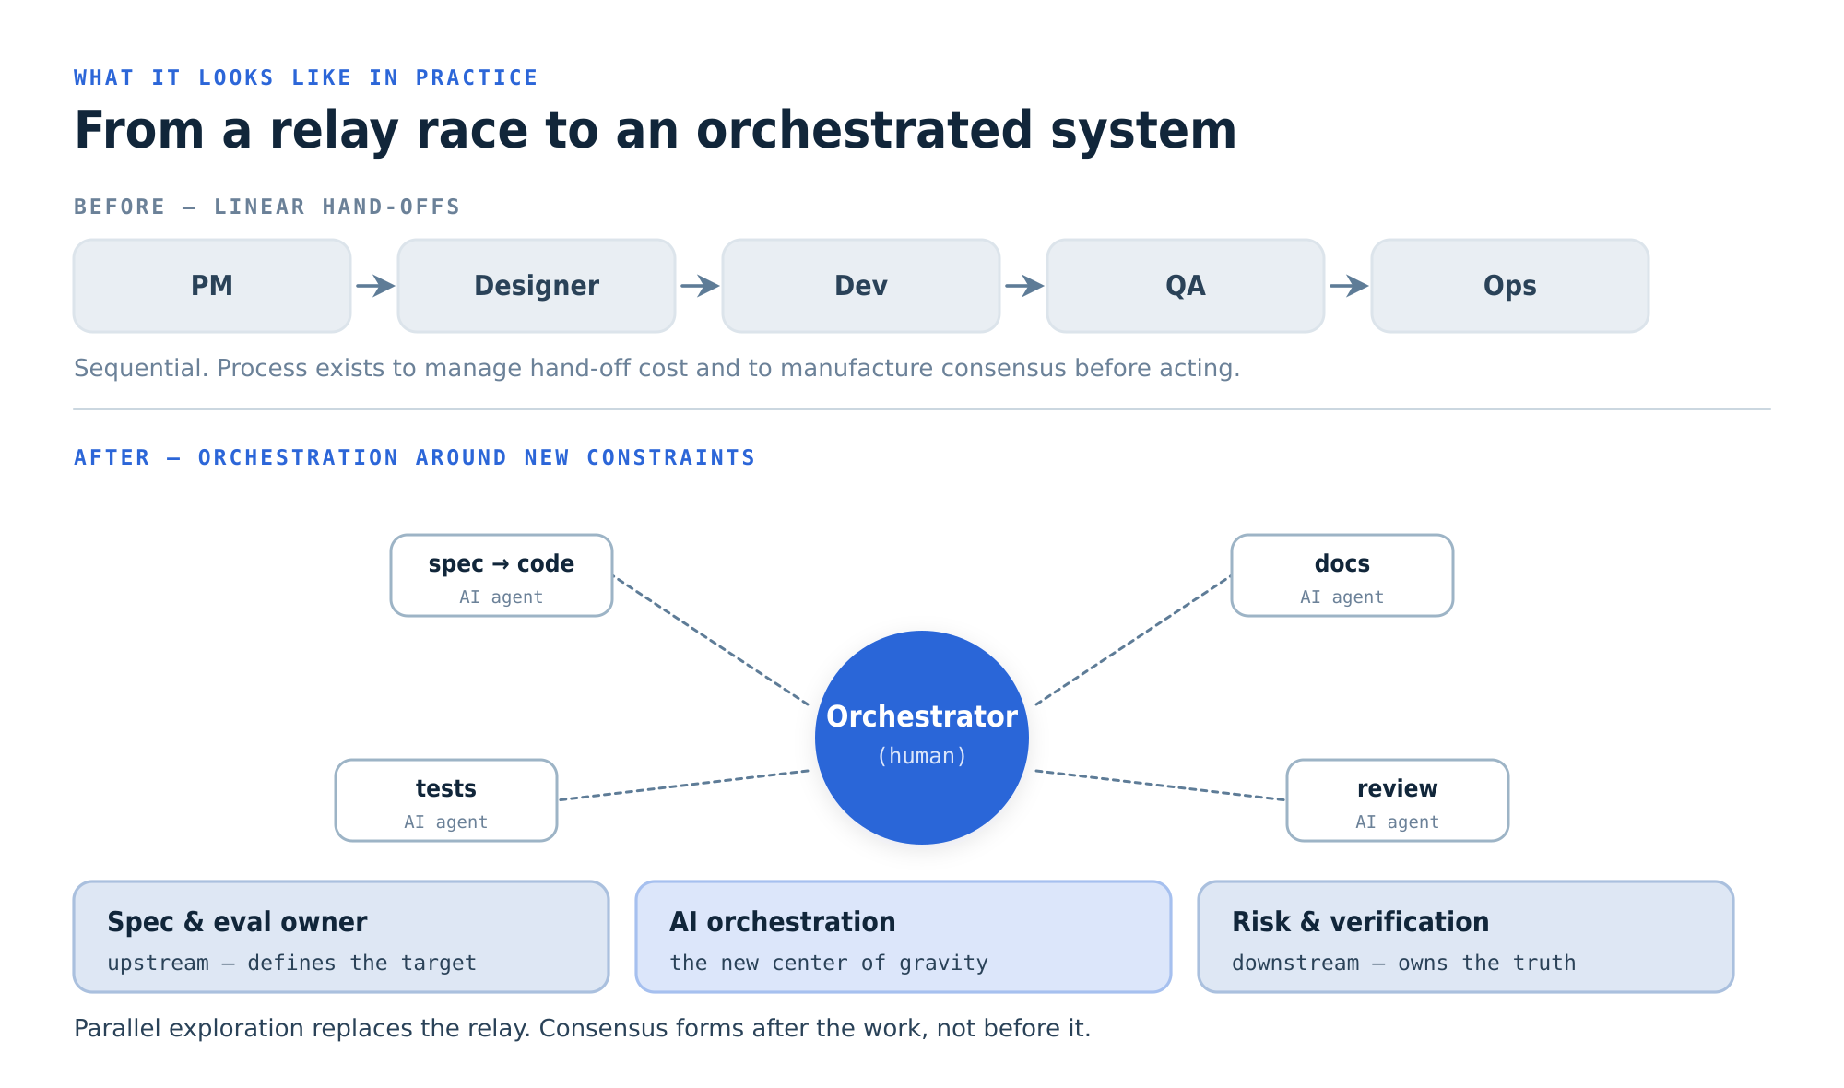
04 · THE NEW SHAPE
Roles rebundle around three durable constraints
RESHUFFLE → SDLC
12
Notes:
SCRIPT — say this: “So what does the team actually look like? Today the SDLC is a relay race — PM hands to design, design to engineering, engineering to QA, QA to ops — and a lot of our process exists just to manage those handoffs and to get everyone to agree before we commit expensive work. Once AI drops the cost of producing each artifact and the cost of translating between roles, that relay comes apart. It rebundles into something more like a person orchestrating parallel agent work, anchored by three roles — the same three from earlier: someone who owns the spec and the evals upstream, someone running the orchestration in the middle, and someone who owns risk and verification — the truth — downstream. Consensus forms after the work now, not before it.” GUIDANCE: • Make it concrete — use our real team and role names. • “Consensus after, not before” is the mindset shift; say it plainly.

Slide 18
04 · SO WHERE DOES VALUE LAND?
Three places advantage concentrates
UPSTREAM
AT VERIFICATION
AT ORCHESTRATION
State the problem precisely and encode it as a spec + eval. The spec becomes the asset; the code becomes a build artifact.
Decide what “correct” means and stand behind it. When generation is infinite, governing output is the job — the Shutterstock position.
Compose many cheap, generated components into a coherent, reliable system — a role that barely existed a few years ago.
Mind the limits. This is value-chain economics, not an engineering law. Distributed-systems complexity, security and the verification oracle don’t collapse — value migrates TO them. And cheaper change is not lower risk: a flood of cheap change makes coordination and verification more load-bearing, not less.
RESHUFFLE → SDLC
13
Notes:
SCRIPT — say this: “If you remember nothing else from the mapping, remember these three places where advantage concentrates. Upstream: the people who can state the problem precisely and turn it into a spec and an evaluation — the spec becomes the real asset, and the code becomes a build artifact. Verification: whoever can decide what ‘correct’ means and stand behind it — when you can generate infinite output, governing it is the job. And orchestration: whoever can compose all those cheap, generated pieces into something coherent and reliable. Now — the honest caveat at the bottom. This is value-chain economics, not a law of engineering. Distributed systems, security, the hard problem of verification — those don’t disappear; value moves toward them. And cheaper change is not the same as lower risk — a flood of cheap changes makes coordination and verification more important, not less.” GUIDANCE: • The three-place summary is the thing to remember — say it slowly. • Do not skip the caveat; it’s what earns credibility with engineers.

Slide 19
THE PLAYBOOK
What to do about it
01
02
03
04
Map constraints first
Specs & evals as truth
Build a verification layer
Name the orchestrator
Name what each team’s work resolves before reskilling.
Treat the spec as the asset; code as a build artifact.
Stand up the harness; give it a named owner.
Make orchestration an explicit role, not implicit.
05
06
07
One workflow, AI as engine
Exploit the seams
Measure outcomes
Redesign one flow end-to-end, not bolt-ons.
Let AI translate between two siloed teams.
Cycle-time-to-verified-value, not lines per hour.
RESHUFFLE → SDLC
14
Notes:
SCRIPT — say this: “So what do we actually do Monday? Seven moves. One: map our constraints before we send anyone off to reskill — know what each team’s work really resolves. Two — and this is the highest-leverage one — make specs and evaluations our source of truth, and treat generated code as disposable. Three: stand up a real verification layer and give it an owner. Four: make orchestration an explicit role, instead of pretending it’s just ‘being a developer.’ Five: pick one workflow and redesign it around AI end-to-end — engine, not bolt-on. Six: find two teams that talk past each other and let AI translate between them. And seven, maybe the most important: change what we measure — cycle time from idea to verified value, not lines of code per hour. If we keep measuring typing speed, we’ll just get faster typing.” GUIDANCE: • Practical close. Flag #2 (specs/evals) and #7 (metrics) as highest-leverage. • Offer to pick one or two of these to commit to as next steps.

Slide 20
THE BOTTOM LINE
“You don’t need an AI strategy.
You need a strategy for the
conditions AI creates.”
— Sangeet Paul Choudary, Reshuffle
Sources: Reshuffle (2025) · reshufflebook.com · platforms.substack.com
Independent synthesis for internal discussion — not affiliated with or endorsed by the author. Concepts & quotations © Sangeet Paul Choudary; diagrams are our own interpretation.
Notes:
SCRIPT — say this: “I’ll leave you with Choudary’s line, because it’s the whole argument compressed: ‘You don’t need an AI strategy. You need a strategy for the conditions AI creates.’ Our job isn’t to guess which tasks AI replaces. It’s to spot where the work reshuffles, find the constraints that survive — spec, judgment, orchestration, verification — and put our best people there. That’s the shift I’m asking us to make. Happy to take questions, or we can dig into any phase of the lifecycle in detail.” GUIDANCE: • Land the quote; let it sit for a beat. • Restate the single ask, then open for questions.

