Slide 1

AGENTIC AI · PROJECT REPORT
ABES Connect
A LinkedIn-style campus network built with agentic AI
ABES Engineering College | Google Antigravity · Next.js · Supabase · Vercel

Slide 2





The project at a glance
The goal was to build ABES Connect — a professional networking platform for the students and alumni of ABES Engineering College — as a serverless full-stack web app, with an AI agent writing the code rather than hand-coding it.
Stack
Next.js · TypeScript · Tailwind · Supabase · Vercel
Built via
Google Antigravity — an agent-first IDE (Gemini 3 Pro)
Guiding principle: MVP-first, then incremental phases — ship a working skeleton, get it live early, then add one feature at a time and verify each before the next.
Approach
MVP-first, phase-by-phase, verified at every step
Scope
Profiles · Feed · Connections · Messaging · Opportunities

Slide 3
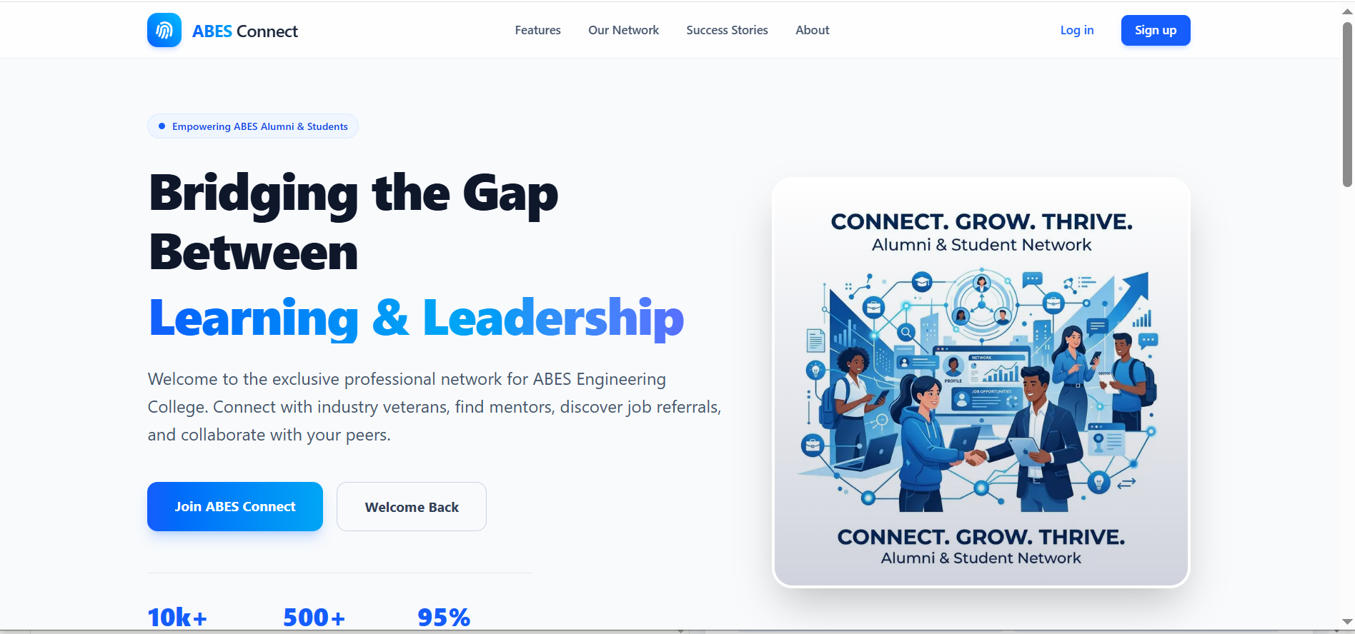
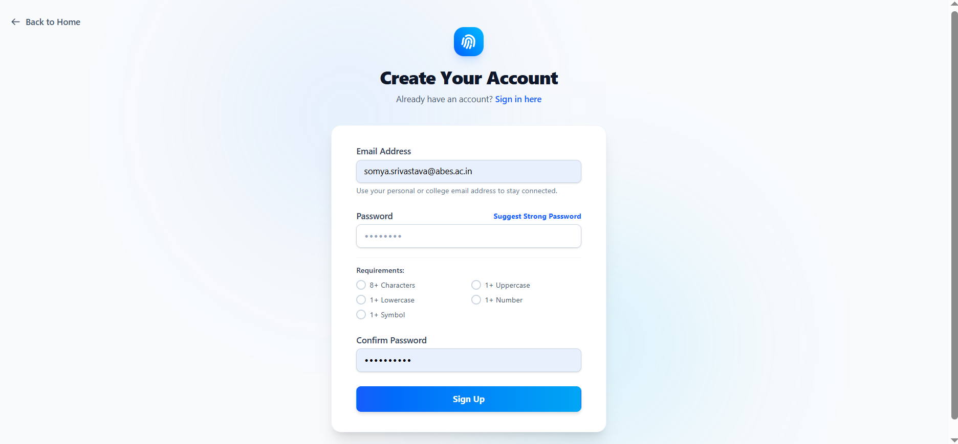
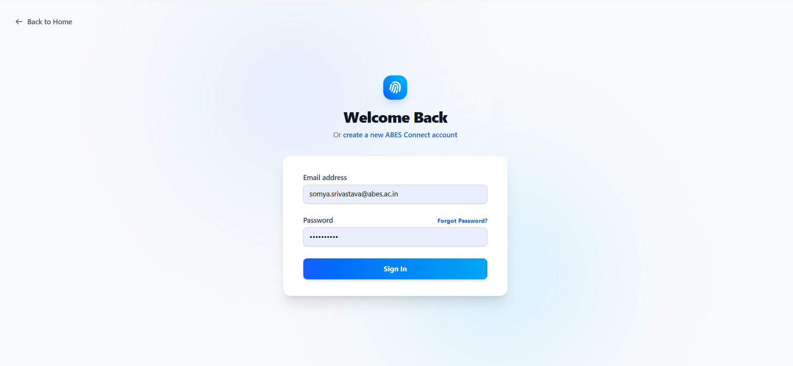
The live product — onboarding
The public landing page, and the college-restricted sign-up & login flow.
Landing page
The public front door for students & alumni
Sign up
Restricted to @abes.ac.in, live password checks
Log in
Returning members sign back in

Slide 4
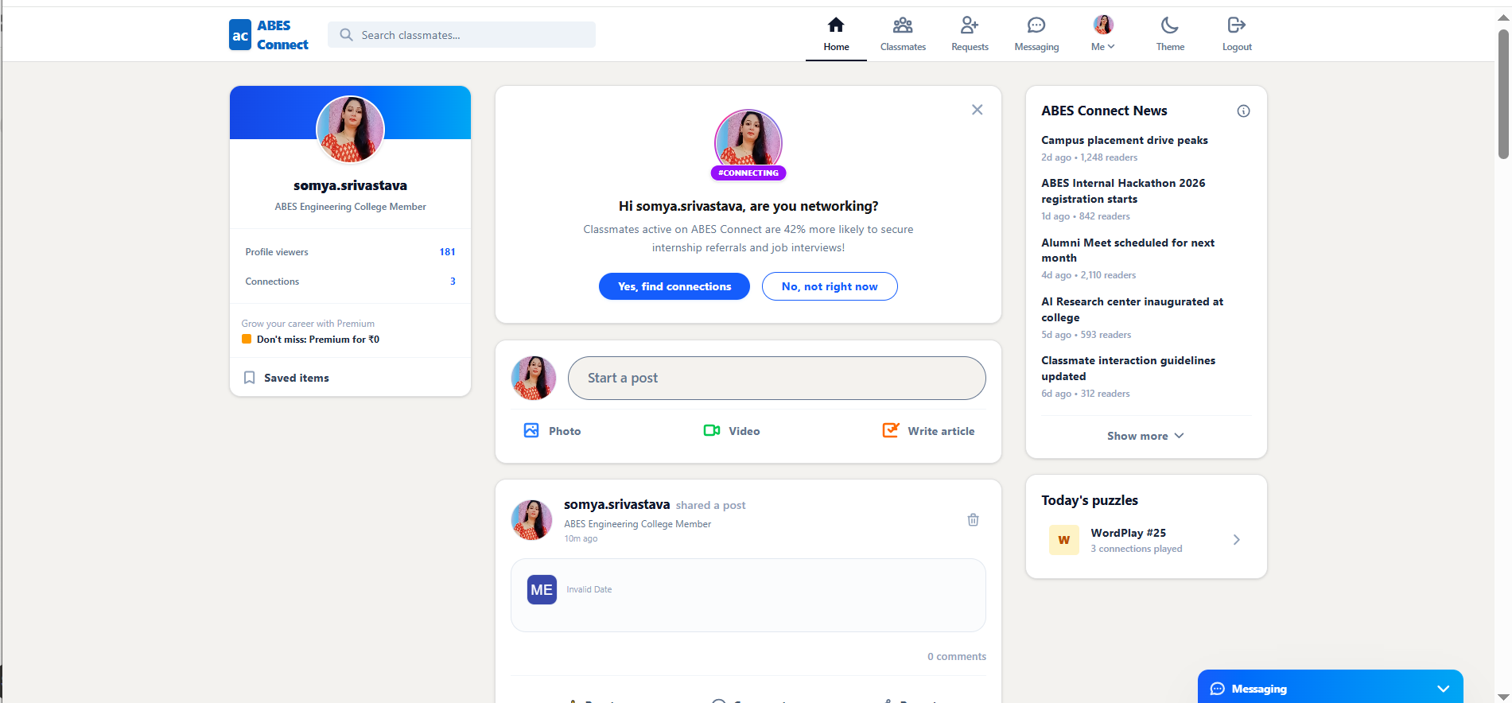
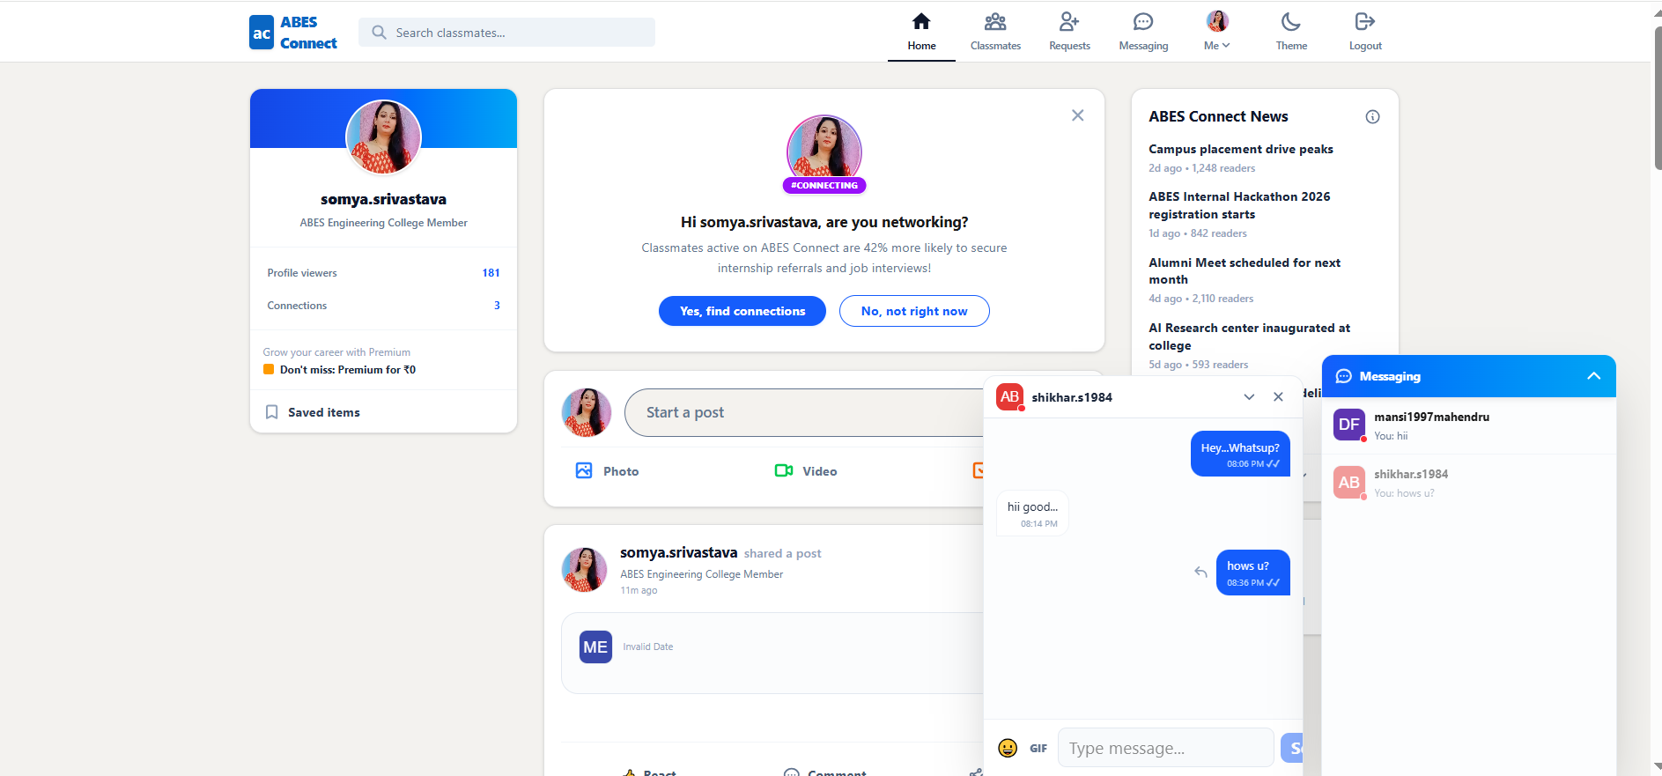

The live product — the network
The core experience: the home feed, and realtime one-to-one messaging.
Home feed & profile
Posts, reactions, profile card & campus news
Realtime messaging
1-to-1 chat with emoji and message editing
Powered by Supabase Realtime: messages appear instantly, with no page refresh.

Slide 5


System architecture
User (browser)
Frontend — Next.js + Tailwind (hosted on Vercel)
Auth pages
Feed & posts
Profiles
Messaging
Supabase client · anon key · Row Level Security
Supabase — backend-as-a-service
Auth
login · signup
Postgres DB
tables + RLS
Storage
photos · images
Realtime
live chat
Build & deploy pipeline: Prompt → Antigravity writes code → GitHub → Vercel auto-deploys. Database changes: AI generates SQL, run in the Supabase SQL Editor.

Slide 6





How code shipped: the build loop
Every feature — from the landing page to the opportunities board — followed the same five-step loop.
1
2
3
4
5
Write a prompt
Antigravity builds
Push to GitHub
Vercel deploys
Live & verify
One feature, with clear constraints
AI agent writes & tests the code
git add · commit · push
Auto-build on every push
Test on the real URL
Database changes ran on a parallel track: Antigravity generated the SQL, and it was run manually in the Supabase SQL Editor — keeping schema changes deliberate and reviewable.

Slide 7


Tools & technologies
The AI and build tools used, and what each was for.
Google Antigravity
Claude (Anthropic)
Supabase
Agent-first IDE (Gemini 3 Pro) that planned, wrote, tested & debugged the code — the primary build tool.
Planning & problem-solving: architecture decisions, writing the prompts, and diagnosing bugs.
Backend-as-a-service: Postgres database, auth, file storage, realtime & Row Level Security.
Next.js · TS · Tailwind
GitHub
Vercel
App Router framework, typed code, and utility-first styling for the interface.
Version control and code repository — the source of every Vercel deploy.
Hosting and continuous deployment — auto-publishes on every push to GitHub.

Slide 8

Prompt sequence — building
Eleven feature prompts, given to Antigravity in order — one job per prompt.
Scaffold + landing page Next.js + TS + Tailwind, run locally
Rich profiles Experience, education, certs, projects, banner
1
A
Authentication Signup/login, @abes.ac.in only, protected home
Rich feed Image posts, reactions, repost, @mentions
2
B
Database schema 5 tables, RLS, auto-profile trigger
Messaging 1-to-1 realtime chat, connections only
3
C
Profile pages View/edit, photo upload to Storage
Notifications Live bell for reactions, comments, requests
4
D
Feed Create posts, likes, comments
Opportunities board Alumni post internships, students apply
5
E
Connections + directory Requests, accept, searchable people
6

Slide 9


Prompt sequence — debugging & improving
Debugging prompts
Improvement prompts
Feed missed connections' posts Query only checked one direction — fixed to match requester OR receiver.
Chat enhancements Emoji reactions and message editing inside the chat box.
Own posts not on profile author_id vs profile-id mismatch between create & query.
Light / dark theme A theme toggle across the whole site.
Git & environment fixes Repo init, PATH, drive/space paths, Vercel env vars, URL vs connection-string.
UI polish Profile viewers, saved items, and a news rail.
RLS & email throttle Verified policies existed; handled Supabase email rate limit.
Design refinement College-tailored labels (“Classmates”) and a cleaner home layout.

Slide 10

What made it work: the prompting method
One feature per prompt
Explicit constraints every time
Small, focused tasks — easy to build and easy to verify.
RLS on, correct env-var names, the email domain — stated up front.
AI writes SQL, human runs it
Test locally, then push
Schema changes stayed deliberate and reviewable in Supabase.
Verify in the browser preview before deploying to Vercel.
Verify each phase before the next
Debug from the exact error
Check the data and console — a solid phase makes the next one easy.
Confirm the data, read the real error, then prompt the true fix.

Slide 11
From prompt to product
A working campus network — profiles, feed, connections and realtime messaging — built phase by phase with agentic AI, and live on Vercel.
Next up: notifications · opportunities board · search & discovery · launch checklist

