Slide 1
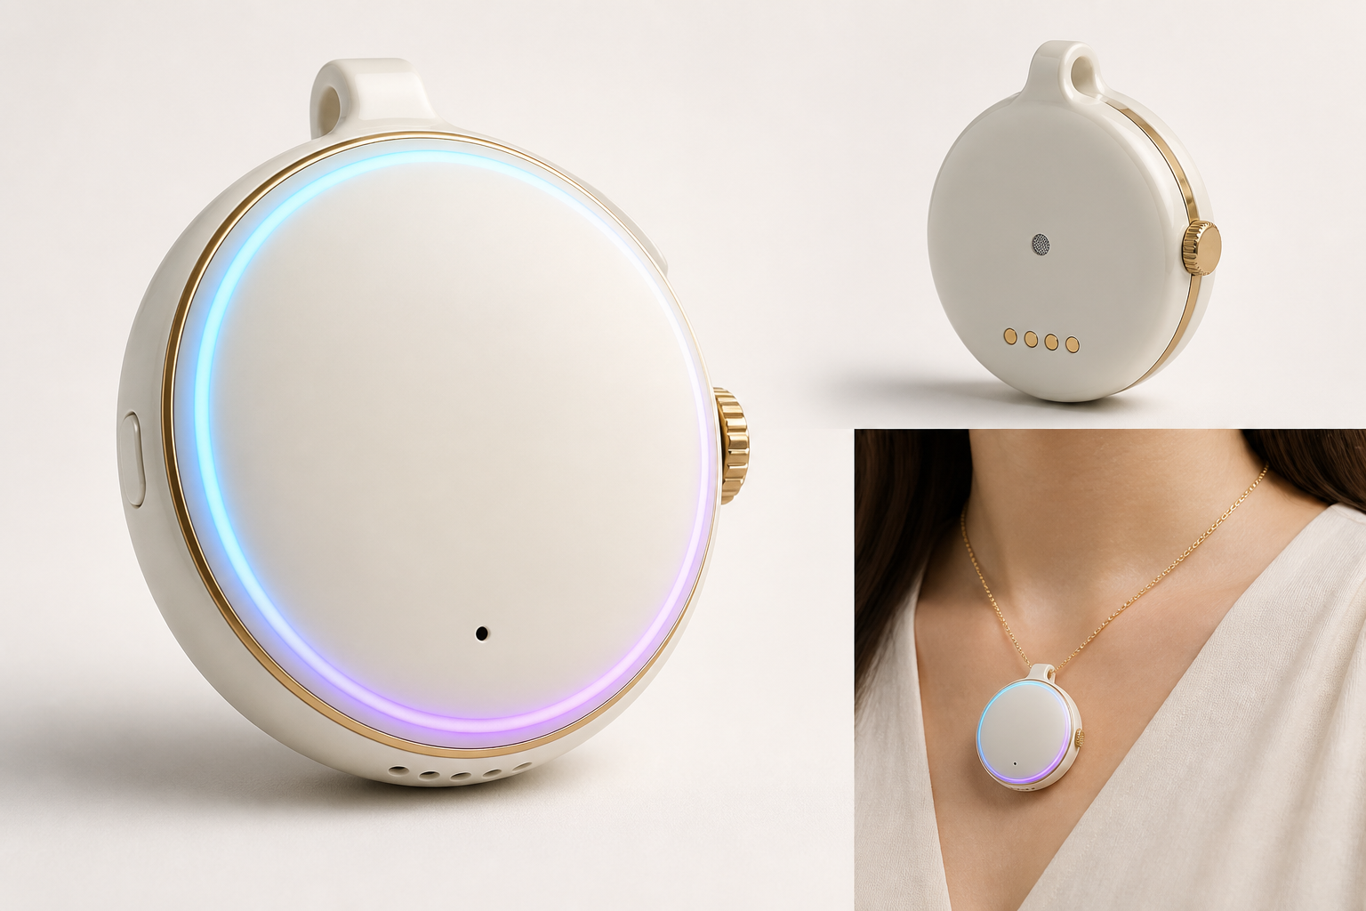
Agentic Pendant
Small, Lightweight, Comfortable, Non-Distractive

Slide 2
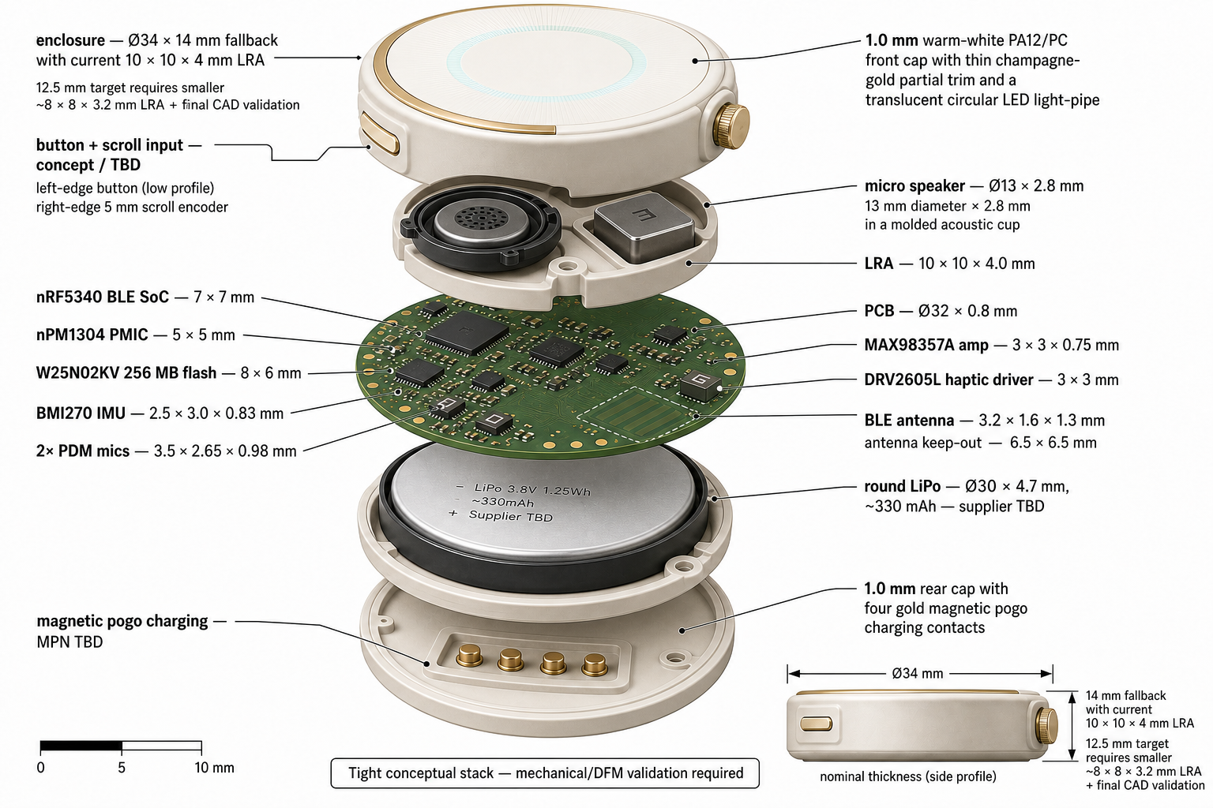

Slide 3
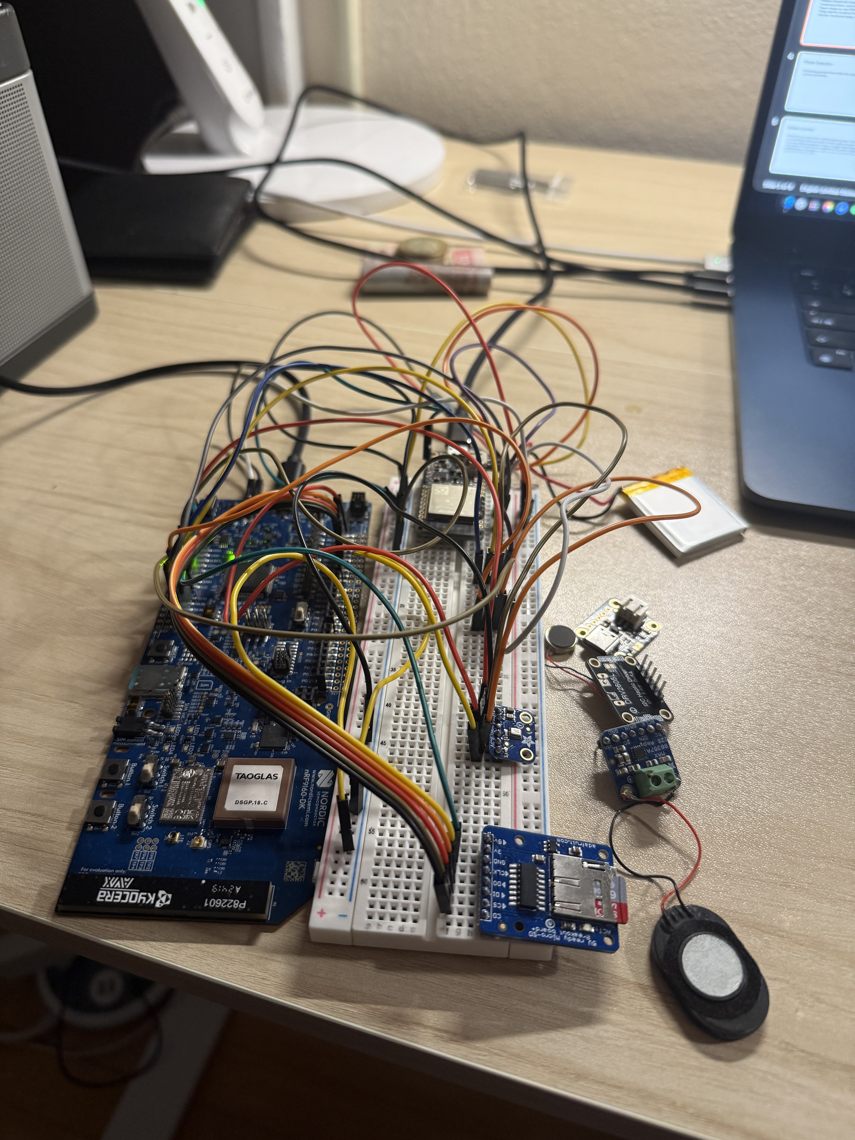
Prototype.
Consisted of breakout boards with breadboard and jumper wires.
For the end product, we only need to buy the bare chips, design our own PCB and then solder all these components together and integrate with the mechanical casing.

Slide 4
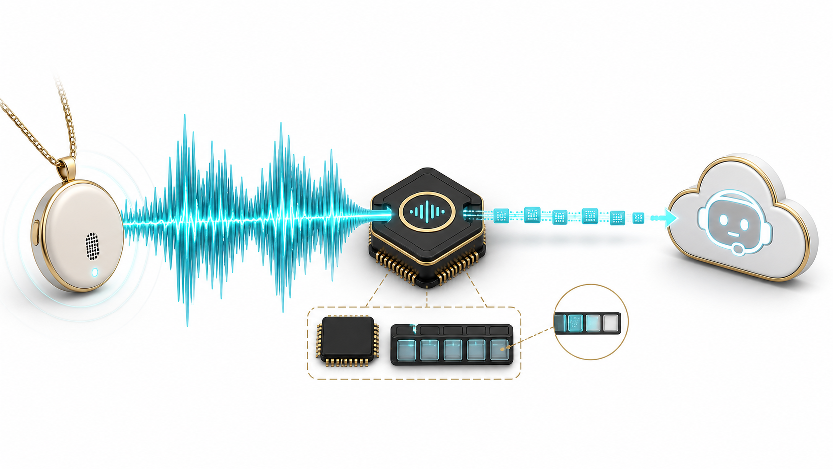
RAM and Bandwidth Constraints
Constraint: A wearable has a tiny memory and link budget.
Encode locally: Opus turns a dense waveform into compact audio frames.
Stream continuously: Send frames as they are captured instead of buffering a full recording.
Notes:
[Sources]
- Visual: OpenAI built-in image generation, created for this deck on 2026-08-11. Conceptual illustration; not a product screenshot or implementation evidence.
- Technical framing: revised from the existing RAM and Bandwidth Constraints slide in the user-provided SAIL.pptx; unverified numeric claims were removed from visible copy.
[/Sources]

Slide 5
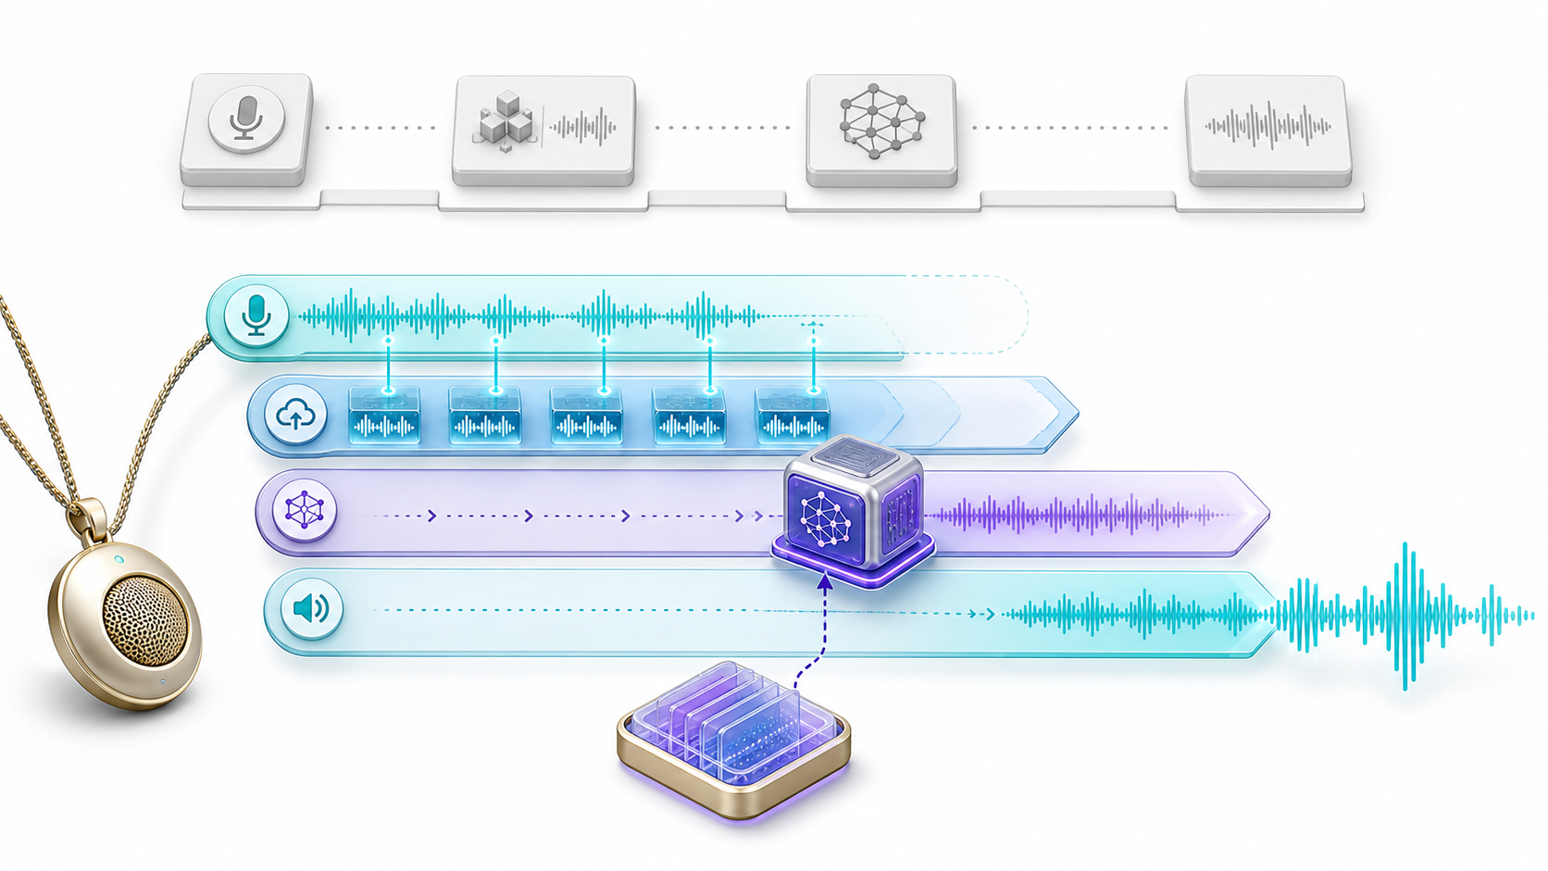
Reducing Latency
Overlap the pipeline: Upload chunks while the user is still speaking.
Skip serial handoffs: Native audio input removes a separate transcript step.
Reuse context: KV caching avoids repeating eligible model work.
Notes:
[Sources]
- Visual: OpenAI built-in image generation, created for this deck on 2026-08-11. Conceptual illustration; not a product screenshot or implementation evidence.
- Technical framing: revised from the existing Reducing Latency slide in the user-provided SAIL.pptx; unverified numeric claims were removed from visible copy.
[/Sources]

Slide 6
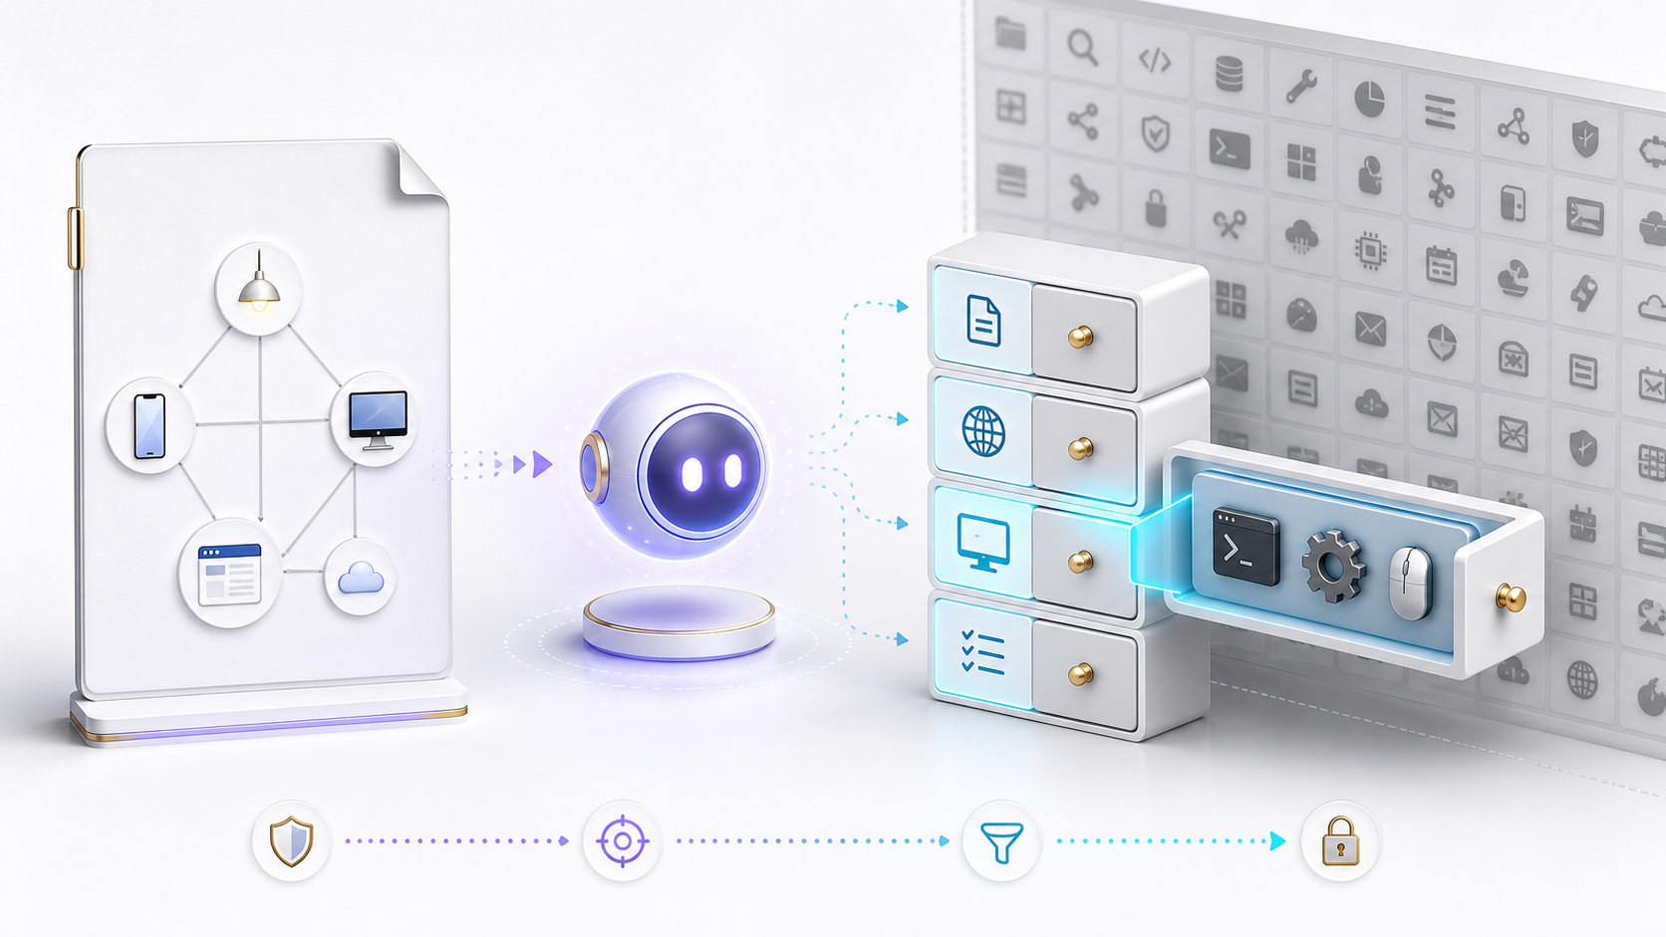
System prompt.
Map the system: The prompt names each node and its role.
Index capabilities: Tools stay grouped by category.
Discover on demand: The agent loads only relevant, permitted tools.
Notes:
[Sources]
- Visual: OpenAI built-in image generation, created for this deck on 2026-08-11. Conceptual illustration; not a product screenshot or implementation evidence.
- Technical framing: revised from the existing System prompt. slide in the user-provided SAIL.pptx; unverified numeric claims were removed from visible copy.
[/Sources]

Slide 7
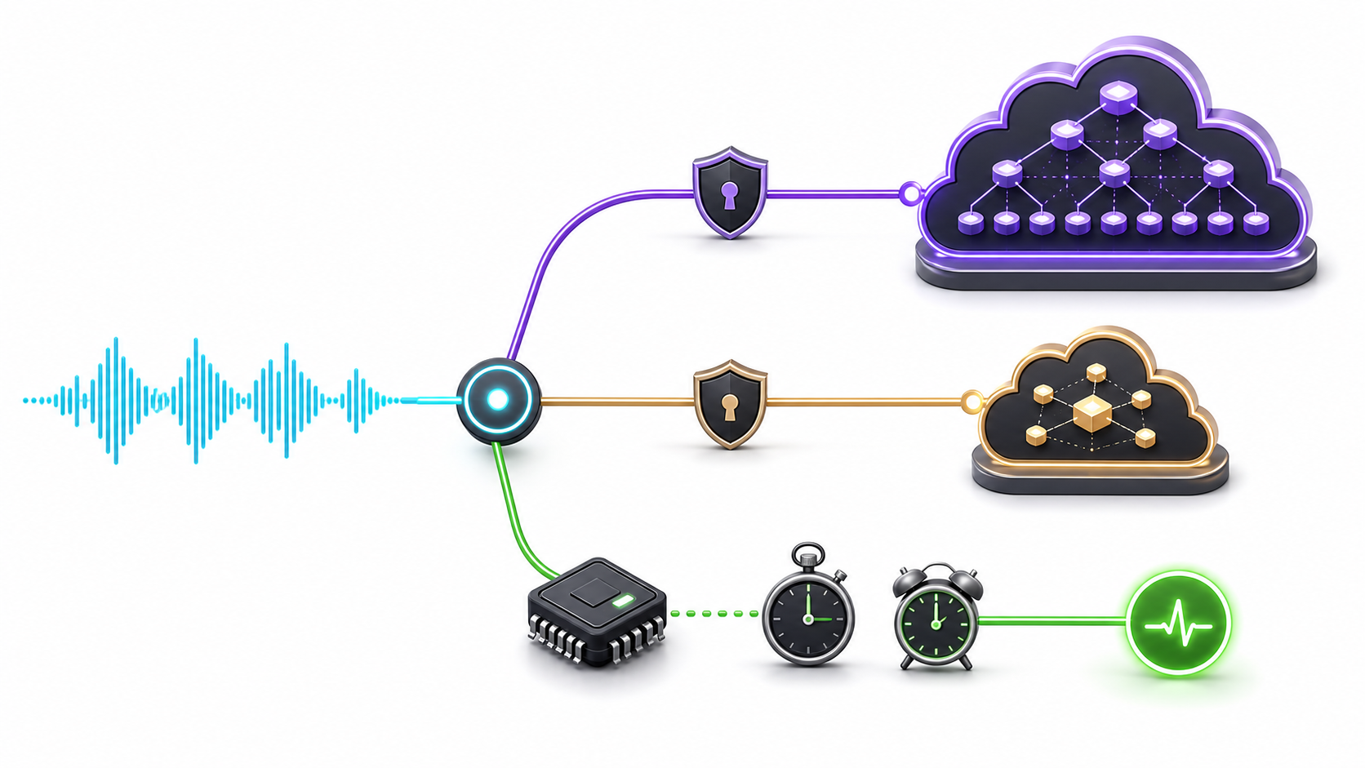
Deterministic vs. LLMs
Local first: Known offline intents—wake words, alarms, and timers.
Escalate simply: Route permitted requests to an economical model.
Add capacity only when needed: Use a stronger model for deeper reasoning.
Notes:
[Sources]
- Visual: OpenAI built-in image generation, created for this deck on 2026-08-11. Conceptual illustration; not a product screenshot or implementation evidence.
- Technical framing: revised from the existing Deterministic vs. LLMs slide in the user-provided SAIL.pptx; unverified numeric claims were removed from visible copy.
[/Sources]

Slide 8
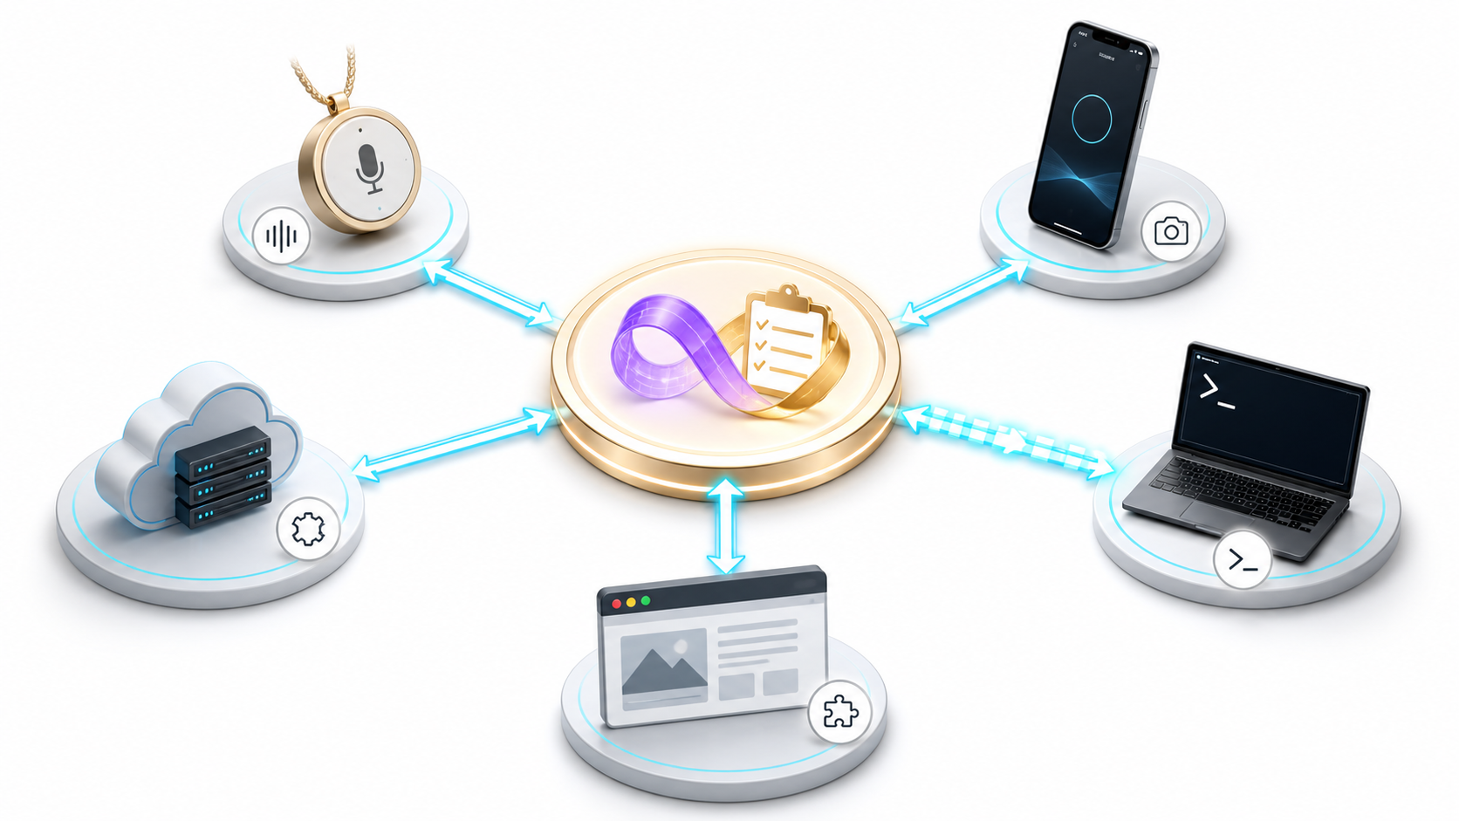
The Hivemind
Five nodes: Pendant, phone, desktop, browser, and cloud relay.
Local context: Each node exposes only its own tools and environment.
Shared coordination: Tasks and memory support cross-node handoff.
Notes:
[Sources]
- Visual: OpenAI built-in image generation, created for this deck on 2026-08-11. Conceptual illustration; not a product screenshot or implementation evidence.
- Technical framing: revised from the existing The Hivemind slide in the user-provided SAIL.pptx; unverified numeric claims were removed from visible copy.
[/Sources]

Slide 9
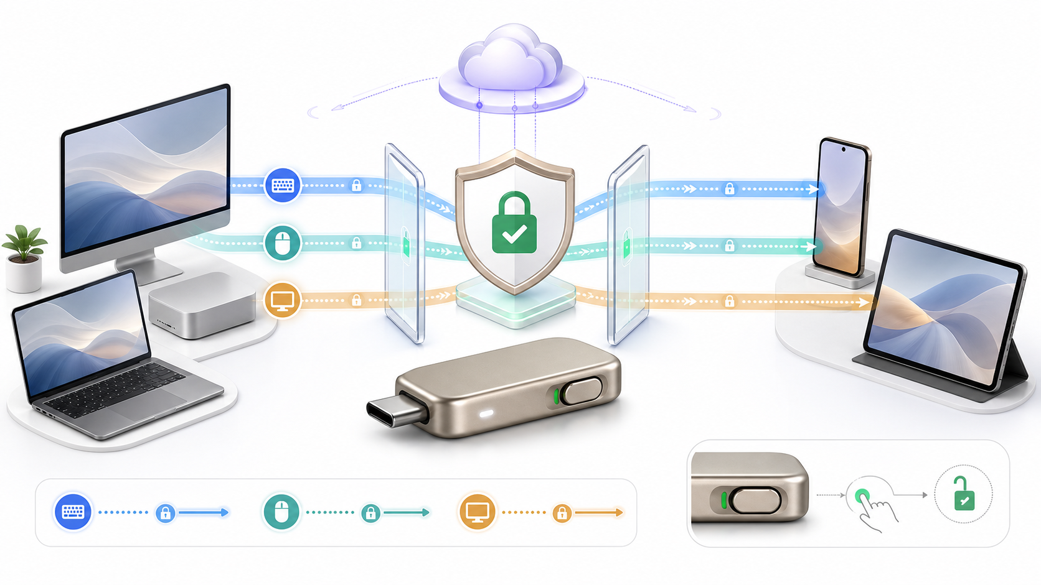
Future possibilities
Exploratory: A USB bridge could expose approved keyboard, pointer, and display paths.
Consent first: Every session should be visible, encrypted, and revocable.
Platform limits apply: Capabilities depend on the host and device.
Notes:
[Sources]
- Visual: OpenAI built-in image generation, created for this deck on 2026-08-11. Conceptual illustration; not a product screenshot or implementation evidence.
- Technical framing: revised from the existing Future possibilities slide in the user-provided SAIL.pptx; unverified numeric claims were removed from visible copy.
[/Sources]

