Slide 1
OneLP Capstone
Proof-of-Concept Deliverables
AI document-intelligence pipeline + portfolio analytics for Limited Partners
Kishan Dhulashia · Max Vanderlinden · Sofia Mollon · Agustin Gentil
June 2026

Slide 2
Three deliverables — all targets met
DELIVERABLE 1
Extraction Accuracy
DELIVERABLE 2
Forecast Backtest
DELIVERABLE 3
Pipeline & Latency
0.968
Hybrid macro F1
5.0%
MAE vs actual
24s
End-to-end P50
✓ Target ≥ 0.90 · critical-field 0.968 (≥ 0.95)
✓ Target < 15% · 1,000-path Monte Carlo
✓ Target < 30s · P95 29s · ECE 0.056

Slide 3
CONTEXT
The problem & the system
The problem
LPs & family offices manage private-market portfolios across GP portals, PDFs, emails and spreadsheets — no standard schema.
• 30–40 hours/month of manual reporting
• Missed capital calls & compliance risk
• No real-time exposure / liquidity view
The OneLP system (3 layers)
1. Ingestion — 2-stage classify, hybrid OCR+LLM extract, merge, validate, auto-apply
2. Analytics — Monte Carlo forecasting, J-curve profiles, stress tests, liquidity reserves
3. Automation — alerts, daily briefing, scheduled reports, AI email drafting
This capstone evaluates the ingestion pipeline (D1, D3) and the analytics engine (D2).

Slide 4
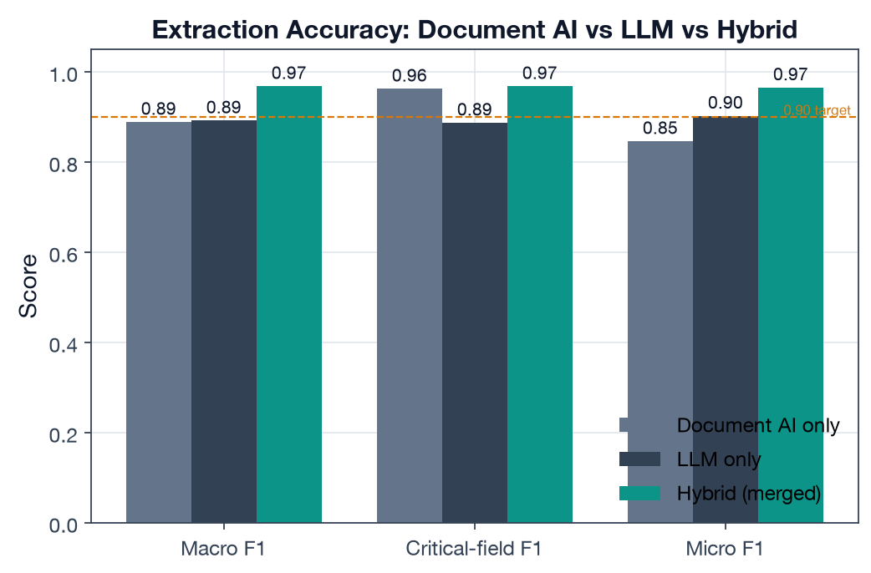
DELIVERABLE 1 · EXTRACTION ACCURACY
Hybrid extraction clears both accuracy targets
0.968 Hybrid macro F1
0.968 Critical-field F1
0.889 Classification acc
Document AI → tables/forms · LLM → narrative · Hybrid → merge precedence (merge.ts). Single engines fail in opposite directions.

Slide 5
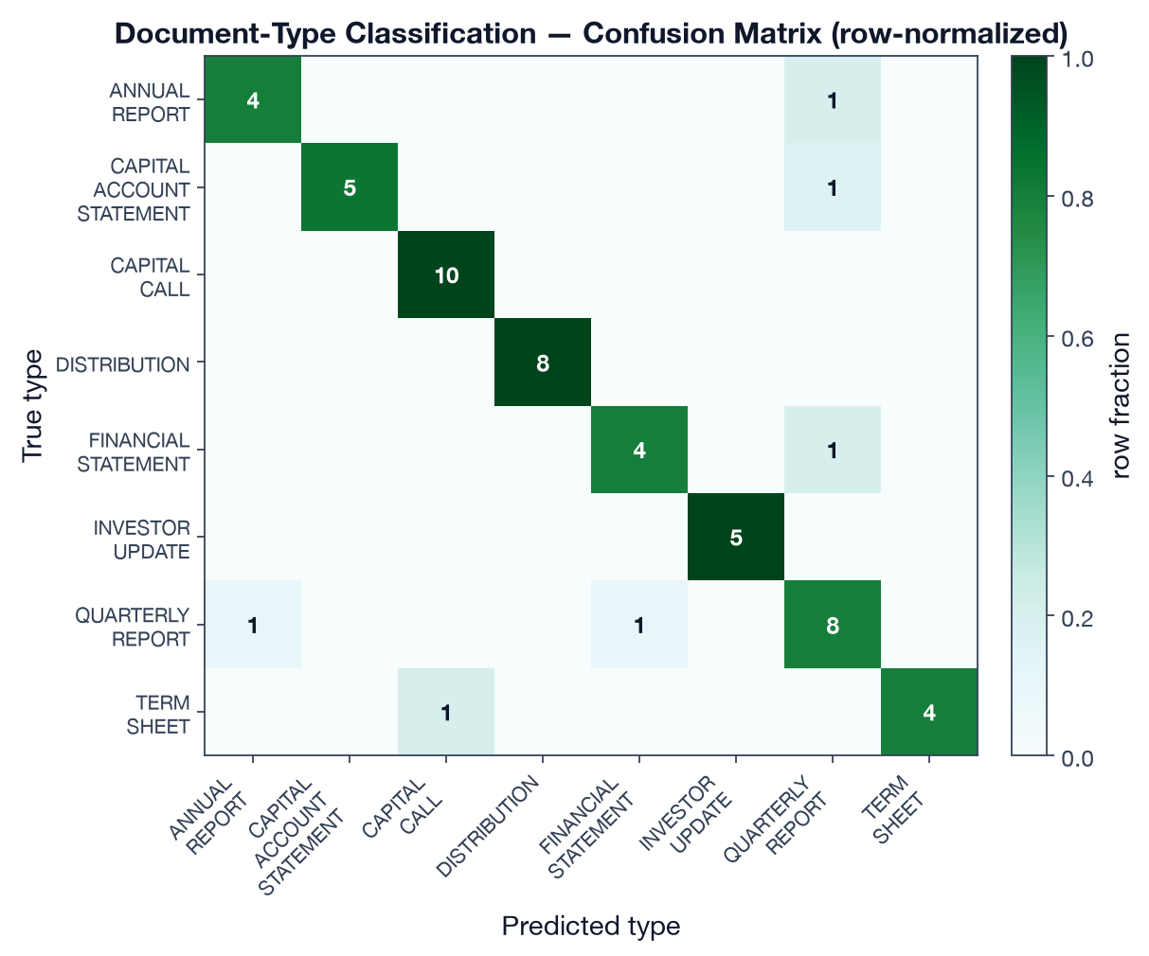
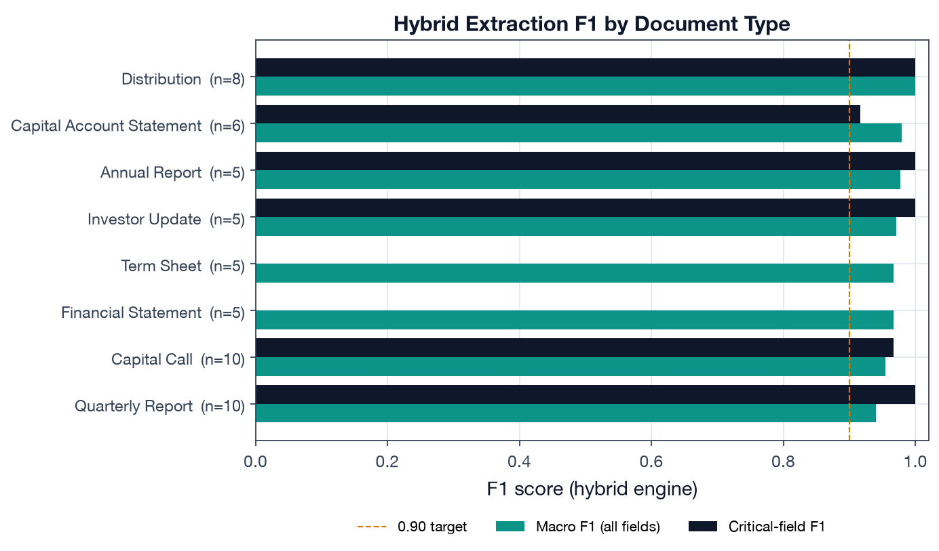
DELIVERABLE 1 · EXTRACTION ACCURACY
Accuracy by document type & classification
Hybrid F1 ≥ 0.94 for every type; classification confusions are only between adjacent periodic-report types.

Slide 6
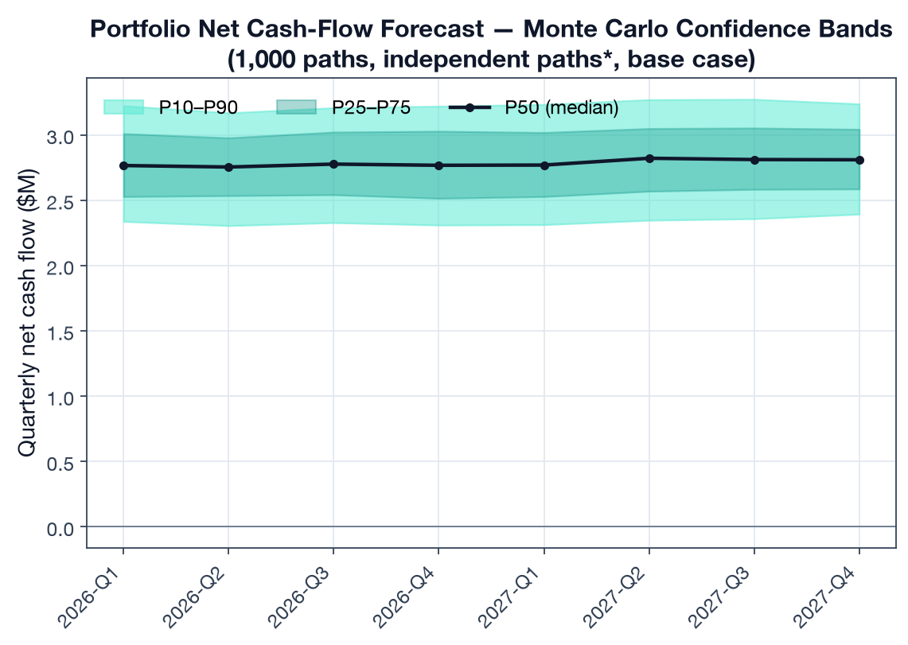
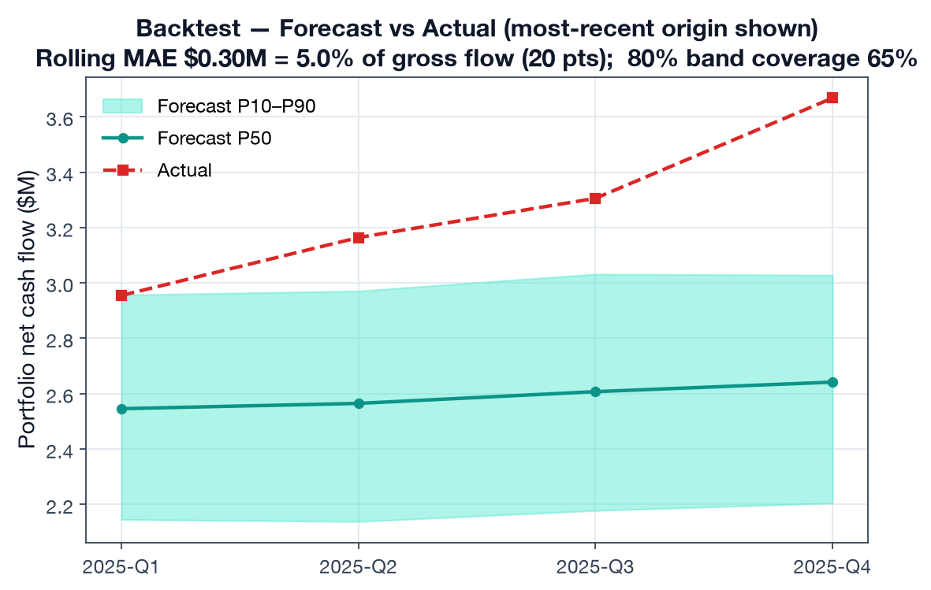
DELIVERABLE 2 · FORECASTING
Monte Carlo forecast & backtest (MAE 5.0% < 15%)
Engine is a line-for-line port of monte-carlo.ts. Rolling-origin backtest, 20 portfolio-quarter test points.

Slide 7
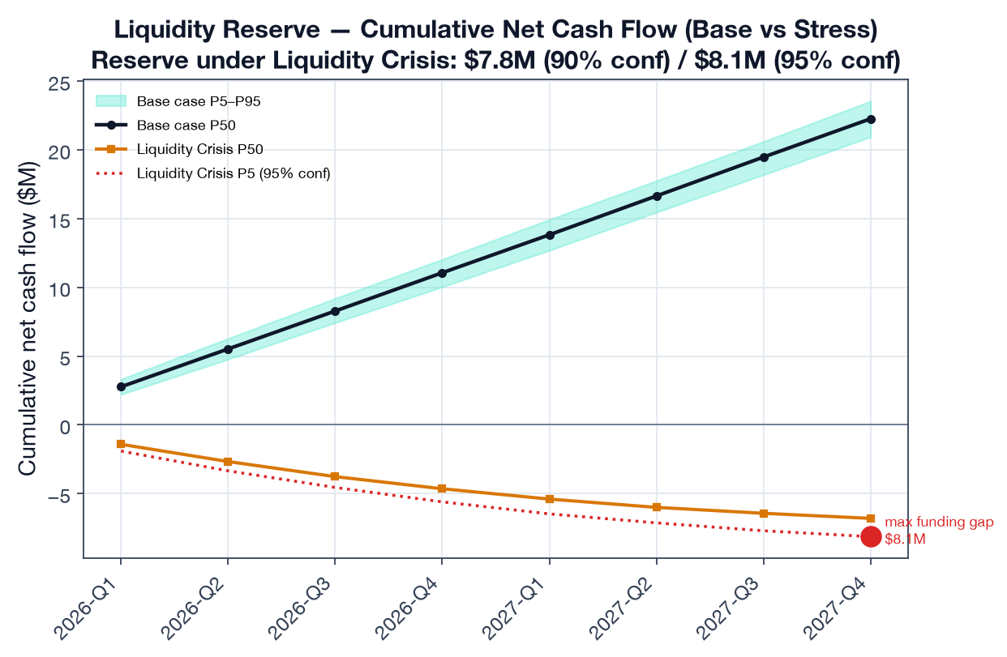
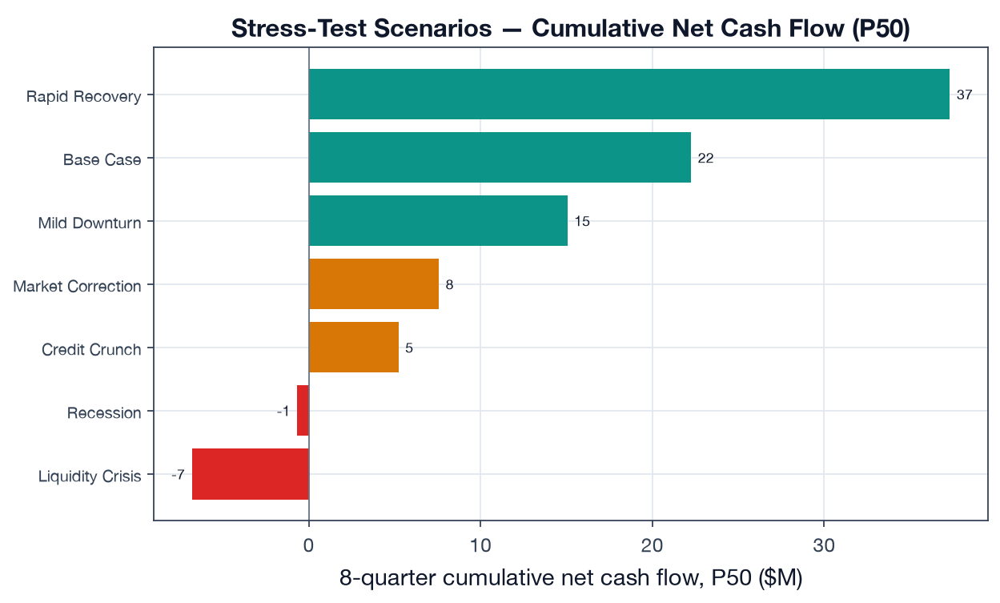
DELIVERABLE 2 · FORECASTING
Stress testing & liquidity reserve
Self-funding in base case; ~$8.1M reserve (95% confidence) needed to survive a Liquidity Crisis.

Slide 8
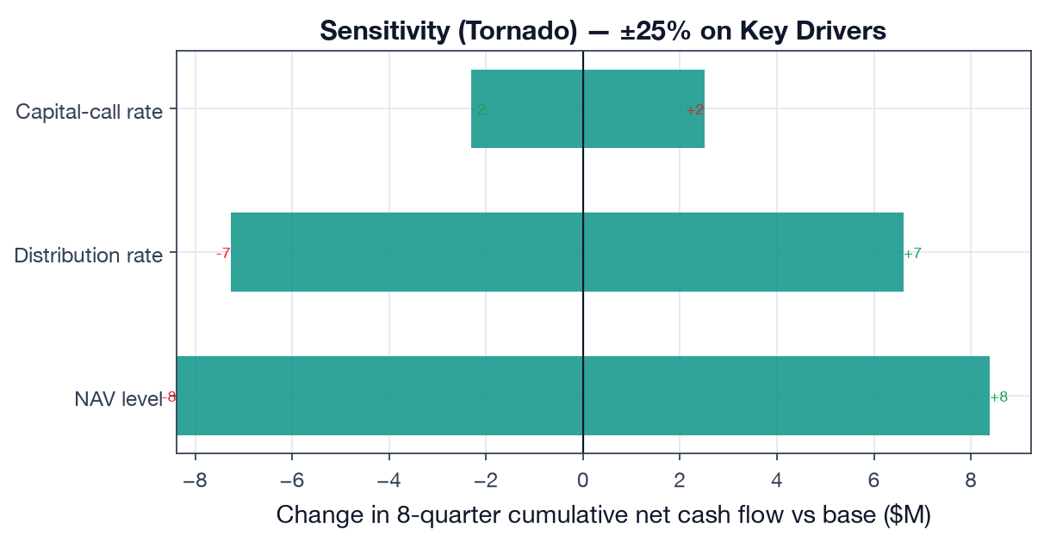
DELIVERABLE 2 · FORECASTING
Sensitivity — what moves the forecast (±25%)
±$17M NAV level
±$14M Distribution rate
±$5M Capital-call rate
NAV level and distribution pacing dominate; call timing matters ~3× less for a mostly-deployed book.

Slide 9
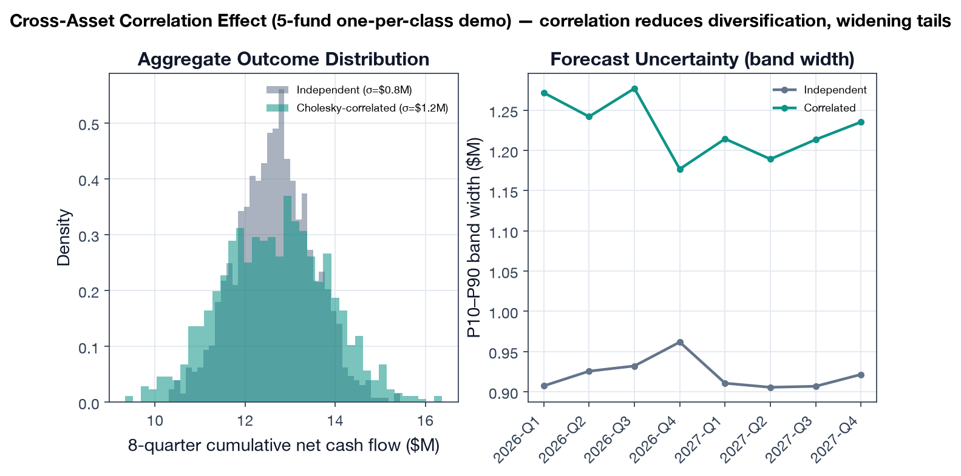
DELIVERABLE 2 · FORECASTING
Cross-asset correlation widens the tails (+39% σ)
Cholesky correlation reduces diversification on a one-per-class demo — but no-ops on the full 16-fund book (singular matrix, monte-carlo.ts:336-341): a documented fix.

Slide 10
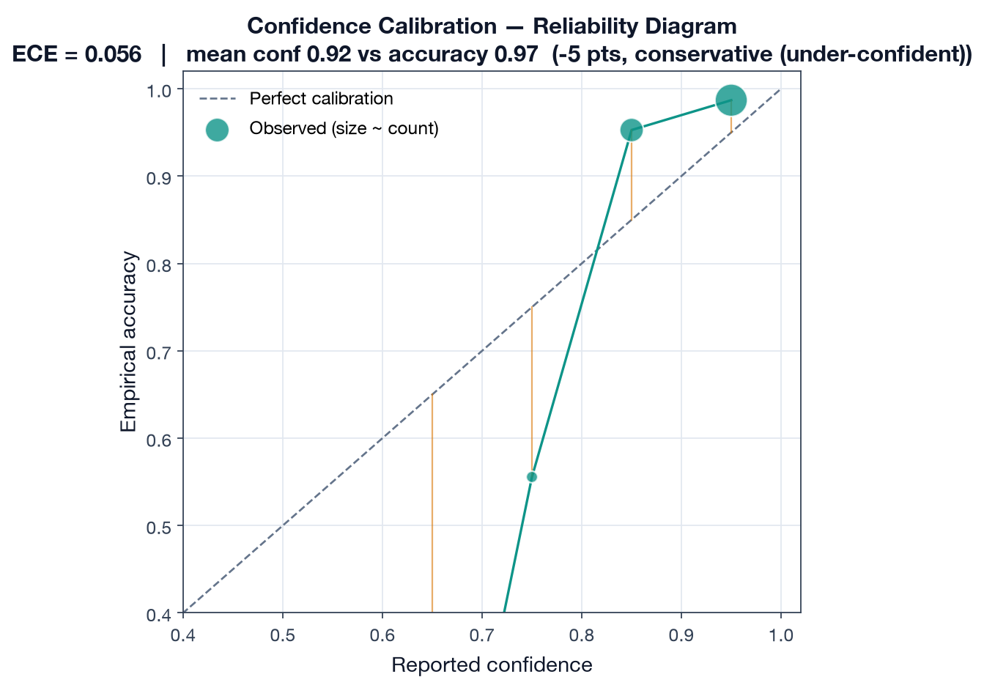
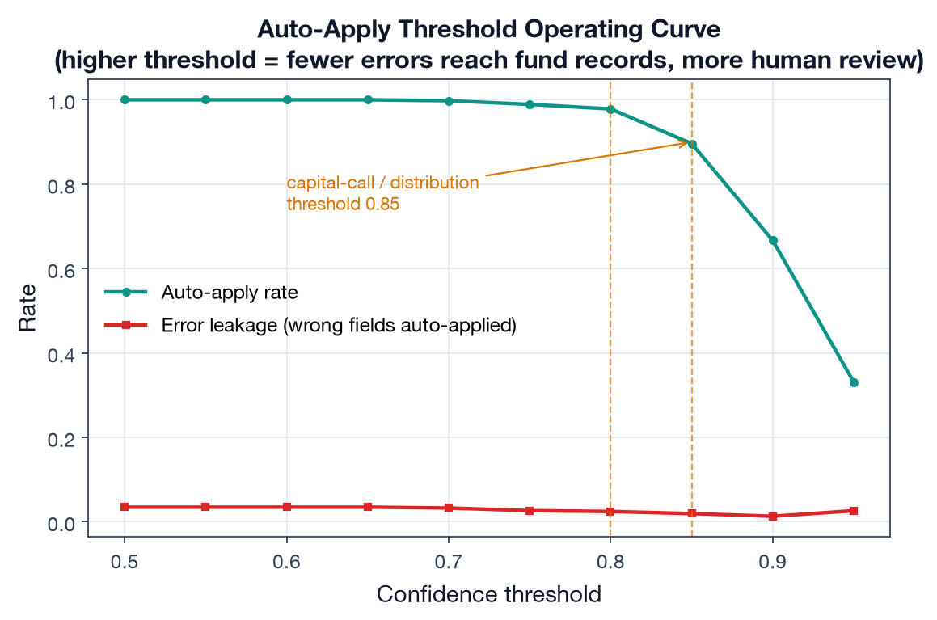
DELIVERABLE 3 · PIPELINE ANALYSIS
Confidence calibration & auto-apply thresholds
Conservatively calibrated (under-states reliability) → thresholds can be relaxed after a calibration pass.

Slide 11
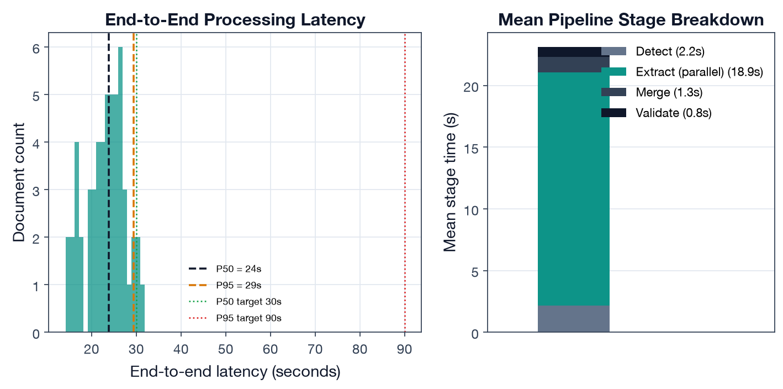
DELIVERABLE 3 · PIPELINE ANALYSIS
Latency meets target: P50 24s / P95 29s (Metric 3)
Targets P50 < 30s / P95 < 90s — both met. Document AI + LLM run in parallel, so extraction cost is the slower engine, not the sum.

Slide 12
Conclusions
Architecture choices are evidence-backed.
Hybrid extraction and Monte Carlo each beat the simpler alternative on the metric that matters.
The system is honest about uncertainty.
Conservatively calibrated (ECE 0.056); classification errors are 'safe' adjacent-type confusions.
Two concrete fixes carry forward.
Widen forecast intervals (65% coverage of an 80% band); regularize the correlation matrix.
Production numbers are wired.
Every metric recomputes unchanged against live extractions / real cash flows — only inputs change.

