Slide 1
OneLP
The AI-native operating system for Limited Partners
Turning fragmented private-market documents into structured intelligence, predictive insight, and automated workflows
Kishan Dhulashia · Max Vanderlinden · Sofia Mollon · Agustin Gentil
Venture Capstone · IE School of Science & Technology · 2026
Notes:
30-second hook: LPs and family offices drown in PDFs and spreadsheets. OneLP is the AI-native system that turns that mess into real-time portfolio intelligence and automated workflows. We have a live product, 7 pilots and €5B+ AUM behind us.

Slide 2
WHO WE ARE
Team
TEAM TO COMPLETE
Kishan Dhulashia
Co-founder
[role / background — TEAM]
Max Vanderlinden
Co-founder
[role / background — TEAM]
Sofia Mollon
Co-founder
[role / background — TEAM]
Agustin Gentil
Co-founder
[role / background — TEAM]
IE School of Science & Technology — MSc in Business Analytics & Big Data. Combined background across data science, software engineering, and private markets.
Notes:
TEAM: replace the placeholder bios with each founder's specific role (CEO/CTO/etc.) and one credibility line (prior experience, relevant domain). Keep it to ~10 seconds.

Slide 3
PROBLEM
LPs run multi-million-euro portfolios on PDFs and email
• Private-market portfolios are managed across fragmented systems — GP portals, PDFs, emails, spreadsheets — with no standard data schema.
Consequences for every LP and family office:
– 30–40 hours/month of manual reporting per family office
– Missed capital calls → late-payment penalties & compliance risk
– No real-time view of exposure, concentration, or liquidity
– 5+ disconnected tools to assemble one portfolio picture
The real problem is not aggregation — it is operationalizing unstructured, multi-source financial data into real-time, actionable intelligence.
30–40h
manual reporting / month
per family office
5+
fragmented tools
to replace
16+
GP document formats
no standard schema
Notes:
Anchor on the pain: a sophisticated LP with hundreds of millions committed still tracks capital calls in a spreadsheet. Quantify it: 30–40 hours/month. That is the wedge.

Slide 4
WHY THIS MATTERS · MARKET SIZE
Market opportunity
TEAM TO COMPLETE
Sizing methodology (TEAM to complete):
– TAM = # LPs/family offices globally × annual software & data spend
– SAM = EU SFO + MFO + LP segments OneLP can serve today
– SOM = realistic 3-yr capture given pilot pipeline & GTM capacity
Evidence of demand (have):
– 7 active pilots representing €5B+ aggregate AUM
– Family-office wealth growing; private-markets allocations rising
– Sources to cite: Preqin / Campden Wealth / Deloitte FO reports
TAM [€ — TEAM]
Global private-markets / LP software spend
SAM [€ — TEAM]
EU family offices, MFOs & LPs (target segments)
SOM [€ — TEAM]
Reachable in 3 yrs via pilot network & GTM
Notes:
TEAM: insert TAM/SAM/SOM figures with one cited source each (Preqin, Campden Wealth, Deloitte family-office reports). Keep the funnel logic explicit. The €5B+ pilot AUM is real evidence of demand — lead with it.

Slide 5
VALUE PROPOSITION
From fragmented documents to decisions
1 · INGEST
2 · UNDERSTAND
3 · ACT
• AI document pipeline
• 16+ doc types
• OCR + LLM hybrid extraction
• Field-level evidence & audit trail
• Real-time NAV / IRR / TVPI / DPI
• Exposure & concentration
• Monte Carlo cash-flow forecasting
• Stress tests & liquidity reserves
• Capital-call alerts & tracking
• AI daily briefing
• Scheduled reports
• AI email drafting to GPs
The wedge: an LP interpretation & decision layer above generic monitoring — not 'we store your data', but 'we turn reports, notices and LPAs into verified answers, alerts and decisions'.
Notes:
Three verbs: Ingest → Understand → Act. Stress the interpretation layer — that is what differentiates us from pure extraction (Canoe) and pure monitoring (Cobalt/Chronograph).

Slide 6
EXISTING SOLUTIONS
Competitive landscape & differentiation
Player | Category | Strong at | Gap OneLP exploits
eFront / iLEVEL | Enterprise platforms | Breadth, institutional scale | Heavy, not LP-opinionated
Chronograph / Cobalt | Monitoring + reporting | Dashboards, doc-aware AI | Monitoring, not decisions
Canoe | Doc extraction layer | Collection & extraction | Plumbing, not intelligence
OneLP | LP intelligence layer | Interpret · forecast · automate | EU-ready, explainable, fast
Our four defensible wedges:
– (1) LP interpretation layer — fees, waterfall, valuation, 'what changed' in plain language
– (2) Decision workflows — pacing, liquidity, commitment recommendations (not just dashboards)
– (3) Europe-ready compliance — AIFMD / SFDR / DORA built in, not bolted on
– (4) Explainable, source-linked AI + faster time-to-value for lean LP teams
Notes:
Don't fight incumbents on their strong ground (breadth, extraction). Win on interpretation, decisions, EU compliance, and explainability. The last row is OneLP.

Slide 7
PRODUCT · MVP
Live product demonstration
BUILT & VERIFIED
▶ LIVE DEMO
Demo flow (≈4 min):
1. Upload a real GP capital-call PDF → watch the pipeline classify & extract
2. Review queue: click-to-highlight evidence on each extracted field
3. Auto-apply to fund records → NAV / metrics / capital-call notice update live
4. Dashboard: exposure, liquidity, concentration update in real time
5. Forecasting tab: Monte Carlo bands, stress tests, daily AI briefing
Live at the deployed platform · demo accounts seeded (Huergo FO, F3 Finance MFO, Atlas MFO). Fallback: recorded screen-capture if connectivity fails.
Notes:
DEMO is the centerpiece. Rehearse the 5-step flow on a seeded demo account. Always have a recorded fallback video. Keep narration tied to the LP's pain: 'this used to take an analyst an afternoon — now it's 30 seconds and fully auditable.'

Slide 8
PRODUCT · CORE ENGINE
Document extraction workflow
BUILT & VERIFIED
1 · DETECT
Two-stage classification: filename/context heuristic (early-exit ≥0.70) → Gemini LLM across 16+ doc types
2 · EXTRACT
Document AI (tables/forms, bounding boxes) + LLM (narrative) run in PARALLEL
3 · MERGE
Precedence-based conflict resolution (parser >0.85 wins, else LLM); conflicts logged
4 · VALIDATE
Schema + per-type confidence thresholds (0.70–0.95); low-confidence fields flagged
5 · APPLY
High-confidence → auto-apply to fund records; else → human review queue
Every field carries raw text, confidence, page number and bounding box → full auditability and click-to-highlight verification.
Notes:
This is the capstone's core technical contribution. Walk the 5 stages. Emphasise the parallel hybrid extraction and the evidence tracking — that is what makes it trustworthy for financial data.

Slide 9
TECHNICAL IMPLEMENTATION
System architecture
BUILT & VERIFIED
APPLICATION Dashboard · review queue · daily briefing · workflow management
WORKFLOW AUTOMATION Async task queue · scheduled exports · alert engine · AI email drafting
ANALYTICS Monte Carlo · stress testing · liquidity reserve · J-curve profiles · explainability
PROCESSING / INGESTION Classification · hybrid extraction · merge · validation · auto-apply
STORAGE PostgreSQL (structured) · Cloud Storage (documents) · cache (forecasts)
Cloud-native on Google Cloud · multi-tenant isolation (clientId) · field-level auditability · RBAC (LP read-only) · async processing · Sentry observability.
Notes:
Five layers, ingestion at the core. Mention: Next.js/React/TypeScript, Prisma/Postgres, Google Document AI + Vertex Gemini, Cloud Run + Cloud Tasks. Accepted into Google Cloud for Startups (infra funded).

Slide 10
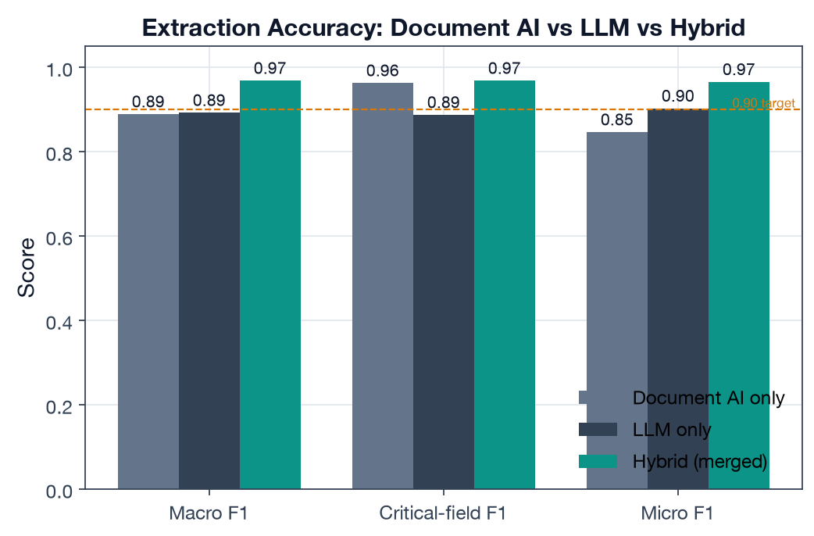
TECHNICAL · DATA SCIENCE
ML/DS #1 — extraction accuracy (hybrid beats either engine)
BUILT & VERIFIED
0.968
Hybrid macro F1 target ≥ 0.90 ✓
0.968
Critical-field F1 target ≥ 0.95 ✓
0.889
Doc-type accuracy 8 types
54-doc labeled set · Document AI (tables/forms) + LLM (narrative) merged with precedence. Evaluation Metric 1 met.
Notes:
Hybrid is the only engine clearing both F1 bars. The two single engines fail in opposite directions — that is WHY we merge. This is real evaluation, not a claim.

Slide 11
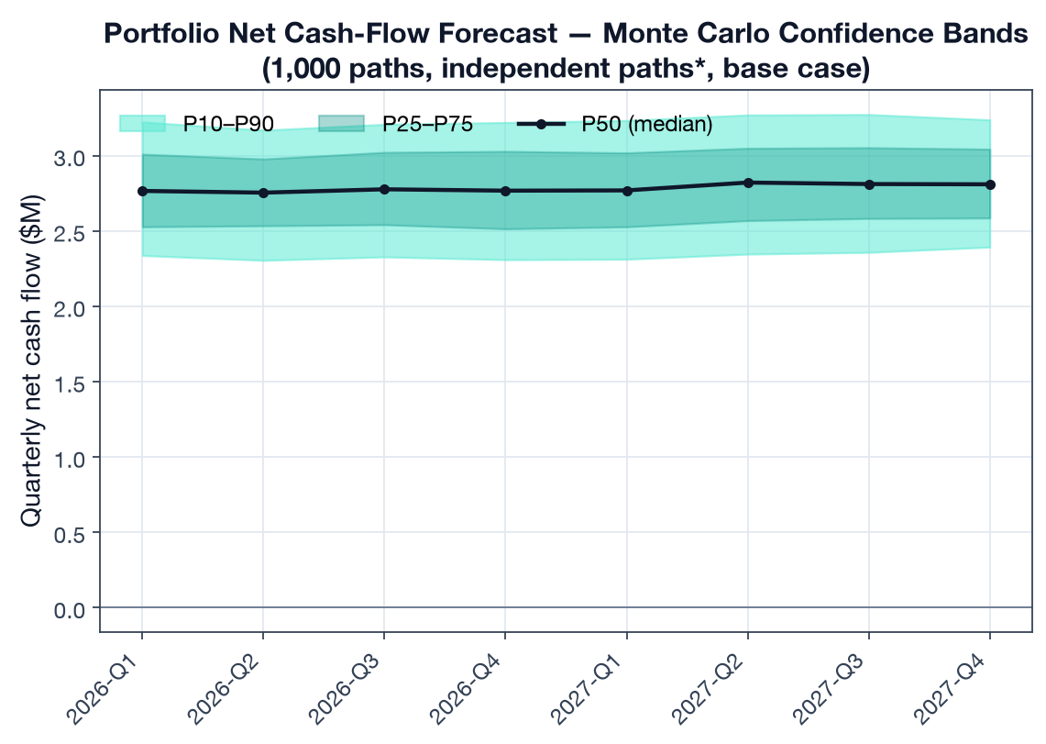
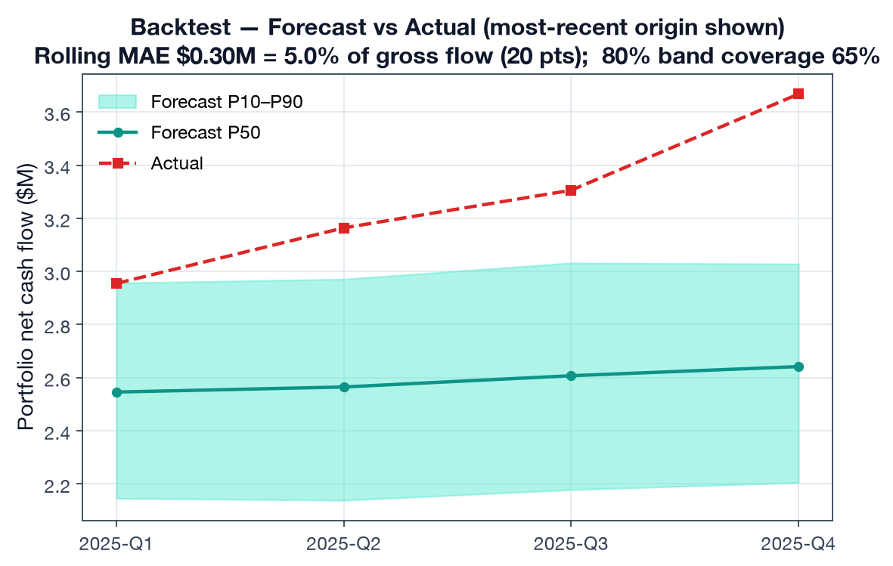
TECHNICAL · DATA SCIENCE
ML/DS #2 — forecasting & backtest (MAE 5.0% < 15%)
BUILT & VERIFIED
1,000-path Monte Carlo (Cholesky cross-asset correlation) · rolling-origin backtest, 20 portfolio-quarter points · Evaluation Metric 2 met.
Notes:
Monte Carlo with cross-asset correlation; backtested against held-out quarters at 5.0% MAE. Also: 7 stress scenarios + liquidity-reserve sizing (~€8M reserve to survive a liquidity crisis).

Slide 12
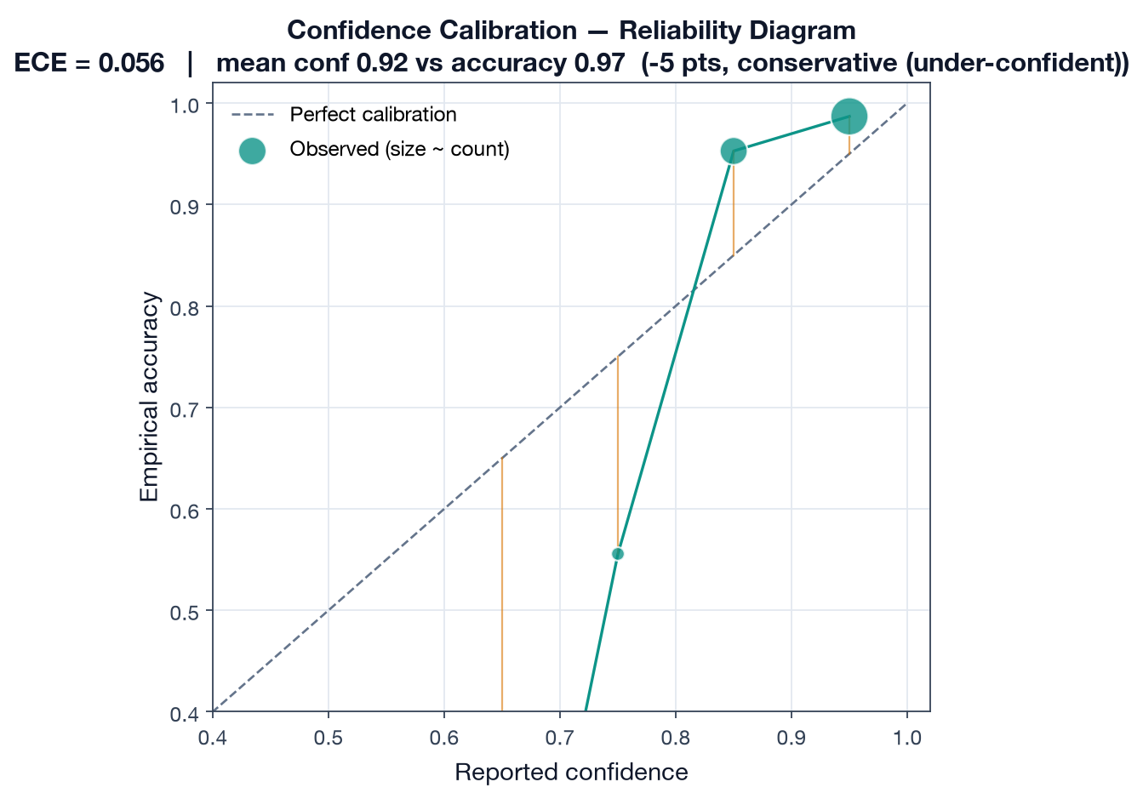
TECHNICAL · DATA SCIENCE
ML/DS #3 — calibration, approach rationale & lessons
BUILT & VERIFIED
Why these choices:
– Hybrid extraction — parser excels at tables, LLM at narrative; merge captures both
– Monte Carlo over closed-form — captures tail risk & cross-asset correlation
– Per-type confidence thresholds — capital calls need 0.85, reports tolerate 0.70
Challenges & lessons learned:
– Pipeline is conservatively calibrated (ECE 0.056) — under-states reliability → thresholds can be safely relaxed
– Correlation matrix goes singular on multi-fund books → engine falls back to independent simulation (documented; fix = regularize matrix)
– End-to-end latency P50 24s / P95 29s — parallel extraction is the key design choice (Metric 3 met)
Notes:
Show analytical maturity: we measured calibration (ECE), found the model is conservative, and we are honest about a real limitation (correlation fallback). Panels in a data-analytics program reward this kind of rigor.

Slide 13
EVIDENCE OF DEMAND
Traction & market validation
DRAFT · from repo — validate
7
active pilots
SFOs · MFOs · LPs
€5B+
aggregate AUM
across pilots
Top 3
of 140+ startups
IE Venture Day
• Live, deployed product with active users iterating in feedback loops
• Live pilot deals: F3 Finance (Belgian MFO) · BEMO Group (SFO) — signed pilot terms
Institutional support:
– Google Cloud for Startups — accepted & funded (infrastructure & architecture costs)
– LvlUp Labs Venture Accelerator — selected
– Best Startup — IE School of Science & Technology
• Demo accounts span real client archetypes (Huergo FO, Atlas MFO, F3 Finance)
Notes:
Lead with traction — it de-risks everything. 7 pilots / €5B+ AUM / Google Cloud / accelerator / award. TEAM: confirm pilot count is current and add any new logos or LOIs.

Slide 14
REVENUE MODEL
Business model — six-tier SaaS pricing
DRAFT · from repo — validate
Tier | Annual (EUR) | Users | Funds
UHNWI | €5,000 | 1 | 15
SFO Core | €15,000 | 5 | 25
SFO White Glove | €30,000 | 10 | 75
MFO Platform | €50,000 | 15+ | unlimited
MFO White Glove | €75–100K | unlimited | unlimited
Enterprise | €100–150K | unlimited | unlimited
• Annual SaaS subscription by client type
• Add-ons: seats (€1.5–2K), funds (€200), family workspaces (€4–6K)
• Pilot program: 6 mo free + infra cost, converts to paid
• Selling now: UHNWI, SFO Core, MFO Platform
• White Glove / Enterprise open 2028+
Source: vault/business/pricing-tiers.md (EUR). Gross margin 80% → 96% as base scales.
Notes:
Land-and-expand SaaS. Pilots convert to paid annual contracts. TEAM: confirm pricing is current vs the Notion source of truth before presenting.

Slide 15
BUSINESS MODEL
Unit economics & 5-year financials
DRAFT · from repo — validate
 | 2026 | 2027 | 2028 | 2029 | 2030
Net revenue | €8K | €110K | €556K | €2.09M | €4.94M
Clients (EOY) | 7 | 22 | 50 | 91 | 141
Gross margin | 80% | 91% | 94% | 95% | 96%
EBIT | -€73K | -€239K | -€330K | -€89K | +€1.23M
LTV : CAC | 14.2x | 37.7x | 23.7x | 20.0x | 35.2x
CAC payback | 4 mo | 4 mo | 5 mo | 7 mo | 5 mo
€4.94M
2030 net revenue
from €8K in 2026
>14x
LTV:CAC every year
capital-efficient
25%
2030 EBIT margin
profitable at scale
Notes:
Pure-SaaS margins, LTV:CAC well above 3x every year, payback under a year. Path to profitability in 2030. TEAM: these are modeled projections — validate assumptions and note they update with actuals as pilots convert.

Slide 16
GTM · TARGET CUSTOMERS
Go-to-market strategy
TEAM TO COMPLETE
Target customers (have):
– Single & multi-family offices, LPs, advisory teams — EU-first
– Beachhead: lean MFO/SFO teams drowning in GP paperwork
Motion so far (have):
– Pilot partner program → warm intros to FO network
– Founder-led sales; bi-weekly pilot touchpoints
Scale-up GTM (TEAM to complete):
– Channel strategy: outbound, partnerships, FO networks, events
– Sales cycle length & conversion by tier (fill from pilot data)
– Geographic expansion sequence beyond EU
– CAC by channel & payback targets
– Referral / network-effect loops
Notes:
TEAM: the customer + current motion is real (pilot program, FO warm intros). Build out the scale-up GTM: channels, sales cycle, conversion rates from pilot data, expansion plan.

Slide 17
FUTURE DEVELOPMENT
Product roadmap
DRAFT · from repo — validate
NOW
NEXT (6–12 mo)
LATER (12–24 mo)
• Ingestion pipeline (16+ types)
• Dashboard & analytics
• Monte Carlo forecasting
• Daily briefing & alerts
• 7 pilots live
• Fee / waterfall / carry verification
• ILPA v2.0 performance logic
• Pacing & commitment engine
• EU compliance (AIFMD/SFDR/DORA)
• Convert pilots → paid
• Portfolio-company KPI pages
• Benchmarking & PME
• White-Glove & Enterprise tiers
• Geographic expansion
• [TEAM: prioritize]
Notes:
NOW is real and shipped. NEXT maps to the competitor wedges (fee verification, ILPA, pacing, EU compliance). TEAM: confirm sequencing and dates.

Slide 18
THE ASK
Funding requirements & use of funds
DRAFT · from repo — validate
Raising: €300K pre-seed
23 months runway to prove product-market fit
Then: €750K seed (mid-2027)
→ self-sustaining profitability by 2030 with €1.4M in the bank
Total dilutive capital to breakeven: ~€1M
Use of pre-seed funds:
– Product development & engineering
– First 3 hires (eng + customer success)
– Pilot client onboarding & conversion
– Cloud infra (partly covered by Google Cloud credits)
Monthly burn: €3K (2026 H1) → €20K (2027) → cash-positive 2030. TEAM: confirm the current ask amount, valuation, and instrument (SAFE / equity) before pitching.
Notes:
The ask: €300K now (23 months), €750K seed mid-2027 to profitability. Use of funds = product, 3 hires, pilot conversion. TEAM: confirm amount/valuation/instrument — these are the team's call and must be current.

Slide 19
OneLP
The data-driven operating system for private markets
Live product · 7 pilots · €5B+ AUM · evaluated to F1 0.968, forecast MAE 5.0%, latency P50 24s
Built on real AI, validated with real clients, measured against real targets.
Thank you · Questions?
Kishan · Max · Sofia · Agustin | info@onelp.capital
Notes:
Close on the trifecta: real AI + real clients + real measurement. Invite technical questions — the appendix deck (OneLP-Capstone-Deliverables) has the deep dive.

