Slide 1
Enhancing Movie Discovery Through a Hybrid Machine-Learning Recommender System
Reginald Lytle
AI‑Receptive Software Development
Final Project – Week 8

Slide 2
Project Overview
CineMatch is an AI-driven movie recommendation system blending collaborative filtering with content-based methods.
Uses MovieLens + TMDB metadata, user surveys, and hybrid modeling.
Goal: Deliver personalized, explainable recommendations through a clean UI.

Slide 3
Week 1 – Project Planning
Defined project scope, dataset plan, and user-centered design goals.
Established Git repository, folder structure, and initial timeline.
Selected tools: Python, Streamlit, scikit‑learn, TensorFlow, Figma.

Slide 4
Week 2 – User Needs Assessment
Designed survey + interviews to identify user preferences.
Processed quantitative + qualitative insights to shape model features.
Early feedback emphasized transparency and clean UI design.

Slide 5
Week 3 – AI Tool Setup
Configured Python 3.11 environment with venv, Jupyter, and key ML libraries.
Resolved TensorFlow compatibility issues and GPU recognition.
Created reproducible requirements.txt + version control workflow.

Slide 6
Week 4 – Data Preprocessing
Merged MovieLens + metadata; cleaned missing values.
Created rating matrices and normalized feature scales.
Ran baseline recommender tests to validate data pipeline.

Slide 7
Week 5 – Model Development
Implemented hybrid system: ALS + Sentence‑BERT embedding re‑ranker.
Used Faiss ANN indexing for fast similarity search.
Hybrid model outperformed baseline across HR@10, NDCG, coverage, cold-start.

Slide 8
Week 6 – UI Wireframes
Designed Home, Search, Recommendation, and Profile screens.
Added collapsible 'Why This?' explanation chip for transparency.
Balanced clarity with aesthetics for clean product‑style interface.

Slide 9
Week 7 – Usability Testing
Observed navigation + spacing issues during peer tests.
Fixed slider update bug and improved layout responsiveness.
Planned final optimizations for latency + overall polish.

Slide 10
Week 8 – Final Integration
Completed slide deck and full narrative alignment.
Performed final APA cleanup and consistency checks.
Final deliverables ready for submission.

Slide 11
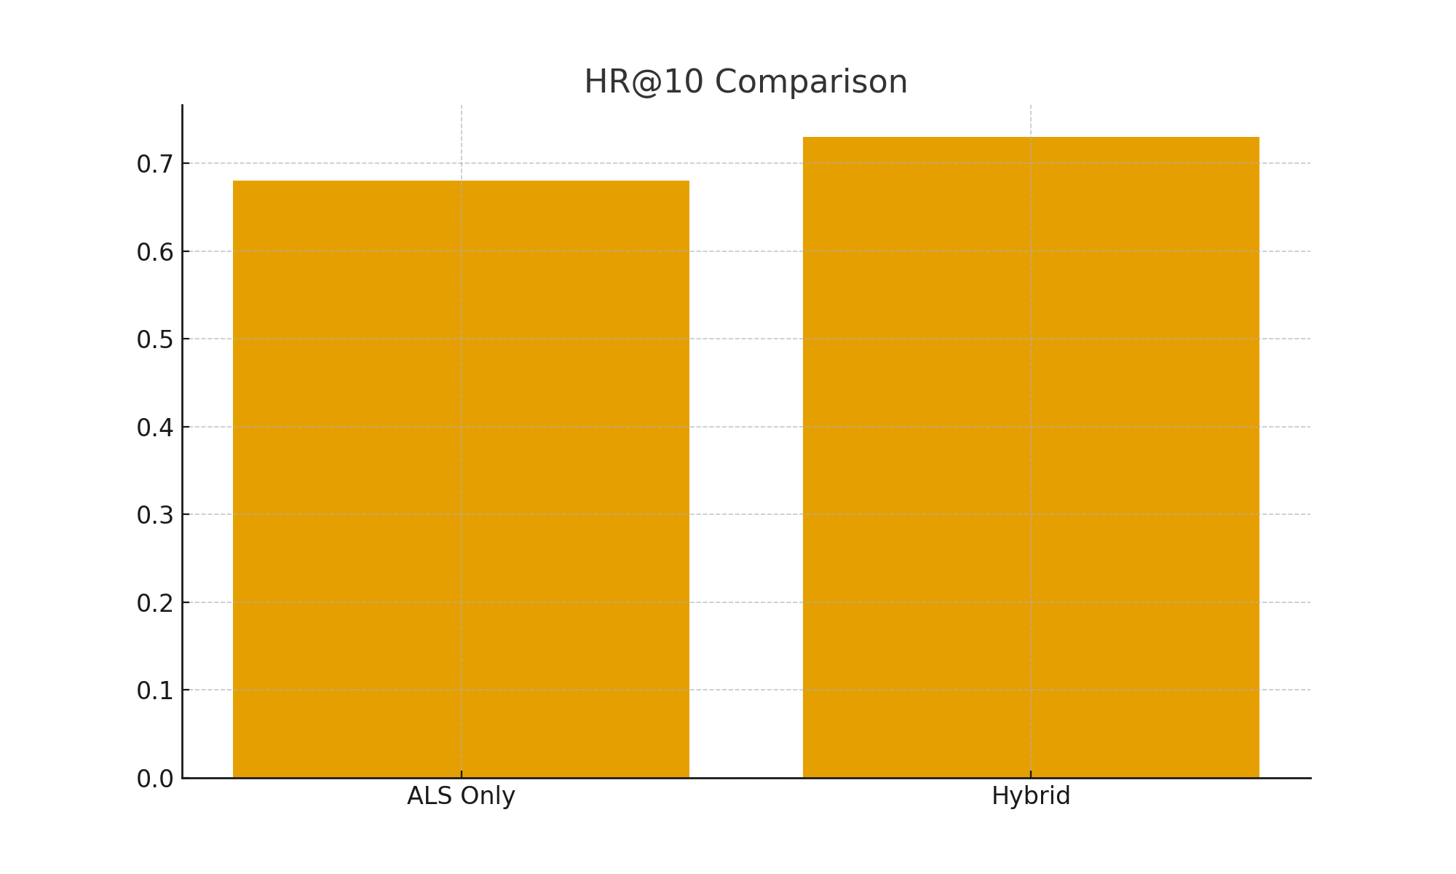
Model Performance: HR@10

Slide 12
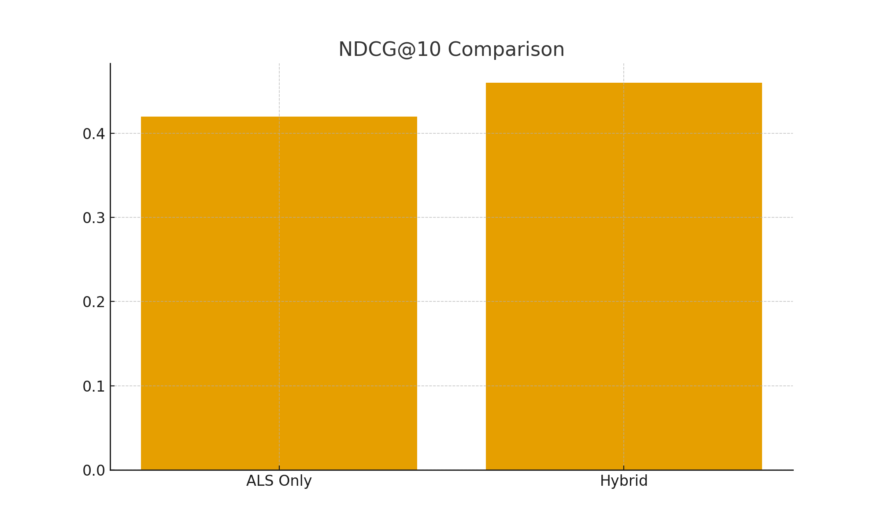
Model Performance: NDCG

Slide 13
System Architecture Overview
User → UI (Streamlit) → API Layer → Hybrid Recommender → Ranked Movie List
Model components: ALS latent factors + SBERT embeddings.
Faiss index provides real-time similarity lookups.

Slide 14
Key Takeaways
Hybrid modeling significantly improved personalization accuracy.
UI testing revealed hidden friction points and guided refinements.
Documentation + reproducible setup prevented major debugging delays.

Slide 15
Conclusion
CineMatch demonstrates a complete end-to-end AI product pipeline.
Blends technical modeling with user-centered design.
Final system delivers personalized, transparent movie recommendations.

