Slide 1
Database Systems Project: Amazon
Winston Biggs, Shane Johnson, Nicholas Pruss, Edwin Saez, Richard Zhao
Notes:
Nicholas

Slide 2
Introduction
Amazon.com is the world’s largest online retailer, so we couldn’t include everything
Our database focuses on the most important features and a small set of products
Most information for the database was available on the Amazon website, but some of it needed to be randomly generated
There are quite a few meaningful and realistic queries that can be used with our database
Notes:
Nicholas

Slide 3
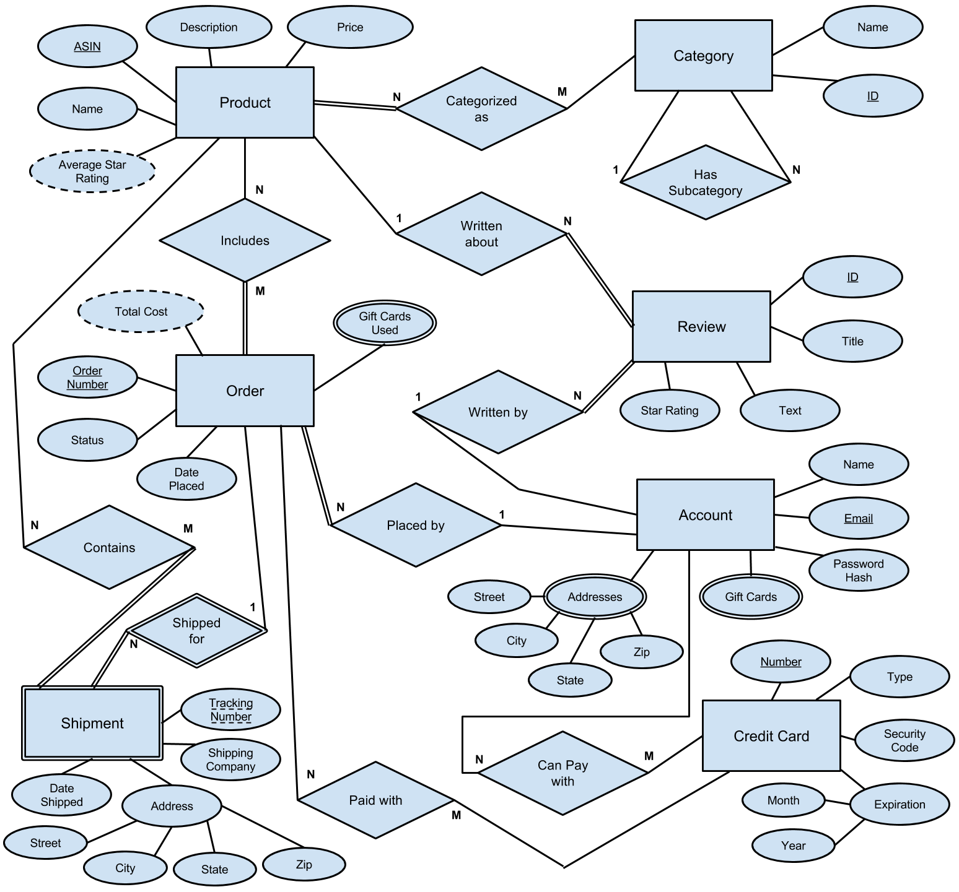
Notes:
Nicholas

Slide 4
Oracle DDL Code
We created 15 tables total in Oracle
Our 7 main entities became tables:
Product, Category, Review, Account, Orders, Shipment, and Credit_Card
Product_Categorized_As is a relationship between Product and Category
Order_Includes is a relationship between Orders and Product
Notes:
Nicholas

Slide 5
Oracle DDL Code (continued)
Shipment_Contains is a relationship between Shipment and Product
Account_Credit_Cards is a relationship between Account and Credit_Card
Order_Paid_With is a relationship between Orders and Credit_Card
Order_Gift_Cards, Account_Gift_Cards, and Account_Addresses represent multivalued attributes from the ER diagram
Notes:
Nicholas

Slide 6
Loading the Data
We added 527 tuples to our database
Python script retrieved information from Amazon for Product, Category, and Review
We provided data from our own Amazon accounts for Account, Orders, and Shipment
Python script generated random information for Credit_Card and other miscellaneous attributes, such as addresses, passwords, gift cards, and reviewers’ email addresses
Notes:
Shane

Slide 7
Sample Tuples #1
INSERT INTO product VALUES ('B00IEYHMIM', 'Sony ICFC1 Alarm Clock Radio, Black', 'Rise and shine with a Sony alarm clock radio...', 6.35);
INSERT INTO category VALUES (509324, 'Electronic Alarm Clocks', 3734911);
INSERT INTO review VALUES ('R2ICA6JQFAB4T5', 'Great quality', 'I really like this Moko slim case for my new Fire 7 kindle...', 5, 'ashleemckim22738@hotmail.com', 'B014KP70F8');
Notes:
Shane

Slide 8
Sample Tuples #2
INSERT INTO account VALUES ('darrenlevine53893@gmail.com', 'Darren Levine', '04d4d58ac863d1856b6c4b41b010d075c593ce91');
INSERT INTO orders VALUES (10211679247601928, '3-OCT-15', 'Complete', 'npruss1@cub.uca.edu');
INSERT INTO shipment VALUES (10211679247601928, '9491889694817050183712', 'USPS', '4-OCT-15', '978 L Ave', 'Conway', 'AR', 72632);
Notes:
Shane

Slide 9
Sample Tuples #3
INSERT INTO credit_card VALUES (2363569869213103, 'MasterCard', 753, 08, 17);
INSERT INTO product_categorized_as VALUES ('B00TSUGXKE', 172282);
INSERT INTO order_includes VALUES (10864849968079468, 'B00N0YYGIU');
INSERT INTO account_gift_cards VALUES ('jjohnson64@cub.uca.edu', 'SNTHLJJ4RV2GSN9');
Notes:
Winston

Slide 10
Query #1: Description
Determine the average star rating of Fundamentals of Database Systems (7th Edition) based on its reviews.
References 2 tables:
Product
Review
Uses the AVERAGE aggregate function
Notes:
Winston

Slide 11
Query #1: Relational Algebra
Matching_Product ← π_{ASIN}(σName='Fundamentals of Database Systems (7th Edition)'(Product))
Product_Reviews ← π_{Star_Rating}(Matching_Product ⋈_{ASIN=Written_About} Review)
Result ← Ʒ_{AVERAGE Star_Rating}(Product_Reviews)
Notes:
Winston

Slide 12
Query #1: Oracle Code
SELECT AVG(star_rating) FROM (SELECT star_rating FROM (SELECT asin FROM product WHERE name='Fundamentals of Database Systems (7th Edition)'), review WHERE asin=written_about);
Notes:
Winston

Slide 13
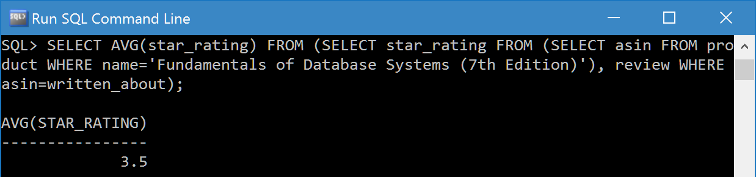
Query #1: Results
Notes:
Winston

Slide 14
Query #2: Description
Find the names and email addresses of everyone who has an American Express credit card saved to their account.
References 3 tables:
Credit_Card
Account_Credit_Card
Account
Notes:
Edwin

Slide 15
Query #2: Relational Algebra
AmEx_Cards ← π_{Card_Number}(σ_{Type='American Express'}(Credit_Card))
AmEx_Emails ← π_{Account_Email}(AmEx_Cards ⋈_{Card_Number=Credit_Card_Number} Account_Credit_Cards)
Result ← π_{Name, Email}(AmEx_Emails ⋈_{Account_Email=Email} Account)
Notes:
Edwin

Slide 16
Query #2: Oracle Code
SELECT name, email FROM (SELECT account_email FROM (SELECT card_number FROM credit_card WHERE type='American Express'), account_credit_cards WHERE card_number=credit_card_number), account WHERE account_email=email;
Notes:
Edwin

Slide 17
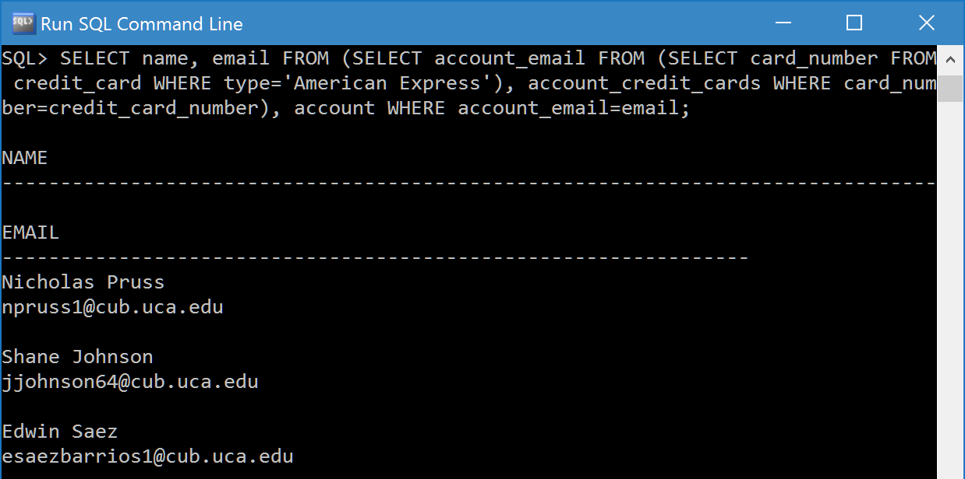
Query #2: Results
Notes:
Edwin

Slide 18
Query #3: Description
Determine the total amount of money that Shane Johnson has spent at Amazon.
References 4 tables:
Account
Orders
Order_Includes
Product
Uses the SUM aggregate function
Notes:
Edwin

Slide 19
Query #3: Relational Algebra
User_Email ← π_{Email}(σ_{Name='Shane Johnson'}(Account))
User_Orders ← π_{Order_Number}(User_Email ⋈_{Email=Placed_By} Orders)
User_Products ← π_{Product_ASIN}(User_Orders ⋈_{Order_Number=Order_Number} Order_Includes)
Result ← Ʒ_{SUM Price}(User_Products ⋈_{Product_ASIN=ASIN} Product)
Notes:
Edwin

Slide 20
Query #3: Oracle Code
CREATE TABLE user_orders AS SELECT order_number FROM (SELECT email FROM account WHERE name='Shane Johnson'), Orders WHERE email=placed_by;
SELECT SUM(price) FROM (SELECT product_asin FROM user_orders, order_includes WHERE user_orders.order_number=order_includes.order_number), product WHERE product_asin=asin;
Notes:
Edwin

Slide 21
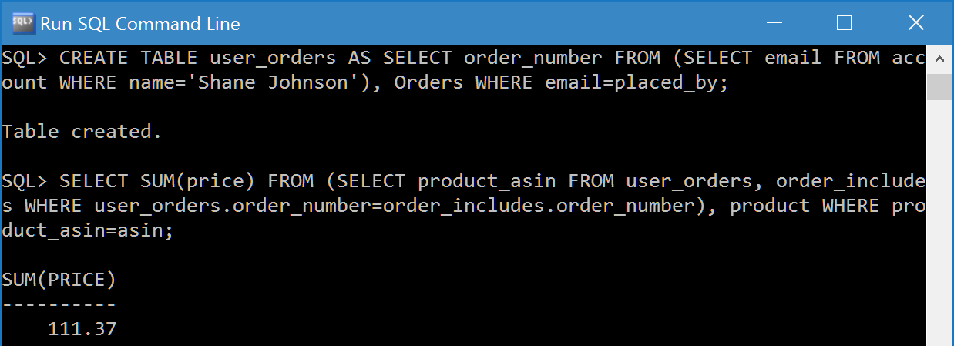
Query #3: Results
Notes:
Edwin

Slide 22
Query #4: Description
Find the names and email addresses of everyone who has purchased a product in the Video Games category.
References 5 tables:
Category
Product_Categorized_As
Order_Includes
Orders
Account
Notes:
Richard

Slide 23
Query #4: Relational Algebra
Games_Category ← π_{Category_ID}(σ_{Name='Video Games'}(Category))
Games_Products ← π_{Product_ASIN}(Games_Category ⋈_{Category_ID=Category_ID} Product_Categorized_As)
Games_Orders ← π_{Order_Number}(Games_Products ⋈_{Product_ASIN=Product_ASIN} Order_Includes)
Games_Accounts ← π_{Placed_By}(Games_Orders ⋈_{Order_Number=Order_Number} Orders)
Result ← π_{Name, Email}(Games_Accounts ⋈_{Placed_By=Email} Account)
Notes:
Richard

Slide 24
Query #4: Oracle Code
CREATE TABLE games_category AS SELECT category_id FROM category WHERE name='Video Games';
CREATE TABLE games_products AS SELECT product_asin FROM games_category, product_categorized_as WHERE games_category.category_id=product_categorized_as.category_id;
CREATE TABLE games_orders AS SELECT order_number FROM games_products, order_includes WHERE games_products.product_asin=order_includes.product_asin;
CREATE TABLE games_accounts AS SELECT DISTINCT placed_by FROM games_orders, orders WHERE games_orders.order_number=orders.order_number;
SELECT name, email FROM games_accounts, account WHERE games_accounts.placed_by=account.email;
Notes:
Richard

Slide 25
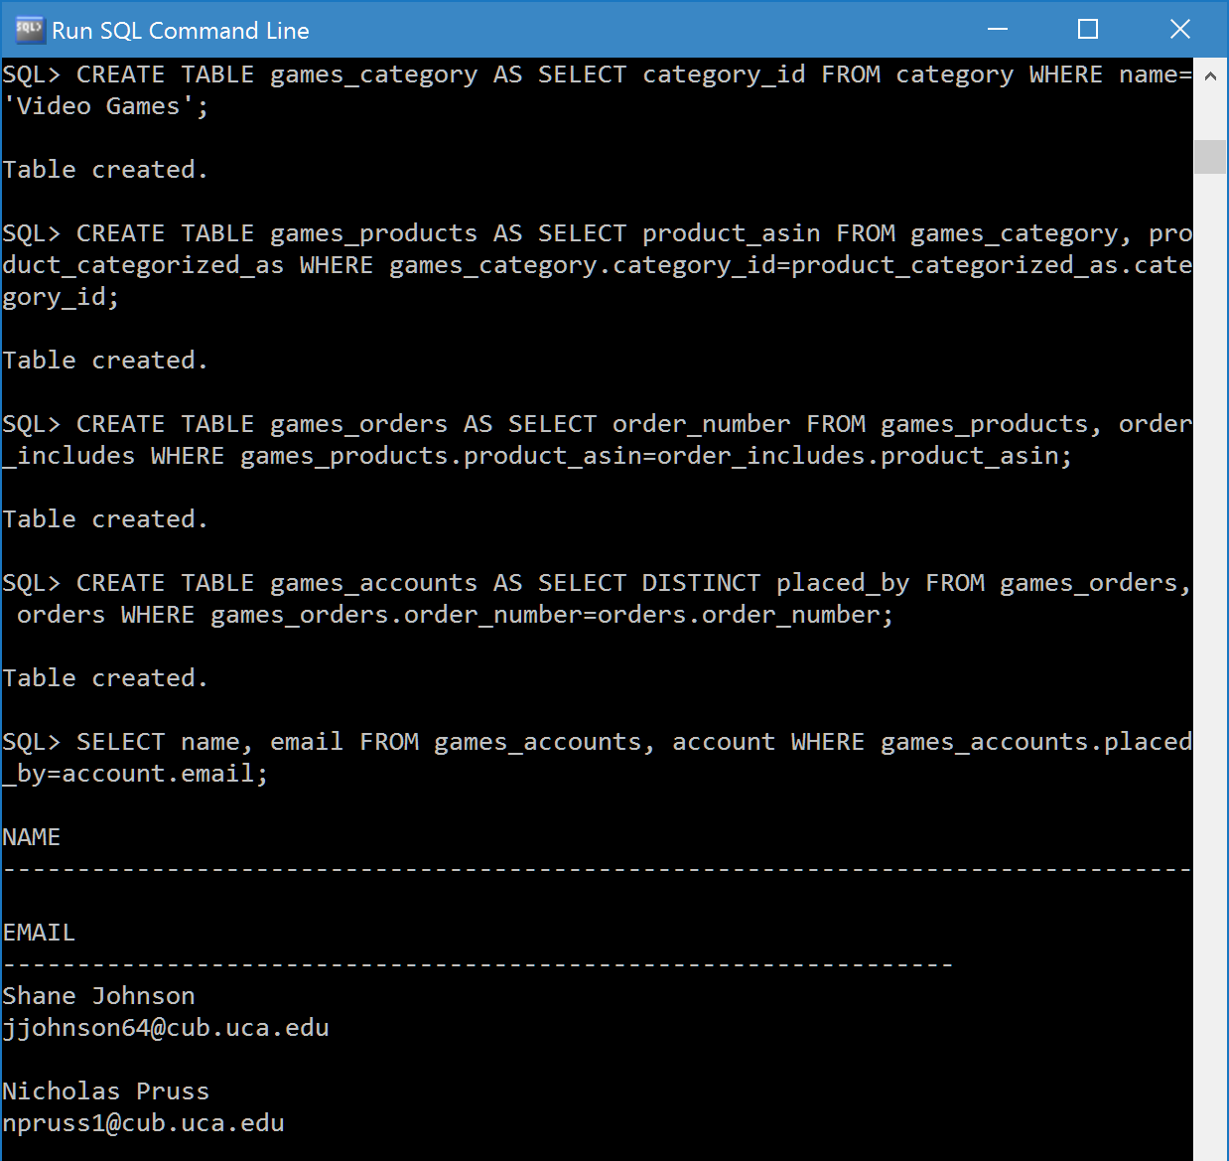
Query #4: Results
Notes:
Richard

Slide 26
Summary
Databases can be very useful for processing large sets of data from sites like Amazon
Our database’s 15 tables represent some of the most important features of Amazon
Our 527 tuples use real data from Amazon’s website as well as some random information
There are many possible queries that retrieve useful information from our database
Notes:
Richard

