Slide 1

Galgotias College of Engineering & Technology, Greater Noida
Final Review – Presentation
Mini Project or Internship Assessment (BCS 752)
• Project Title: Real-Time Intraday Volatility Regime Classifier
• Team Members:
1. Abbhinav Bharadwaj – 2300970100003
2. Abhinav Sharma – 2300970100011
3. Alok Kumar Priyadarshi – 2300970100033
4. Atharva Agrawal – 2300970100070
• Project Guide: Dr. Lopamudra Mohanty, Assistant Professor
Department of Computer Science & Engineering
Session: 2026–27 (ODD SEM)
Notes:
Introduce the team and the project: VRDet tells an intraday trader every 15 minutes whether the NIFTY 50 is Quiet, Normal or Chaotic, and alerts them when it turns Chaotic.

Slide 2

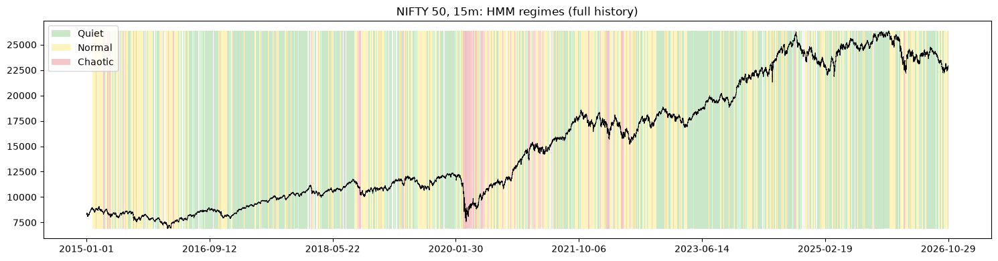
Introduction
The problem
93% of individual F&O traders lost money in FY22–24; 70% of intraday cash traders lost money in FY23 (SEBI studies).
Much of the damage happens in sudden volatility bursts that are hard to recognise while they are happening.
India VIX is a 30-day measure; a price chart shows the burst only after the damage.
Our answer
VRDet classifies the NIFTY 50 every 15 minutes into a volatility regime and alerts on Chaotic. It nowcasts the current state; it does not forecast prices.
Quiet
Small, orderly moves · 49% of bars
Normal
Typical trading · 43% of bars
Chaotic
Violent moves, ~6× Quiet · 7.4% of bars, 342 episodes
NIFTY 50 15-minute closes, 2015–2026, shaded by the hindsight regime (green Quiet, yellow Normal, red Chaotic)
Notes:
Motivation: retail losses (SEBI). Key framing: nowcasting, not forecasting. Three regimes defined by an HMM; Chaotic is rare (7.4% of bars) but comes in 342 episodes over 2015-2026.

Slide 3
Literature Survey
Study | Method | Key finding
Hamilton (1989) | Markov-switching model | Market regimes as a hidden Markov state
Rabiner (1989) | HMM: forward filter, Viterbi | Real-time (filtered) vs hindsight (decoded) states
Andersen & Bollerslev (1997) | Intraday periodicity | Time-of-day pattern must be removed
Gu, Kelly & Xiu (2020) | 12 ML methods on stocks | Tree ensembles and shallow nets perform best
Grinsztajn et al. (2022) | Trees vs deep nets, 45 datasets | Trees still win on tabular data
Gunnarsson et al. (2024) | Review of ML volatility models | LSTM/GRU promising; GARCH/HAR still competitive
Kumar, Rao & Dhochak (2025) | VMD + ANN-LSTM-GRU (NIFTY, INFY) | Hybrid deep model best for volatility forecasts
Research gaps
Most work forecasts a volatility number; few recognise the current regime in real time.
Regime papers report hindsight states that use future data.
Little intraday (15-minute) regime work on the NIFTY 50 with India VIX.
Deep models often compared on one split, without confidence intervals.
No free, local tool for retail traders.
Mini Project (BCS-752)
ODD Semester 2026-27
Notes:
The literature gives us the HMM machinery (Hamilton, Rabiner) and tells us trees usually beat deep nets on tabular data. The gaps on the right are what VRDet addresses.

Slide 4
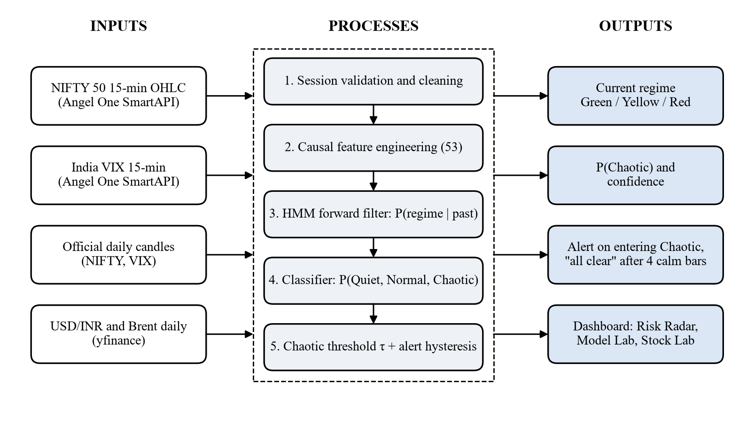
Problem Formulation & Objectives
Problem statement
Using only data up to bar t (NIFTY 50 and India VIX 15-minute candles, USD/INR and Brent daily), recover the regime that a hindsight HMM assigns to bar t, with high macro-F1, short delay and few false alarms, and show it to the trader within a minute of the bar closing.
Objectives
Validated 11-year intraday archive from Angel One SmartAPI
Credible hindsight labels (3-state HMM), checked on shock days
Strictly causal features: bar t uses data ≤ t
Beat the HMM-filter benchmark in a walk-forward test, 2022–26
Compare 22 models with confidence intervals
Local Streamlit dashboard on live data with alerts
Inputs → processes → outputs
Mini Project (BCS-752)
ODD Semester 2026-27
Notes:
Formal task: y_t is the hindsight label, x_t uses only data up to t. The benchmark is the same HMM run forward in real time; if ML cannot beat it, the HMM alone should power the app.

Slide 5
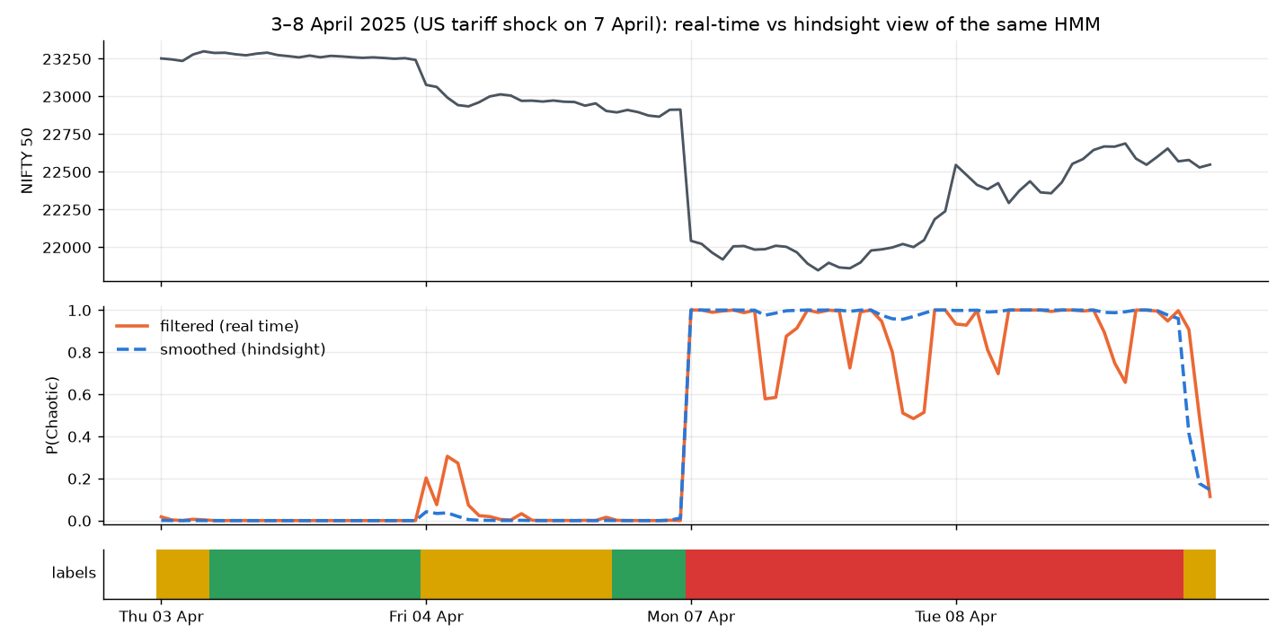
Methodology/ System Design/ Architecture
1
Download NIFTY 50 + India VIX 15-min candles (2015–26), USD/INR + Brent daily
2
Validate each session against official daily candles
3
Build 53 causal features (deseasonalised returns, range volatility, VIX, calendar, lags)
4
Label every bar: 3-state sticky HMM, Viterbi + 4-bar minimum (fitted 2015–21)
5
Add the HMM forward-filter probabilities → 56 inputs
6
Walk-forward: train on 2017..Y−1, tune τ on last year, test year Y (2022–26)
7
Score vs hindsight labels; bootstrap CIs; pick production model
Same HMM, two views: real-time filter (wavers) vs hindsight smoother (decisive), 7 Apr 2025
Freeze model; live loop: fetch → features → score → alert → dashboard
Key idea: truth = HMM in hindsight; benchmark = the same HMM in real time; the classifier must close the gap (filter agrees 85%, smoother 95%).
8
Mini Project (BCS-752)
ODD Semester 2026-27
Notes:
Walk through the 8 steps. Emphasise: labels come from hindsight decoding, features are causal, so the target is not a function of the inputs (no circularity). Walk-forward means every score is out of sample in time.

Slide 6
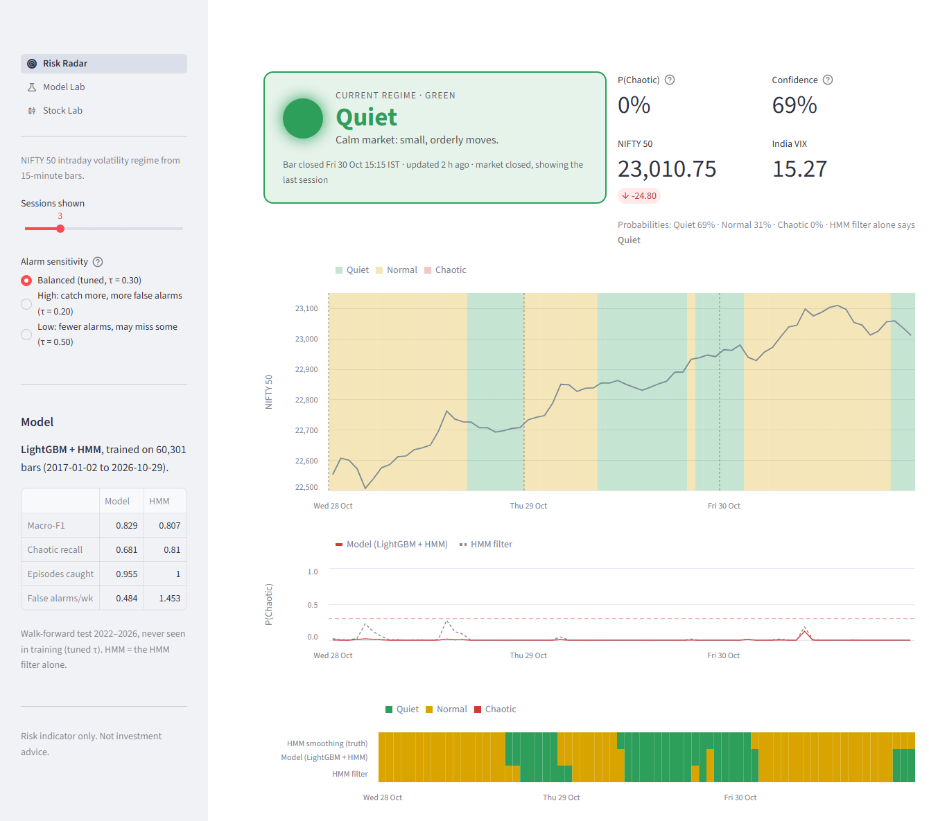
Implementation
Data
Angel One SmartAPI (TOTP login, chunked requests), yfinance; Parquet archive
Models
Python 3.13, scikit-learn, LightGBM, XGBoost, CatBoost, PyTorch, hmmlearn
Live runner
Every bar close + 45 s; one cycle ≈ 12 s; alerts with 4-bar hysteresis
Dashboard
Streamlit, 127.0.0.1 only: Risk Radar, Model Lab (22 models, one-at-a-time queue), Stock Lab (~2,700 NSE stocks)
Safety
Credentials in git-ignored .env; same feature code in training and live (verified: max difference 0.0)
Risk Radar: live regime, P(Chaotic), regime-shaded chart, truth row
Notes:
Everything runs locally on a laptop CPU. Show the Risk Radar live or with replay mode (python app/run.py --replay 2025-04-07) if the market is calm.

Slide 7
Results/ Discussion
0.829
macro-F1
HMM filter 0.807
0.48
false alarms / week
HMM filter 1.45
95.5%
Chaotic episodes caught
134 test episodes
1 bar
median detection delay
15 minutes
Discussion
Production LightGBM + HMM beats the HMM filter in every test year and cuts false alarms by two thirds.
Of 22 models, 20 beat the benchmark; only soft voting and XGBoost are significantly better (+0.01). Most are statistically tied.
LSTM and GRU are significantly worse; learning curves show the limit is the number of Chaotic episodes, not bars.
Notes:
Headline numbers from the 2022-2026 walk-forward test (29,625 bars, never used for training). Block bootstrap: 252 weekly blocks, 300 resamples. Production kept LightGBM for the fewest false alarms (0.48/week).

Slide 8
Conclusion/ Future Work
Conclusion
Validated 11-year NIFTY 50 + India VIX intraday dataset; vendor defects found and fixed
Credible hindsight regimes: all 10 major shock days flagged Chaotic
Real-time classifier beats the honest benchmark: 0.829 vs 0.807 macro-F1, 0.48 vs 1.45 false alarms/week
Small, well-validated models are enough; deep models are not better with this much data
Working local app: Risk Radar, alerts, Model Lab, Stock Lab
Limitations
Truth is itself a model (HMM); other labelers disagree (κ ≈ 0.5)
Few episodes (134 in test) make small differences unresolvable
Detects chaos once it starts (1-bar delay); cannot warn before the first violent bar
Single-broker data dependence; stocks are harder than the index
Future work
Early warning model for the next bars, with event calendars
Futures OI, option skew, breadth and news sentiment as inputs
Embargoed validation, calibration and input-group ablations
Pooled training across stocks to get more Chaotic episodes
Soft-voting ensemble in production; secure multi-user deployment
Notes:
Main lesson: defining the target carefully, causal features and an honest benchmark matter more than model complexity.

Slide 9
References
[1] J.D. Hamilton (1989), A new approach to the economic analysis of nonstationary time series and the business cycle, Econometrica 57(2).
[2] L.R. Rabiner (1989), A tutorial on hidden Markov models and selected applications in speech recognition, Proc. IEEE 77(2).
[3] M.B. Garman and M.J. Klass (1980), On the estimation of security price volatilities from historical data, J. Business 53(1).
[4] T.G. Andersen and T. Bollerslev (1997), Intraday periodicity and volatility persistence in financial markets, J. Empirical Finance 4.
[5] G. Ke et al. (2017), LightGBM: a highly efficient gradient boosting decision tree, NeurIPS 30.
[6] S. Gu, B. Kelly and D. Xiu (2020), Empirical asset pricing via machine learning, Review of Financial Studies 33(5).
[7] L. Grinsztajn, E. Oyallon and G. Varoquaux (2022), Why do tree-based models still outperform deep learning on tabular data?, NeurIPS 35.
[8] E.S. Gunnarsson et al. (2024), Prediction of realized volatility and implied volatility indices using AI and ML: a review, IRFA 93.
[9] S. Kumar, A. Rao and M. Dhochak (2025), Hybrid ML models for volatility prediction in financial risk management, IREF 98.
[10] M. López de Prado (2018), Advances in Financial Machine Learning, Wiley.
[11] SEBI (2024), Analysis of profit and loss of individual traders dealing in equity F&O segment, FY22–FY24.
Notes:
Full list of 50 references in the report.

Slide 10
Thank You
Notes:
Invite questions. Have the dashboard (or replay mode) ready to demo.

