Slide 1

UNIVERSITY PROJECT | 2026
FAZA'A
Road Assistance & Car Delivery
A replacement car on the spot, and your damaged car handled until it is repaired, across all 13 regions of Saudi Arabia.
PROJECT TEAM
Nawaf Fahad Alharbi
170490
Abdulaziz Alfarraj
170467
Faris Alsuhaibani
170426
Mohammed Aljuryban
171623
Hatim Alsubaie
170503
1
Notes:
Good morning. We are presenting FAZA'A, a road assistance service built around one idea: when your car stops, your trip should not. We designed the operating model and built a working bilingual mobile web app for it. I am Nawaf, and with me are Abdulaziz, Faris, Mohammed and Hatim. Each of us will take part of the story.

Slide 2

THE PROBLEM
3–7
Stranded on the shoulder
Long highways between cities, heat, and waiting for a tow truck with no clear arrival time.
Workshop guesswork
days a driver can lose without a car after one breakdown or accident (team estimate).
Finding a trusted workshop, getting quotes, and chasing updates by phone.
Lost mobility
Work, school runs and family trips stop while the car sits in repair.
2
Notes:
Think about the last time a car broke down on the road between Riyadh and Qassim. The tow is only the start. Then comes finding a workshop you trust, waiting on quotes, and calling for updates. Our own estimate is that a driver can lose three to seven days of normal life to a single incident. That gap is what we set out to close.

Slide 3
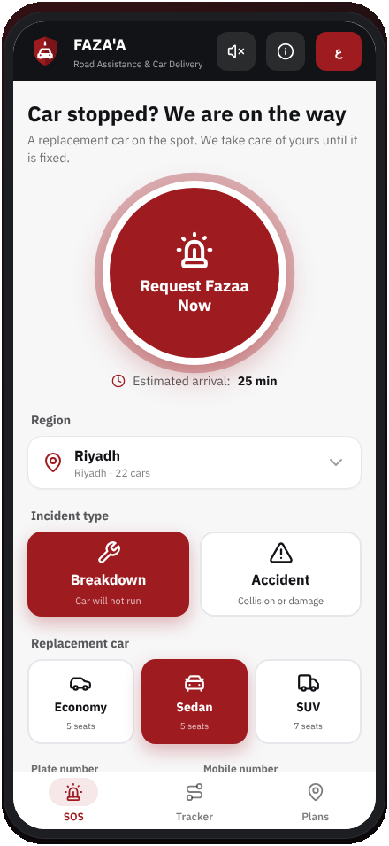
THE FAZA'A VALUE PROPOSITION
One request. We handle
the rest.
1
Instant replacement car
A field specialist arrives with an Economy, Sedan or SUV so you drive on immediately.
2
We stay with your car
The specialist guards the damaged car at the roadside until it is loaded.
3
Specialized workshops
Repair in FAZA'A partner workshops with agreed SLAs and quality checks.
4
Seamless handover
We return your repaired car and collect the replacement in one visit.
3
3
Notes:
Our promise fits in one line: one request, and we handle the rest. The specialist brings a replacement car, so the customer leaves within minutes. The same specialist stays with the damaged car, moves it to one of our partner workshops, and we manage the repair. When it is ready, we swap cars back in a single visit.

Slide 4
HOW FAZA'A WORKS
From roadside SOS to workshop handover
Sample request FZ-26-0417, Riyadh, Asia/Riyadh time. Each step updates the customer's tracker live.
1
2
3
4
5
Specialist & replacement car en route
Car handed over, specialist guards yours
Towed to FAZA'A specialized workshop
Repair & quality inspection
Ready for handover & return
14:05
14:31
15:12
Day 2 · 10:40
Day 3 · 13:15
4
Notes:
Here is the workflow using one real sample request from our app, number FZ-26-0417 in Riyadh. The specialist leaves at 14:05 and hands over the replacement car twenty-six minutes later. The car reaches the workshop by 15:12, repair and inspection finish the next morning, and handover happens on day three. The customer sees each step change live.

Slide 5
KINGDOM-WIDE COVERAGE
All 13 regions, one network
13
120 replacement cars and 24 partner workshops, weighted by traffic and highway length.
regions covered
Riyadh
Makkah
Madinah
120
22 cars · 4 WS · 25 min
20 cars · 4 WS · 28 min
9 cars · 2 WS · 32 min
replacement cars
Al-Qassim
Eastern Province
Asir
8 cars · 2 WS · 30 min
18 cars · 3 WS · 27 min
8 cars · 2 WS · 38 min
24
Tabuk
Hail
Northern Borders
partner workshops
6 cars · 1 WS · 42 min
6 cars · 1 WS · 40 min
4 cars · 1 WS · 48 min
25–48
Jazan
Najran
Al-Baha
6 cars · 1 WS · 40 min
5 cars · 1 WS · 45 min
4 cars · 1 WS · 44 min
min target arrival
Al-Jouf
4 cars · 1 WS · 46 min
5
Notes:
Coverage matters because breakdowns do not stay in Riyadh. We placed one hundred twenty replacement cars and twenty-four partner workshops across all thirteen regions. Riyadh, Makkah and the Eastern Province carry the largest share, shown in red. Smaller regions such as Al-Baha and Al-Jouf get fewer cars and a longer arrival target, which keeps the fleet affordable.

Slide 6
MOBILE-FIRST PWA & TECH STACK
Built for a stressed driver on the roadside
TypeScript PWA
Bilingual & tactile
Supabase + Vercel
— Vite + React + TypeScript
— Installable, phone-sized layout (430 px)
— Oversized 60 px touch targets
— Pulsing one-tap SOS button
— Arabic RTL / English LTR, one tap
— IBM Plex Sans Arabic + IBM Plex Sans
— Web Audio click, SOS and step tones
— SVG vector icons only
— PostgreSQL through PostgREST
— Realtime updates on the tracker
— Seeded local state works offline
— Zero-config Vercel deployment
6
Notes:
We built the app for someone standing next to a broken car, maybe in the heat, maybe stressed. That is why the buttons are big, the SOS button pulses, and every tap gives a short sound. It switches between Arabic and English instantly. Behind it is Supabase PostgreSQL, but the app still runs on seeded local data if the connection drops.

Slide 7
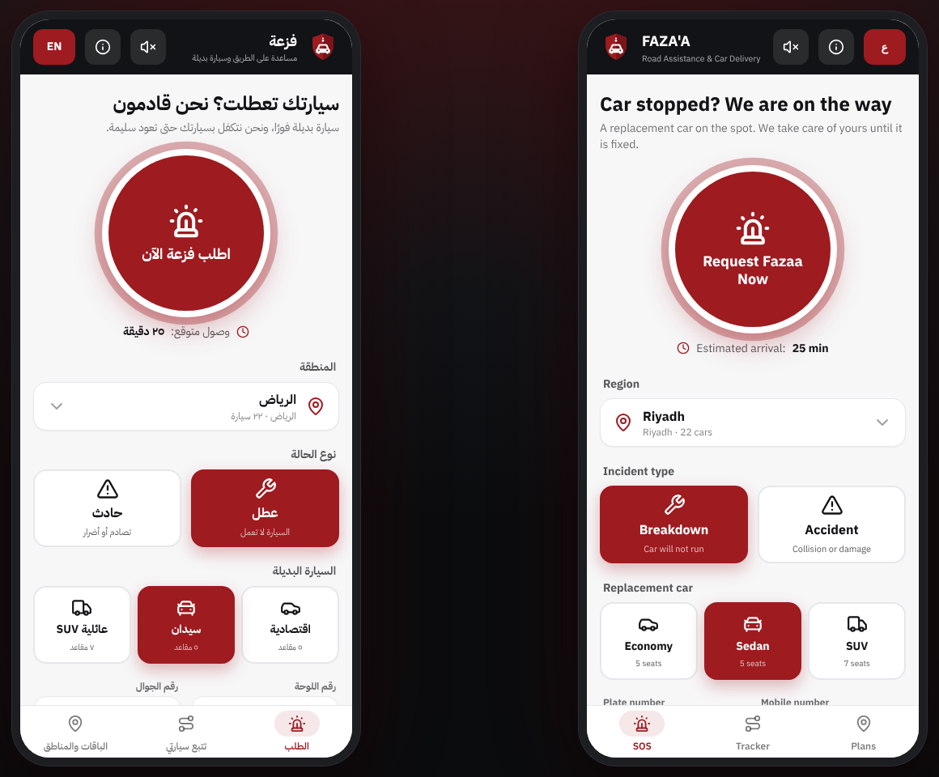
APP WALKTHROUGH
One-tap SOS & car selection
1
Request Fazaa Now
The pulsing button sends the request with smart defaults in a single tap.
2
Region picker
Bottom sheet listing all 13 regions with live arrival estimates.
3
Breakdown or accident
Two large cards decide the response crew.
4
Replacement car
Economy, Sedan or SUV, plus plate and mobile number.
Live capture: Arabic (left) and English (right)
7
Notes:
This is a real capture of the running app, Arabic on the left and English on the right. The customer can request help with one tap, because region, incident type and car are already filled with sensible defaults. If they want to change something, every option is a large card or a bottom sheet, never a small dropdown.

Slide 8
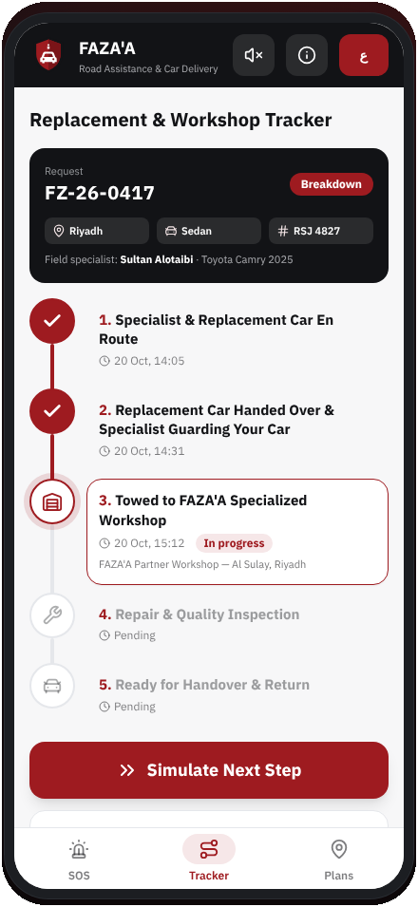
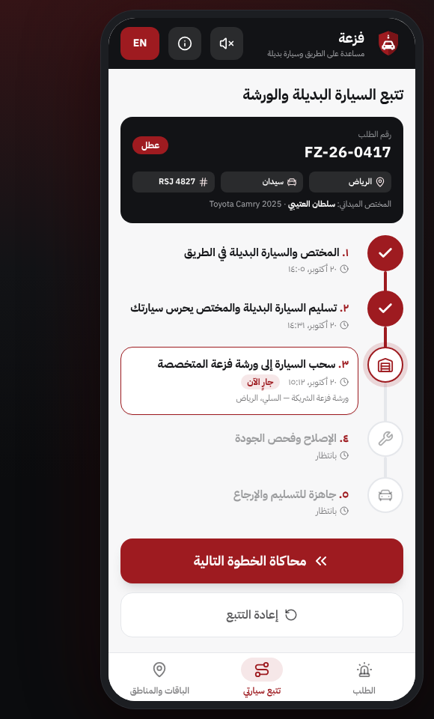
APP WALKTHROUGH
Live replacement & workshop tracking
Request FZ-26-0417 · Sedan (Toyota Camry 2025) · plate RSJ 4827
Completed steps
Filled crimson circles with Asia/Riyadh timestamps.
Active step
Highlighted card with the assigned partner workshop.
Simulate Next Step
Advances the timeline, plays a completion tone and writes to the database.
Restart tracking
Resets the demo to the seeded sample request.
8
Notes:
Once the request is sent, the customer lands on the tracker. Five steps run from the specialist leaving to the final handover, each with a Riyadh-time stamp. In the demo, Simulate Next Step moves the request forward, plays a short tone and writes the change to the database, so a second phone watching the same request updates too.

Slide 9
ESTIMATED OPERATIONAL COSTS & PRICING MODEL
What it costs to run each month
Assumed figures for academic requirement, in SAR.
Cost line | Basis | Monthly (SAR)
Replacement fleet leasing | 120 cars x 2,400 | 288,000
Field specialists | 52 staff x 7,500 | 390,000
Towing logistics | 26 flatbeds x 6,500 | 169,000
Specialized workshop SLAs | 13 regions x 9,000 | 117,000
Tech & cloud | Supabase + Vercel + SMS + maps | 18,500
Total |  | 982,500
SERVICE PRICING
Pay per Call
349 SAR / request
FAZA'A Plus
79 SAR / month
Business Fleet
1,490 SAR / vehicle / year
9
Notes:
These numbers are assumptions for the course, not quotes from suppliers. Running the network costs about nine hundred eighty-two thousand riyals a month, and staff and fleet leasing are the two biggest lines. Revenue comes from three tiers: pay per call, a monthly Plus subscription, and an annual price per vehicle for business fleets, which gives the steadiest income.

Slide 10
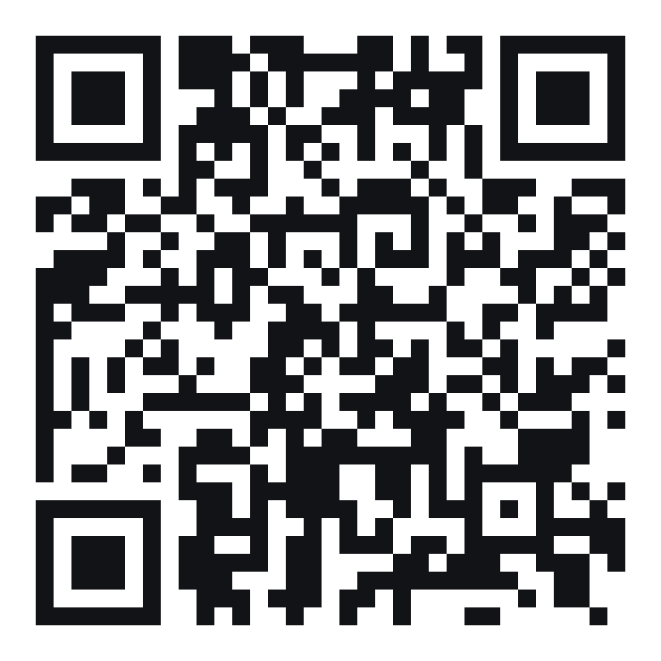
EXPERIENCE FAZA'A NOW
Scan to open the
live mobile app
1
Open your phone camera
2
Point it at the code
3
Tap the link and press Request Fazaa Now
fazaa-app-rose.vercel.app
Works in Arabic and English
10
Notes:
Please take out your phones and scan the code. The app opens straight in the browser with no download, and you can add it to your home screen. Try a request, switch the language, and press Simulate Next Step to follow a car to the workshop. Thank you for listening. We are happy to take your questions now.

