Slide 1

Lecture 11: Parsimonious
Parsing
cs302: Theory of Computation
University of Virginia
Computer Science
David Evans
http://www.cs.virginia.edu/evans

Slide 2
Menu
Fix proof from last class
Interpretive Dance!
Parsimonious Parsing (Parsimoniously)
PS3 Comments Available Today
PS3 will be returned Tuesday

Slide 3
Closure Properties of CFLs
If A and B are context free languages then:
A^{R} is a context-free language TRUE
A* is a context-free language TRUE
A is a context-free language (complement)?
A ∪ B is a context-free language TRUE
A ∩ B is a context-free language ?

Slide 4
Complementing Non-CFLs
L_{ww} = {ww | w ∈ Σ* } is not a CFL.
Is its complement?
Yes. This CFG recognizes is:
S → 0S0 | 1S1 | 0X1 | 1X0
X → 0X0 | 1X1 | 0X1 | 1X0 | 0 | 1 | ε
What is
the actual language?
Bogus Proof!
S → 0X1 → 01X01 → 0101 ∈ L_{ww}

Slide 5
CFG for L_{ww} (L_{¬ww})
All odd length strings are in L_{¬ww}
S → S_{Odd} | S_{Even}
S_{Even} → XY | YX
X → ZXZ | 0
Y → ZYZ | 1
Z → 0 | 1
S_{Odd} → 0R | 1R | 0 | 1
R → 0S_{Odd} | 1S_{Odd}
How can we prove this is correct?

Slide 6
S_{odd} generates all odd-length strings
S_{Odd} → 0R | 1R | 0 | 1
R → 0S_{Odd} | 1S_{Odd}
Proof by induction on the length of the string.
Basis. S_{Odd} generates all odd-length strings of length 1. There are two possible strings: 0 and 1. They are produces from the 3rd and 4th rules.
Induction. Assume S_{Odd} generates all odd-length strings of length n for n = 2k+1, k ≥ 0. Show it can generate all odd-length string of length n+2.

Slide 7
S_{Odd} generates all odd-length strings
S_{Odd} → 0R | 1R | 0 | 1
R → 0S_{Odd} | 1S_{Odd}
Induction. Assume S_{Odd} generates all odd-length strings of length n for n = 2k+1, k ≥ 0. Show it can generate all odd-length string of length n+2.
All n+2 length strings are of the form abt where t is an n-length string and a ∈ {0, 1}, b ∈ {0, 1}. There is some derivation from S_{Odd} ⇒* t (by the induction hypothesis). We can generate all four possibilities for a and b:
00t: S_{Odd}→ 0R → 00S_{Odd} ⇒* 00t
01t: S_{Odd}→ 0R → 01S_{Odd} ⇒* 01t
10t: S_{Odd}→ 1R → 10S_{Odd} ⇒* 10t
11t: S_{Odd}→ 1R → 11S_{Odd} ⇒* 01t

Slide 8
CFG for L_{ww} (L_{¬ww})
S → S_{Odd} | S_{Even}
S_{Even} → XY | YX
X → ZXZ | 0
Y → ZYZ | 1
Z → 0 | 1
S_{Odd} → 0R | 1R | 0 | 1
R → 0S_{Odd} | 1S_{Odd}
?
Proof-by-leaving-as-“Challenge Problem” (note: you cannot use this proof technique in your answers)

Slide 9
Even Strings
S_{Even} → XY | YX
X → ZXZ | 0
Y → ZYZ | 1
Z → 0 | 1
Show S_{Even} generates the set of all even-length strings that are not in L_{ww}.
Proof by induction on the length of the string.
Basis. S_{Even} generates all even-length strings of length 0 that are not in L_{ww}. The only length 0 string is ε. ε is in L_{ww} since ε = εε, so ε should not be generated by S_{Even}. Since S_{Even} does not contain any right sides that go to ε, this is correct.

Slide 10
Closure Properties of CFLs
If A and B are context free languages then:
A^{R} is a context-free language TRUE
A* is a context-free language TRUE
A is not necessarily a context-free language (complement)
A ∪ B is a context-free language TRUE
A ∩ B is a context-free language ?
Left for you to solve (possibly on Exam 1)

Slide 11
Violates Pumping Lemma
For CFLs
0^{n}1^{n}2^{n}
0^{n}1^{n}
A
ww
Violates Pumping Lemma For RLs
0^{n}
Described by DFA, NFA, RegExp, RegGram
w
Described by CFG, NDPDA
Regular Languages
Deterministic CFLs
Context-Free Languages

Slide 12
English ∉ Regular Languages
The cat likes fish.
The cat the dog chased likes fish.
The cat the dog the rat bit chased likes fish.
…
This is a pumping lemma proof!

Slide 13
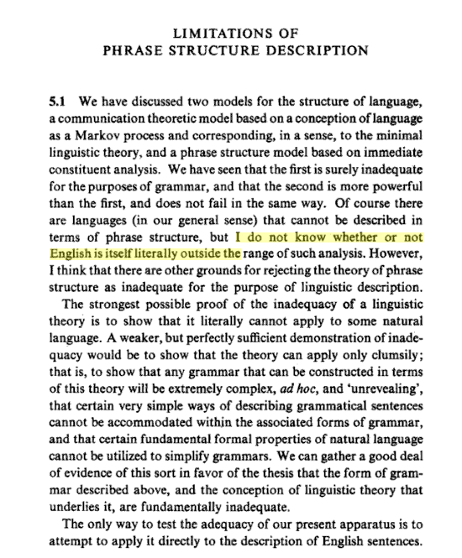
Chomsky’s Answer (Syntactic Structures, 1957)
= DFA
= CFG

Slide 14
Current Answer
Most linguists argue that most natural languages are not context-free
But, it is hard to really answer this question:
e.g.,
“The cat the dog the rat bit chased likes fish.” ∈ English?

Slide 15
Where is Java?
Violates Pumping Lemma
For CFLs
0^{n}1^{n}2^{n}
0^{n}1^{n}
A
ww
Violates Pumping Lemma For RLs
0^{n}
Described by DFA, NFA, RegExp, RegGram
w
Described by CFG, NDPDA
Regular Languages
Deterministic CFLs
Context-Free Languages

Slide 16
Interpretive Dance

Slide 17
Where is Java?
Violates Pumping Lemma
For CFLs
0^{n}1^{n}2^{n}
0^{n}1^{n}
A
ww
Violates Pumping Lemma For RLs
0^{n}
Described by DFA, NFA, RegExp, RegGram
w
Described by CFG, NDPDA
Regular Languages
Deterministic CFLs
Context-Free Languages

Slide 18
What is the Java Language?
public class Test {
public static void main(String [] a) {
println("Hello World!");
}
}
In the Java Language
Test.java:3: cannot resolve symbol
symbol : method println (java.lang.String)
// C:\users\luser\Test.java
public class Test {
public static void main(String [] a) {
println ("Hello Universe!");
}
} }
Not in the Java Language
Test.java:1: illegal unicode escape
// C:\users\luser\Test.java

Slide 19
// C:\users\luser\Test.java
public class Test {
public static void main(String [] a) {
println ("Hello Universe!");
}
} }
> javac Test.java
Test.java:1: illegal unicode escape
// C:\users\luser\Test.java
^
Test.java:6: 'class' or 'interface' expected
} }
^
Test.java:7: 'class' or 'interface' expected
^
Test.java:4: cannot resolve symbol
symbol : method println (java.lang.String)
location: class Test
println ("Hello World");
^
4 errors
Scanning error
Parsing errors
Static semantic errors

Slide 20
Defining the Java Language
{ w | w can be generated by the CFG for Java in the Java Language
Specification }
{ w | a correct Java compiler can build
a parse tree for w }

Slide 21
Parsing
S
S → S + M | M
M → M * T | T
T → (S) | number
S
+
M
M
M
*
T
Parsing
Derivation
Programming languages
are (should be) designed to make parsing easy, efficient, and unambiguous.
T
T
1
3
2
3 + 2 * 1

Slide 22
Unambiguous
S → S + S | S * S | (S) | number
S
S
S
+
S
S
*
S
S
*
S
3
S
+
S
1
2
1
3
2
3 + 2 * 1
3 + 2 * 1

Slide 23
Ambiguity
How can one determine if a CFG is ambiguous?
Super-duper-challenge problem: create a program that solve the “is this CFG ambiguous” problem:
Input: CFG
Output: “Yes” (ambiguous)/“No” (unambiguous)
Warning: Undecidable Problem Alert!
(Not only can you not do this, it is impossible for any program to do this.)
(We will cover undecidable problems after Spring Break)

Slide 24
Parsing
S
S → S + M | M
M → M * T | T
T → (S) | number
S
+
M
M
M
*
T
Parsing
Derivation
Programming languages
are (should be) designed to make parsing easy, efficient, and unambiguous.
T
T
1
3
2
3 + 2 * 1

Slide 25
“Easy” and “Efficient”
“Easy” - we can automate the process of building a parser from a description of a grammar
“Efficient” – the resulting parser can build a parse tree quickly (linear time in the length of the input)

Slide 26
Recursive Descent Parsing
S → S + M | M
M → M * T | T
T → (S) | number
Parse() { S(); }
S() {
try { S(); expect(“+”); M(); }
catch { backup(); }
try { M(); } catch {backup(); }
error(); }
M() {
try { M(); expect(“*”); T(); } catch …
try { T(); } catch { backup(); }
error (); }
T() {
try { expect(“(“); S(); expect(“)”); } catch …;
try { number(); } catch …; }
Advantages:
Easy to produce and understand
Can be done for any CFG
Problems:
Inefficient (might not even finish)
“Nondeterministic”

Slide 27
LL(k) (Lookahead-Left)
A CFG is an LL(k) grammar if it can be parser deterministically with ≤ tokens lookahead
S → S + M | M
M → M * T | T
T → (S) | number
1
+
2
S → S + M
S → M
S → S + M
LL(1) grammar

Slide 28
Look-ahead Parser
Parse() { S(); }
S() {
if (lookahead(1, “+”)) { S(); eat(“+”); M(); }
else { M();}
M() {
if (lookahead(1, “*”)) { M(); eat(“*”); T(); }
else { T(); } }
T() {
if (lookahead(0, “(“)) { eat(“(“); S(); eat(“)”); }
else { number();}
S → S + M | M
M → M * T | T
T → (S) | number

Slide 29
JavaCC
https://javacc.dev.java.net/
Input: Grammar specification
Output: A Java program that is a recursive descent parser for the specified grammar
Doesn’t work for all CFGs: only for LL(k) grammars

Slide 30
Language Classes
Violates Pumping Lemma
For CFLs
Scheme
0^{n}1^{n}2^{n}
0^{n}1^{n}
ww
Violates Pumping Lemma For RLs
0^{n}
Described by DFA, NFA, RegExp, RegGram
w
Described by LL(k) Grammar
Described by CFG, NDPDA
Regular Languages
Deterministic CFLs
LL(k) Languages
Java
Context-Free Languages
Python

Slide 31
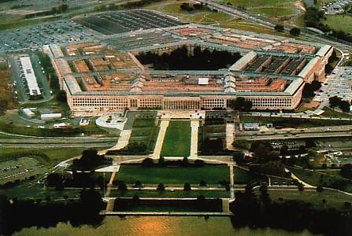
Next Week
Monday (2): Office Hours
(Qi Mi in 226D)
Monday (5:30): TA help session
Tuesday’s class (Pieter Hooimeyer): starting to get outside the yellow circle: using grammars to solve security problems
Wednesday (9:30am): Office Hours (Qi Mi in 226D)
Wednesday (6pm): TAs’ Exam Review
Thursday: exam in class

